Slide 1
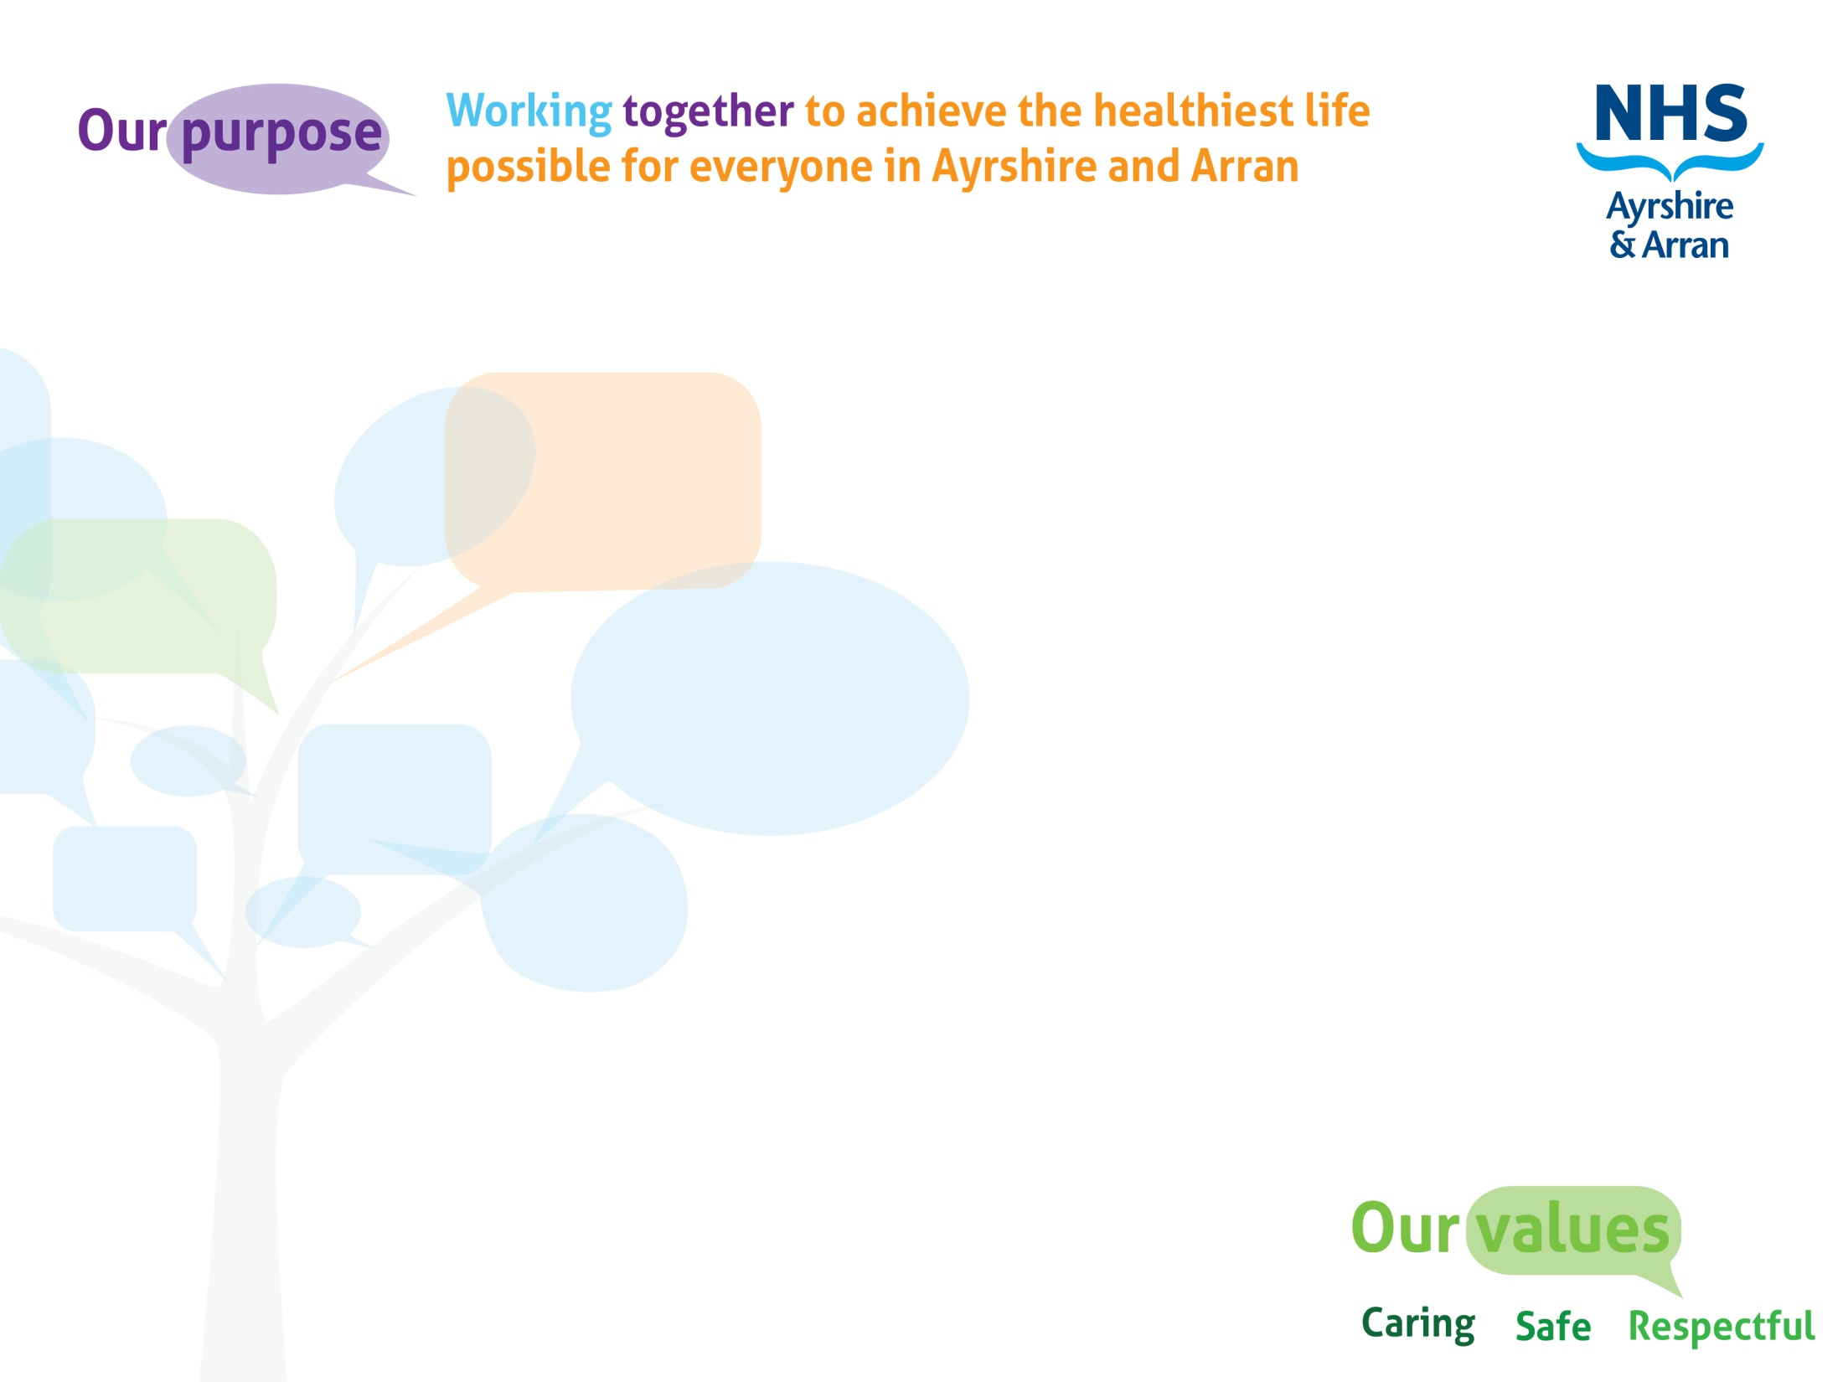
Speech Sound Development for Parents & Carers
Speech & Language Therapy Department, NHS Ayrshire & Arran

Slide 2

Voice clips
Wherever you see this symbol…
… double-click on it
or hover over and press play
to hear more information

Slide 3

Learning aims
To give you a better understanding of speech sound development
To think about the speech sounds your child might be struggling with
To think about ways to help at home

Slide 4

Why are parents & carers so important?
You know your children so well: you are their first teacher in so many things
Speech sound practice can be carried out any time, any place, any where!
You know what they like to chat about

Slide 5
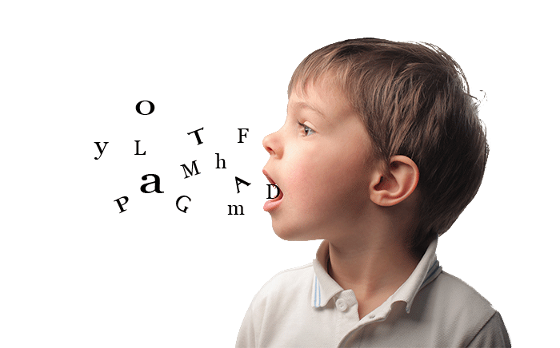
What is speech sound development?
The gradual process of acquiring adult speech sounds
Similar developmental pattern for each child
May occur at different rates

Slide 6
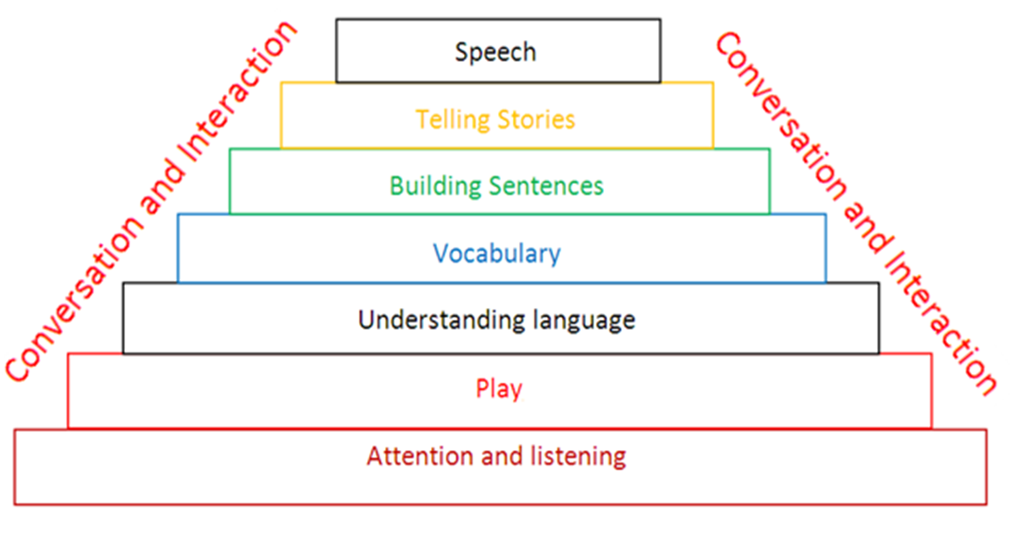
Building Blocks of Language Development
﻿

Slide 7
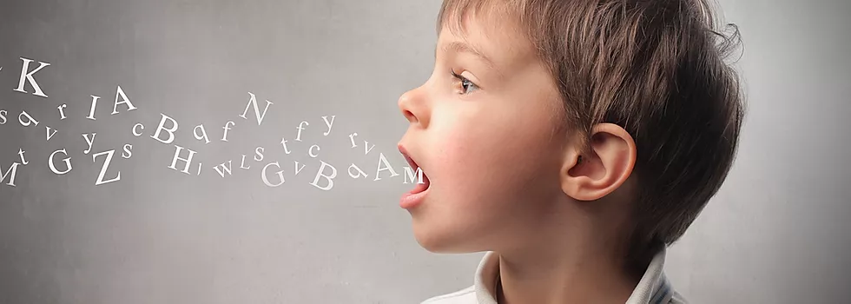
Talking is tricky!
Just like any skill, some children take longer to learn to use all their sounds
Most requests for assistance to Speech & Language Therapy are for concerns about speech sounds

Slide 8
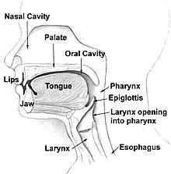
Where are speech sounds made?
Some sounds are made with the lips
p, b, m, f, v, w
Some sounds are made with the front of the tongue
t, d, n, s, z, l, r
Some sounds are made with the back of the tongue
k, g, ng

Slide 9
Speech sound development: which order do you think children develop these sounds in?
p b t d
s f
k g

Slide 10
Development of speech sounds
Sound | Age sound should be in place
Vowel sounds | 3 years
p b m n t d w | 3 years
k g f h y | 4 years
sp st sm sl sk | 5 years
ng s | 5 years
l | 6 years
sh ch j z v | 6 years
r | 7 years
th zh (as in vision) | 7 years

Slide 11

What about your wee one?
What words or sounds do they find difficult to say?

Slide 12
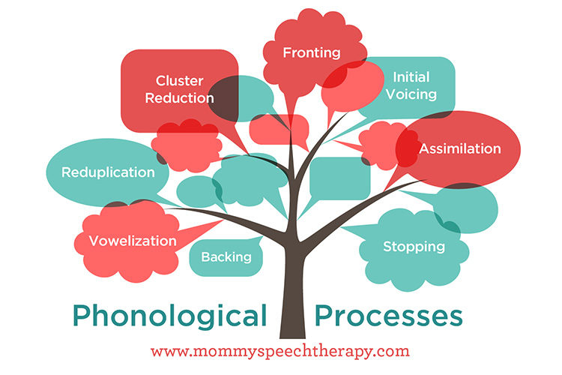
Common errors
Cat ‘tat’
Doggy ‘doddy’
Red ‘wed’
Spider ‘pider’
Fish ‘bish’
Sun ‘dun’

Slide 13
Common errors
Not using ‘long’ sounds:
s, z, f, v, sh, zh
Your child uses ‘short’ sounds in place of longer sounds, for instance:
sad: he says “Dad”
four: he says “bour”

Slide 14
Common errors
Not using sounds made with the back of the tongue such as ‘k’ & ‘g’
Your child might say “tea” instead of key
or “boot” instead of book
or he might say “dough” instead of go
or “bad” instead of bag

Slide 15
Common errors
Missing the end sounds of words
Your child sounds like he is missing the end of some words
Your child might say “she” instead of “sheep”

Slide 16




How do I help my wee one make these sounds?
To make ‘s’ and ‘z’ (‘z’ is the noisier sound)
To make ‘f’ and ‘v’ (‘v’ is the noisier sound)
To make ‘sh’ (also ‘zh’ – the noisier sound)

Slide 17

How do I help my wee one make these sounds?
‘k’ and ‘g’
use a big wide open mouth
make the sound at the back of the mouth
keep front of tongue down
These can be tricky sounds to produce
Your wee one might not be developmentally ready to make them.
keep trialling different ways to get this sound or wait till they are a bit more grown up

Slide 18
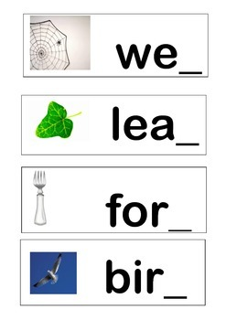
How do I help my wee one make these sounds?
End sounds
Can be described to little ones as ‘tail’ sounds
Listening for the ‘tail’ sound is an important first activity
Then you can try modelling the ‘tail’ sound on the end of words for your wee ones to try

Slide 19

Why does my child find some sounds difficult?
Sometimes we are not sure!
Children may find sound patterns confusing
Sometimes it takes time for the brain and the mouth to work together to make the sounds
Children learn and develop at different rates

Slide 20

Other things to consider
Hearing
Attention and listening
Colds, ear infections, chest infections
Opportunities to hear language: background noises, interactions, language learning opportunities
Children who have been later learning to talk, may well also be later developing their speech sounds

Slide 21
Other things to consider
Phonological awareness (please see our learning presentation for parents)
Motor co-ordination of muscles for speech
Structural abnormalities e.g. cleft palate or teeth missing
Speech sound difficulties are not due to ‘laziness’
Cognitive ability
Dummy misuse

Slide 22
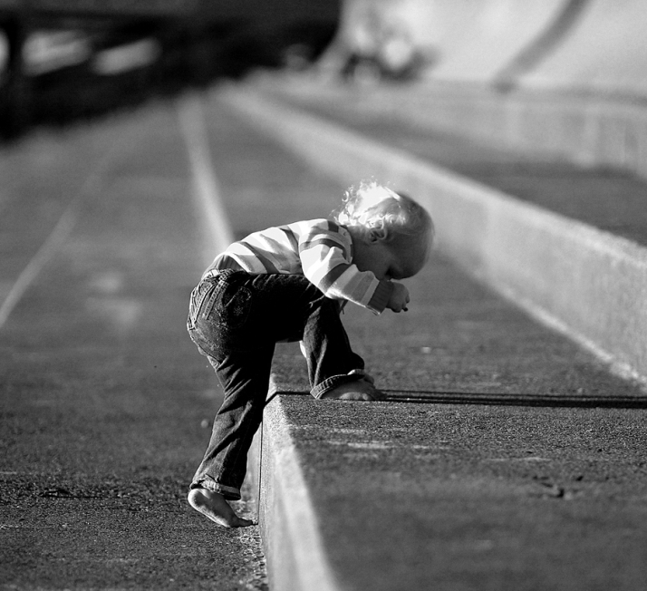
Stages to work through
Listening and hearing the differences between sounds
Learn about the concept and position of the sound in the mouth
Say sound on its own
Say sound in a word
Say more words with same sound
Say the words in sentences
Use the sound in words and sentences in daily life

Slide 23
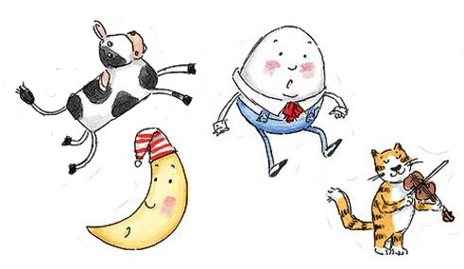
Which nursery rhyme...?
Inty Winty Pider
Timed up de water pout
Down tame de wain
An wot de pider out
Out tame de tuntine
And died up all de wain
To Inty Winty Pider
Timed up de pout adain

Slide 24
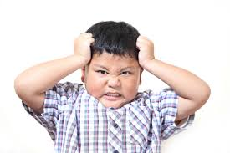
Possible impact of speech sound difficulties
Frustration
Loss of confidence
Less talking
Does not want to talk in front of other adults, or their peers/class
Avoids participating in activities that involve talking
Struggling to make friends
Reading & writing difficulties

Slide 25
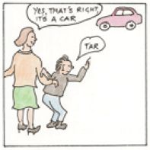
How to support
speech sound development
Model the correct word or sound if they make an error e.g.
Child: “It’s a tat”
Adult: “Yes, it is a cat”
Child: “I saw a nate”
Adult: “I saw a snake

Slide 26
How to support
speech sound development
Emphasise and highlight target sounds
Slow down your production of the sound, emphasise the target sound, “look I opened my mouth wide to say that ‘k’ sound...castle”
Use photos & pictures
Having visuals can really help your wee one to think about the sound they are practising, and it can make practice fun too

Slide 27

Praise & Encouragement
Keep speech sound development a positive experience!
Emphasise the correct sounds, but do not ask your wee one to repeat after you
Use encouraging statements or questions e.g.
“Did you mean ‘tea’ or ‘key’?”
Praise any attempts they make e.g.
“You tried really hard with ‘k’”
“You did some great listening there”
“ I heard you make a lovely long /s/ sound there, well done”

Slide 28

What to do if you don’t understand your wee one...
Look for clues to help you understand e.g. what have they just been looking at / playing with?
Ask them to show you what they have been talking about e.g.
“Can you show me?”

Slide 29

How to prevent your wee becoming frustrated when not understood
Don’t pretend to understand if you haven’t!
Put the blame on yourself e.g. “Sorry my ears are tired/not working well today, can you say that again please?” or
“It’s very noisy here and I couldn’t hear you well”

Slide 30
How to prevent your wee one becoming frustrated when not understood
Repeat back any words you have understood e.g. “You’re telling me something about a park and mum – did you go to the park with mum?”
– This way they know some of their message has been successful and does not have to repeat the whole message
If you still don’t understand...
- “Could you please tell me later?”

Slide 31

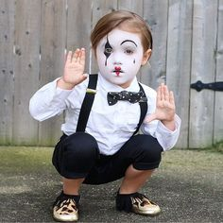
Other strategies to use
Play detective
Using what you have learned today, try to find out which sounds the child has difficulty with and work out what sounds & words they were trying to say
Mime and gesture
If you cannot understand what they are saying , see if they can show you in another way – such as pointing, acting it out, taking you to it

Slide 32
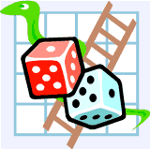
Games & activities
Encourage an interest in the specific speech sound – create a scrap book or bag/box of items beginning with the targeted sound i.e. /k/ box (car, key, cake, cat, king)
“I spy” using sounds instead of letters e.g. something that begins with the sound /f/ - phone, fish
Go on a sound walk – how many things can you find that begin with...? Remember to use the sounds
Mirror practice – exploration of sounds and where they are produced in the mouth using a mirror

Slide 33
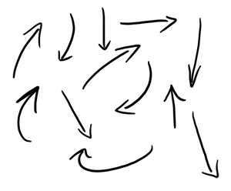
What next?
Try out some strategies & games with your child at home
If you need further help/advice, please contact your local speech and language therapy helpline (see next slide)
Useful websites:
www.ican.org
www.talkingpoint.org
https://mommyspeechtherapy.com/
https://www.wchc.nhs.uk/services/childrens-speech-language-therapy/self-care-resources-and-support/

Slide 34
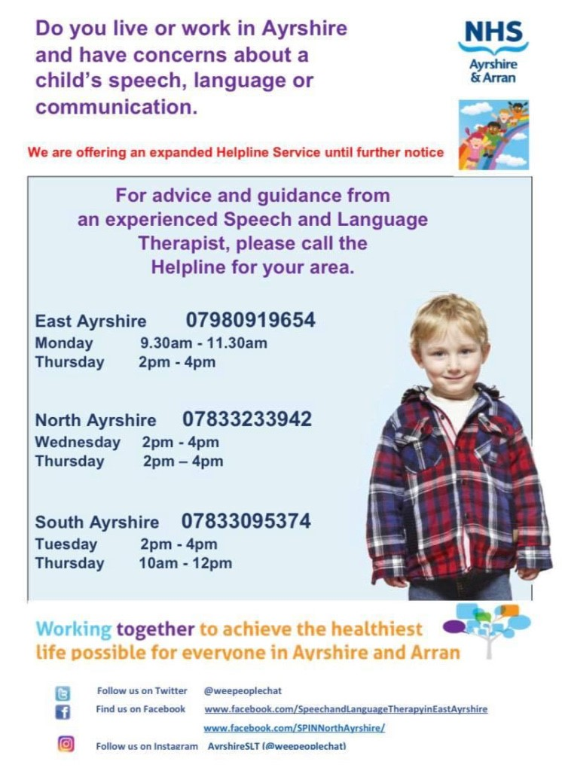

Slide 35

What will we do?
We will listen to your concerns
We will try to reassure you on the phone
We will offer advice on how to help your wee one
We may advise that your child is referred to us for a full assessment if your wee one’s speech difficulties are having a negative impact on them

Slide 36

However…
You may hear us say that your child has normal speech development and does not require assessment
You will possibly hear us say that your wee one is too young for therapy, or maybe not ready for therapy

Slide 37

Speech therapy is not helpful when...
Chidlren are not motivated or cooperative
Children not able to say the sound (not developmentally ready for therapy)
Children are not aware of any speech sound difficulty
Children are not bothered about their speech and does not see it as a problem (it is having no impact on them)
There is no ‘therapy partner’ to work with them, whether at home or at nursery/school

Slide 38

Some children are not affected by their speech sound difficulties and are…
Unaware
Talkative
Confident communicators
Want to talk in front of their peers/family/whole class and share information
Enjoy participating in activities that involve talking
Very sociable
No literacy difficulties
If this sounds like your wee one, direct individual intervention from a speech & language therapist at this time could do more harm than good

Slide 39




The Speech and Language Therapy Service is on social media! Come & find us online for more top tips ☺
On Facebook
Speech and Language Therapy in East Ayrshire
On Facebook
SPIN North
Ayrshire SLT
On Facebook
South Ayrshire Speech and Language Therapy
On Twitter
@weepeoplechat
On Facebook
Makaton
Ayrshire
Ayrshire SLT @weepeoplechat
Visit our webpages: www.nhsayrshireandarran.com &
https://www.nhsaaa.net/allied-health-professionals-ahps/speech-and-language-therapy/speech-and-language-therapy-for-children-and-young-people/

Slide 40

Have fun!
The most important thing is to stay calm and make speech sound development fun!
Enjoy having special ‘talking times’ with your wee ones
Call us on the helpline for advice ☺

