Slide 1
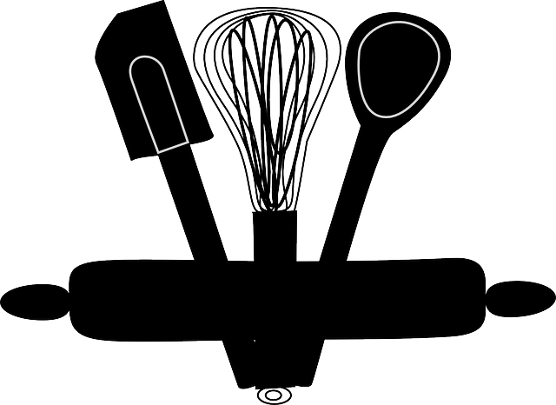
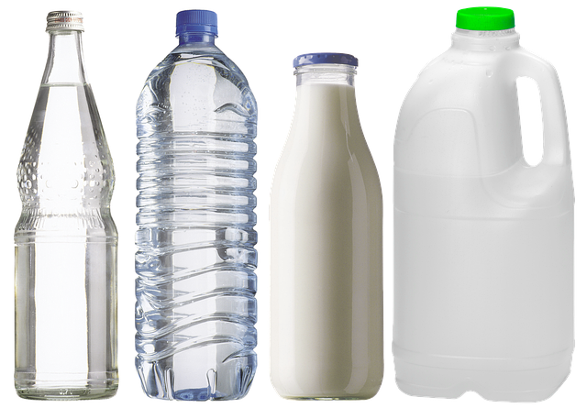
Home Learning
Ideas P1-4
Children learn best when they are working on something that interests them and has a purpose. As an incentive, ask friends and family members to send requests for letters, stories, information and videos. Anything that gets them reading, writing, counting, investigating, playing and laughing is beneficial.
Write a postcard to a friend or relative in self isolation.
Cut out the card, draw a picture on the front and write a message on the back.
2) Write a letter to a key worker, thanking them for helping everyone.
3) Go on a shape hunt around the house. How many different shapes can you find? What are they good for? Stacking/rolling/joining etc.
4) Rewrite a recipe doubling/halving the ingredients. Use simple measurements such as 4 teaspoons or 6 cups. Send it to a relative (who has requested it). Then make it!
5) Make a poster, giving advice to other children about what activities that you can do to stay entertained during school closures (and then do these activities!)
6) Make playdough using water, oil, flour and salt (there are lots of recipes online). How many different shapes can you make?
7) Make some squash/water/juice for the family and measure how much liquid different containers can hold. Who would like the most? Which container should they have?
8) Practice patterning by making paper chains using different colour paper. Can they follow a pattern you have created? Can they make their own pattern?

Slide 2
Home Learning
Ideas P5-7
Children learn best when they are working on something that interests them and has a purpose. As an incentive, ask friends and family members to send requests for letters, stories, information and videos. Anything that gets them reading, writing, thinking, counting, investigating, playing and laughing is beneficial.
1) Write a story for a younger child/friend/relative, that needs entertaining while in isolation.
2) Create a leaflet/poster/video for a younger friend/sibling/relative with activities to keep them entertained during school closures. Then do some of these activities!
3) Save all the empty cardboard boxes. Open them out to see their net. Challenge your child to create their own cardboard box by drawing a net.
4) Explore coding by setting the task of writing instructions for a robot. A family member becomes the robot and tests out the instructions. Were the instructions precise enough?
5) Write a newspaper article about what is happening in the local area or globally. How are people helping one another? Alternatively, record a news broadcast from a child’s perspective.
6) Ask a friend or relative to request information on a topic that you know is of interest to your child. Ask your child to research the topic and present the information to the friend/relative. It could be in the form of a letter, a poster, a leaflet, a PowerPoint or a video.

