Slide 1
P1 Specialist Placement Process
October 2020

Slide 3
Background and Context
In 2017-18 we reviewed effectiveness of the PreSCAT system and meeting process
Looking Inwards: Established data and information re strengths and areas to improve
Looking Outwards: Gathered key parent/carer; practitioner and partner views
Looking Forwards: Agreed a new system and process
Notes:
Inwards – increasing number of children and therefore meetings: 29-51 3 year period
Still average 40 children per year

Slide 4
What did our parents/carers say…
Process:
Informative, contributions from all, smooth, beneficial overall
Daunting, overwhelming, worried, more contact required
Feelings:
Apprehensive; relationships important; worried about contributing; being alone; unprepared for what to expect;
Meeting:
Positive overall, helped with planning, right people there, impact of anyone missing minimal
Prior meetings had been held though
Added Value?
What would you change?
Information, communication, location

Slide 5
Looking Outwards:
Additional preschool years:
South Ayrshire – Early Years’ Forum
North Ayrshire – Early Years’ Coordinator Team
For alternative provision to mainstream
Nursery identifies concerns
Request for Assistance to EPS
TAC & collaborative Assessment commences
Central Admission Group (CAG)
Extended CAG
SAC
Nursery identifies concern
TAC
First stage: Assessment commences
Second Stage:
Further collaborative Assessment
Inclusion Group meeting
NAC

Slide 6
Conclusions
Strengths included:
robust assessment
multi-agency collaboration in assessment and recommendations,
with continuous parental involvement
Key areas requiring improvement were:
reduce duplication of effort and time for practitioners and parents
forward planning for specialist school placement
location of the meeting
timescales to allow effective transition

Slide 7
New Process
Forum to consider recommendations retaining strengths of previous model, and aimed to meet improvement needs
Strengths of other models
Reviewed after Year 1 and made some further amendments to the system:
start earlier; have HTs on the group; clarity re assessment paperwork; clarity for parents
18/19: 30 children across 6 meetings
19/20: 47 children across 6 meetings
Notes:
For 40-50 children meant 9-10 mornings every fortnight for 4-5 months
And for the people involed.

Slide 8
Timeline
Notes:
Regular meetings of the Group will be held between November and February, dependent upon numbers of children being considered.
This group will have a multi-agency representation, and include Senior Education Managers, Psychological Service, Specials School Heads, Early Years officers and Health Visiting representation.

Slide 9
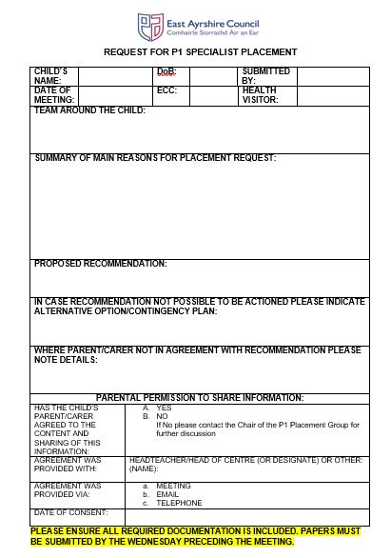

Slide 10
Key Information:
TAC Minute/Child’s Plan with clear recommendation
Ensure clear record of parent/carer views
2. Teaching Talking assessment, gathered over time
3. ICAN tracker if appropriate
4. Transition Profile
5. My World Triangle reports from partners
This is not essential but welcome where appropriate
6. Request Form
Where parents/carers are not in agreement please ensure views are accurately recorded on the paperwork, both on the Request Form and within the TAC minute

Slide 11
Triangulation
By using a process known as triangulation, we obtain data from a number of different sources, to gain a rich picture of the problem
By collecting data from multiple sources, we can verify the data against each other increasing the likelihood of an accurate picture of the child’s needs and strengths
This makes the process more reliable and valid, reducing the likelihood of relying on a ‘one off’, a ‘test’ or on one person’s opinion
Teaching Talking
ICAN Tracker
Observations

Slide 12
Key elements of process
Following a period of assessment, intervention and support a child may be identified during preschool year as potentially requiring specialist school placement for Primary 1
A Team Around the Child Meeting should be held to discuss this and conclude a recommendation. All options should always be discussed, recognising the presumption of mainstreaming.
If the outcome of the meeting is a recommendation for specialist placement, Heads of Centre/Head Teachers should send the Request for P1 Specialist Placement Form to: Education - Admin Education-Admin@east-ayrshire.gov.uk with associated assessment information.
Parents/carers are notified, and conclusion of process by March
Transition planning March - June

Slide 13
You can locate the Guidance and Request Form on the EL and CC GLOW tile
If you have any queries at any point, please consult with your EP, or get in touch with Nicola :
Corporate email : nicola.stewart@east-ayrshire.gov.uk
Glow email: nicola.stewart1@eastayrshire.org.uk

