Slide 1
Realising the Ambition:
Being Me
Sections 1 - 4

Slide 2
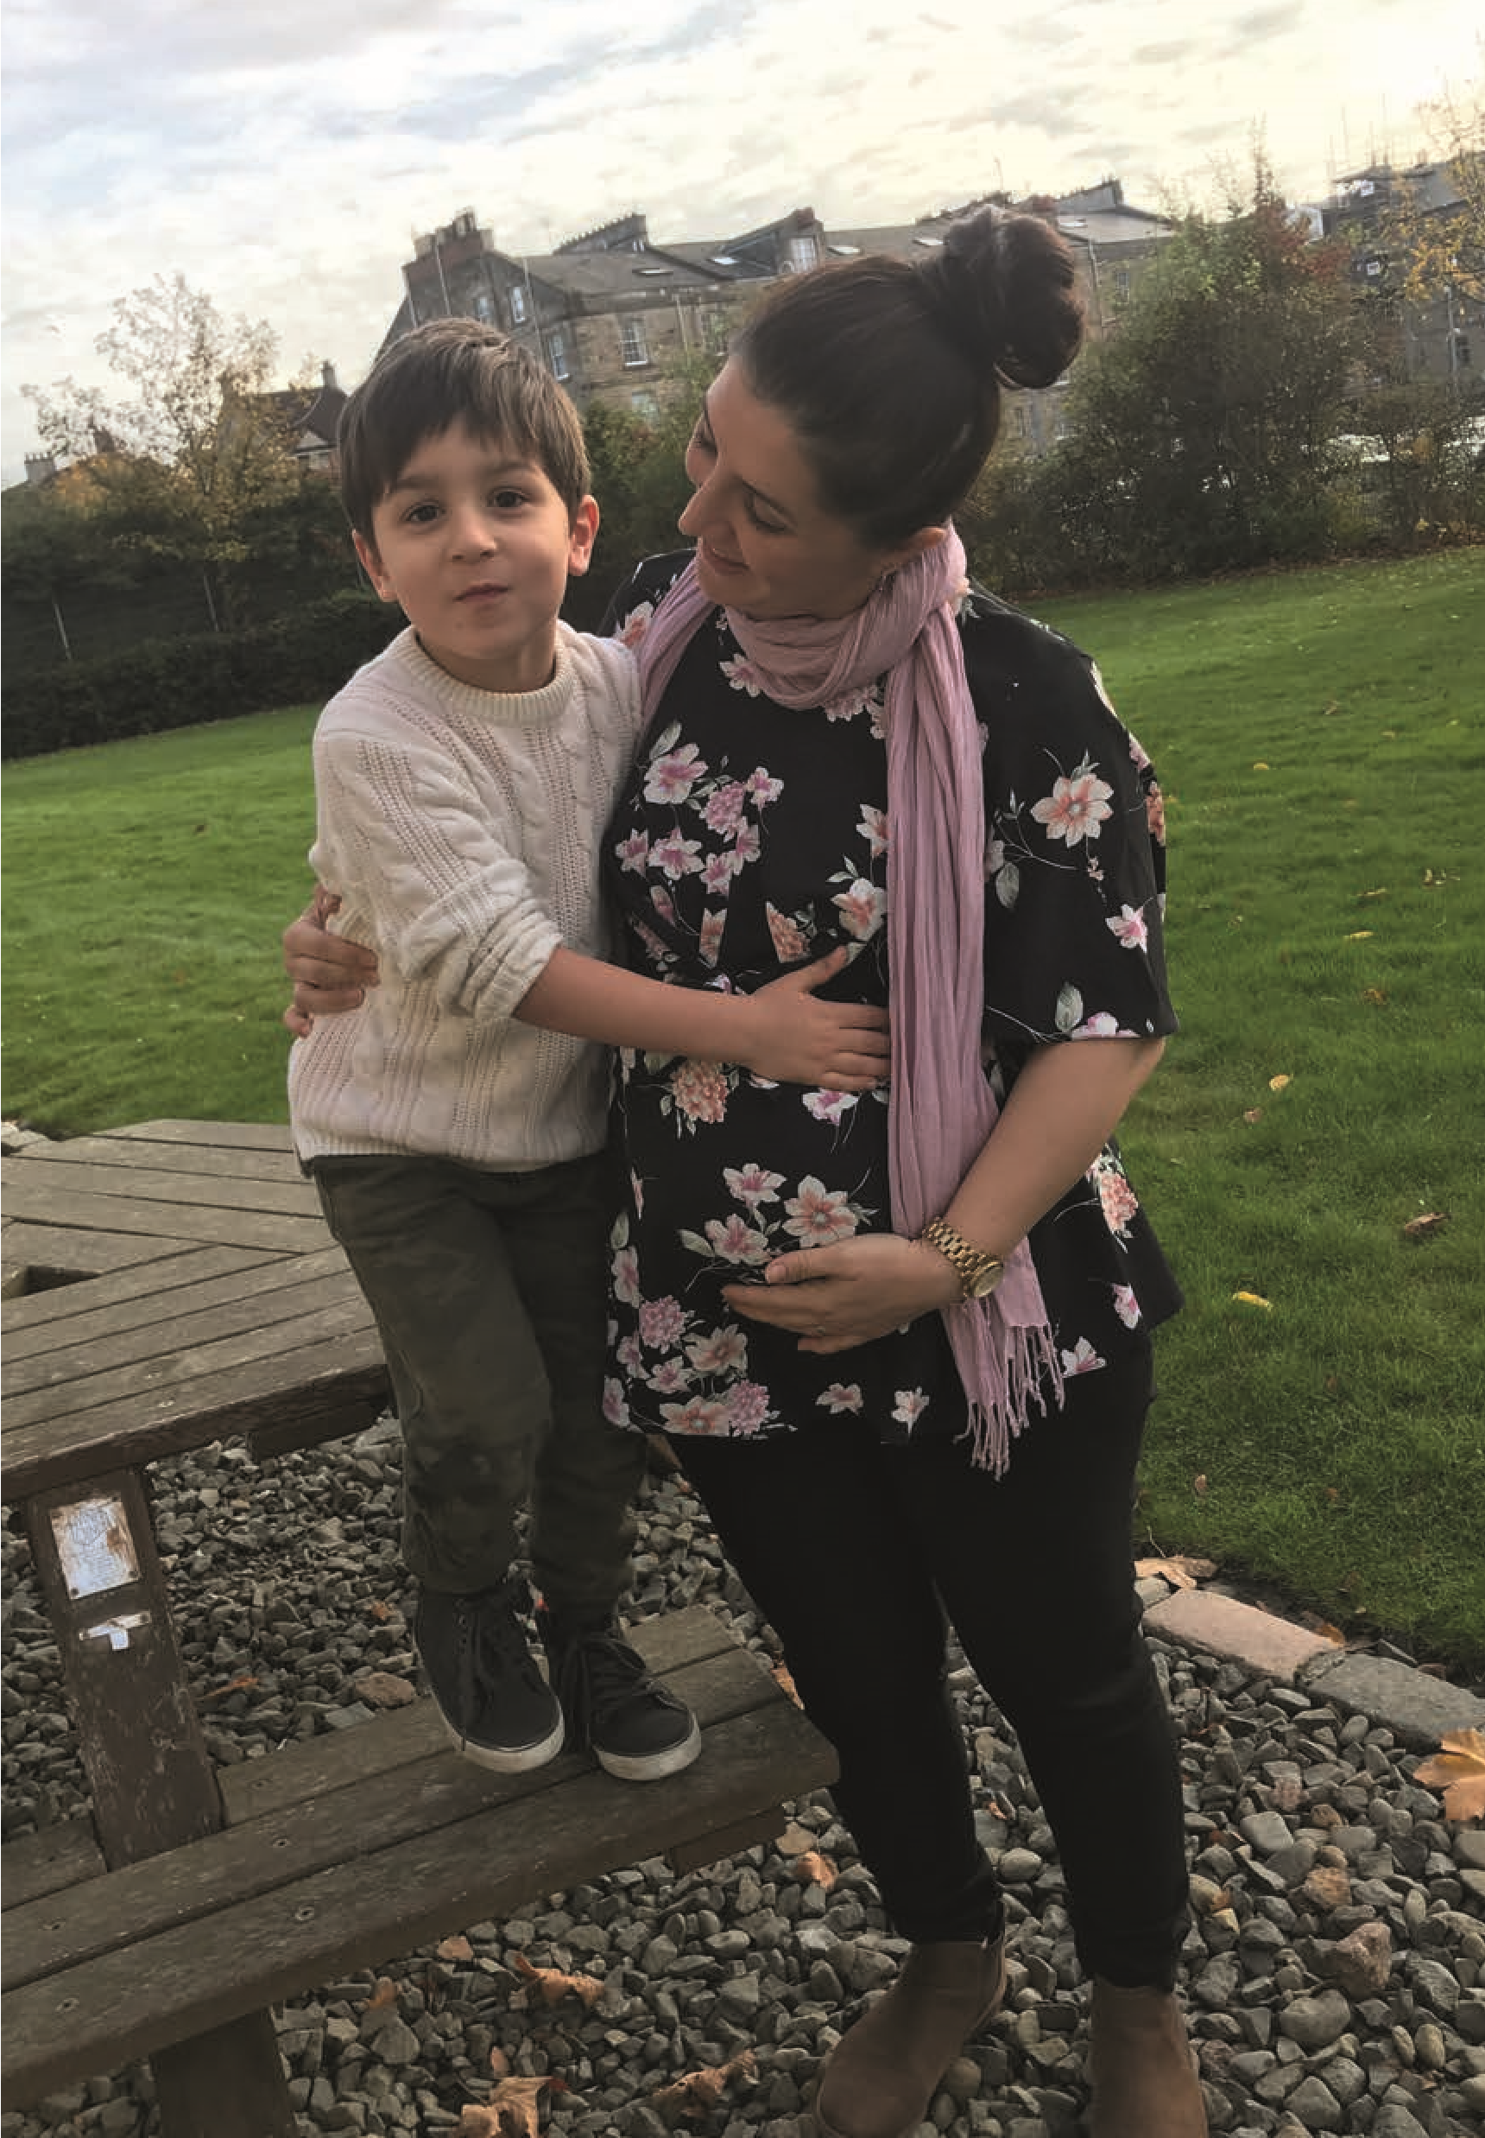
Section 2 :
Being Me – Starting Strong
Being Me
Realising the Ambition:
Me as an individual
Me and my environment
My surrounding culture
There is a balance to be struck. On the one hand, there is the knowledge and skills that we want children to develop, such as self-regulation, confidence, and curiosity. On the other hand, we know that this is best done in a child centred way where children have permission to follow their interests and to develop at their own pace.
Discuss

Slide 3
Section 2 :
Being Me – Starting Strong
We need to be confident we are providing the kind of rich culture, including high quality experiences and sensitive interactions in a variety of outdoor and indoor spaces, which will develop in babies, toddlers and young children, the emotional resilience they need to form a secure wellbeing base.
How do we define quality?
What are sensitive interactions?

Slide 4
Section 3:
What I need to grow and develop
5 dimensions of child development
Executive function and self-regulation
Communication and language
Confidence, creativity and curiosity
Movement and coordination
Self and social development

Slide 5
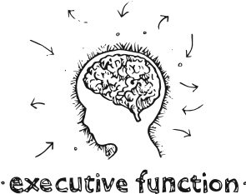
Section 3:
What I need to grow and develop
Definitions
Executive function is sometimes referred to as the brain’s “air traffic control system”. It includes working memory, which is a set of stores for information we are using right now – for example when we hold directions to a new place in our mind until we get there. When we pay attention to something for a while, or switch focus to a new thing, or when we persist with an activity despite distractions all of these draw on executive function.

Slide 6
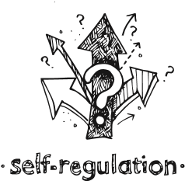
Section 3:
What I need to grow and develop
Definitions continued:
Self-regulation covers all the skills and processes that help us to stay safe and to get through the day. For babies and young children, the necessary abilities, and the brain systems that underlie them, are still developing. They don’t know whether one situation is more serious than another, and their brains may well take the “safety first” approach of assuming it is worse than it is. They do not have the skills or experience to manage strong feelings, whether of fear, hunger or happiness.

Slide 7
Section 3:
What I need to grow and develop
The role of responsive routines
Regularity and predictability give security and a sense of safety. However, over-regimenting can have the opposite effect if children’s choices get side-lined, or valuable activities are interrupted because “it is now time for …”
We also have to be aware that children learn routines gradually and at their own pace. We have a role in showing children what to do, supporting and promoting choice, and in explaining what is happening. Some children may not have enough receptive language to cope with this, especially when under stress, so visual and sound prompts can be helpful.

Slide 8
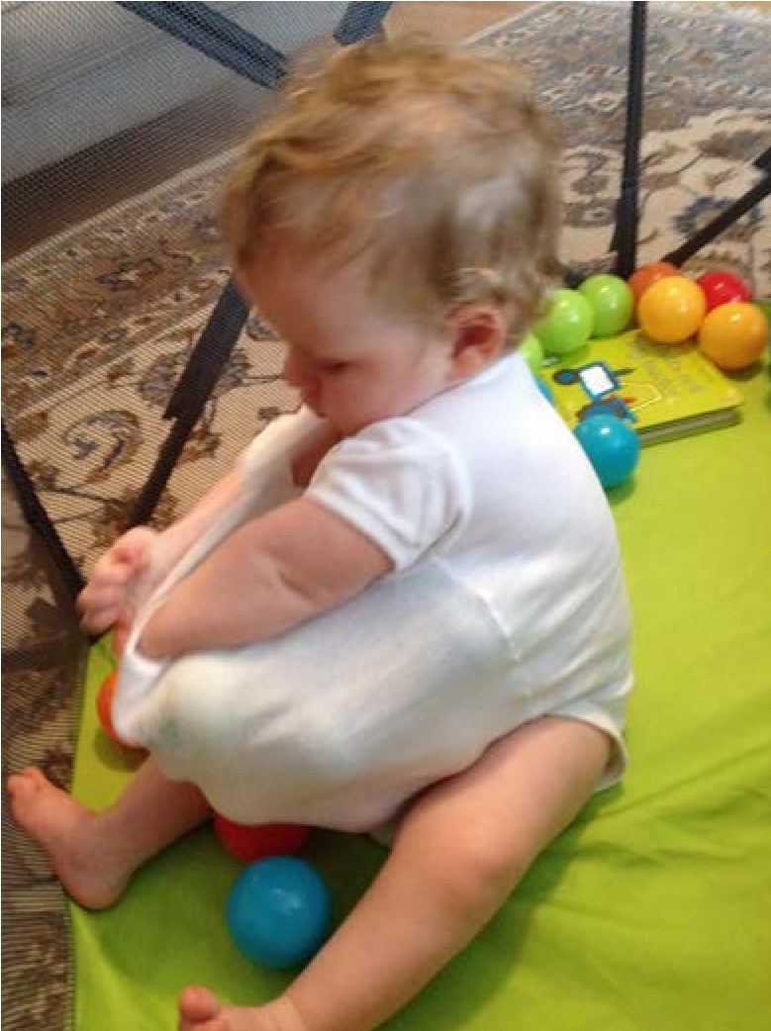
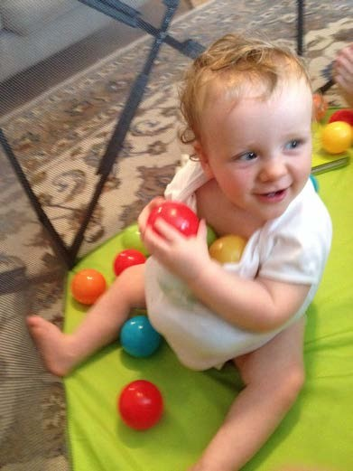
Section 3:
What I need to grow and develop
Schemas
A child’s schema will be evident across a range of different situations. It is important for a practitioner to understand that a child is not being disruptive when engaged in schematic play but be able to recognise this as early learning and help to support the child by offering opportunities to test out their thinking.

Slide 9
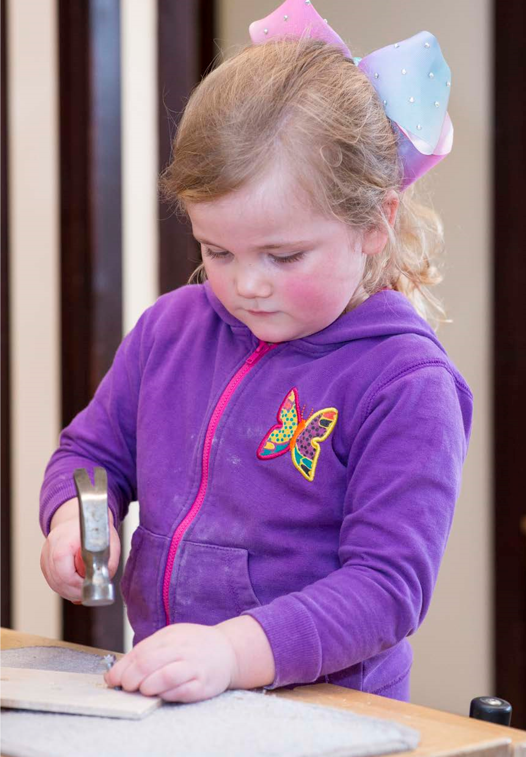
Section 3:
What I need to grow and develop
The impact of conscious and unconscious gender bias
It is crucial that children are given the opportunity and encouragement to access all areas of the curriculum from an early stage so they have equality of opportunity in the future. We are expert at focussing on the needs of an individual child and being child-led.

Slide 10


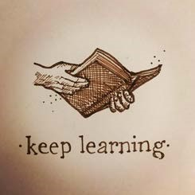


Section 3:
What I need to grow and develop
An important note about being you…..
Working with babies and young children is extremely rewarding – but can be very demanding of us physically, cognitively and – sometimes emotionally.
To give our youngest the best we must strive to be at our best. And to do this it’s important for us a workforce to look after ourselves and each other.

Slide 11
Section 4:
Child’s work: the importance of play
Play can be and mean many different things to children and adults. We may describe the activities we plan as ‘play’ whereas a child may not see these as play at all. ‘Play’ is therefore both a tricky word and concept to describe. It can be fun and joyful or difficult and complicated. This is a challenge for us as the act can be misinterpreted as being ‘just play’. The intrinsic value of what a child is actually doing and learning can be missed or ignored and therefore seen as less valuable. We may consciously or unconsciously place more value on tasks we plan and lead with pre-determined outcomes.
Discuss

Slide 12
Section 4:
Child’s work: the importance of play
Whitebread (2012) tells us about two areas in particular where the evidence about the benefits of play is strong. Firstly, early language development through imaginative play either with another adult or with other children, and, secondly, through play the child’s ability to self-regulate is enhanced.

Slide 13
Section 4:
Child’s work: the importance of play
One of the many challenges we face when considering play pedagogy in early stages of school is the pressure we can face from external forces or our own beliefs and values to evidence the child’s progress in key aspects of their learning. While important, this should not deter us from adopting pedagogical approaches which embrace play as the medium through which young children learn best.
Discuss

Slide 14
Section 4:
Child’s work: the importance of play
Consider how useful or affording the experiences are outside and inside the setting. To do this, ask yourself, can and do the children use the experiences they have on offer in different ways to test and explore their theories? Has both intentional and responsive planning for continuity and progression using Curriculum for Excellence Early Level been considered? Collaboration with the children, parents, other members of staff and the consideration of opportunities in the wider community ensures a play provision which is relevant, challenging and exciting.

Slide 15
Section 4:
Play pedagogy
Achieving a consistent pedagogical approach across the ELC sector and the early primary stages should be a key aspiration. Regular planning discussions between practitioners across both sectors and with children themselves would help to improve continuity of experience and learning.
How is this achieved in your
establishment?

Slide 16
Section 4:
Play pedagogy
In ELC and beyond into school, the social environment of interactions should provide children with opportunities to continue to develop positive relationships with others; while also supporting and developing an understanding of the notion of boundaries; self-regulation, negotiation and choice. As the complexity of the child’s play develops, learning should be facilitated through a cyclical process of responsive and intentional planning, which includes observations, interpretation and documentation of learning, responsive and intentional planning and facilitation.
Planning – do you cover this?
Could it be improved?

Slide 17
Section 4:
Play pedagogy

Slide 18
Section 4:
The role of the adult in supporting learning
Stepping back and noticing what the children are involved in is a skill that must be embedded into practice both in ELC and school settings. After reflecting on the key learning for the child we can facilitate a provocation or response to allow the child to further pursue their own thinking. The provocation/response allows further time for us to capture what the child’s thinking is prior to interacting with them and then developing a plan for building or extending the child’s thinking.

Slide 19
Section 4:
The role of the adult in supporting learning
The role of the adult is a delicate balance of supporting, enriching and proposing on the one hand, and keeping back to give the children space and time to build their own ideas on the other. Barbara Rogoff (2003) describes learning as a co-operative process between children and adults, where children ‘borrow’ adult knowledge and skills, and at any given moment the lead and responsibility passes back and forth. From the adult’s point of view, one can imagine this as a ‘ladder’ that they can go up and down, always aware of the child’s interest and initiative.

Slide 20
Section 4:
The role of the adult in supporting learning
Conversations around observations of play need to feature regularly in team meetings and during professional training or collegiate moderation opportunities. Photographs taken or short videos of the children playing within the setting can be used to support these conversations. These also provide meaningful documentation opportunities for the children to revisit their experiences.
It is impossible to design a progression or tracker for everything a child might do or find interesting.
Do you have these conversations?
Are they a part of your core business?

Slide 21
This is what it is all about – our children!

