Slide 1
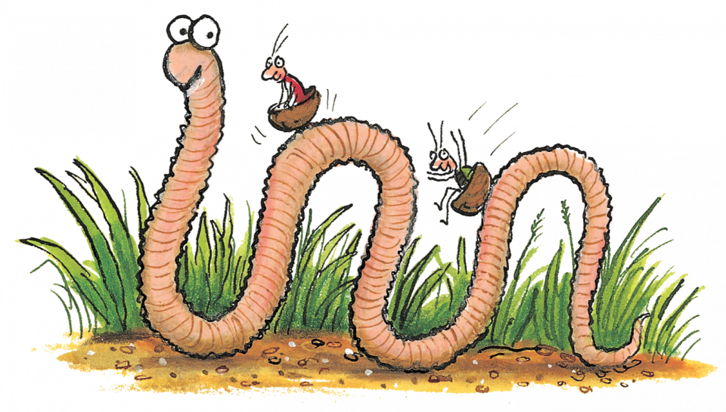
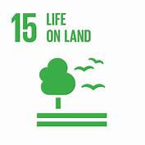
Super worm STEM Trail By Emma Brown NAC STEM Team
Super Worm STEM Trail By Emma Brown NAC STEM Team
STEM Experiences:
Planet Earth
Biodiversity and interdependence:
Learners explore the rich diversity of living things and develop and understanding of how organisms are interrelated at local and global levels.
By exploring interaction and energy flow between plants and animals
(including humans) learners develop their understanding of how species depend on one another and on the environment for survival.
Learners investigate the factors affecting plant growth and develop their understanding of the positive and negative impact of the human population on the environment.

