Slide 1
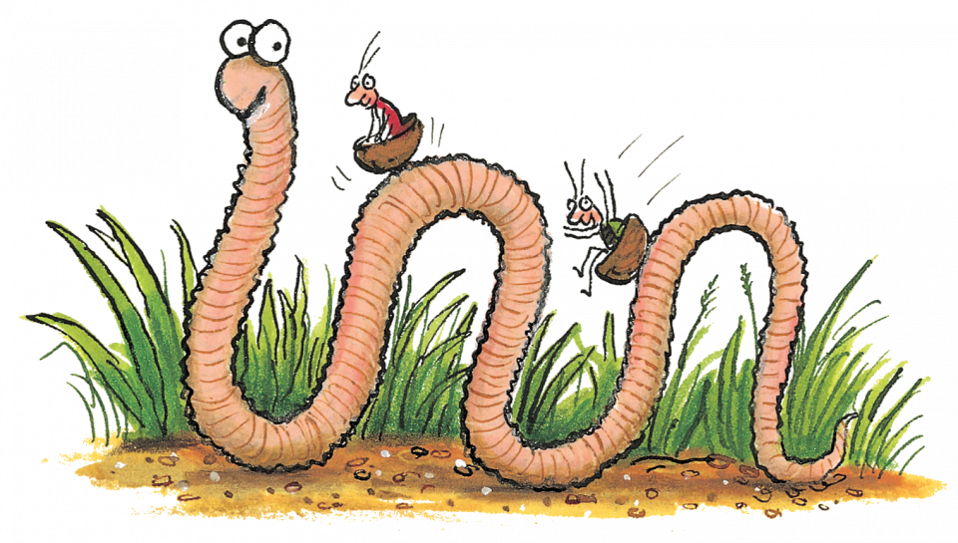
Super worm STEM Trail By Emma Brown NAC STEM Team
Super Worm STEM Trail By Emma Brown NAC STEM Team
STEM trails provides numerous ideas for teachers to help children to discover and understand STEM concepts in primary schools, using the outdoor environment as a stimulus.
This Super Worm STEM Trail has been created to encourage staff and children to go outdoors and look at Biodiversity in the school grounds and how worms help food production. (LFS)
You can start by reading or watching Super worm and then you can either set up the trail around your school grounds or take them with you.
These trail cards can either be done in one session or over a few weeks and can be adapted across all the stages.
I hope you find them useful and enjoy learning outdoors.

