Slide 1
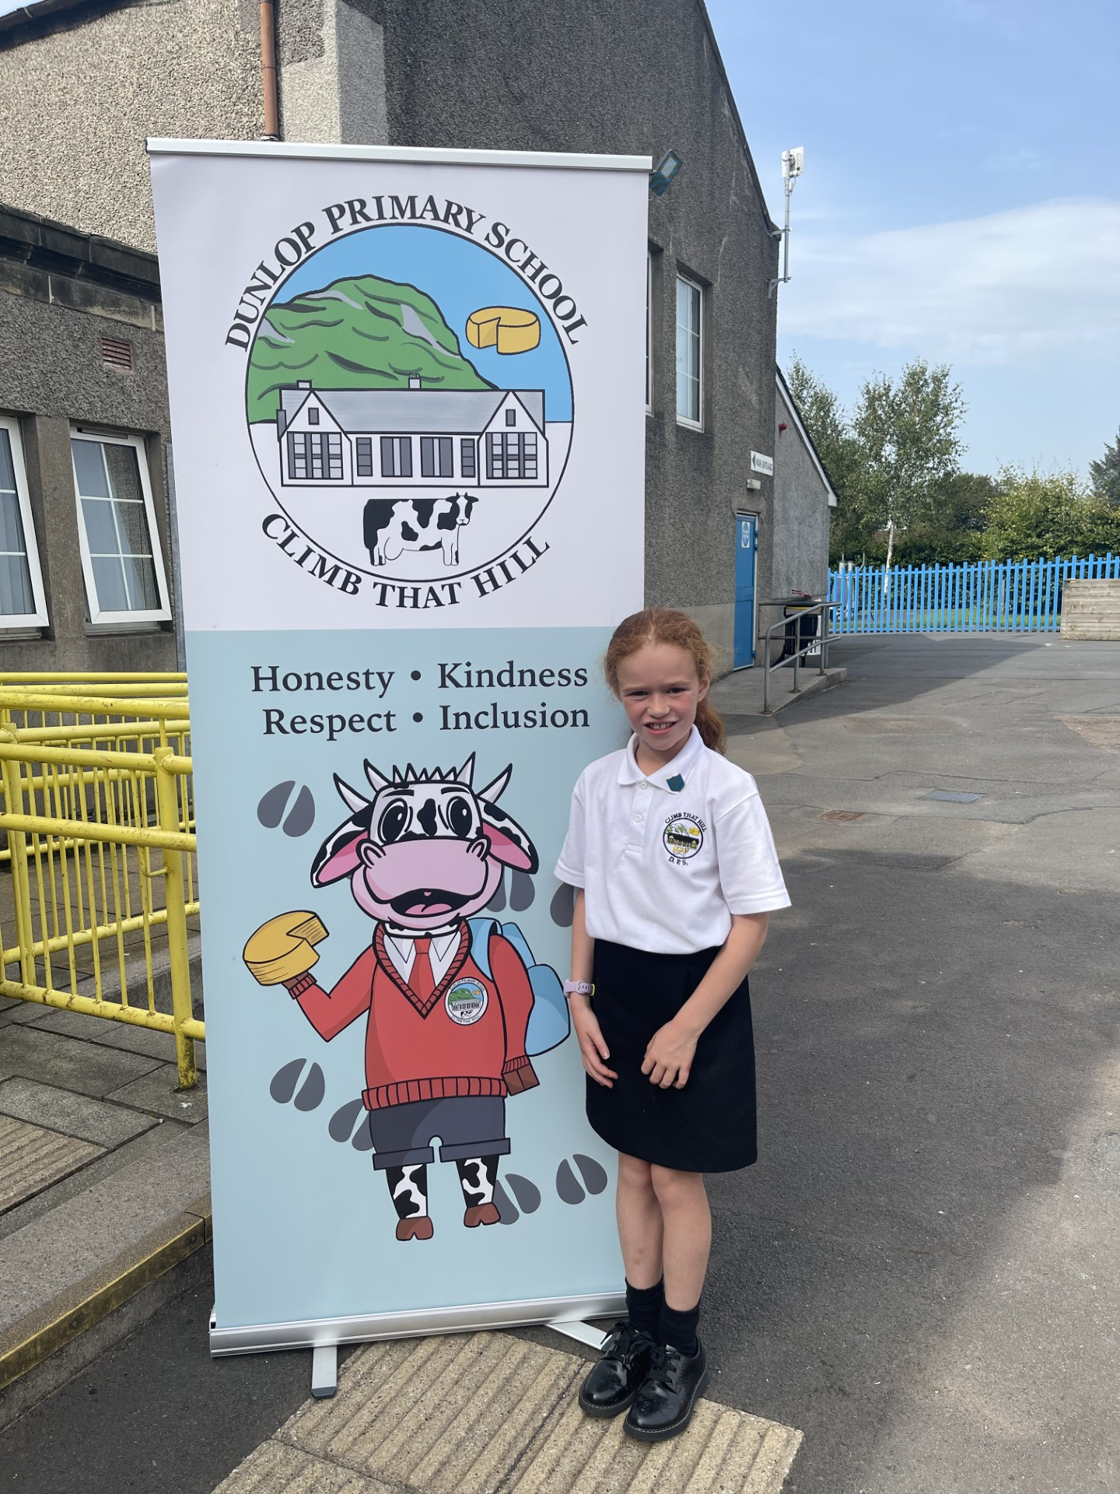
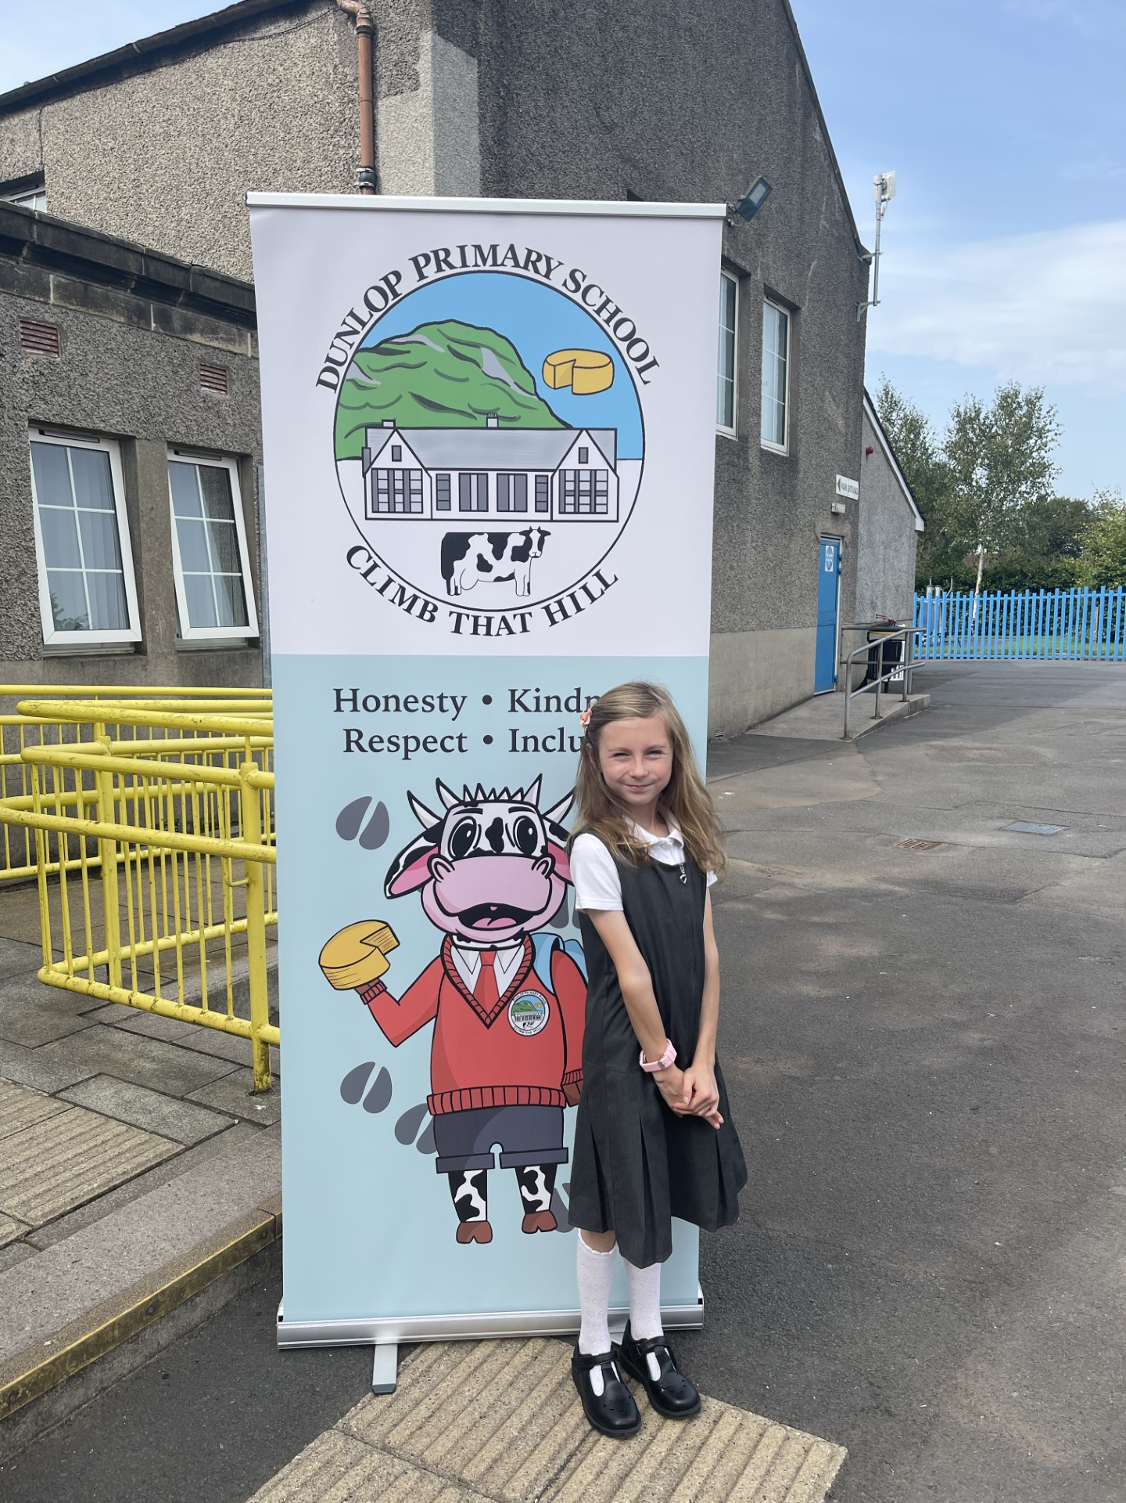
Dunlop Primary School
Clerkland Captain
Dunlop Primary School
Clerkland Vice-Captain

