Slide 1
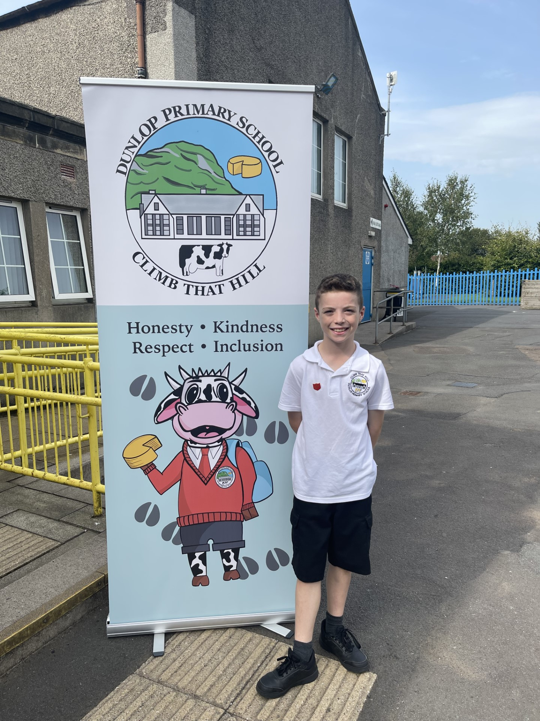
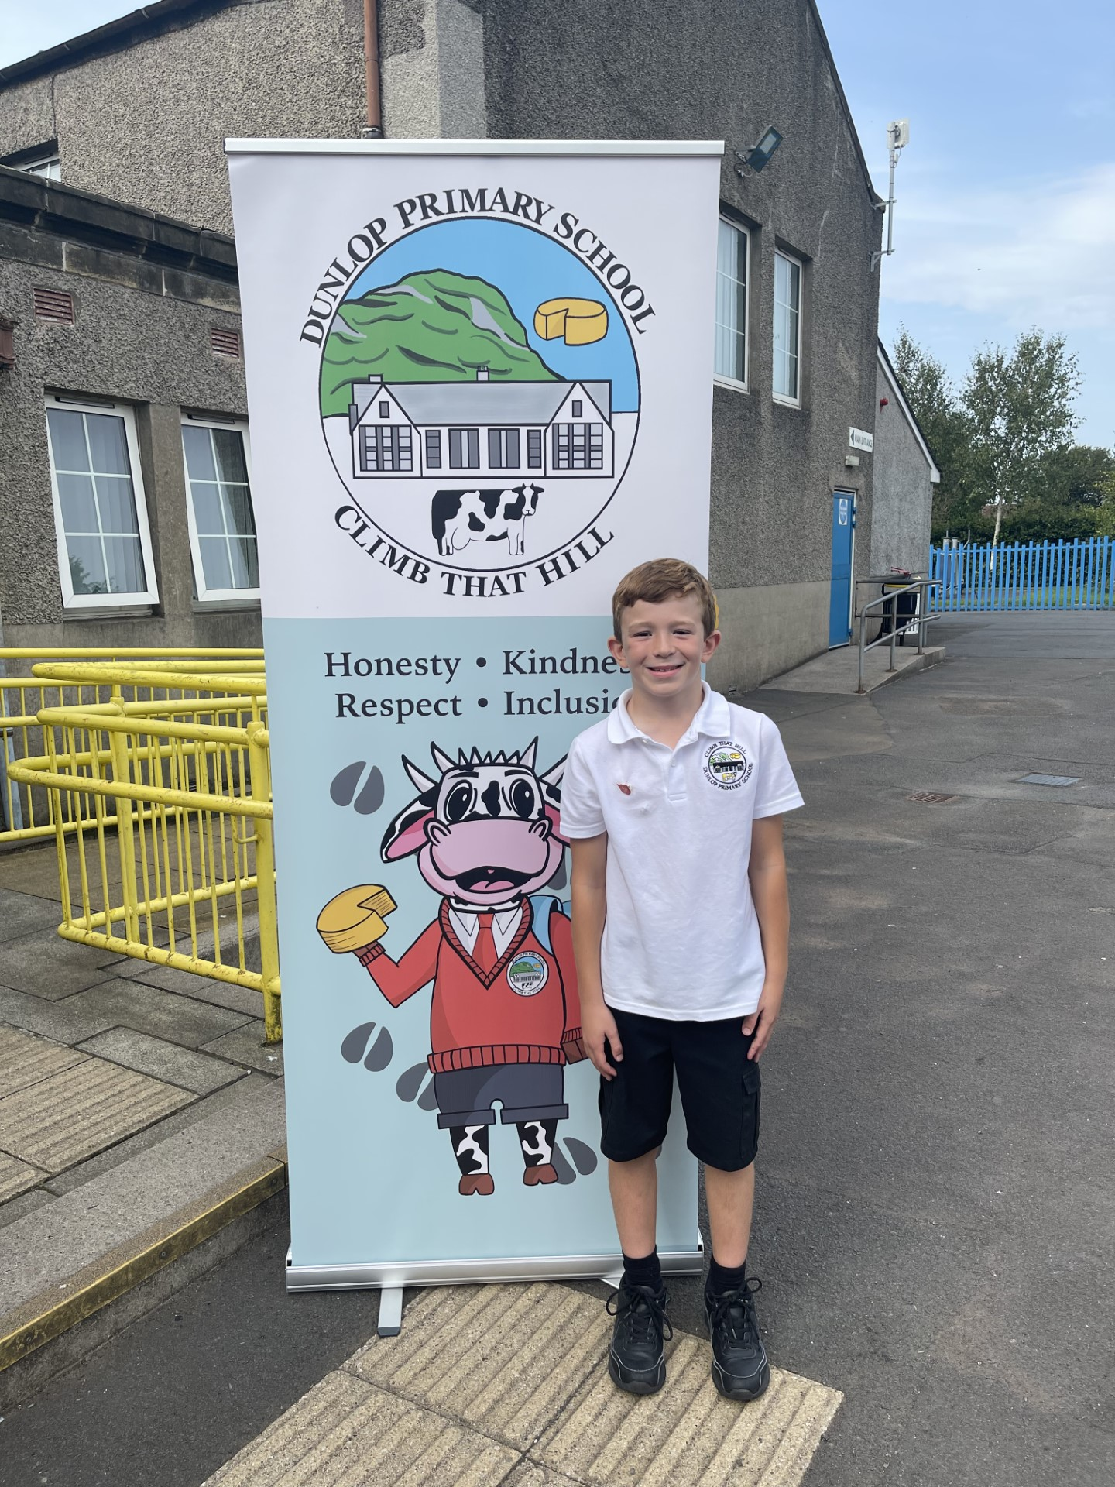
Dunlop Primary School
Lugton Captain
Dunlop Primary School
Lugton Vice-Captain

