Slide 1
Dunlop Primary – Parent Information Microsoft Teams

Slide 2
What is Microsoft TEAMs
Microsoft Teams is a unified communication and collaboration platform. The Most popular blogging system on the Web.
Free to user having a glow account
Free app for mobile devices
Web (browser version) or Application
Full integration with Microsoft products , FORMS, SWAY, Office applications and more.
Ideal for Staff Collaboration
Can be used for Homework, P5-S6
Tools such as Immersive Reader

Slide 3
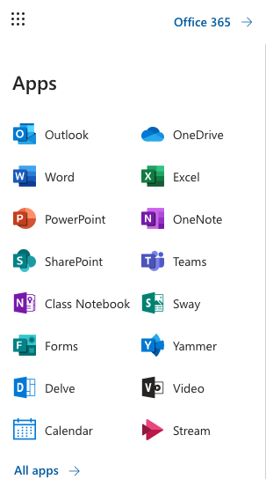
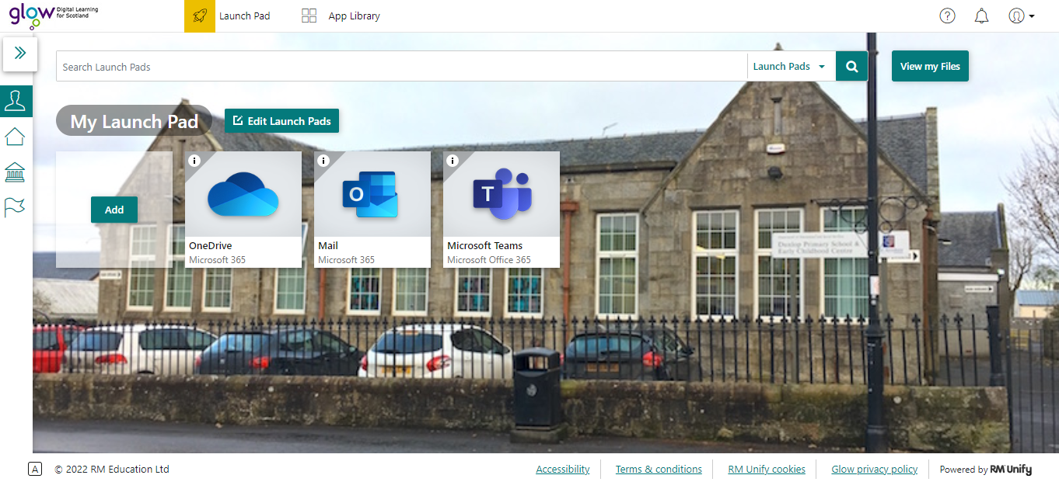
Getting Start
Depending on which version of MS Teams you decide to use will determine how to access it. We will look at the Web Version.
MS Teams web version can be found in two ways, On the Launchpad (if added). The other way is to find it on the Waffle or app ion on any SharePoint site.
Waffle
Launchpad

Slide 4
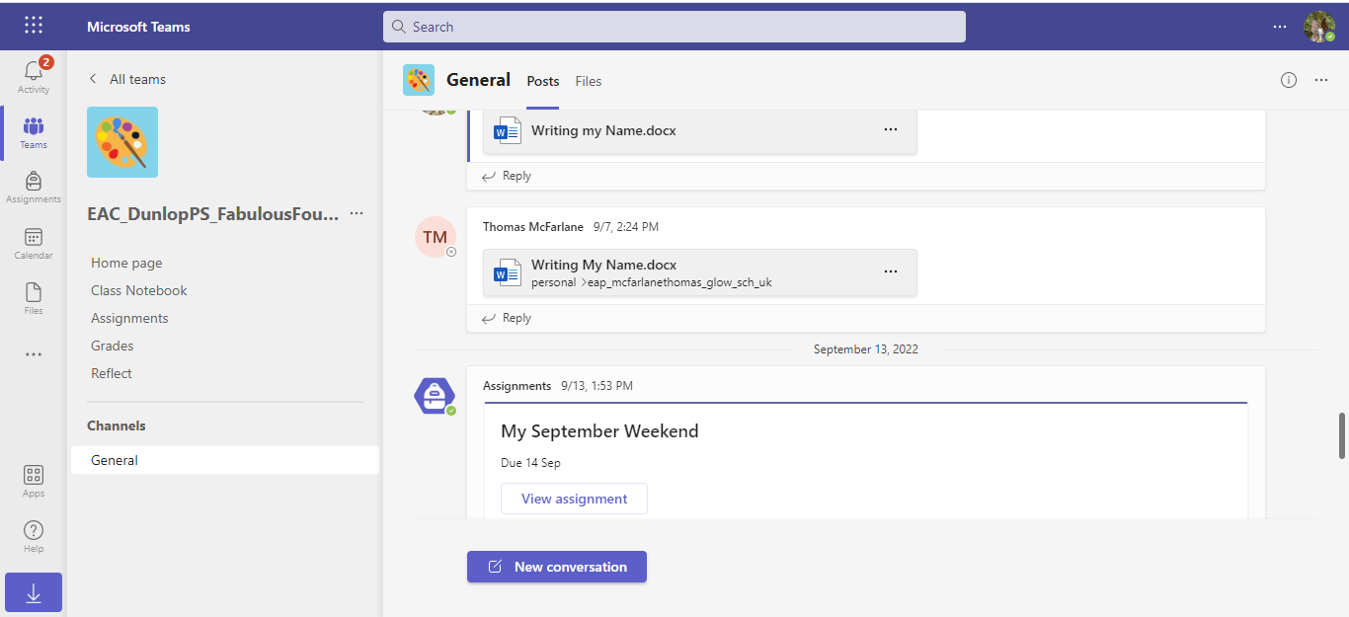
MS Teams (Web)
Depending on which version of MS Teams you decide to use will determine how to access it. We will look at the Web Version.
Browser & Content
Window

Slide 5
Areas
 | Shows what you have been doing
 | This is the chat area with members or channels
 | Teams you can belong to any number.
 | Use to set assignments or tasks with your TEAM
 | Calendar, set meetings with in the team
 | Communications, can be just a call or video conferencing.
 | Files, with your TEAMs, Recent and your OneDrive
 | Other applications (can be added)

Slide 6
Chat
This is a great place to chat with your MSTeam members, the actual streams in MSTEAMs is know as CHANNELs
Channels
Can be for serious work or even some fun. Great win working with Students in the Primary schools. Stickers, emoji and more

Slide 7
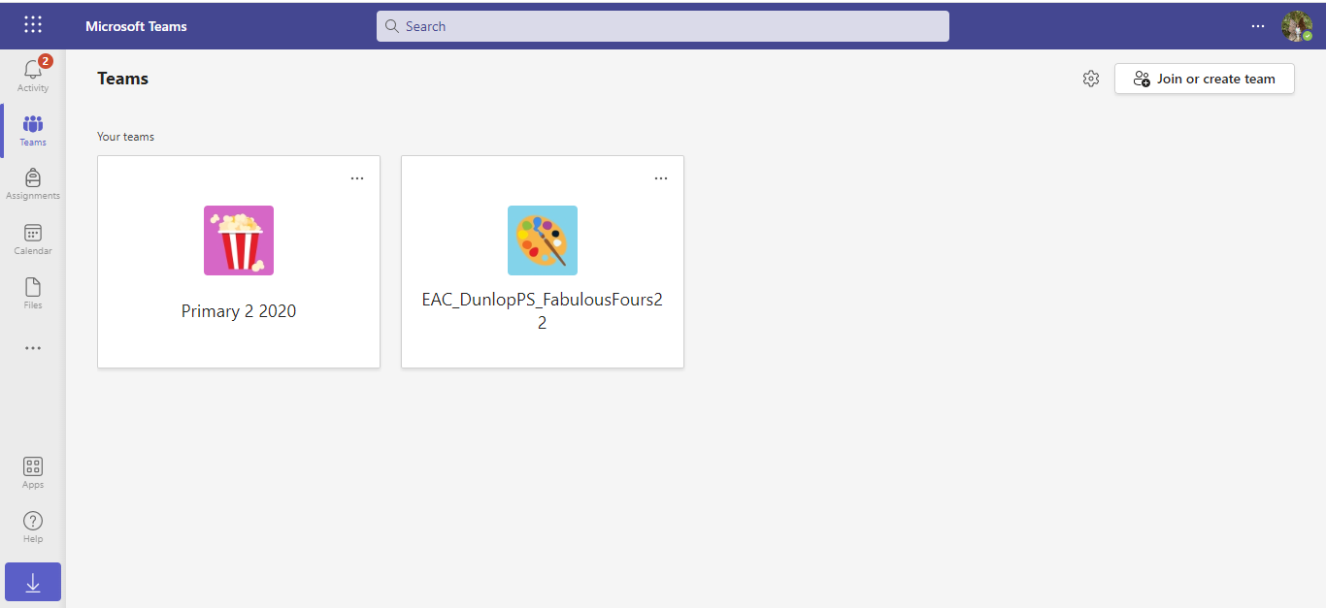
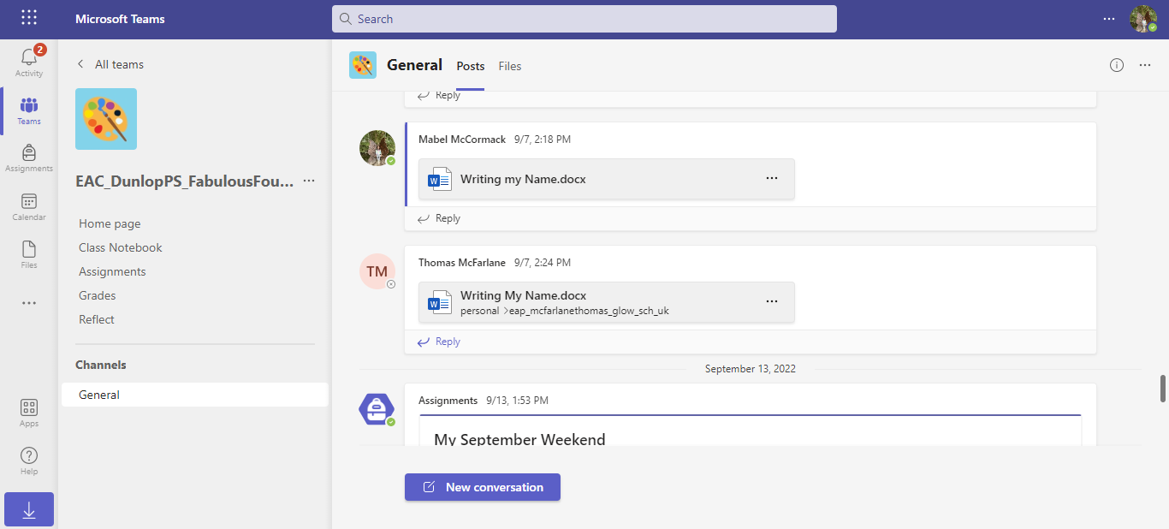
TEAMs
In most cases when you click on this Team you will may only have a few MSTEAMs you are in, own or member.
TEAMS or Classes
TEAM view

Slide 8
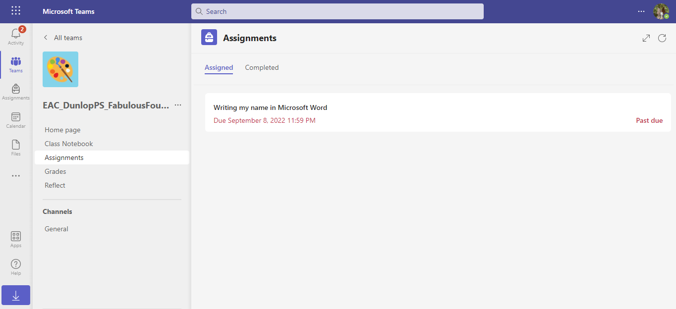
Assignments
Teachers Create assignments from previous ones, assign them with deadlines (returns) They can be graded if required. The assignments can also be recycled and used again with a different class/TEAM. If quiz mode use you can even automate the marking.
The assignment can use all types of document, FORMs, word, PDF , Powerpoint, Excel and more. They student/pupil can send back items or work collaboratively on a piece of work.

Slide 9
Immersive Reader
The text can be changed via the Text Options
This can be set for the needs for the particular user, which includes Text Size, FONT, Themes (Colour background for those who require this).
Also colour coding to aid
Grammar can be set and Line Focus and even Picture prompting.

Slide 10
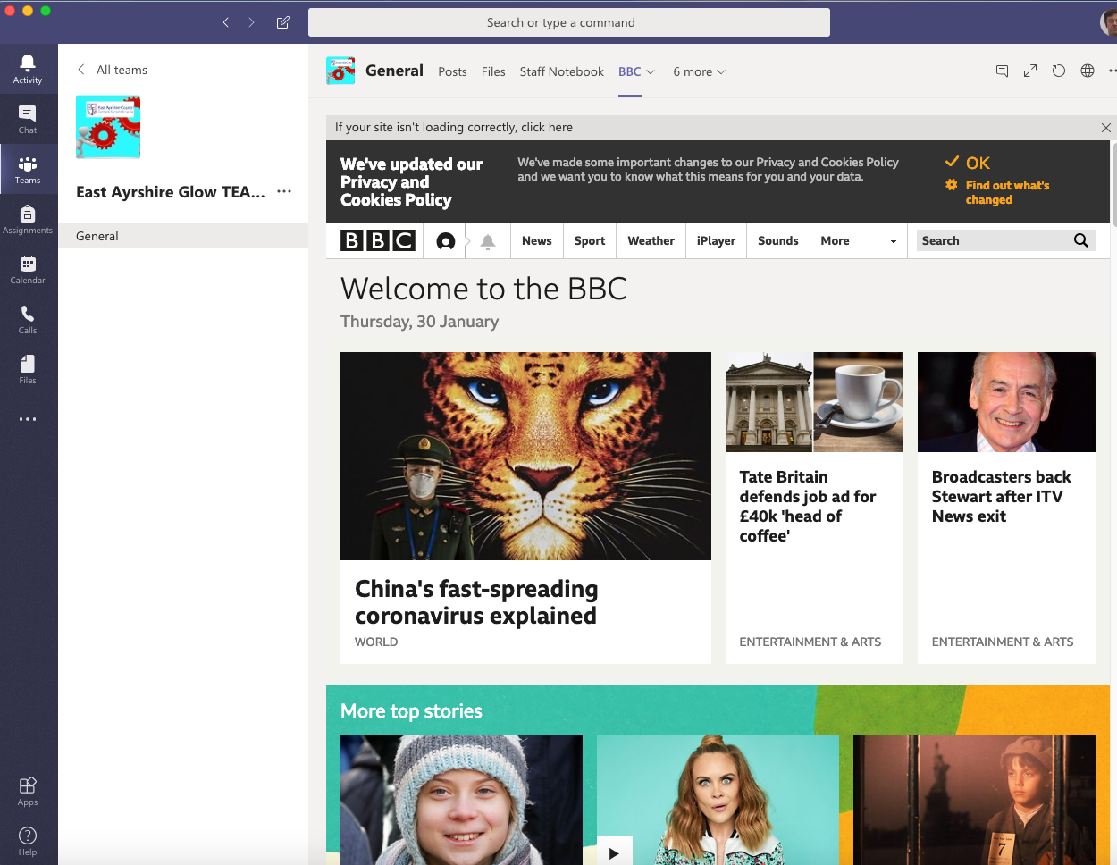
Application Version
This can be added to the computer the student/member is working on. There are advantages. If you log into the computer the application can open automatically into your MS Teams. The application is a Browser in its own right and will be able to display websites in the the channel window directly in this case the BBC.
You may Need to log into the glow at this point when prompted if not already in.
It also means the school could place the sharepoint for the class/members right into the MSTeams Platform.

Slide 11
APP on Mobile devices
An app can be downloaded for free to your mobile/tablet and activated using your glow e-mail address (RM one). apps store iOS (apple) or Play store (android) look for MS Teams.
The RM one will be
Eap.firstname.second@glow.sch.uk
You get the full service once activation and notifications also work directly to the app on the device.

Slide 12
Summary
The application and web based teams allow users to work from different platforms, share and collaborate. It has many tools for communication. MS Teams works directly with Glow mail and other MS Products.
Advantages:- FREE for all glow users. Available for Primary and Secondary. Immersive reader for additional support and is a professional application used by organisations outside of Education.
This presentation has only scratched the surface of what this application can do. It is constantly being updated and improved by Microsoft.

Slide 13
Introduction Microsoft TEAMs

