Slide 1
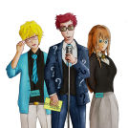
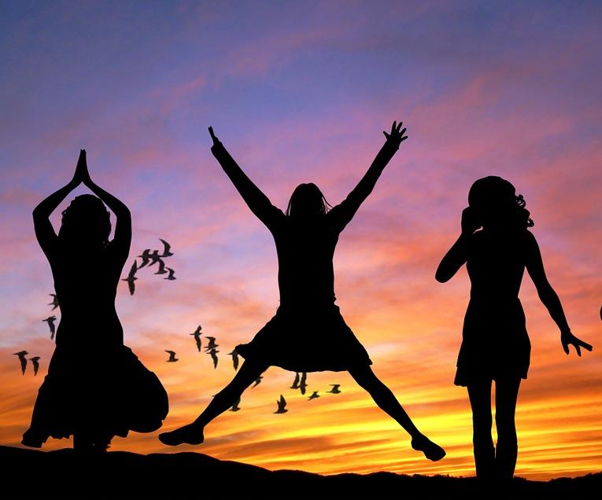
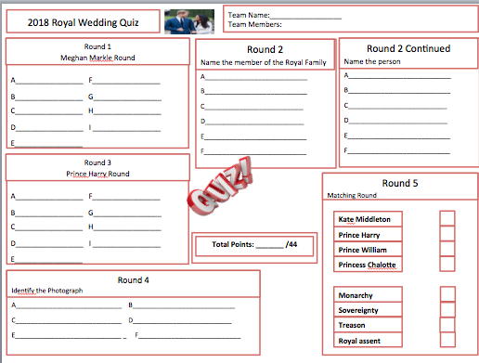
International Women’s Day
HERE’S TO STRONG WOMEN
MAY WE KNOW THEM
MAY WE BE THEM
MAY WE RAISE THEM
Notes:
Copyright Attributes:
BACKGROUND IMAGE - GraysonArthur2017
1. Free for commercial use
A list of licenses for the images used in this presentation can be found here: https://creativecommons.org/licenses/
https://pixabay.com/en/african-american-america-black-1292905/

Slide 2
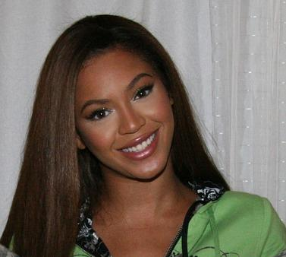
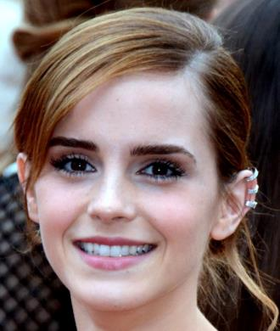
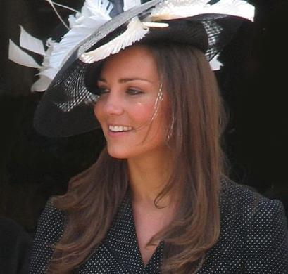
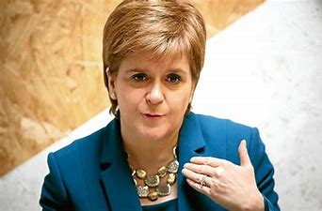
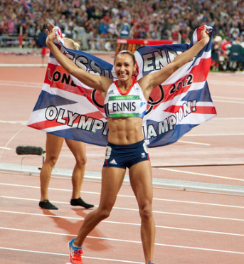
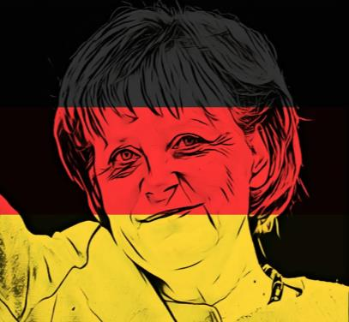
ROUND 1
IDENTIFY THE FAMOUS FEMALE
A
B
C
D
E
F
Notes:
Copyright Attributes:
BACKGROUND IMAGE - GraysonArthur2017
TOP LEFT AND RIGHT - 1. Free for commercial use
A = Pixabay
B = https://commons.wikimedia.org/wiki/File:Emma_Watson_2013.jpg
C = https://commons.wikimedia.org/wiki/File:Kate_Middleton_at_the_Garter_Procession_2008.jpg
D =https://pixabay.com/en/cartoon-celebrity-comic-female-2026564/
E = Free for commercial use
F = https://pixabay.com/en/merkel-chancellor-politician-3560150/

Slide 3
ROUND 2
TRUE OR FALSE
A
A U.K. poll revealed that 68% of women believe their mothers are the most inspirational women they know.
E
Women are now fairly represented in most legal professions.
B
International Women’s Day can be traced back to 1908 when women marched demanding the right to vote.
F
There is not a single country in the world where an average women earns as much as an average man.
C
100,000 women and men are said to have marched in U.K. cities on the first day of Donald Trump’s Presidency.
G
As of 2020, women represent 50% of senior managers in top companies.
D
The number of female MP’s in parliament has nearly doubled in the last 20 years.
H
#BeBoldForChange was the theme for International Women’s Day in 2017.
Notes:
Copyright Attributes:
BACKGROUND IMAGE - GraysonArthur2017
TOP LEFT AND RIGHT 1. Free for commercial use
A list of licenses for the images used in this presentation can be found here: https://creativecommons.org/licenses/

Slide 4
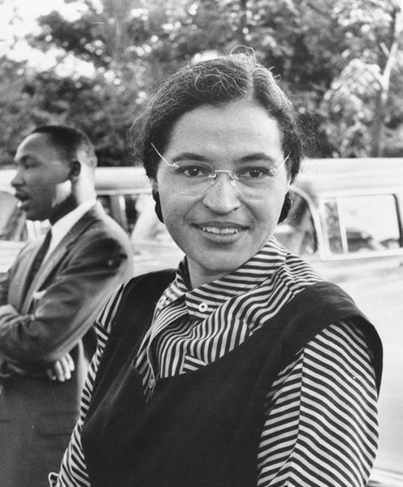
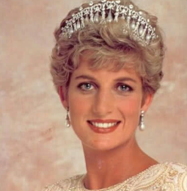
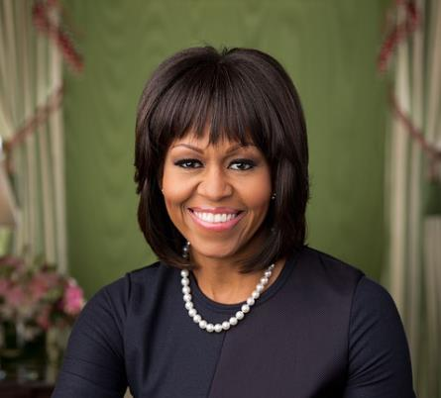
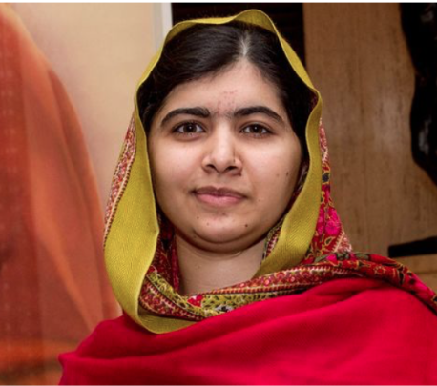
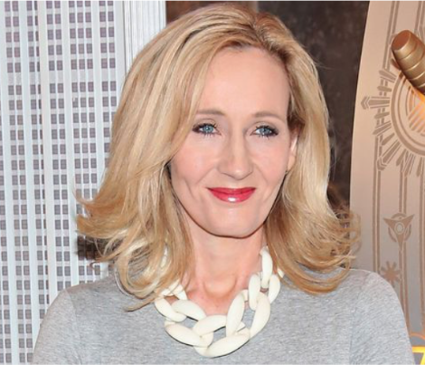
ROUND 3
IDENTIFY THE FAMOUS WOMEN IN HISTORY
A
B
C
D
E
F
Notes:
Copyright Attributes:
BACKGROUND IMAGE - GraysonArthur2017
TOP LEFT AND RIGHT - 1. Free for commercial use
A = https://commons.wikimedia.org/wiki/File:Rosaparks.jpg
B = Free public domain
C = https://commons.wikimedia.org/wiki/File:Spice_Girls_(6_janv)_56.jpg
D = https://pixabay.com/en/michelle-obama-2013-1129160/
E = Schlesinger Library, RIAS, Harvard University
F = No attribution required under CCO
presentation can be found here: https://creativecommons.org/licenses/
A list of licenses for the images used in this presentation can be found here: https://creativecommons.org/licenses/

Slide 5
ROUND 4
MATCH THE ICONIC FEMALE FIGURE
A
Diane Abbott
1
Leader of the British Suffragette movement 1858 - 1928
B
Emmeline Pankhurst
2
First female British Poet Laureate
C
Carol Ann Duffy
3
First female black British Member of Parliament in 1987
D
Margaret Thatcher
4
First Female British Prime Minister in 1979 - 1990
Notes:
Copyright Attributes:
BACKGROUND IMAGE - GraysonArthur2017
TOP LEFT AND RIGHT - 1. Free for commercial use
A list of licenses for the images used in this presentation can be found here: https://creativecommons.org/licenses/

Slide 6
ROUND 4
MATCH THE KEY WORD TO THE DEFINITION
A
Misogyny
1
A belief that males are naturally superior to females
B
Gender Prejudice
2
Discrimination, often in the workplace, with bias towards a person’s sex.
C
Male Chauvinism
3
A dislike, hatred or continuous prejudice against women.
D
Sexual Discrimination
4
Often called sexism, referring to pre-judgement of a person based on their gender.
Notes:
Copyright Attributes:
BACKGROUND IMAGE - GraysonArthur2017
TOP LEFT AND RIGHT - 1. Free for commercial use
A list of licenses for the images used in this presentation can be found here: https://creativecommons.org/licenses/

Slide 7
ROUND 5
MULTIPLE CHOICE ROUND
What year did Queen Elizabeth II take the throne?
A
1922
1952
1972
1992
Which British female singer sang the song ‘Firework’?
B
Cheryl Cole
Jess Glynne
Paloma Faith
Katy Perry
How many Nobel Peace prizes did Marie Curie win?
C
0
1
2
3
How old was Anne Frank when she wrote her diary?
D
13-14
15-16
11-12
7-8
Notes:
Copyright Attributes:
BACKGROUND IMAGE - GraysonArthur2017
TOP LEFT AND RIGHT - 1. Free for commercial use
A list of licenses for the images used in this presentation can be found here: https://creativecommons.org/licenses/

Slide 8
ROUND 6
ANAGRAMS –UNSCRAMBLE THE WORDS
Clue: Traits needed to be good role model
ECNEDIFNOC
A
B
ENIQUU
ILHUMITY
C
RTESILIEN
D
Notes:
Copyright Attributes:
BACKGROUND IMAGE - GraysonArthur2017
TOP LEFT AND RIGHT - 1. Free for commercial use
A list of licenses for the images used in this presentation can be found here: https://creativecommons.org/licenses/

Slide 9
ROUND 7
OBSERVATION ROUND 2 minutes to study the picture
TIME’S UP
1 Minute!
2 Minutes
START
TIMER
Notes:
https://commons.wikimedia.org/wiki/File:Spice_Girls_(6_janv)_56.jpg

Slide 10
ROUND 7
OBSERVATION ROUND
A
How many Spice Girls are there?
E
Were any of them sporting tattoos?
B
What are the nicknames of the spice girls?
F
How many of them had outfits that covered their knees?
C
What colour was the dress on the far right?
G
How many musical instruments were in the photo?
D
What colour dress was the lady singing wearing?
H
Which Spice Girl was wearing the pink outfit?

Slide 11
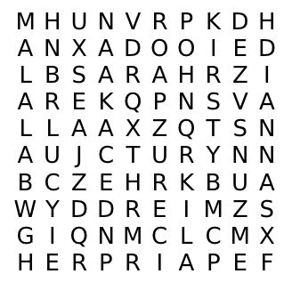
ROUND 9
WORDSEARCH – FIND THE WORDS
YOU HAVE 5 MINUTES TO:
FIND ALL 8 different girls names hidden in the wordsearch
TIME’S UP
1 Minute!
2 Minutes
3 Minutes
4 Minutes
5 Minutes
START
TIMER
Notes:
Copyright Attributes:
BACKGROUND IMAGE - GraysonArthur2017
TOP LEFT AND RIGHT - 1. Free for commercial use
A list of licenses for the images used in this presentation can be found here: https://creativecommons.org/licenses/

Slide 12
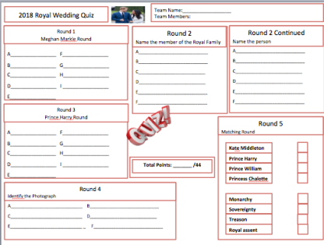
International Women’s Day
Notes:
Copyright Attributes:
BACKGROUND IMAGE - Free for commercial use
TOP RIGHT - Free for commercial use No attribution required
A list of licenses for the images used in this presentation can be found here: https://creativecommons.org/licenses/

Slide 13
ROUND 1
IDENTIFY THE FAMOUS FEMALE
A
B
C
Beyonce
An actress and American singer and song writer who inspires many around the world
Emma Watson Famous actress and activist for women’s rights, feminist campaigner and UN icon
Kate Middleton
Works very hard to give back to the community, and a big campaigner for anti-bullying
D
E
F
Jessica Ennis
Promotes sport and athletics for women and won Gold in the Heptathalon at London 2012 Olympics
Angela Merkel
German politician who is currently Chancellor of Germany and very influential in the European Union
Nicola Sturgeon
First Minister of Scotland and leader of the SNP.
Notes:
Copyright Attributes:
BACKGROUND IMAGE - GraysonArthur2017
TOP LEFT AND RIGHT - 1. Free for commercial use
A = Pixabay
B = https://commons.wikimedia.org/wiki/File:Emma_Watson_2013.jpg
C = https://commons.wikimedia.org/wiki/File:Kate_Middleton_at_the_Garter_Procession_2008.jpg
D =https://pixabay.com/en/cartoon-celebrity-comic-female-2026564/
E = Free for commercial use
F = https://pixabay.com/en/merkel-chancellor-politician-3560150/

Slide 14
ROUND 2
TRUE OR FALSE
A
A U.K. poll revealed that 68% of women believe their mothers are the most inspirational women they know.
E
Women are now fairly represented in most legal professions.
False
False
B
International Women’s Day can be traced back to 1908 when women marched demanding the right to vote.
F
There is not a single country in the world where an average women earns as much as an average man.
True
True
C
100,000 women and men are said to have marched in U.K. cities on the first day of Donald Trump’s Presidency.
G
As of 2018, women represent 50% of senior managers in top companies.
True
False
D
The number of female MP’s in parliament has nearly doubled in the last 20 years.
H
#BeBoldForChange was the theme for International Women’s Day in 2017.
True
True
Notes:
Copyright Attributes:
BACKGROUND IMAGE - GraysonArthur2017
TOP LEFT AND RIGHT 1. Free for commercial use
A list of licenses for the images used in this presentation can be found here: https://creativecommons.org/licenses/

Slide 15
ROUND 3
IDENTIFY THE FAMOUS WOMEN IN HISTORY
A
B
C
Rosa Parks
Prompted the Montgomery bus boycott to become “the first lady of Civil Rights” in America.
Princess Diana- Dubbed ‘The people’s Princess’, she is known and celebrated worldwide for her humanitarian work.
Spice Girls
Girl power became popular in the late 90s, paving the way for modern day pop singers like Adele.
D
E
F
J.K Rowling
Sold millions of Harry Potter books worldwide and created one of the most well loved fictional characters of all time.
Michelle Obama
Is an American lawyer and writer who was First Lady of the United States from 2009 to 2017.
Malala Yousafzai
At the age of 17, she was awarded the Nobel Peace prize for her work as an activist for Women’s rights.
Notes:
Copyright Attributes:
BACKGROUND IMAGE - GraysonArthur2017
TOP LEFT AND RIGHT - 1. Free for commercial use
A = https://commons.wikimedia.org/wiki/File:Rosaparks.jpg
B = Free public domain
C = https://commons.wikimedia.org/wiki/File:Spice_Girls_(6_janv)_56.jpg
D = https://pixabay.com/en/michelle-obama-2013-1129160/
E = Schlesinger Library, RIAS, Harvard University
F = No attribution required under CCO
presentation can be found here: https://creativecommons.org/licenses/
A list of licenses for the images used in this presentation can be found here: https://creativecommons.org/licenses/

Slide 16
ROUND 4
MATCH THE ICONIC FEMALE FIGURE
A
Diane Abbott
1
Leader of the British Suffragette movement 1858 - 1928
B
Emmeline Pankhurst
2
First female British Poet Laureate
C
Carol Ann Duffy
3
First female black British Member of Parliament in 1987
D
Margaret Thatcher
4
First Female British Prime Minister in 1979 - 1990
Notes:
Copyright Attributes:
BACKGROUND IMAGE - GraysonArthur2017
TOP LEFT AND RIGHT - 1. Free for commercial use
A list of licenses for the images used in this presentation can be found here: https://creativecommons.org/licenses/

Slide 17
ROUND 4
MATCH THE KEY WORD TO THE DEFINITION
A
Misogyny
1
A belief that males are naturally superior to females
B
Gender Prejudice
2
Discrimination, often in the workplace, with bias towards a person’s sex.
C
Male Chauvinism
3
A dislike, hatred or continuous prejudice against women.
D
Sexual Discrimination
4
Often called sexism, referring to pre-judgement of a person based on their gender.
Notes:
Copyright Attributes:
BACKGROUND IMAGE - GraysonArthur2017
TOP LEFT AND RIGHT - 1. Free for commercial use
A list of licenses for the images used in this presentation can be found here: https://creativecommons.org/licenses/

Slide 18
ROUND 5
MULTIPLE CHOICE ROUND
What year did Queen Elizabeth II take the throne?
A
Correct
1922
1952
1972
1992
Which British female singer sang the song ‘Firework’?
B
Correct
Cheryl Cole
Jess Glynne
Paloma Faith
Katy Perry
How many Nobel Peace prizes did Marie Curie win?
C
Correct
0
1
2
3
How old was Anne Frank when she wrote her diary?
D
Correct
13-14
15-16
11-12
7-8
Notes:
Copyright Attributes:
BACKGROUND IMAGE - GraysonArthur2017
TOP LEFT AND RIGHT - 1. Free for commercial use
A list of licenses for the images used in this presentation can be found here: https://creativecommons.org/licenses/

Slide 19
ROUND 6
ANAGRAMS –UNSCRAMBLE THE WORDS
Clue: Traits needed to be good role model
ECNEDIFNOC
A
CONFIDENCE
B
ENIQUU
UNIQUE
ILHUMITY
C
HUMILITY
RTESILIEN
D
RESILIENT
Notes:
Copyright Attributes:
BACKGROUND IMAGE - GraysonArthur2017
TOP LEFT AND RIGHT - 1. Free for commercial use
A list of licenses for the images used in this presentation can be found here: https://creativecommons.org/licenses/

Slide 20
ROUND 7
OBSERVATION ROUND
A
How many Spice Girls are there?
E
Were any of them sporting tattoos?
Five
Yes
B
What are the nicknames of the spice girls?
F
How many of them had outfits that covered their knees?
Sporty, Baby, Posh, Scary and Ginger
Two
C
What colour was the dress on the far right?
G
How many musical instruments were in the photo?
Blue
None
D
What colour dress was the lady singing wearing?
H
Which Spice Girl was wearing the pink outfit?
Gold
Baby Spice – AKA Emma Bunton

Slide 21
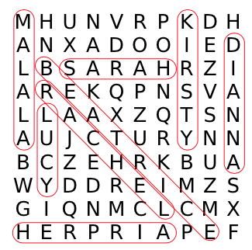
ROUND 9
WORDSEARCH – FIND THE WORDS
YOU HAVE 5 MINUTES TO:
FIND ALL 8 different girls names hidden in the wordsearch
Notes:
Copyright Attributes:
BACKGROUND IMAGE - GraysonArthur2017
TOP LEFT AND RIGHT - 1. Free for commercial use
A list of licenses for the images used in this presentation can be found here: https://creativecommons.org/licenses/

Slide 22
Women’s Day
Name:_________________________________________________
Round 1
Identify the famous female
A_________________ D_________________
B_________________ E_________________ C_________________ F_________________
Round 4
Matching Key terms
Round 5
Multiple Choice Round
A_______________________________
B_______________________________
C_______________________________
D_______________________________
Diane Abbott
Emmeline Pankhurst
Carol Ann Duffy
Margaret Thatcher
Round 2
True or False
A____________________ E___________________
B____________________ F___________________
C____________________ G___________________
D____________________ H___________________
Misogyny
Gender Prejudice
Round 6
Anagrams Round
A_______________________________
B_______________________________
C_______________________________
D_______________________________
Male Chauvinism
Sexual Discrimination
Round 3
Identify the women in history
A_________________ D_________________
B_________________ E_________________ C_________________ F_________________
PAGE 1:
Total Points: _______ /36

Slide 23
Women’s Day
Team Name:_________________________________________________
Team Members:
Round 6
Observation Round
A____________________ E___________________
B____________________ F___________________
C____________________ G___________________
D____________________ H___________________
Round 7
Word search Round
1____________________ 2___________________ 3____________________ 4____________________ 5___________________ 6____________________
7____________________ 8___________________
PAGE 2:
Total Points: _______ /16
OVERALL TOTAL
Points: _______ /52

