Slide 1
Baby Quiz
Cuteness overload!!

Slide 2
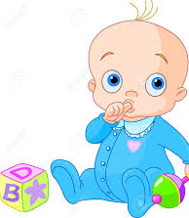
Aim of the Game
I’m sorry! It’s another lockdown quiz ☺
You will be shown baby/toddler pictures of some Dalrymple ECC staff members and all you have to do is guess who they are!
Answers will be given at the end of the quiz.
…..The real question is though….who’s the cutest??

Slide 3
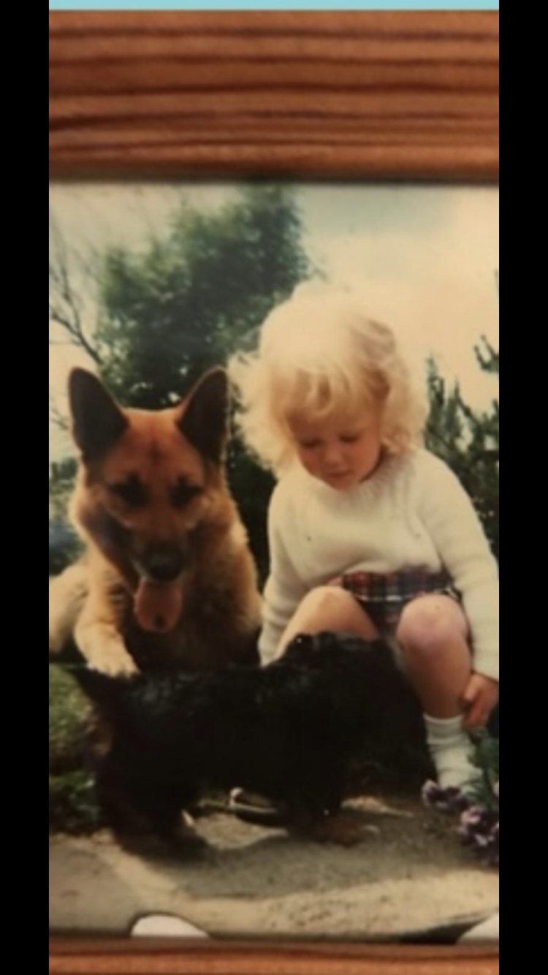
Baby Number 1
Blonde hair and short curls…Mega Cute!!

Slide 4
Baby Number 2
Brown eyes and a big smile…
bonnie baby!

Slide 5
Baby Number 3
Big eyes and thick locks…Cuteness O’clock

Slide 6
Baby Number 4
Mary Bo Peep has lost her sheep…
and found a Tellytubby.
(Keep in mind the quality of this photo when guessing this one ☺)

Slide 7
Baby Number 5
A white dress for a lovely Princess

Slide 8
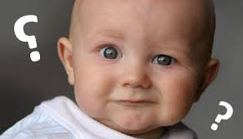
What ever happened to us?
It Can’t be the job we’re in??

Slide 9
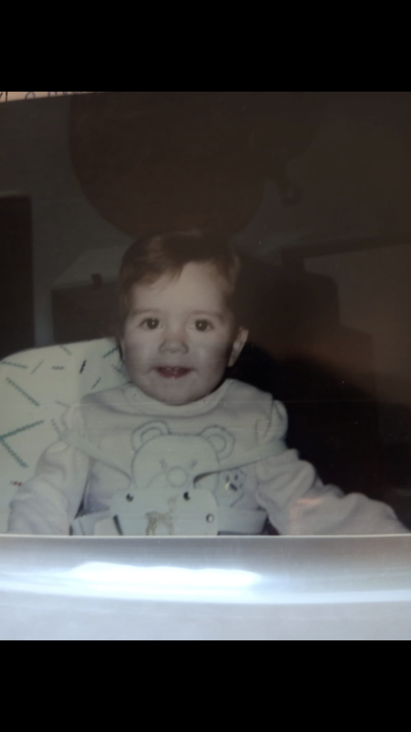
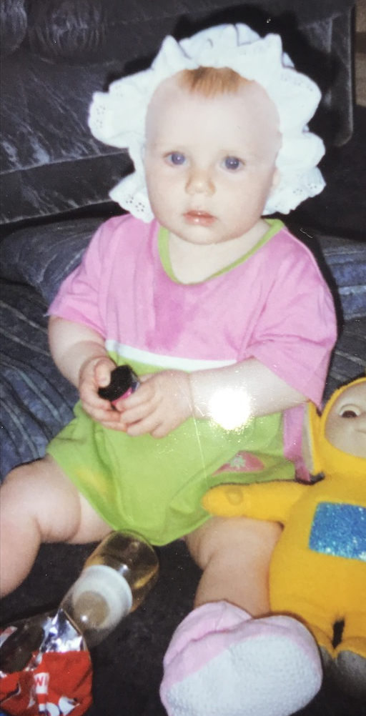
Answers
Baby Number 1
Baby Number 2
Baby Number 3
Baby Number 4
Tania
Marcia
Laura
Emma

Slide 10
Baby Number 5
Natalie

Slide 11
Hope you had fun laughing at your teachers!
Keep Safe ☺

