Slide 1
Parent Council Meeting Monday 20th May

Slide 2
Staffing - School
Core staffing is same as last year.
Waiting on information regarding Classroom Assistant hours and probationer.
Proposals have been submitted to retain CA hours and probationer teacher to allow for flexibility in teaching groups.
No Home Link Worker support at present

Slide 3
Staffing - ECC
Rachel has been needed at another ECC to maintain ratios there.
Supply to help us cover lunches while she is elsewhere.
Next session, we have a smaller cohort of 12 children in the ECC so staffing required will be 2.5 ELCPs.
Awaiting guidance on how this will be organised.
Review of 52 week provision. Doesn't affect us directly.

Slide 4
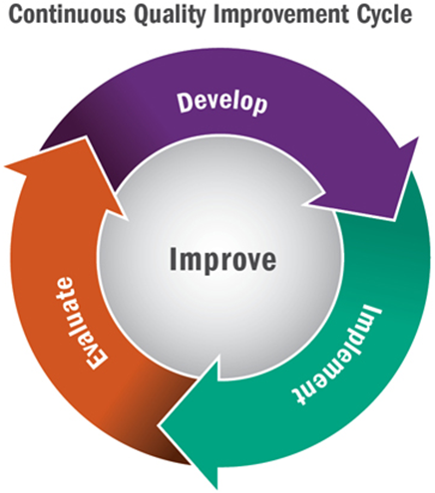
Improvement Plan – Term 4
Communication Friendly Approaches - Awarded
Refocus on the 4 capacities – curriculum drivers Community and Learning for Sustainability – Outdoor Learning
Rights Respecting Schools – looking at the Gold Action Plan . Focus on LfS will help drive this forward
Completed work with the Education Manager. High Quality Maths assessments used in classes. Question Bank for each maths topic to identify children's starting points
Evaluation Toolkit – has been used for classroom observations
ECC – Circle Framework – approaches to assessment of Language and Communication
ECC – Using the new curriculum framework milestones for observations
ECC/P1 Practitioner Enquiry Playful Maths - completed
School – Reading Enquiry – bringing together results of this in June. We will share the results with parents.
This Photo by Unknown author is licensed under CC BY-SA.
This Photo by Unknown author is licensed under CC BY.

Slide 5
Learning and Teaching
Tracking period 3 is being completed this week
Programme for monthly discussions with the teacher have allowed us to identify gaps in learning quickly and put supports in place
Curriculum Overviews developed – with room for creativity and innovation
Continue to review our approach to target setting so all children have at least monthly conversations with a trusted adult about their learning.
This Photo by Unknown author is licensed under CC BY.

Slide 6
Attendance
Month | Average Attendance
August | 90%
September | 85%
October | 85%
November | 87%
December | 89%
January | 94%
February | 94%
March | 89%
April | 94%
Average | 89%
Maintaining attendance and learning engagement levels about 90% is crucial for children's progress in learning and their peer relationships
Develop a policy
Promoting this with parents via the app and at Parents' Night

Slide 7
Parental Engagement
Sharing the Learning Event
Outdoor
PE
STEM
Baking lessons
P1/2 autumn completed
P3/4 Summer term
P5/6 Feb – completed
P6/7 Jan-Feb completed
ECC throughout the session
ECC
Craft and Play 6th Dec
Winter Community Walk 31st Jan
Reading Breakfast 7th Mar – whole school
Den Building 8th May
Dean PArk Trip 7th June
ECC Graduation 21st June
Link to all materials from workshops
https://blogs.glowscotland.org.uk/ea/dalmellingtonpseccmain2017/maths-masterclasses/

Slide 10
Pupil Groups
Junior Librarians –Reading Schools Silver Achieved – 5th school in EA
Pupil Council – PB funding update and Junior Leader Award
Eco Committee – out in the Community/Care Homes
Sports Committee Sports Day
JRSO Walk to School Week
Digital Leaders support IT every week
Dexters Learning Squad achieved Communication Friendly Accreditation
This Photo by Unknown author is licensed under CC BY-NC.

Slide 11
ECC
All Care Plan meetings took place
Den Building
Dean Park Trip next parent event
Graduation plans
This Photo by Unknown author is licensed under CC BY-ND.

Slide 12
Doon Valley Community Campus
Councillors visited the Campus to look at the existing building as part of the decision making process.
No further update from then.

Slide 13
Transition
ECC – Have had 3 sessions in the P1 class. They have 2 more sessions before they join with the new P2 for bump up day
ECC/P1 Practitioner Enquiry has been completed
P7 – S1 – working with Joanne HLW since October P7s all achieved their RSPB award working with Joanne
P7 have visited subject areas in Doon Academy for face to face sessions – these to continue until the induction days
May – 2 STEAM (Science, Technology, Engineering, Art and Maths) Days
June – Induction Days – follow an S1 timetable
Mrs McLurkin working a project based on the children's local communities. Started P7 to complete in S1
Mrs Telfer has consulted with P7 and P6 around Doon Academy's new values/uniform/house sytem

Slide 14
Proposed Class Structure for 2024-2025
P2/1 - 14 P1 coming in and 7 P2 21 pupils
P4/3 - 20 pupils
P5/4 - 21 pupils
P7/6 - 23 pupils

