Slide 1

Parent Council Meeting
Tuesday 12th March

Slide 2

Staffing - School
No change at present.

Slide 3

Staffing - ECC
The Support Assistant and part time ELCP haven't been advertised

Slide 4

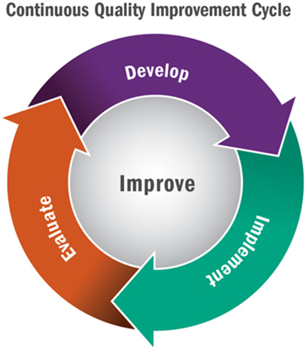
Improvement Plan – Term 3
Communication Friendly Approaches – Achieved this
Refocus on the 4 capacities – curriculum drivers Community and Learning for Sustainability
Rights Respecting Schools – looking at the Gold Action Plan
Focus on Assessment – working with Education Manager for Numeracy and Maths
Evaluation Toolkit – trial the toolkit
ECC – Circle Framework – approaches to assessment of Language and Communication
ECC – Using the new curriculum framework milestones for observations
ECC/P1 Practitioner Enquiry Playful Maths
School – Reading Enquiry
This Photo by Unknown author is licensed under CC BY-SA.
This Photo by Unknown author is licensed under CC BY.

Slide 5

Learning and Teaching
Tracking period 2 is complete
Programme for monthly discussions with the teacher are progressing well.
Focus on Curriculum and progression in other areas of the curriculum
Continue to review our approach to target setting so all children have at least monthly conversations with a trusted adult about their learning.
Outcome of reporting consultation
Feedback policy
Lesson Evaluation Toolkit
This Photo by Unknown author is licensed under CC BY.

Slide 6
Tracking Period 2
Dalmellington PS | Reading | Writing | Listening and Talking | Literacy Combined | Numeracy
P1 | 100 | 100 | 100 | 100 | 100
P4 | 100 | 100 | 100 | 100 | 91
P7 | 87 | 87 | 100 | 87 | 93
P1,4 and 7 combined | 94 | 94 | 100 | 94 | 94
East Ayrshire Average | Reading | Writing | Listening and Talking | Literacy Combined | Numeracy
P1 | 82 | 80 | 88 | 77 | 85
P4 | 68 | 64 | 84 | 61 | 71
P7 | 64 | 60 | 82 | 56 | 66
P1,4 and 7 combined | 71 | 68 | 84 | 64 | 74

Slide 7
Attendance
Month | Average Attendance
August | 90%
September | 85%
October | 85%
November | 87%
December | 89%
January | 94%
February | 94%
Average | 94%
Maintaining attendance and learning engagement levels about 90% is crucial for children's progress in learning and their peer relationships
Develop a policy
Promoting this with parents via the app and at Parents' Night

Slide 8

Parental Engagement
Maths Masterclasses
  Second level completed
  First level – completed
  Early Level - completed
Baking lessons
  P1/2 autumn completed
  P3/4 Summer term
  P5/6 Feb – Mar
  P6/7 Jan-Feb completed
  ECC throughout the session
ECC
Craft and Play 6th Dec
Winter Community Walk 31st Jan
Reading Breakfast 7th Mar – whole school
Den Building 8th May
ECC Graduation 21st June
Literacy Masterclasses
Gauge interest – not much uptake
A different approach
Link to all materials from workshops
https://blogs.glowscotland.org.uk/ea/dalmellingtonpseccmain2017/maths-masterclasses/

Slide 9

Pupil Groups
Junior Librarians – Working on developing the library; World Book Day
Pupil Council – PB funding
Eco Committee – out in the Community/Care Homes
Sports Committee Easter Hop
JRSO Sustrans event
Digital Leaders support IT every week
Dexters Learning Squad achieved Communication Friendly Accreditation
This Photo by Unknown author is licensed under CC BY-NC.

Slide 10

ECC
Parental engagement has been really good.
All Care Plan meetings took place
Community Walk
Toast and Tales
Den Building next
This Photo by Unknown author is licensed under CC BY-ND.

Slide 11
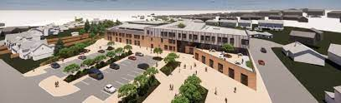
Doon Valley Community Campus
RIBA Stage 4 detailed design development is progressing and tender documents are currently being prepared (for the new Doon Campus) with the revised project programme targeting commencement of construction works, following planning approval, in Autumn 2024 with completion Summer 2026.

Slide 12
Transition
ECC – P1 started in November – Every Thursday join P1 for PE and Listening and Talking Activities to continue until May
P1 working on a project in the ECC over the next 4 weeks
May – June 6 weeks dropped off at school. Spend the morning in P1 class with Miss Donnelly any and an ELCP from the ECC. Last week join up with new P2
P6 Chat'n'Play Buddies will be starting next week on a fortnightly rota
ECC/P1 Practitioner Enquiry in Maths to start February
P7 – S1 – working with Joanne HLW since October
24th Jan – Parents and pupils invited to tour the school
Apr – weekly inputs using Team with each department
May – 2 STEAM (Science, Technology, Engineering, Art and Maths) Days
June – Induction Days – follow an S1 timetable

Slide 13
Proposed Class Structure for 2024-2025
P1/2 - 14 P1 coming in and 7 P2
P3/4 - 20 pupils
P4/5 - 20 pupils
P6/7 - 22 pupils

