Slide 1
Parent Council Meeting Wednesday 18th January 2024

Slide 2
Staffing - School
No change at present.

Slide 3
Staffing - ECC
The Support Assisstant and part time ELCP haven't been advertised
Rachel Montgomery – a peripatetic ELCP has come back

Slide 4
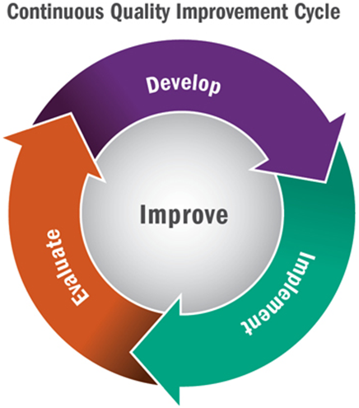
Improvement Plan – Term 3
Communication Friendly Approaches – Accreditation Date set for 31st Jan
Curriculum framework
Refocus on the 4 capacities – curriculum
Rights Respecting Schools – looking at the Gold Action Plan
Focus on Assessment – working with Education Manager for Numeracy and Maths
Evaluation Toolkit – trial the toolkit
ECC – Circle Framework – approaches to assessment of Language and Communication
ECC – Using the new curriculum framework milestones for observations
ECC/P1 Practitioner Enquiry Playful Maths
School – Reading Enquiry
This Photo by Unknown author is licensed under CC BY-SA.
This Photo by Unknown author is licensed under CC BY.

Slide 5
Learning and Teaching
Programme for monthly discussions with the teacher are progressing well.
Focus on Literacy/Numeracy/HWB projections for 2nd tracking period over the next 4 weeks
Then a focus on the curriculum and progression in other areas of the curriculum
Continue to review our approach to target setting so all children have at least monthly conversations with a trusted adult about their learning.
Starting to write reports in preparation for March. Looking for volunteers to work on making these as jargon free as possible
Feedback policy
Lesson Evaluation Toolkit
This Photo by Unknown author is licensed under CC BY.

Slide 6
Parental Engagement
Maths Masterclasses
Second level completed
First level – completed
Early Level - in progress
Baking lessons
P1/2 autumn completed
P3/4 Summer term
P5/6 Feb – Mar
P6/7 Jan-Feb
ECC throughout the session
ECC
Craft and Play 6th Dec
Winter Community Walk 31st Jan
Reading Breakfast 7th Mar – whole school
Den Building 8th May
ECC Graduation 21st June
You said... We did
Literacy Masterclasses
Start 5th Feb – 4 sessions
Phonics
Listening and Talking
Reading
Writing
Sign ups?
Link to all materials from workshops
https://blogs.glowscotland.org.uk/ea/dalmellingtonpseccmain2017/maths-masterclasses/

Slide 7
Pupil Groups
Junior Librarians – Awarded Reading Schools award. Moving onto the next level
Pupil Council – working on Global Goals
Eco Committee – working on Journey to Jupiter and planning a Climate Conference of their own. Starting the 'Dinnae Forget Your Caddy' initiative.
Sports Committee Santa Dash
JRSO successful Be Bright Be Seen
Digital Leaders support IT every week
Dexters Learning Squad working on the Communication Friendly Accreditation
This Photo by Unknown author is licensed under CC BY-NC.

Slide 8
ECC
Parent Group have met once in November and once in January
This Photo by Unknown author is licensed under CC BY-ND.

Slide 9
Doon Valley Community Campus
No further information around timescale

Slide 10
Transition
ECC – P1 started in November – Every Thursday join P1 for PE and Listening and Talking Activities
P6 Chat'n'Play Buddies will be starting next week on a fortnightly rota
ECC/P1 Practitioner Enquiry in Maths to start February
P7 – S1 – working with Joanne HLW since October
Team meeting today to meet the guidance staff and SLT
24th Jan – Parents and pupils invited to tour the school
Apr – weekly inputs using Team with each department
May – 2 STEAM (SCience, Technology, Engineering, Art and Maths) Days
June – Induction Days – follow an S1 timetable

Slide 11
Residential
Residential – meeting on 6th Feb to discuss last minutes things. Any medication can be brought along to this meeting but to be handed in by Feb weekend so that it can be properly labelled and organised.

Slide 12
Safer Internet Day
6th February
Parent information session request?

Slide 13
World Book Day
Parents Breakfast 8.30-9.30
Toast and Tales
Being organised by the Junior Librarians

Slide 14
Partnership
PC Dunlop

