Slide 1
Parent Council Meeting Wednesday 13th September 2023

Slide 2
Staffing - School
In the school, Demi Somerville has joined us for the year. She will be working with Miss Wallace and P3/4
Kim Mulholland has been with us since our return. She was successful at interview and will be joining us for the session.
As part of our submission to the Inclusion Resource Group, our CA allocation stayed the same and Mrs Somerville is being fully funded by the LA.

Slide 3
Staffing - ECC
In the ECC, Mary Gracie has joined us
We have 3 full time staff members: Claire, Paige and Mary and 1 part time: Stacey.
We also have Gabriella as our support assistant. She is expecting and is due to finish up in November.

Slide 4
This session – 5 classes to 4 classes
4 classrooms set up
The Sunflower Room moved to the old P6/7 classroom and timetabled for P3/4 as part of the team teaching approach
The Garden Room – STEM; Food Tech and Wellbeing Groups
Family Room – end room
This Photo by Unknown author is licensed under CC BY-NC.

Slide 5
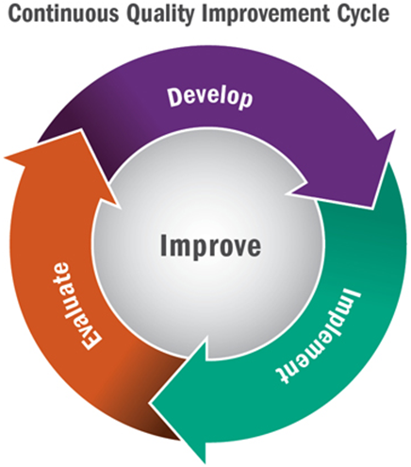
Improvement Plan – update
New Improvement Plan and last years' Standards and Quality report on the school blog
Work that has been started so far this session: Enquiry into teaching of reading; Circle Framework; Communication Friendly Schools (phonological work); target setting and curriculum
Assessment Framework in place
Maths Assessments are being completed and trialled this session.
This Photo by Unknown author is licensed under CC BY.
This Photo by Unknown author is licensed under CC BY-SA.

Slide 7
Learning Visit
4th and 5th October
Meet with SLT – presentation about PLTA (QI 2.3)
Classroom observations
Speak to teachers, support staff, children and parents
Look at the evidence
Present another QI of our choice
3.1 Ensuring Wellbeing, Equality and Inclusion

Slide 8
Care Inspectorate Visit
Took place June 6th – report is on Care Inspectorate site and shared on the school app.
1.1 Nurturing Care and Support
1.3 Play and Learning
2.2 Children experience high quality facilities
3.1 Quality Assurance and Improvement are led well
4.3 Staff deployment
We were rated 5 for each of the QIs, which is very good.
"demonstrates major strengths in
supporting positive outcomes for people. There are very few areas for improvement. Those
that do exist will have minimal adverse impact on people’s experiences and outcomes. While
opportunities are taken to strive for excellence within a culture of continuous improvement,
performance evaluated as very good does not require significant adjustment."

Slide 9
Learning and Teaching
Setting end of session learning targets for pupils just now. New monitoring and tracking system. Moved from 4 point scale to 3 point scale
Education Group moderation focus is reading into writing. Planning meeting took place today and will be continued on in service day.
I have nearly finished the first classroom observation of the session in each class and will be meeting with all teachers to discuss how classes have settled
Implementing the assessment calendar to ensure regular assessment of children's progress is happening in Literacy, Numeracy and HWB
This Photo by Unknown author is licensed under CC BY.

Slide 10
Parental Engagement
Home link worker setting up a parents' group
Maths Masterclasses
Second level 18th Sept – Oct
First level – November
Early Level - January
Chat 'n' Play – 9th Oct
Baking lessons
P1/2 autumn
P3/4 Summer term
P5/6 Feb – Mar
P6/7 Jan-Feb
ECC throughout the session
Anything else parents are looking for?

Slide 11
Communication
New school app has been set up, although they still seem to be working on ironing out any issues.
98 parent/carer accounts set up
New ECC app. Haven't set this up due to request from parents. They'd prefer to use LJ or the school app
Learning Journals set up after the summer

Slide 12
Pupil Groups
Start this Friday.
Children have chosen from
Dexter's Learning Squad
Digital Leaders
Eco Committee
JRSO
Junior Librarians
Health and Wellbeing Group
Pupil Council
This Photo by Unknown author is licensed under CC BY-NC.

Slide 13
ECC
Move complete – most of snagging complete too
Had PEEP sessions for parents but nor particularly well attended – looking to see how we can improve this for our ECC parents.
Official opening end of Oct/beginning Nov
Planning/Observations/Learning Journals
This Photo by Unknown author is licensed under CC BY-ND.

Slide 14
Doon Valley Community Campus
Some work about the interiors has been completed
These are on view for children and parents to have a look at
Discussion around exams and shared spaces

Slide 15
HEART – Help Everyone At the Right Time
Discussions around what communities need
Feedback

Slide 16
Next year's improvement plan suggestions
This Photo by Unknown author is licensed under CC BY-NC-ND.

