Slide 1
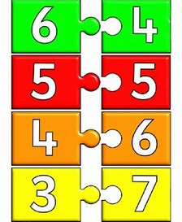
Number bonds to 10
Mrs Agnew

Slide 2
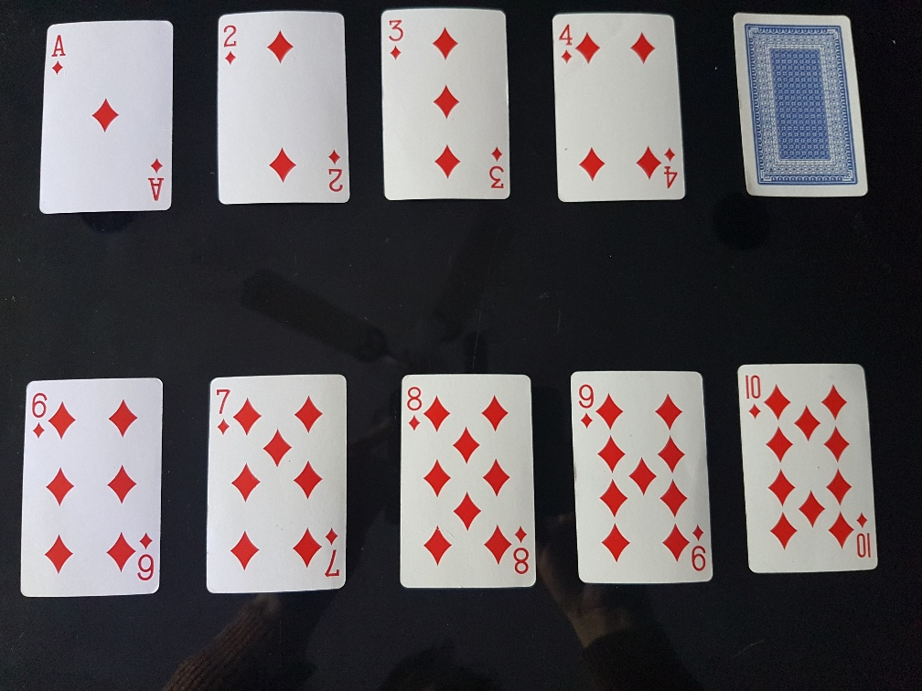
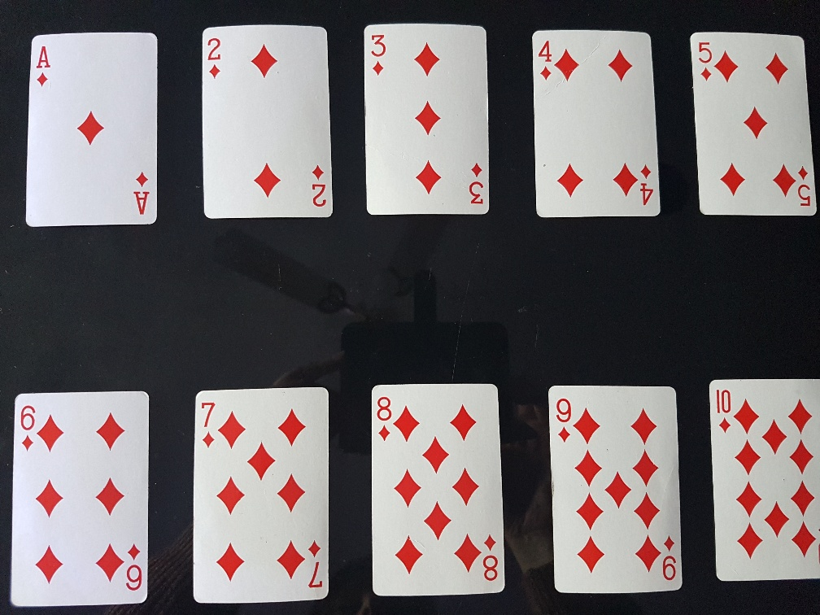
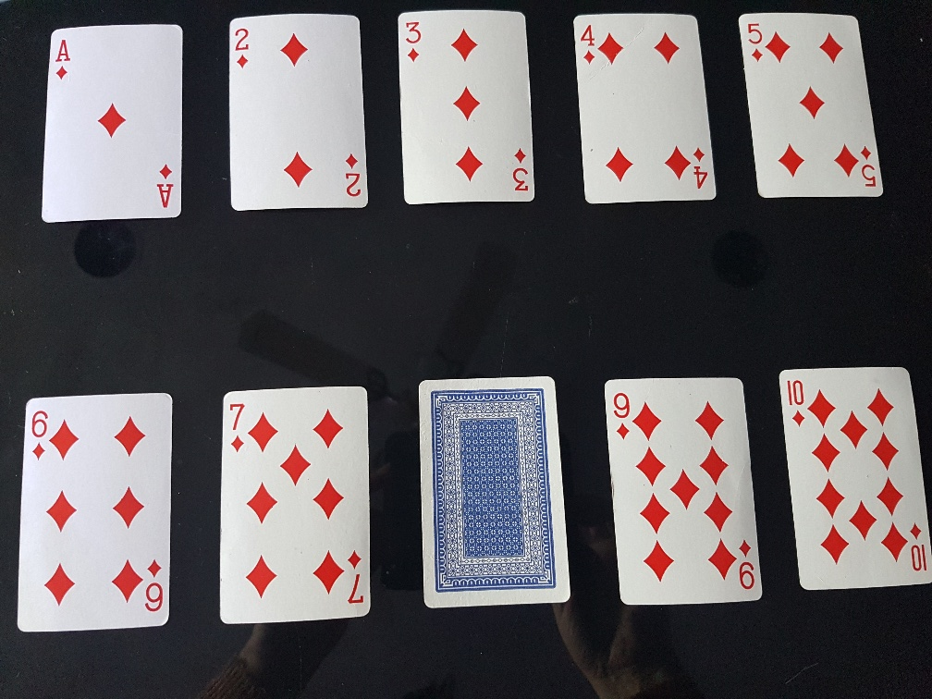
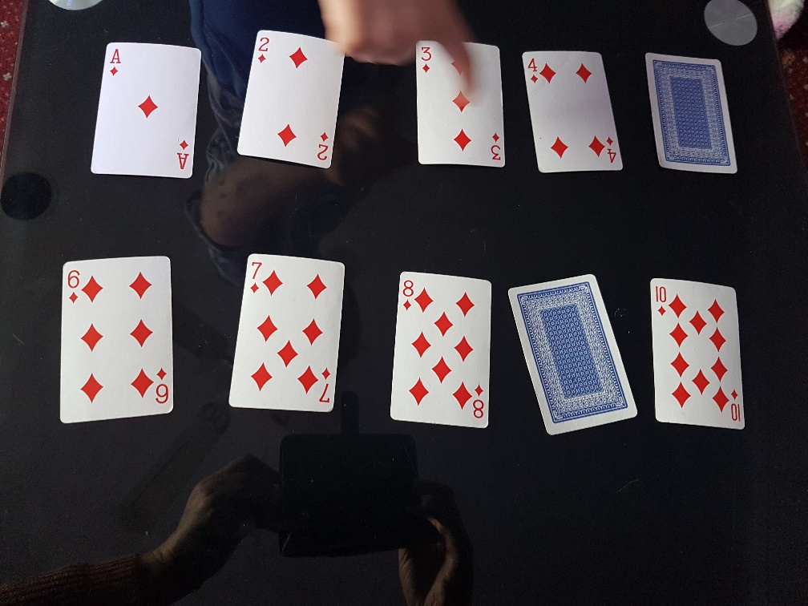
Give your child lots of practise of recognising and identifying numbers to 10 before we move on to adding up to 10.
Place number cards/playing cards from 1 to 10. Ask your child to point to a given number. Speed up to increase their interest.
Get them to close their eyes and turn over one number. Before they guess get them to identify the numbers before and after.
Take turns. Kids love to try to trick you.
Once they are secure try covering 2 cards at a time. Give them a chance to count from one if this makes it easier for them but the ideal is to identify the number before so they can say the next number , Or the number after so they can say the previous number.

Slide 3
Number bonds are the 2 numbers which add together to make a given answer.
At school we have been working on building up awareness of different ways to make a number.
This week I would like you to work on numbers which go together to make 10.
We did a few activities on this before the holidays, maybe your child will remember the Christmas stocking game to 10.
Take a look at the videos below for some fun ideas.
https://www.youtube.com/watch?v=pd2zVDrGHoc
https://www.youtube.com/watch?v=PAV-gwoLTIs
https://www.youtube.com/watch?v=lD9tjBUiXs0

Slide 4
When learning our number bonds to 10, using our fingers is our best resource. Children are aware by now that they have 5 fingers on each hand and 10 fingers altogether.
Start with all 10 fingers. We are holding up 10 fingers which means that we have 0 fingers held down. This is a number bond to 10 :
10 + 0 = 10
0 + 10 = 10

Slide 5
Start with 9 fingers. We are holding up 9 fingers which means that we have 1 finger held down.
This is a number bond to 10 :
9 + 1 = 10
1 + 9 = 10

Slide 6
Start with 8 fingers. We are holding up 8 fingers which means that we have 2 finger held down.
This is a number bond to 10 :
8 + 2 = 10
2 + 8 = 10

Slide 7
Start with 7 fingers. We are holding up 7 fingers which means that we have 3 finger held down.
This is a number bond to 10 :
7 + 3 = 10
3 + 7 = 10

Slide 8
Start with 6 fingers. We are holding up 6 fingers which means that we have 4 finger held down.
This is a number bond to 10 :
6 + 4 = 10
4 + 6 = 10

Slide 9
Start with 5 fingers. We are holding up 5 fingers which means that we have 5 finger held down.
This is a number bond to 10 :
5 + 5 = 10
Here are all the number bonds to 10 :
0 + 10 = 10 10 + 0 = 10 5 + 5 = 10
1 + 9 = 10 9 + 1 = 10
2 + 8 = 10 8 + 2 = 10
+ 7 = 10 7 + 3 = 10
4 + 6 = 10 6 + 4 = 10
Your child might point out the links between the bonds – the ones which switch round.

Slide 10
0 + 10 = 10 10 + 0 = 10
1 + 9 = 10 9 + 1 = 10
2 + 8 = 10 8 + 2 = 10
+ 7 = 10 7 + 3 = 10
4 + 6 = 10 6 + 4 = 10
5 + 5 = 10
Practise using fingers to work out the number bonds. You could cut out 2 hand shapes as you saw in one of the videos – this might help to visualise more clearly.
Say 7 and… your child holds up 7 fingers and counts how many more make 10.
Do this for all the number bonds but mix them up.

Slide 11
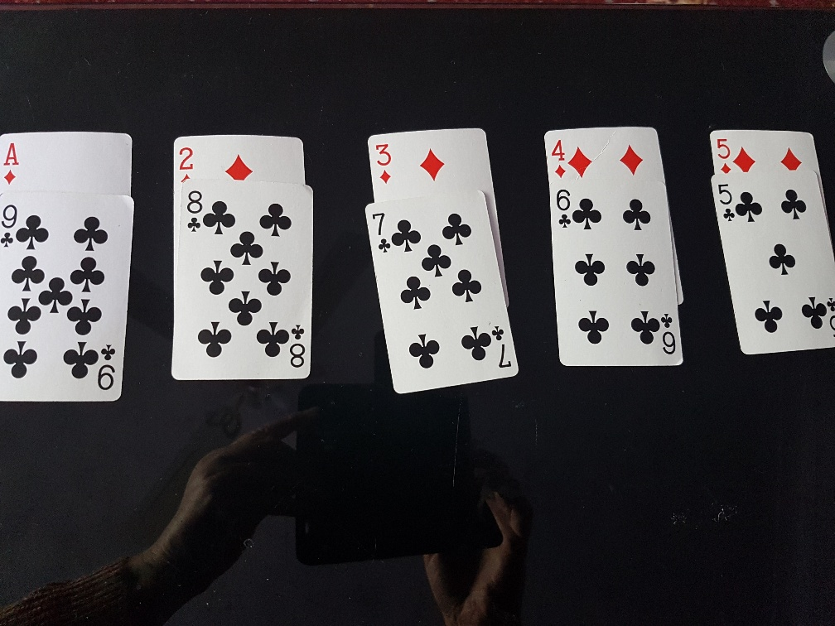
Using this knowledge you can try using other resources.
Make towers using blocks or lego showing all the number bonds to 10.
Match up the bonds using your number cards or playing cards – Ace = 1.

Slide 12
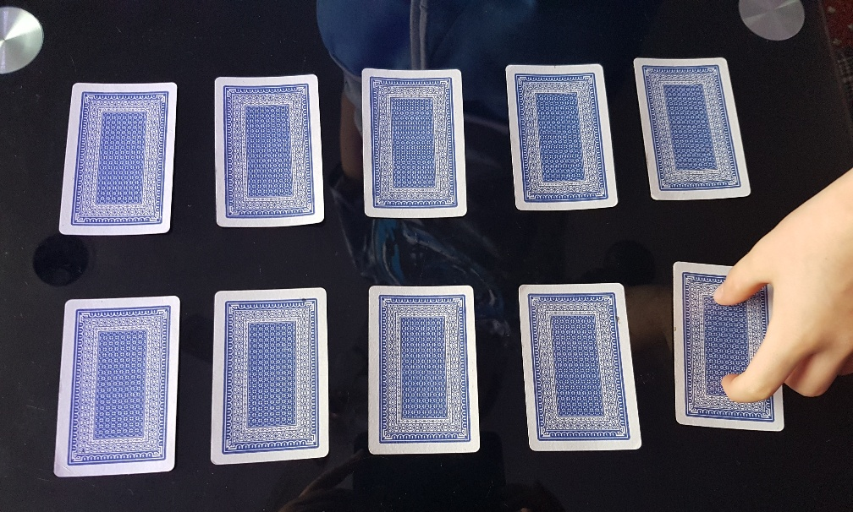
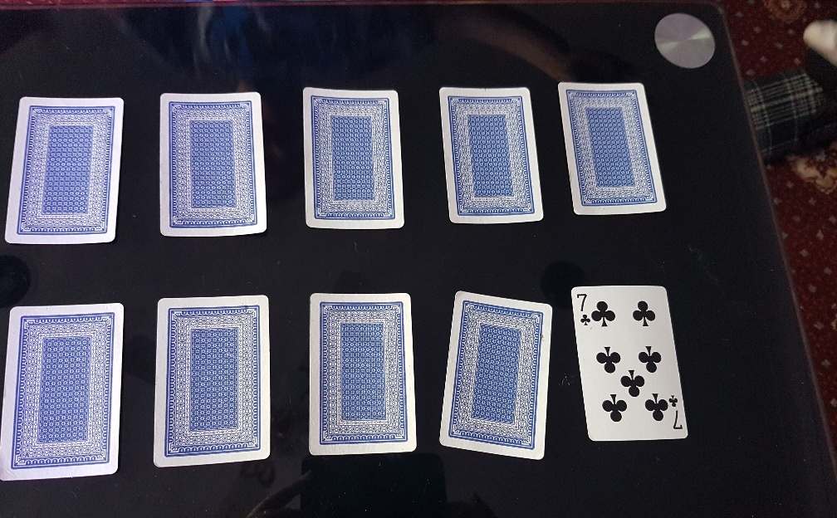
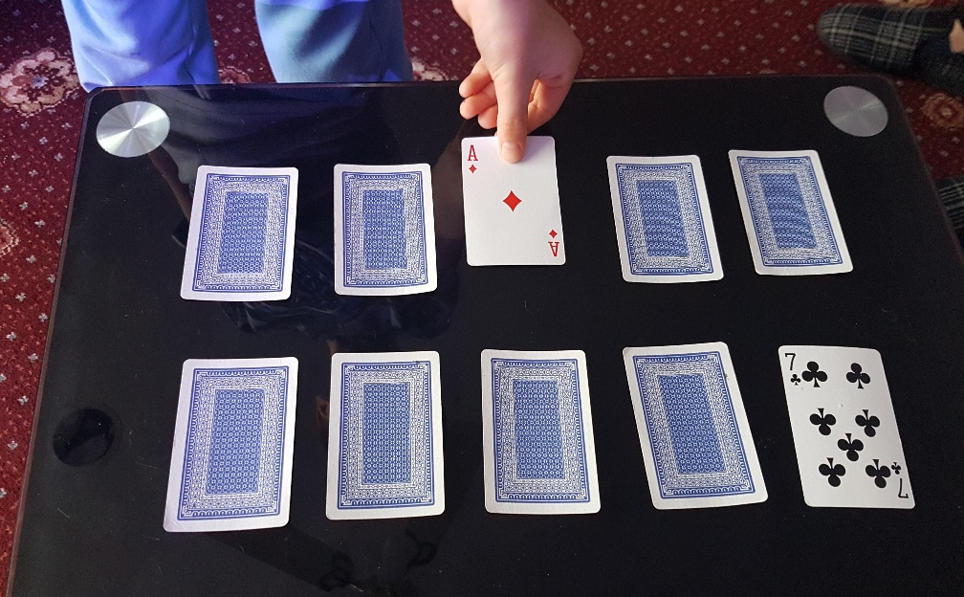
Using these pairs of cards you can play a pairs memory game.
Mix up all the cards and lay them face down in rows.
Turn over 1 card but keep it in its place face up. Choose another card. If they are a bond of 10 then the player keeps the pair. If not they turn back over in their place. So in this game that’s not a matching pair.

Slide 13
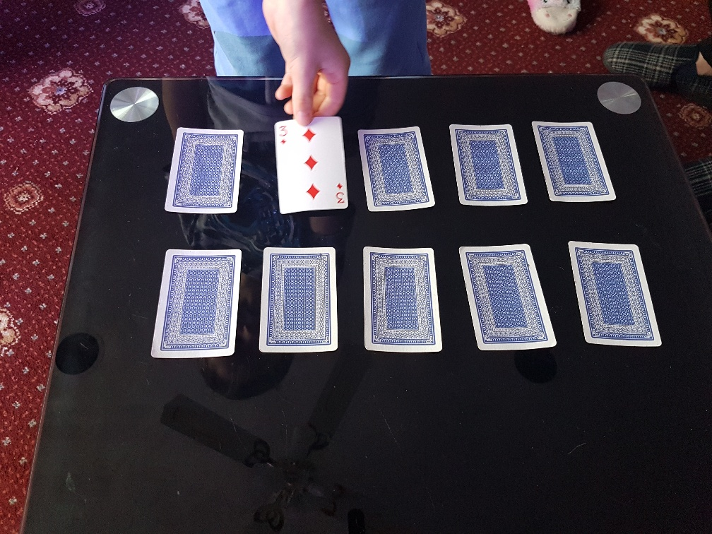
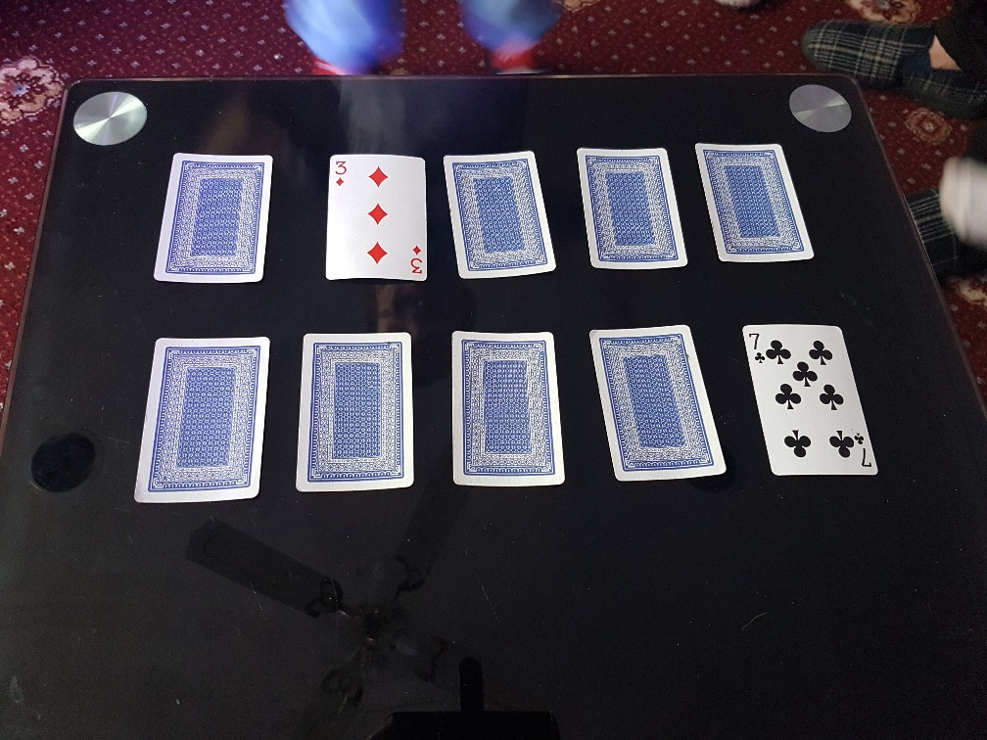
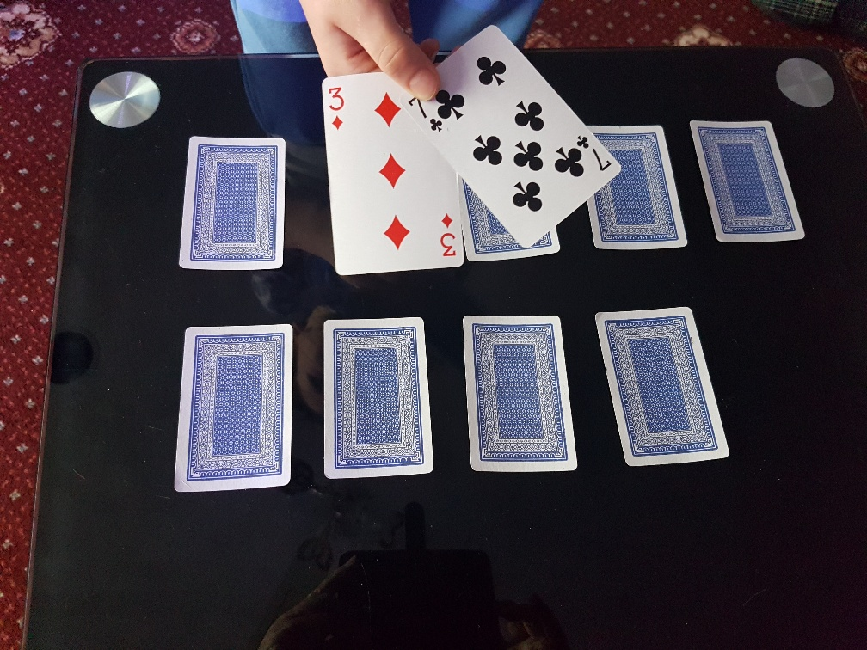
Next player chooses 1 card to turn over and they should try to work out what they would need to make a matching pair. This player has chosen 3 so they must try to find 7 because 3 and 7 adds up to 10.
7 and 3 are bonds of 10 so this would be a matching pair.
Play continues until all the cards have been matched. The winner is the player with most cards.

Slide 14
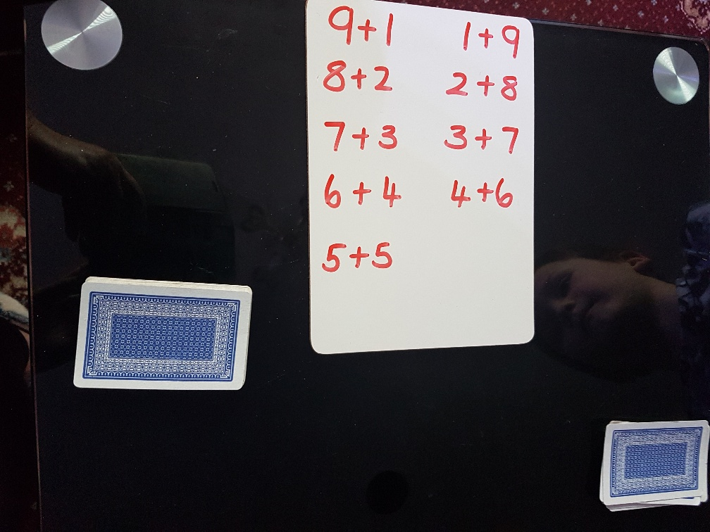
Once you feel that your child is beginning to quickly recall bonds to 10 then play tens snap. This is a game where it is not matching numbers (except 5 and 5) but matching bonds.
Write all the number bonds on a board or paper so they can be seen by both players.
Make a pile of all red cards from Ace to 10 and a pile of black cards from ace to 10.
Take turns to play a card. Check your bonds to see what is needed to make 10.
if a player puts a 10
down this is a snap
10 + 0 = 10.
if
7 is needed to snap
3+6 – no snap
6+8 – no snap
2 needed to snap
4 needed to snap

Slide 15
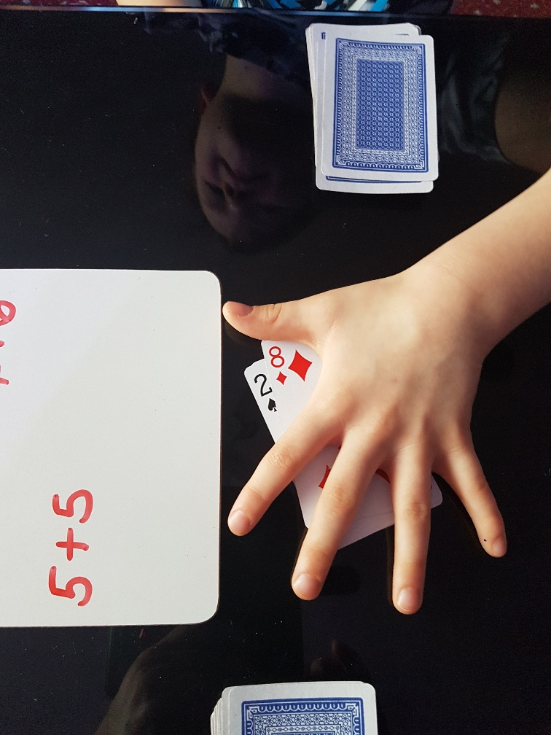
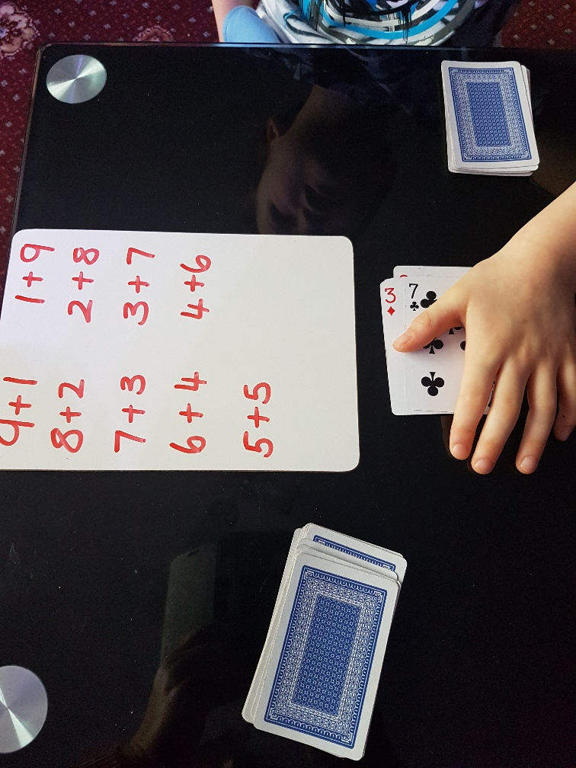
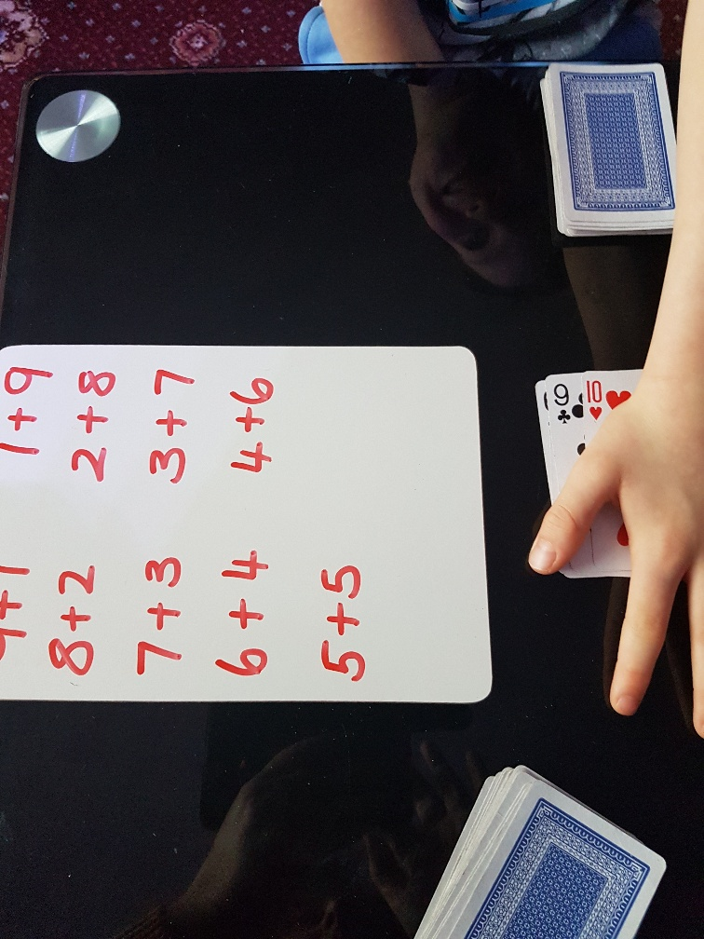
Here are examples of cards which make a snap. The first person to recognise the number bond hits the pile to say ten! As in snap, they get all the cards from that pile and put them to the bottom of their pile. Game continues until one player ends up with all the cards.
7 is needed to snap
3+6 – no snap
4 needed to snap

Slide 16
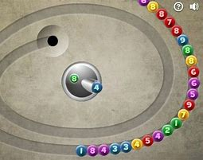
I hope that you have found this presentation useful.
There are many great number bond to 10 videos, songs and games. A quick internet search will help you to select what you think your child might be interested in. Topmarks is a great child friendly website. I’ve already linked “hit the button” into our numeracy grid. Mathplayground is another good one – just click on adding games. One of my favourites is the number bond to 10 game where you match the numbers on the balls but your are up against a challenge! It looks like this. You click on the one which says number
Bonds to 20 or 30 but when you go to options you can choose 10.
Please let me know if you need anything to help you deliver this learning with your child or if you come across something you really liked so we can all share.
My email address is : Mrs Forsyth’s email address is :
donna.agnew@eastayrshire.org.uk margaret.forsyth@eastayrshire.org.uk
We are here to help because we are all in this together!

