Slide 1
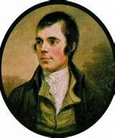
Rabbie Burns
Robert Burns is Scotland’s most famous poet.
He wrote lots of different poems about Scotland, the country he loved.
We celebrate his life and work on 25th January each year.

Slide 2
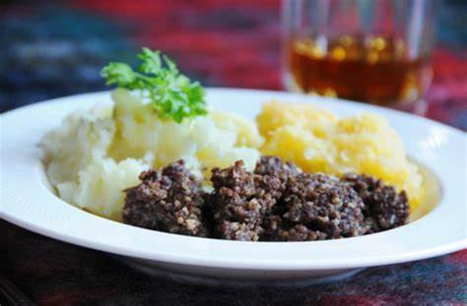
Our famous Scottish dish of
haggis is eaten on this day
because this was Rabbie’s
favourite food and he
always ate it on his birthday
on the 25th January.

Slide 3
This year on Monday 25th January, Dalmellington will still celebrate this great poet.
We will be involved in some Scottish art work and we would also like you to learn a Scottish poem.
To give you some choice, we have got 3 for you to choose from. Have a wee practise of
each poem and choose the one you like
best. One is about food, one is about
fishing and one is about a wee red car.

Slide 4
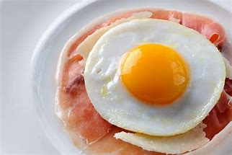
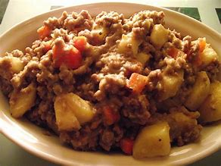
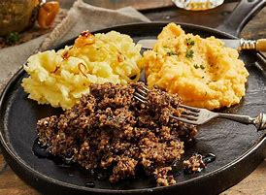
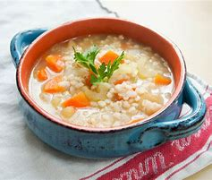
Food
I like marmalade,
I like jam.
I like a plate
O eggs and ham.
Mince is smashin’
Stovies are rare.
Haggis and broth
Are hamely fare.
By J K Annand

Slide 5
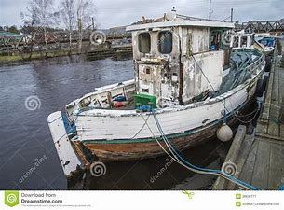
Fishin Boat
Jings I’m wishin’
They’d tak me tae the fishin’.
Gif I catcht a haddie
I’d fry it for my daddy.
Gif I catcht anither
I’d cook it for my mither.
Gif I Catch’t three
We’d aa hae fish for tea.
By J K Annand

Slide 6
The Wee Rid Motor
In ma wee rid motor,
I can gang for miles.
Up an doon the gairden,
Through the lobby whiles.
Mony a bigger motor
Gangs tae toons afaur.
Nane can gang whaur I gang,
In ma wee rid caur.
By Sandy Thomas Ross

Slide 7
To practise your chosen poem, you
always begin with the title and poet.
E.g. Fishing boat by J K Annand.
Then you would say this poem using a good,
steady pace and Scottish accent in a clear voice.
Remember to slow your speaking down when you
are talking to an audience.
If you want to do actions too this would be good.
Please ask an adult at home to take a wee video of
you saying your poem and send it to us. Dalmellington PS and
ECC will be putting together a Burn’s celebration video to go
out at the end of the day on Monday 25th January and your video might be in it!

