Slide 1
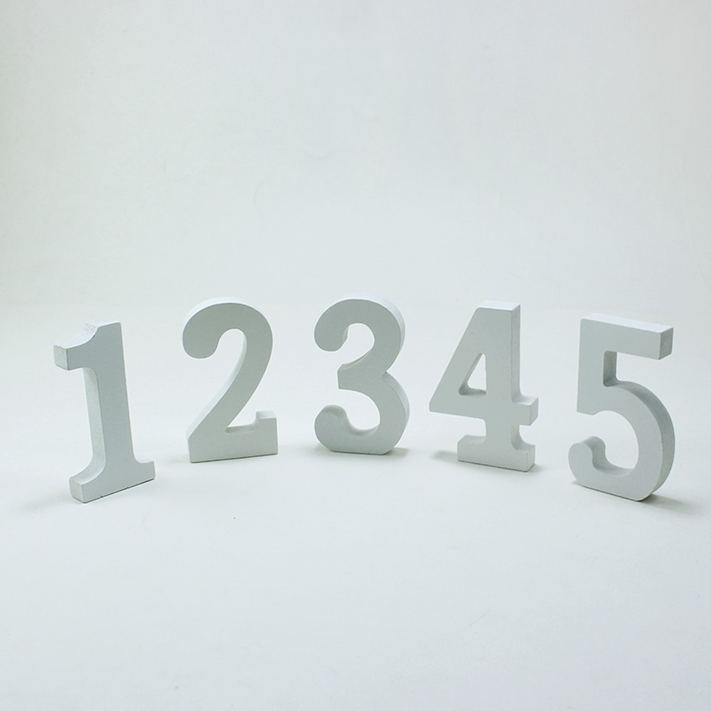
Numeracy Ideas for term 3 in P1
Mrs Agnew

Slide 2
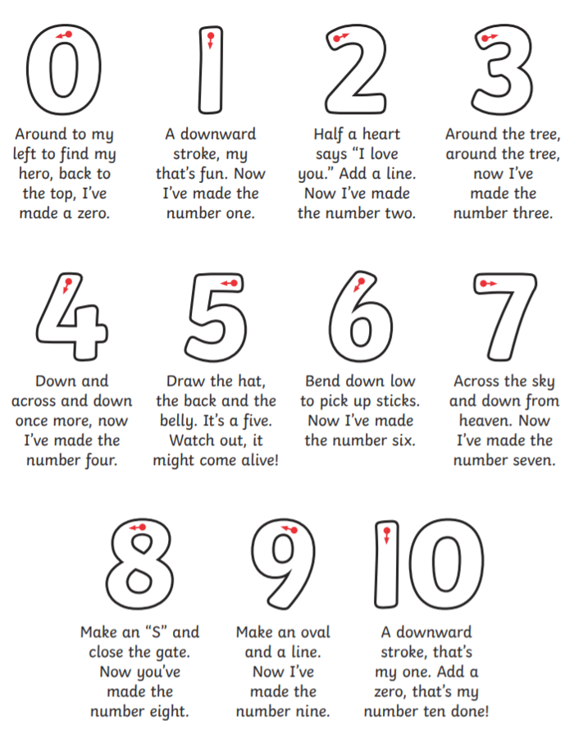
Practising writing numbers properly is very important.
Every number begins at the top and follows a path. These little rhymes might help to stop number reversals which is very common in young children.
Make numbers fun – draw outside with chalk, or trace the numbers in the snow or the sand.

Slide 3
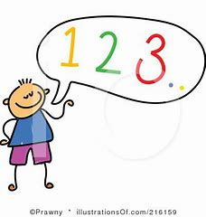
Daily counting practise will help to secure your child’s knowledge of the order and sequence of numbers.
Start at different numbers to count on or back. Counting back is much more tricky so more thinking time will be needed.
Start within 10 then increase to within 20.
Start at 13 and count on :
13, 14, 15, 16 and so on.
Start at 18 and count back:
18, 17, 16 and so on.
In class we use a counting box. This box has numbers from 0 – 30. We sit in a circle and the first person opens the box and chooses a number. We start at 0 and count up to that number. The person holding the box at that number, opens the box and chooses another number. If it is less than the number we have counted to then we count back from that number to the new number. If it is more then we continue from that number up to the new number. Ask your child about this game as they liked playing it.

Slide 4
What’s the Missing number is a good way to find out if your child can state the number before or after. You can draw a simple number line to 10 and hide one of the numbers.
or you can use playing cards like here. Playing cards are good for ordering too. Place face down and choose 3 cards to put in order.
Once your child can confidently state one missing number, then move on to 2, then 3. Then try moving on to numbers to 20 when you think they might be ready.
When moving to numbers to 20 there needs to be some chat about what these numbers look like. 11 is 10 and 1. 12 is 10 and 2. And so on.

Slide 5
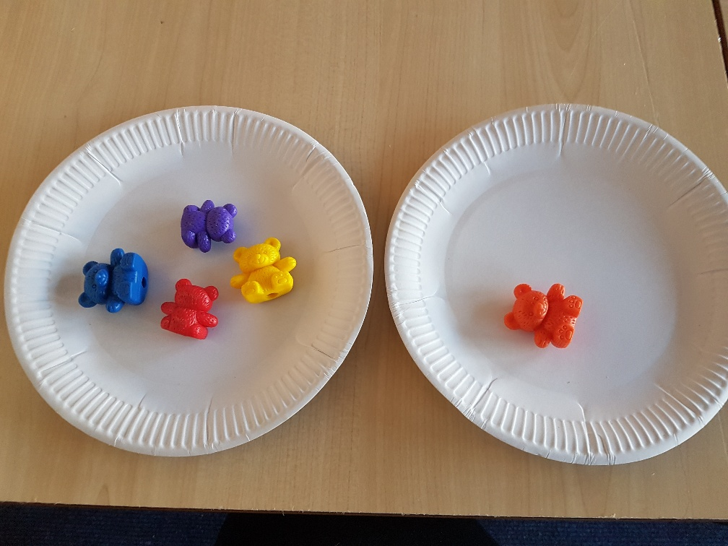
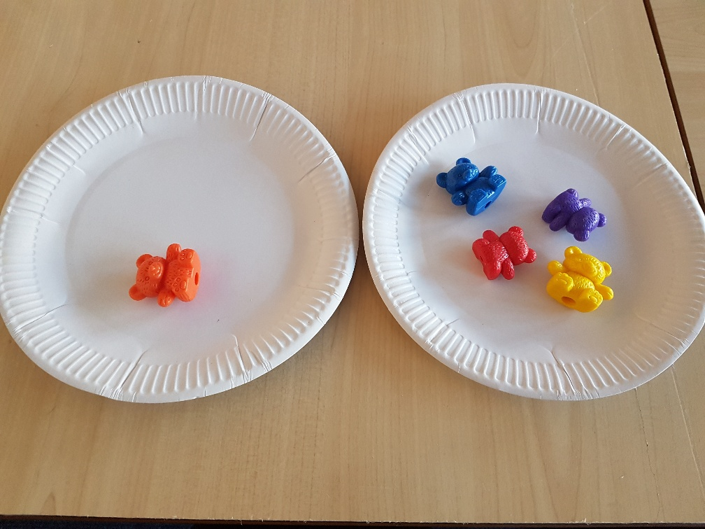
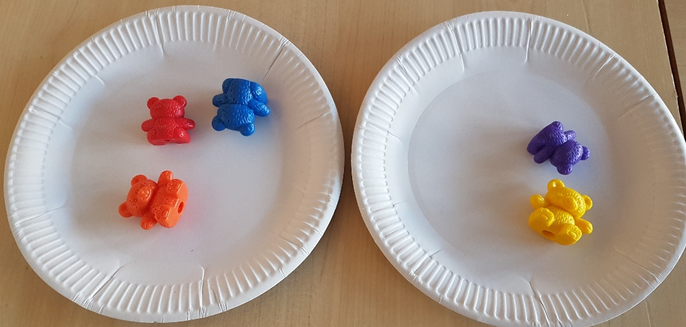
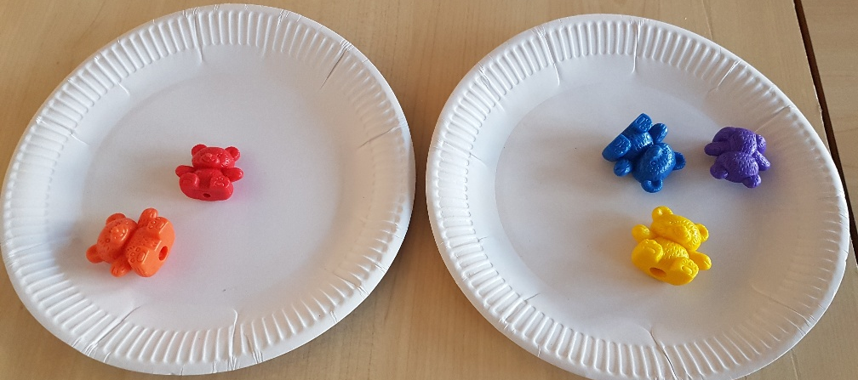
At the end of last term P1 were learning about adding up 2 numbers. You can use any materials to help with this. A good favourite is lego pieces but you could use pasta shapes, marbles, toy cars – whatever you have around. It is a good idea to make 2 sets for your numbers as you can see in the pictures.
If we have 4 bears then we add another 1 bear, how many bears do we have altogether?
If we have 3 bears then we add another 2 bears, how many bears do we have altogether?
Ask them what they notice about addition facts which are switched around. We call them the “switcheroos!”

Slide 6
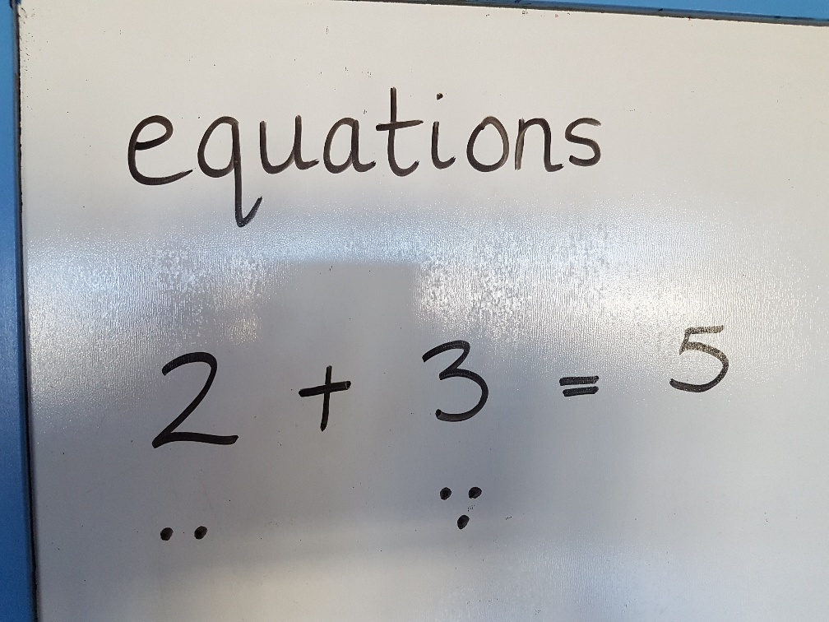
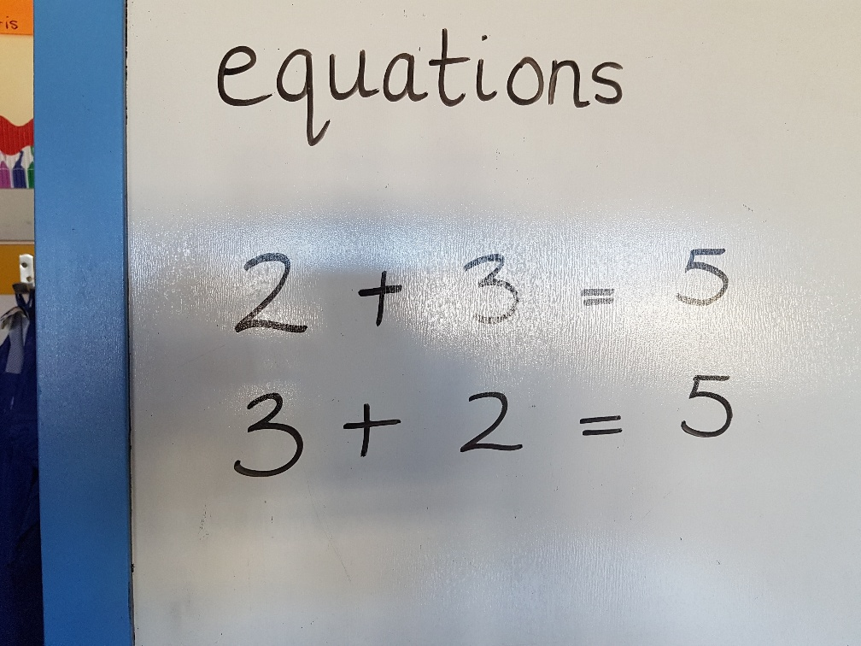
We had made a start at writing the equation (the sum or total of the numbers in addition) as shown here.
Only encourage the writing of the equation if your child is keen to do written tasks or if they want to show you what they know or if they have shown confidence when making the adding groups.
Use the words ‘plus’, ‘add’ and ‘equals’ when reading your equation.
“2 plus 3 equals 5.”
When splitting your total amount into 2 groups, ask your child if they can spy a “switcheroo!” If they can, encourage them to physically switch around the plates/bowls/paper cirles which you are using.
A “switcheroo” is just a linked fact.
If you know that 3 + 2 = 5 then you automatically know that 2 + 3 = 5.

Slide 7
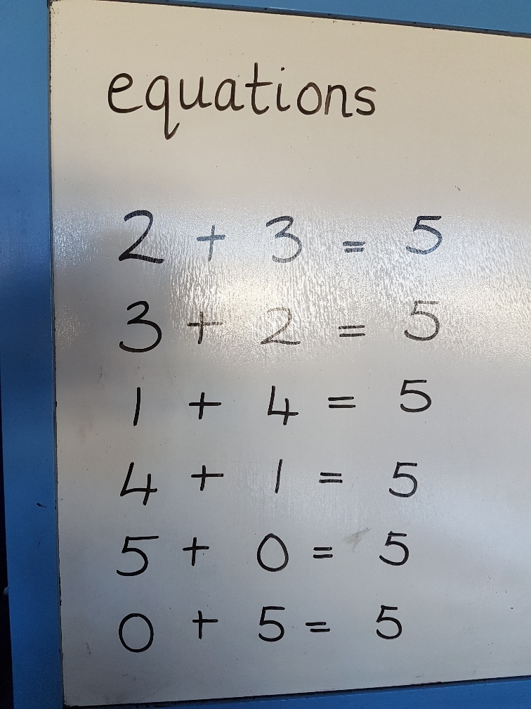
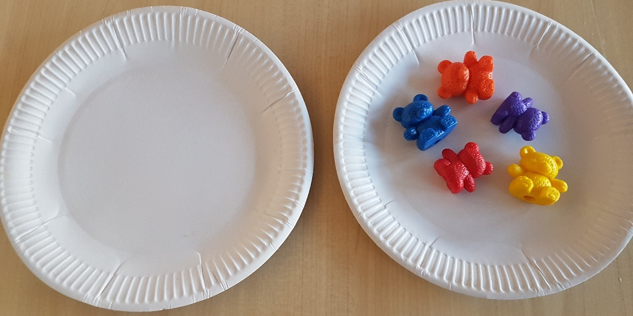
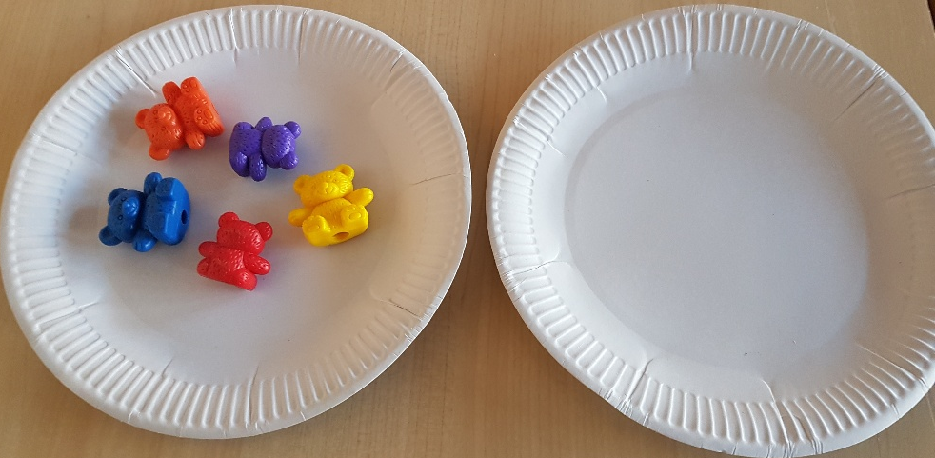
You can choose an amount of items and try to write all the ways this amount could be split into 2 sets.
If your child is keen to write all the equations which go with this then encourage them to do so but they may wish to only put the items into adding sets.
So if your amount of items is 5 then you should be able to make these sets and equations.
Try doing this for different amounts of items up to a total of 10.
Watch out for 5 + 5 = 10. Double 5 does not have a switcheroo!

Slide 8
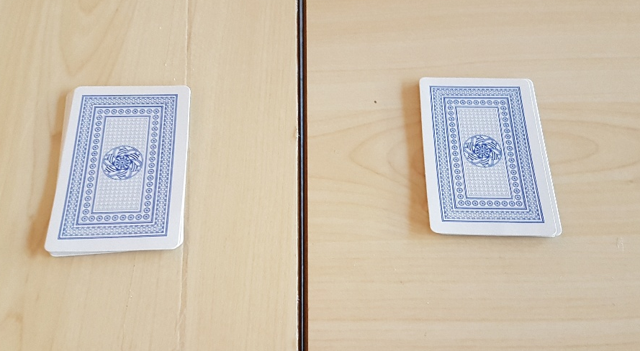
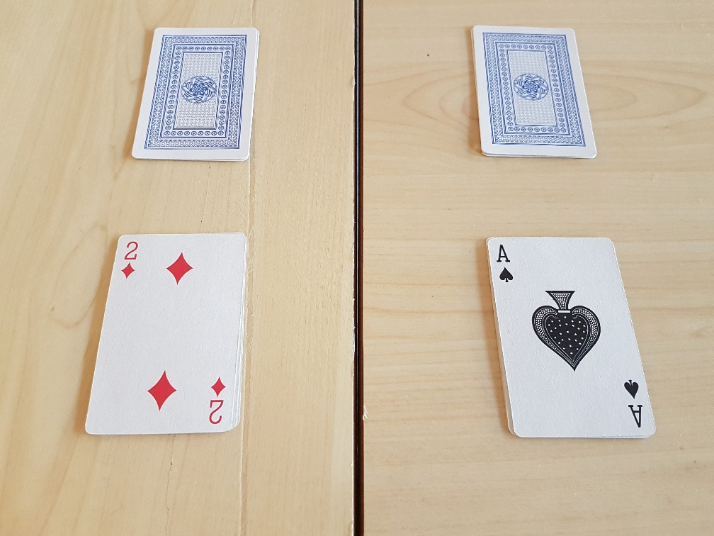
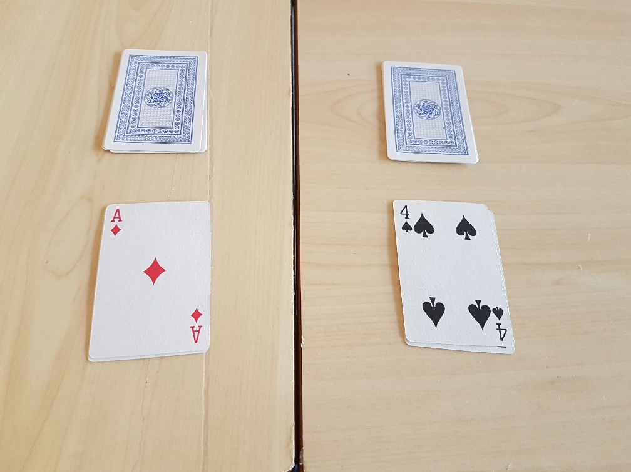
Dominoes and Playing cards is another good way of making addition equations.
Sort 2 suits of cards Ace to 5 in 2 piles. Each of you turns over your top card and try to work out the total of the 2 cards as shown here.
Once your child has become confident and picks up speed with adding 2 numbers together, then you could make this into a speed game with the quickest to answer keeping the cards. The winner would be the person with most cards! Also once more confident, begin to add in some of the other playing cards up to 10.

Slide 9
“screening” is important in addition as this gives the information of the total number of objects but it has a missing group. This missing group is called the “addend”.
This is new learning for p1 so please take time to introduce this.
Here is a group of 6 bears. We know that this is the total because we only have 6 bears. So already we know that our total will be 6 :
___ + ___ = 6
Share with your child the amount that you will be using.
“Here we have 6 bears.”
“I will be hiding some of these bears. Close your eyes, then we will see if you can
try to work out how many I have hidden.”

Slide 10
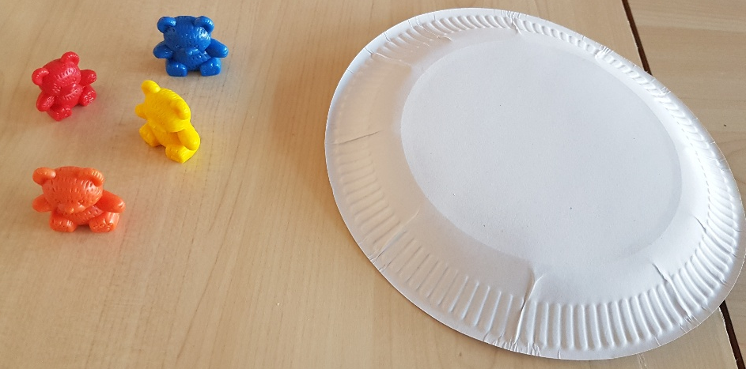
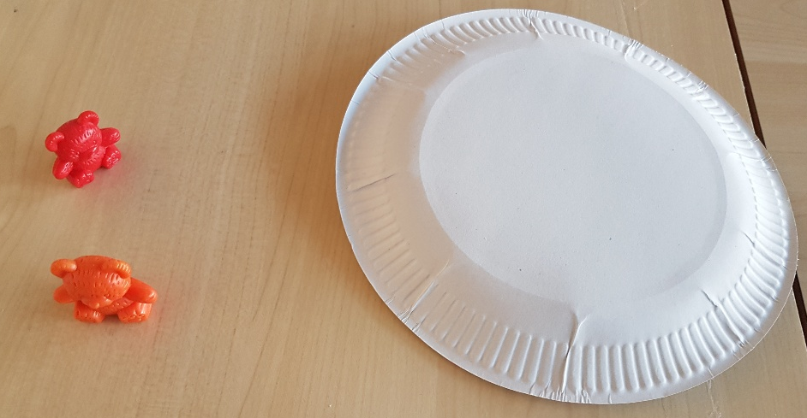
“we have 6 bears. Close your eyes so that I can hide some bears. How many bears do you think are hidden?
Discuss how many they can see, as this is their first addition group. They will need to work out if they see 4 then there must be 2 hidden because 4 plus 2 equals 6.
if they see 2 then there must be 4 hidden because 2 plus 4 equals 6.
Do this activity several times with different starting amounts before you think of writing any equations.
Children need lots of practise and exploring numbers before they can confidently write them.

Slide 11
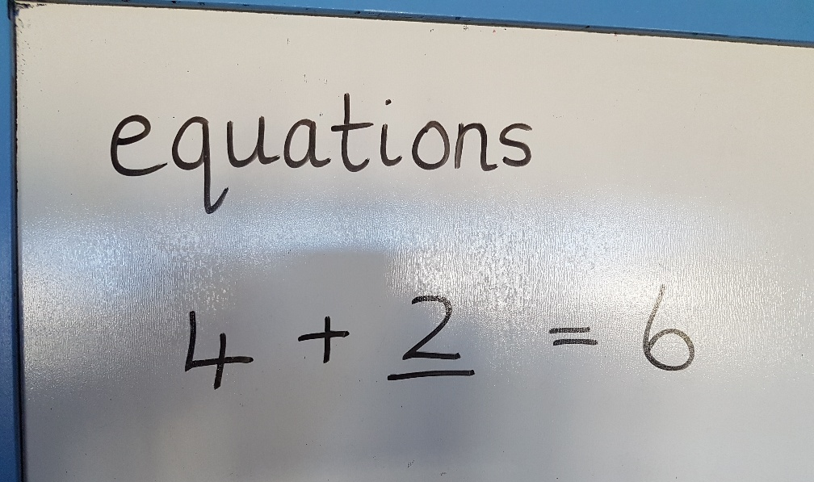
When we write these “screened” equations we record them like this:
4 + ____ = 6
The missing number represents the amount which has been screened.
Do this activity several times with different starting amounts before you think of writing any equations.
Children need lots of practise and exploring numbers before they can confidently write them.

Slide 12
I hope that you have found this presentation useful.
There is a huge amount of numeracy skills involved in this short powerpoint. Please do not feel that you have to do all of this every day. Your children are used to learning in a “hands on” “interactive” and “fun” way and it would be great if this could continue as much as you are able with our support. We are a team, working together for the benefit of your child.
Choose different aspects and work on them until you feel that your child is confident and ready to move on. Take your lead from your child also – there may be things which they would like to work more on to help them to consolidate their learning and help them move on to the next step of their learning journey.
Please let me know if you need anything to help you deliver this learning with your child.
My email address is :
donna.agnew@eastayrshire.org.uk
Mrs Forsyth’s email address is :
margaret.forsyth@eastayrshire.org.uk
We are here to help you and your child to excel.

