Slide 1
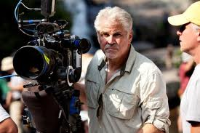
Hunger Games Genre – Film, Fiction, Sci-Fi
Media Studies – Analysis Section Notes
40 marks/80

Slide 2
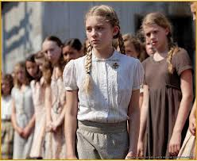
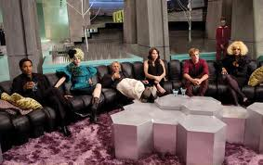
Technical Codes - Colour
District 12 – colours associated with poverty and oppression. Muted blues, greys, drab browns etc
Panem – bright jewel colours associated with wealth and oppulence, Fantastical, cartoonish clothes and make up.

Slide 3
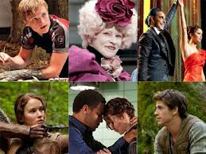
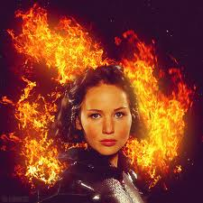
Technical Codes – Camera Angles and types of shots
Using the camera to tell the story…
Establishing shots to show location.
Mid shots to show one character with another (two shot or over the shoulder) or one character taking aim at an animal etc
Close ups to show emotion
Filmed from underneath to show power, skill
Filmed from above to show vulnerability

Slide 4
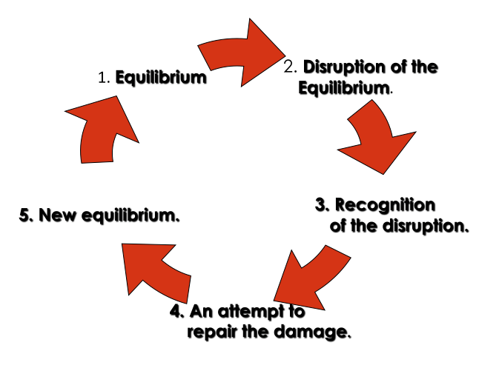
Todorov’s Theory
Equilibrium – beginning - normal
Disequilibrium – middle - problem
New equilibrium – end – new normal

Slide 5
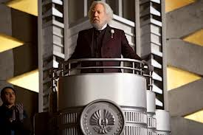
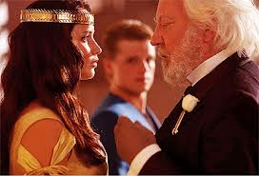
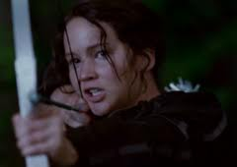
Two main character types
Heroine
Villain

Slide 6
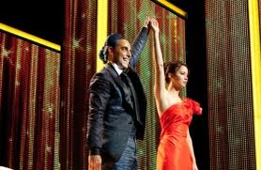
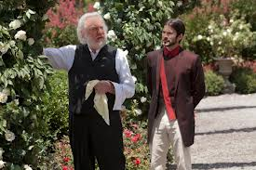
The theory of opposites – e.g. good versus evil / underdog against power
Fighting for good – Katniss
Fighting for evil or power – Panem government under President Snow

Slide 7
Stereotypes
The following stereotypes appear in the film:
Heroine -Katniss
Helper - Peta
Villain – President Snow or one of the other teenagers from other Districts (e.g. District 1)
What do they:
do
say
wear
that makes them look like one type or another?

Slide 8
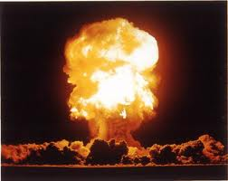
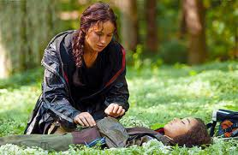
Technical Codes – Diagetic and non-diagetic sound
Diagetic (natural)
Special effect noises such as explosions added in afterwards in studio.
Non-diagetic (not natural)
E.g. added in music in background (soundtrack) to match action – sad music for Rue’s burial scene

Slide 9
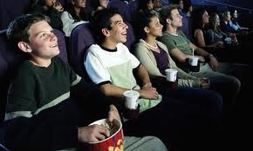
Target Audience(s)
Target audience
One possible target audience is the teenager. What has been included to appeal to that demographic?
Teenage main character Attractiveness of the protagonist to the audience
Modern music by…
Special effects
Exciting plot line Source material - block buster novel with very high sales - ready made market
12A rating
Teenagers like:
Action?
Love interest?
Music?
Fights?
Explosions?
Danger?
Youth versus age? – Who wins?

Slide 10
Institutional Factors
Institutional Factors include
Filming/editing so that there is no sustained gore or horror
Excessive and lustful kissing, lustful embracing, suggestive gestures and postures
are unacceptable
Explicit nudity is unacceptable
Swearing is unacceptable
Brutality and possibly gruesomeness had to be treated within the careful limits of good
taste - it cannot be too bloody or on the screen for too long
Using famous stars to bring in paying audiences into the cinema
The need to make a profit
Naming the institution(s) involved with making the film
12 A Rating

