Slide 1
Crosshouse Primary School & Communication Centre
Silver Evidence

Slide 2
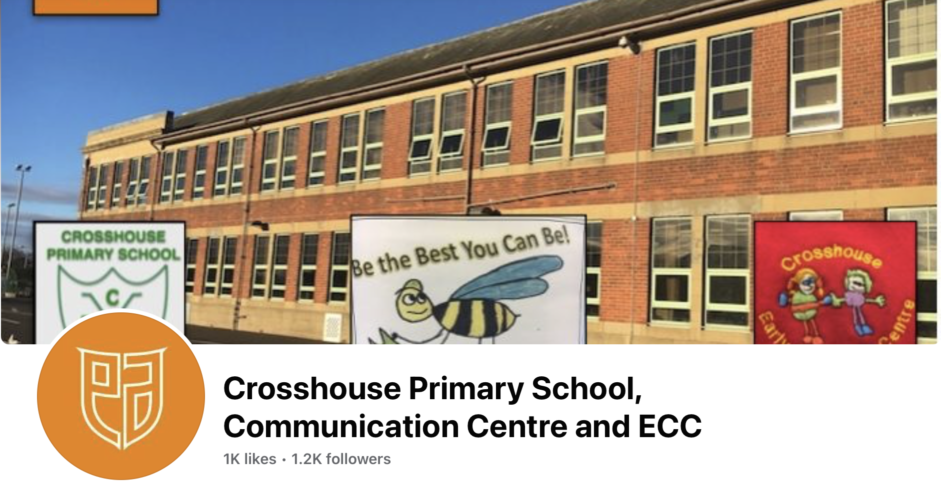
Strand A – Teaching and Learning about Rights
Contents:
Link to School Website
Example of Curriculum Overview
Photographs of Children’s work
Links to Assembly/Power Points
School Blog
School Facebook Page

Slide 3
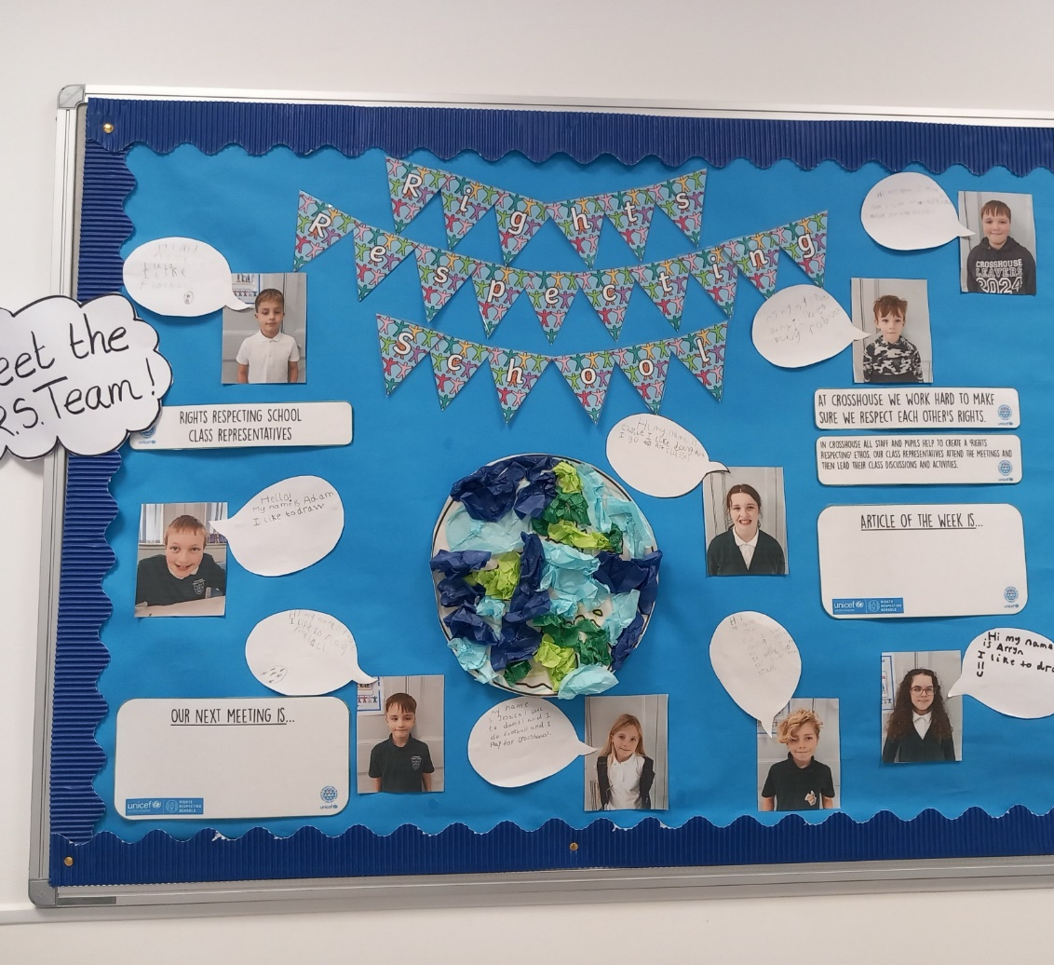
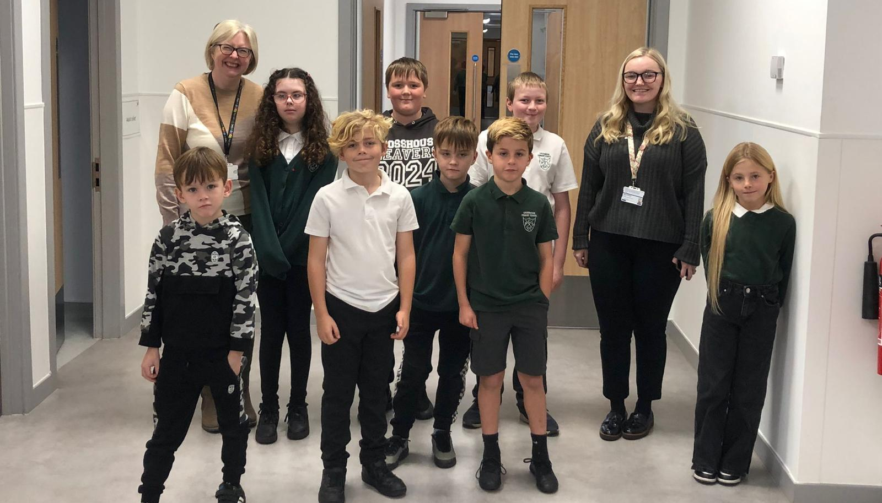

Slide 4
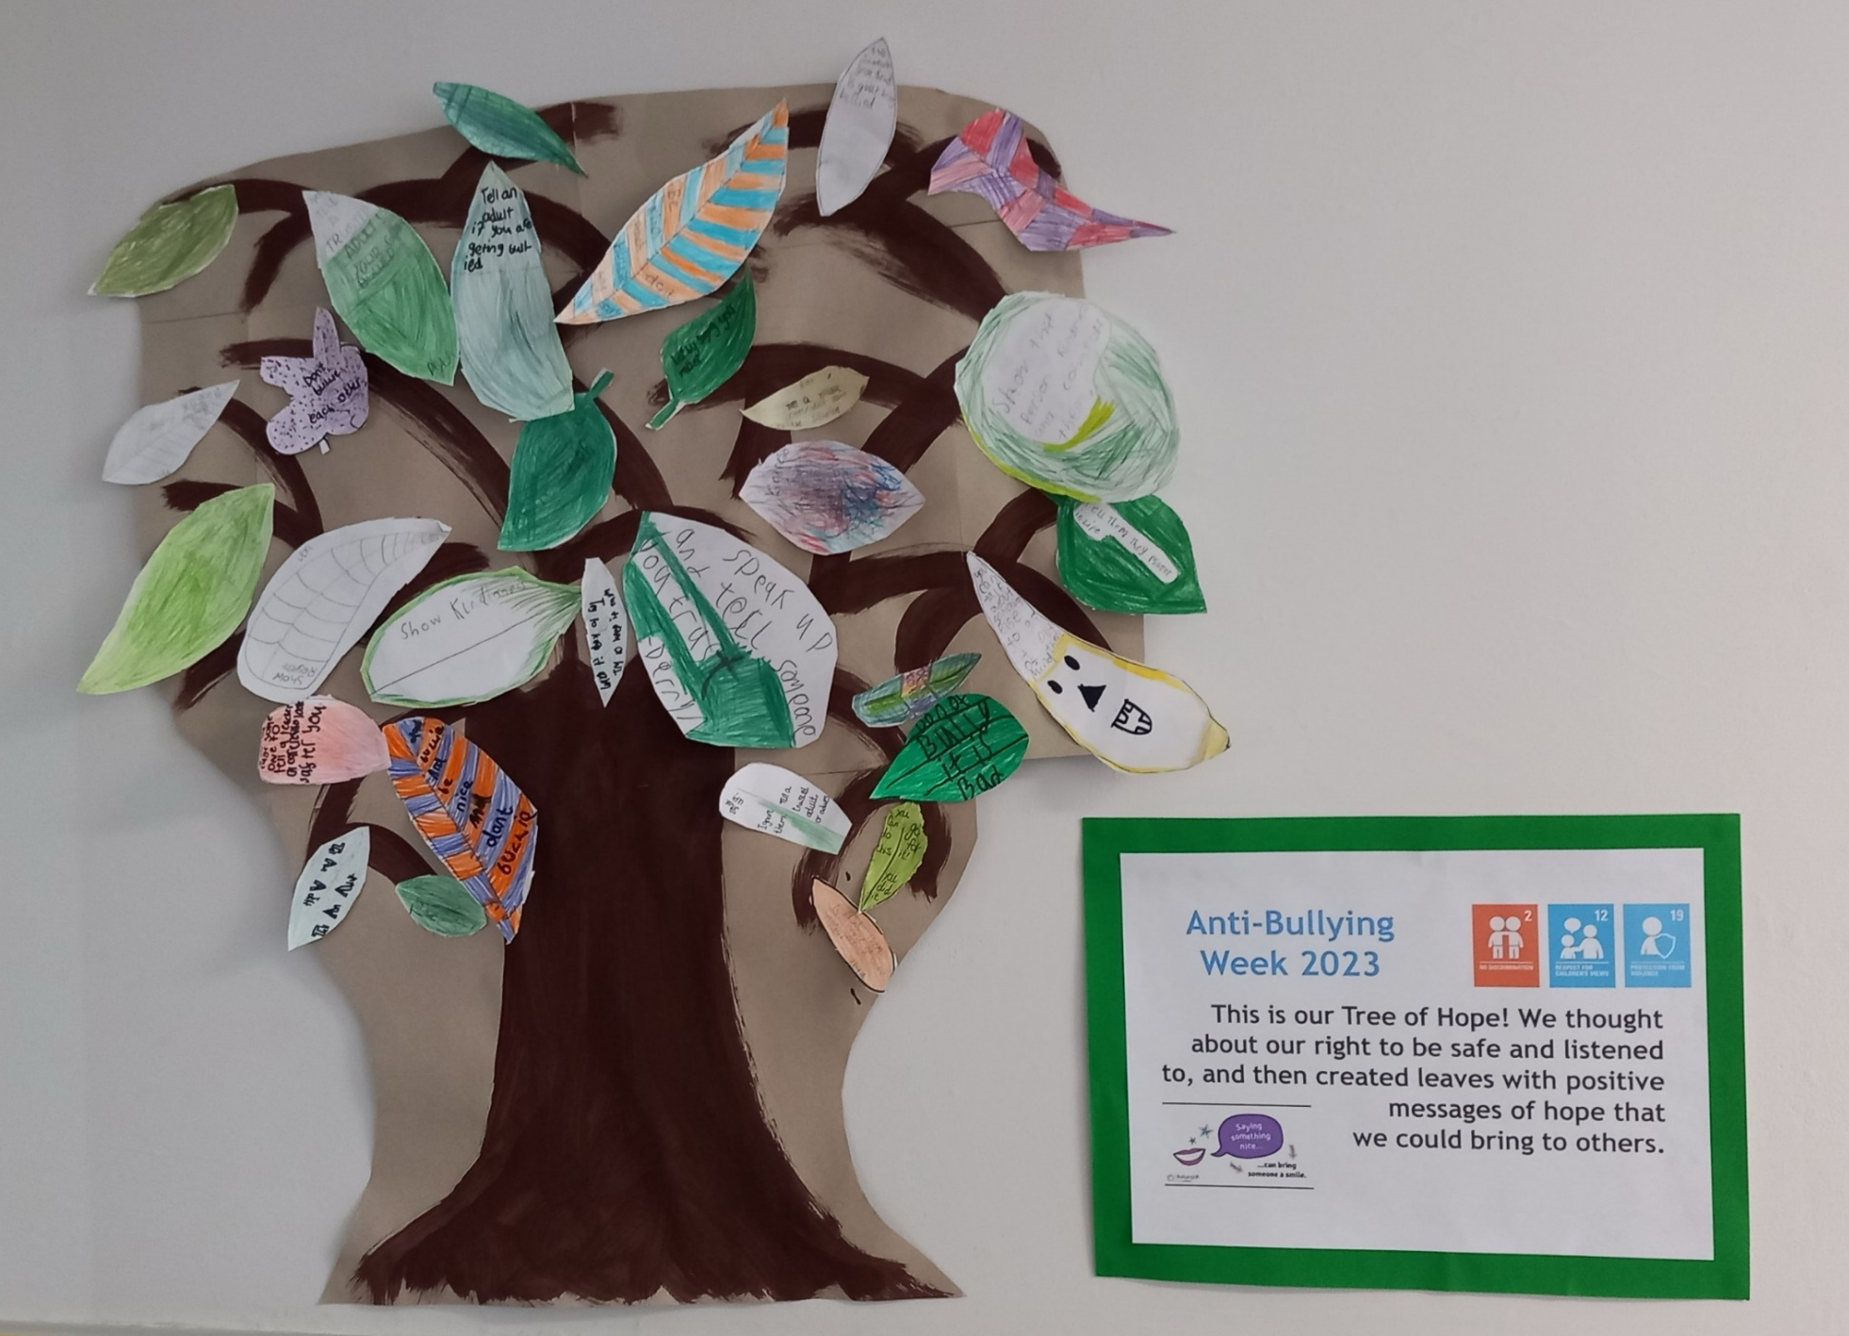
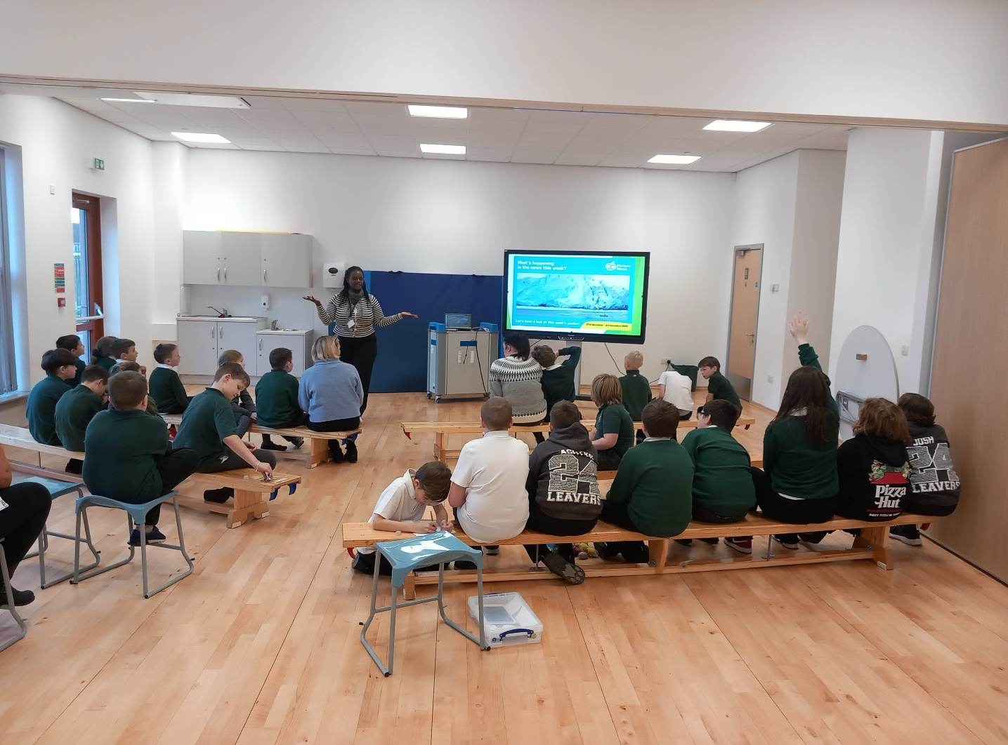
OUTCOME 1
Children, young people and the wider school community know about and understand the United Nations Convention on the Rights of the Child and can describe how it impacts on their lives and on the lives of children everywhere.

Slide 5
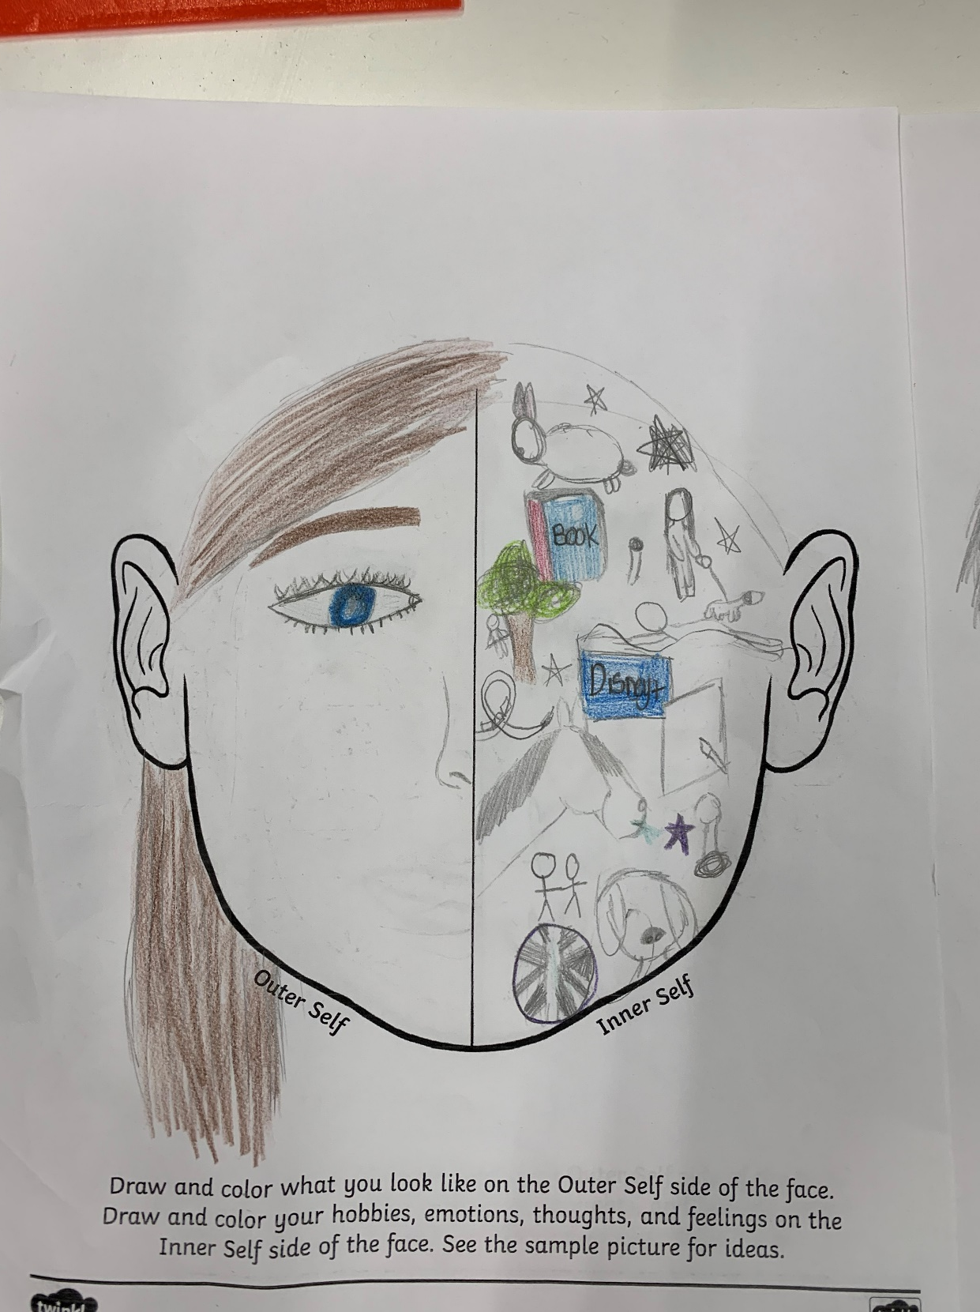
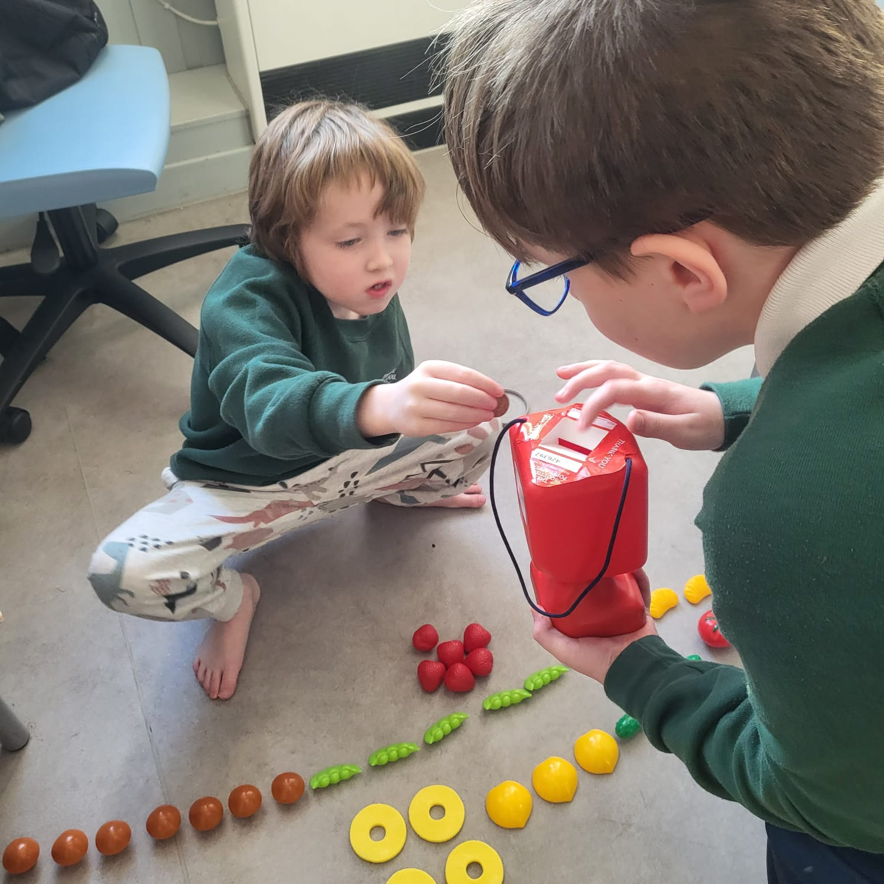
OUTCOME 1 - continued

Slide 6
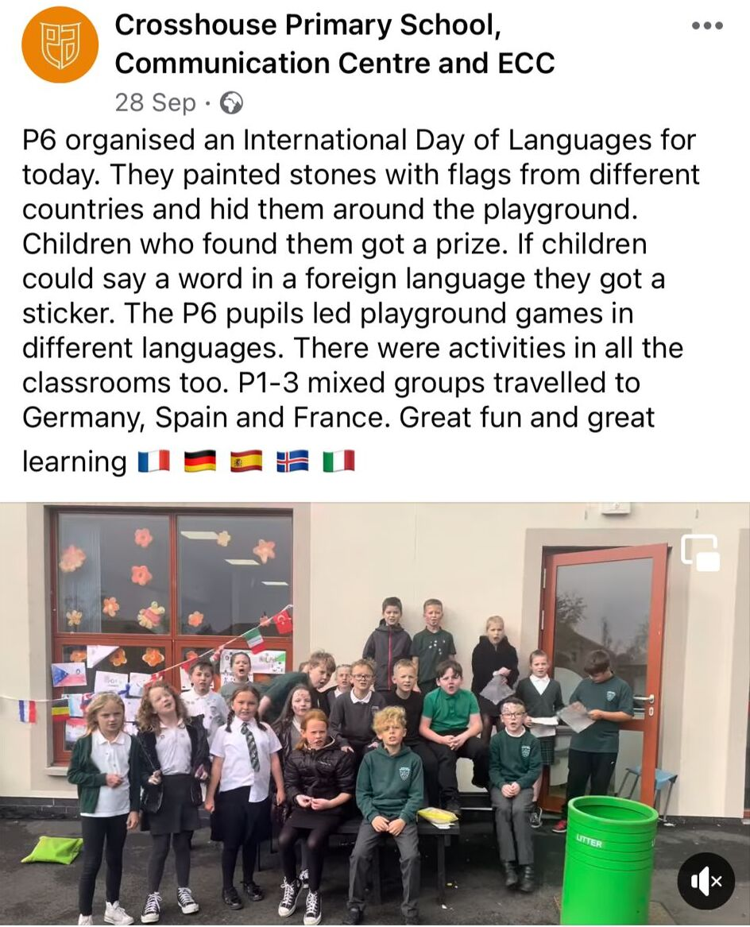
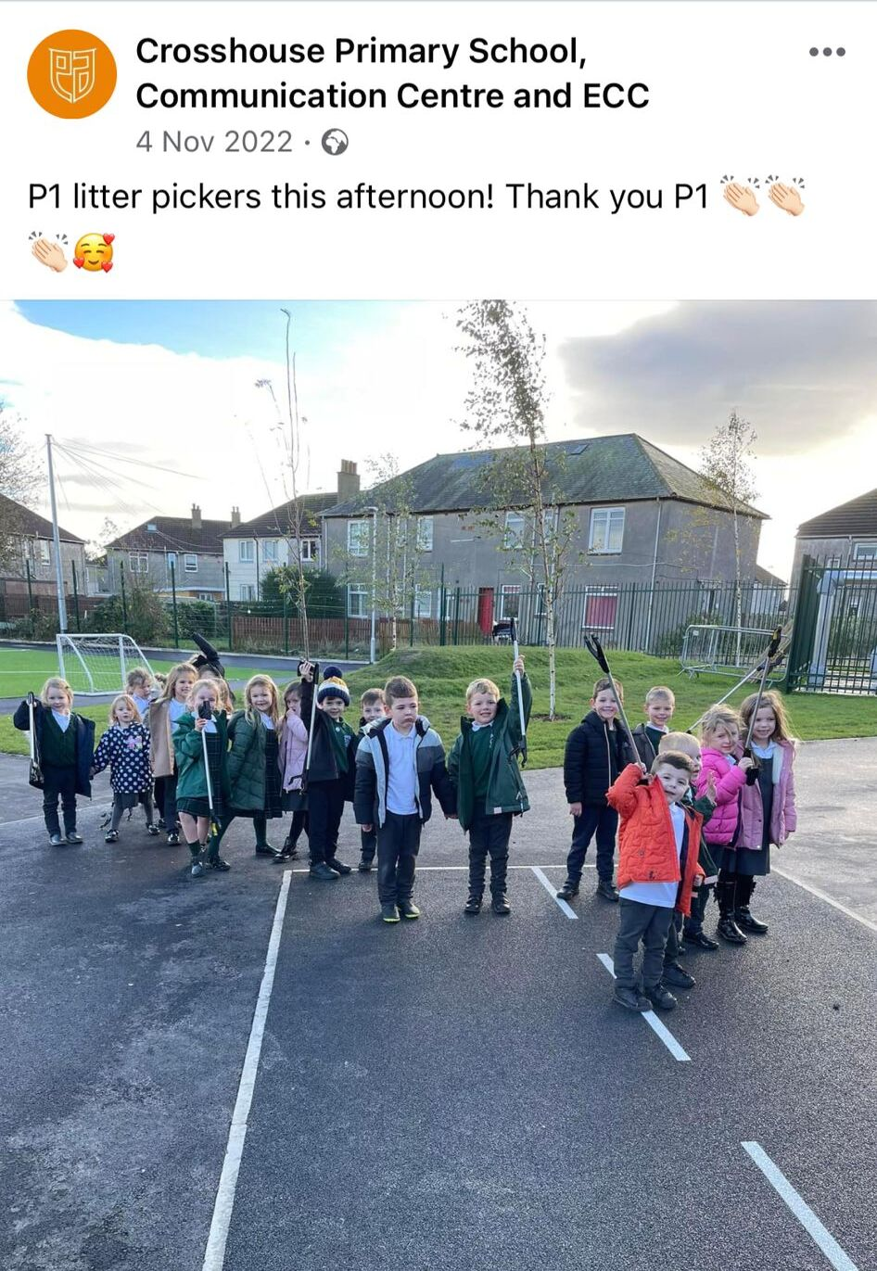
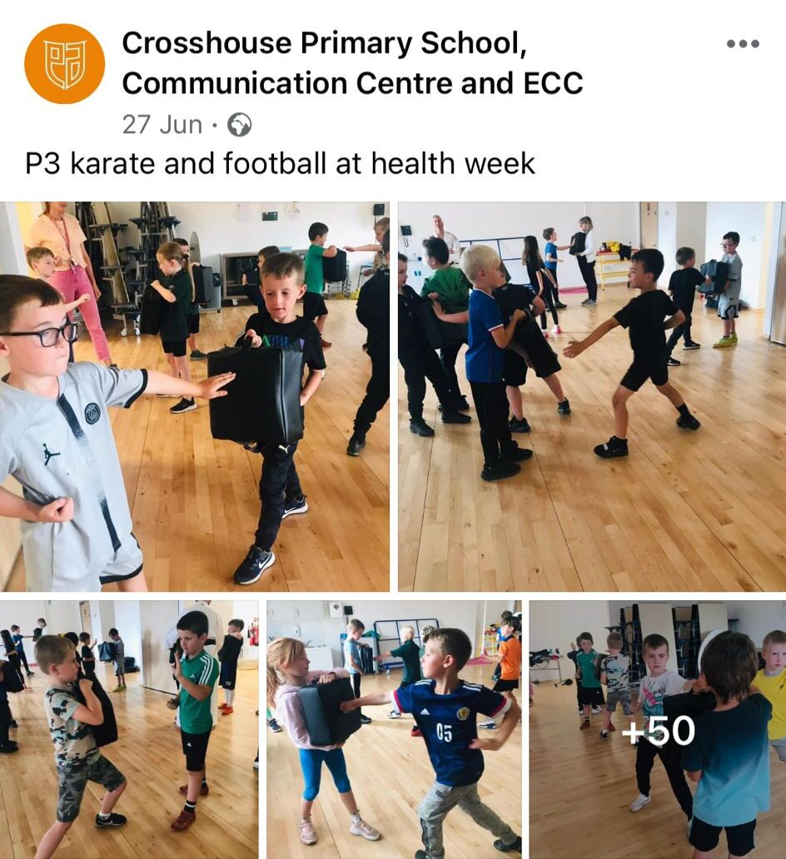
OUTCOME 1 - continued

Slide 7
Strand B – Teaching and Learning through Rights: Ethos & Relationships
Contents:
Crosshouse Opinion Matters groups
Class Charters
Working Walls & WOW Work Boards
Our Learning Journey wall
Anti Bullying week

Slide 8
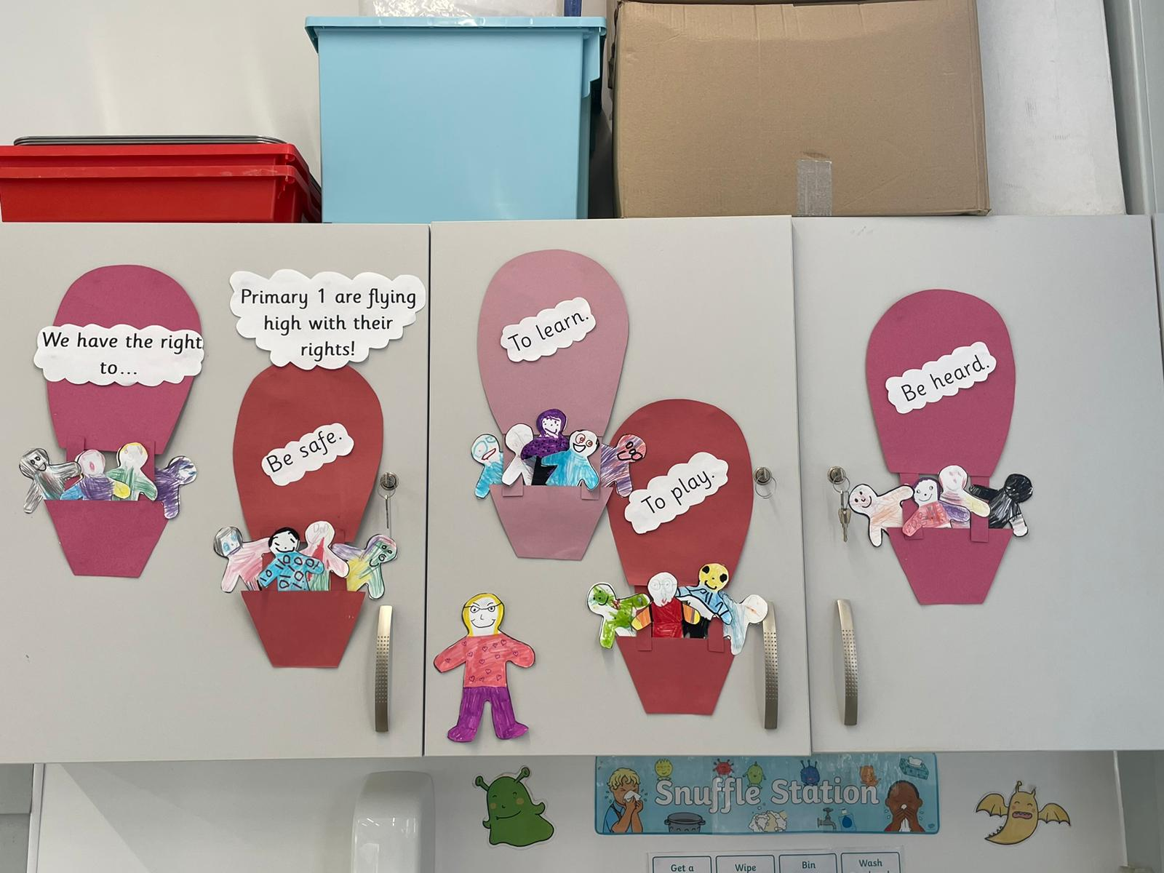
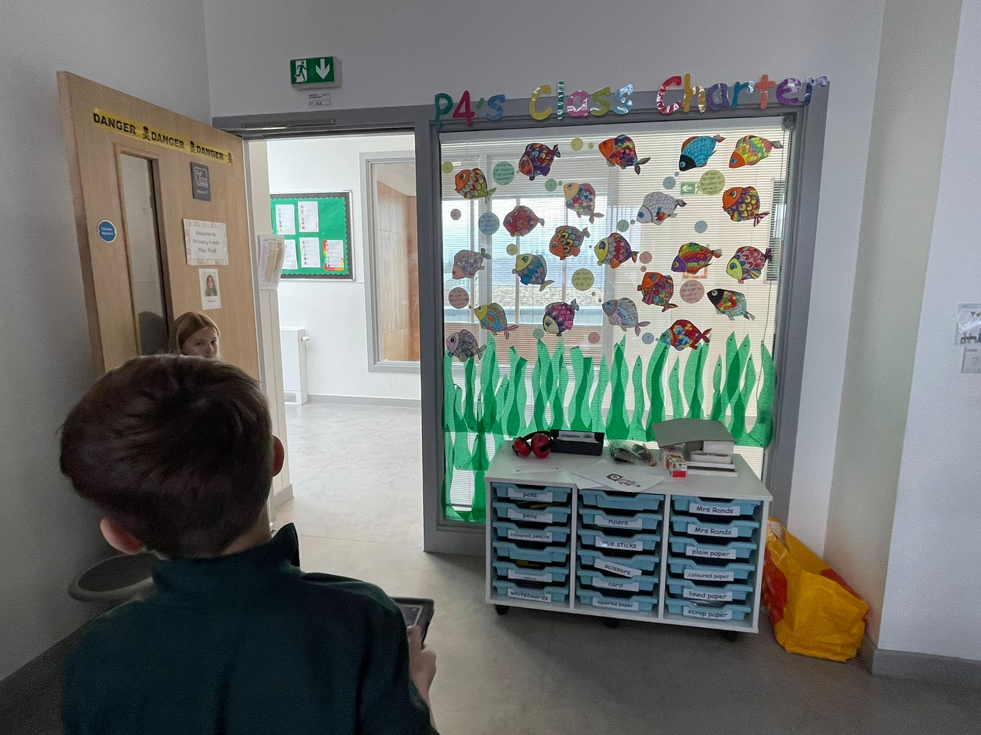
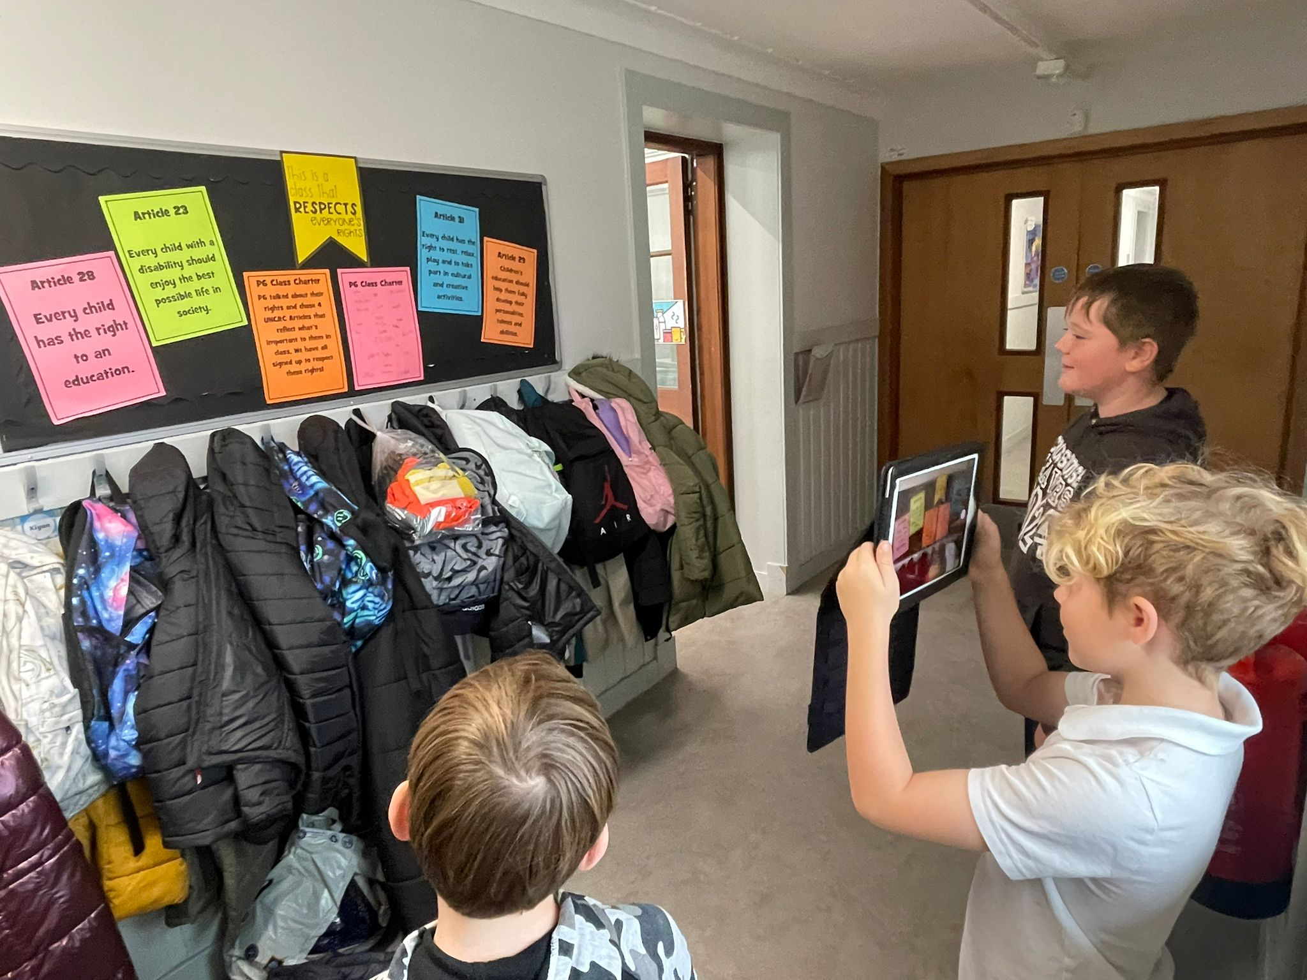
OUTCOME 2
In school, children and young people enjoy the rights enshrined in the United Nations Convention on the Rights of the Child.

Slide 9
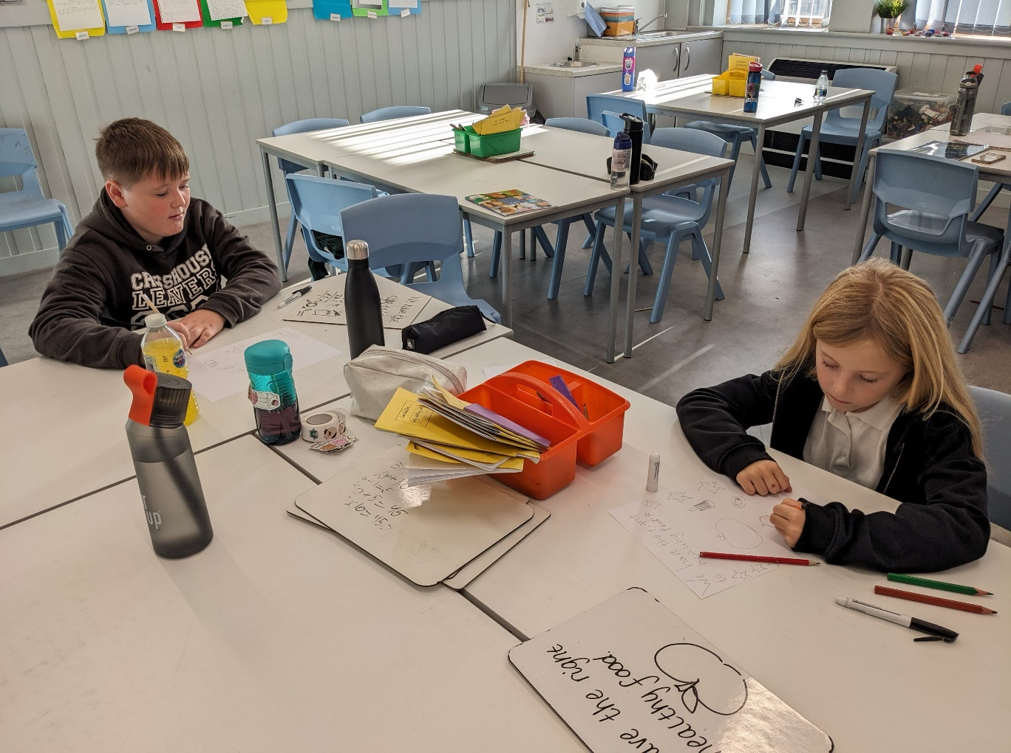
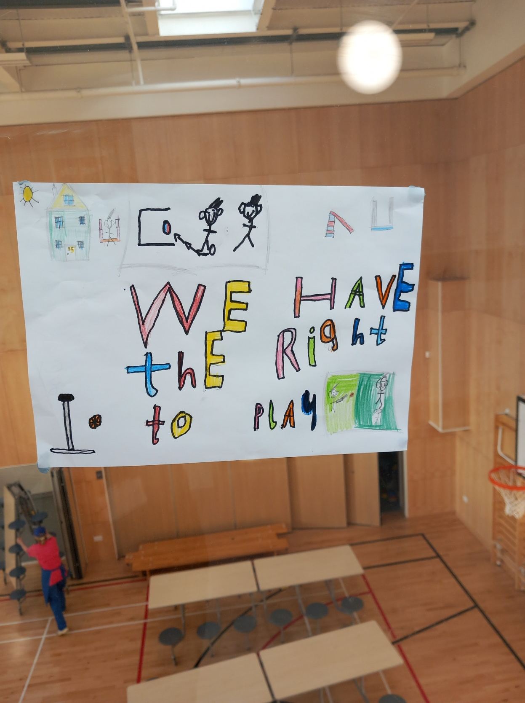
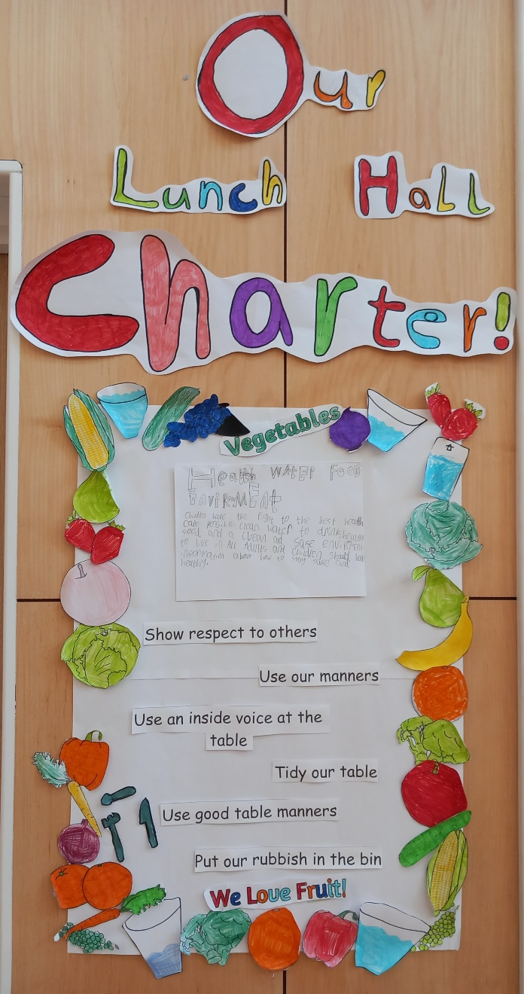
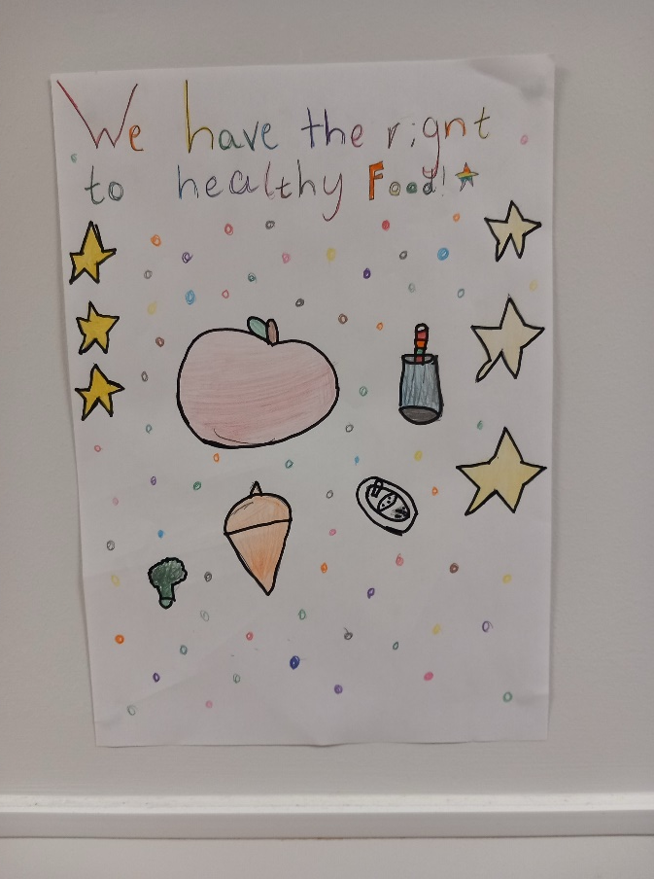
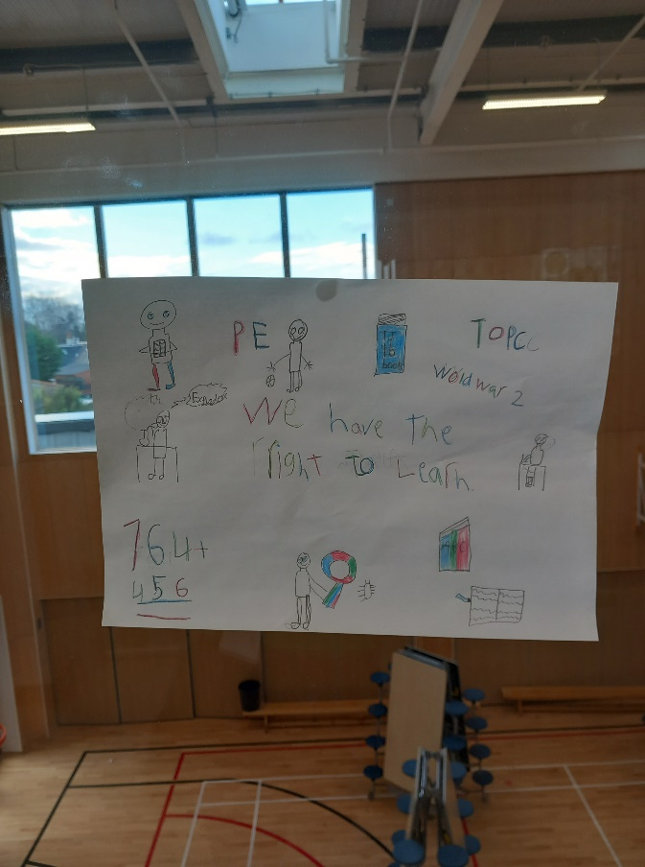
OUTCOME 2 - continued

Slide 10
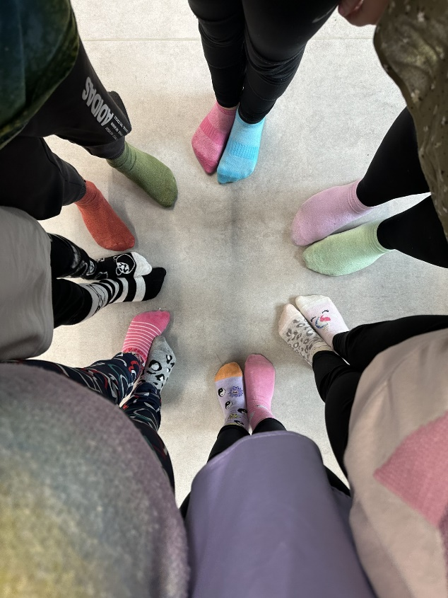
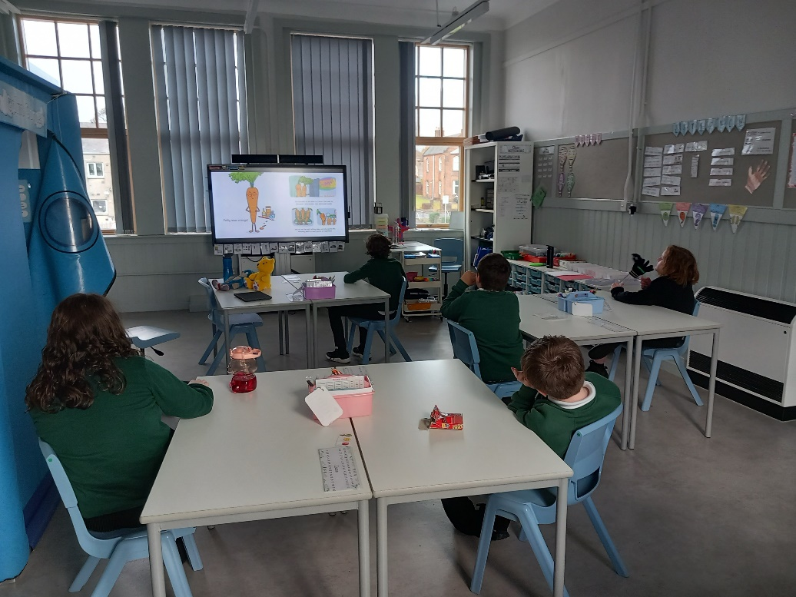
OUTCOME 3
Relationships are positive and founded on dignity and a mutual respect for rights.

Slide 11
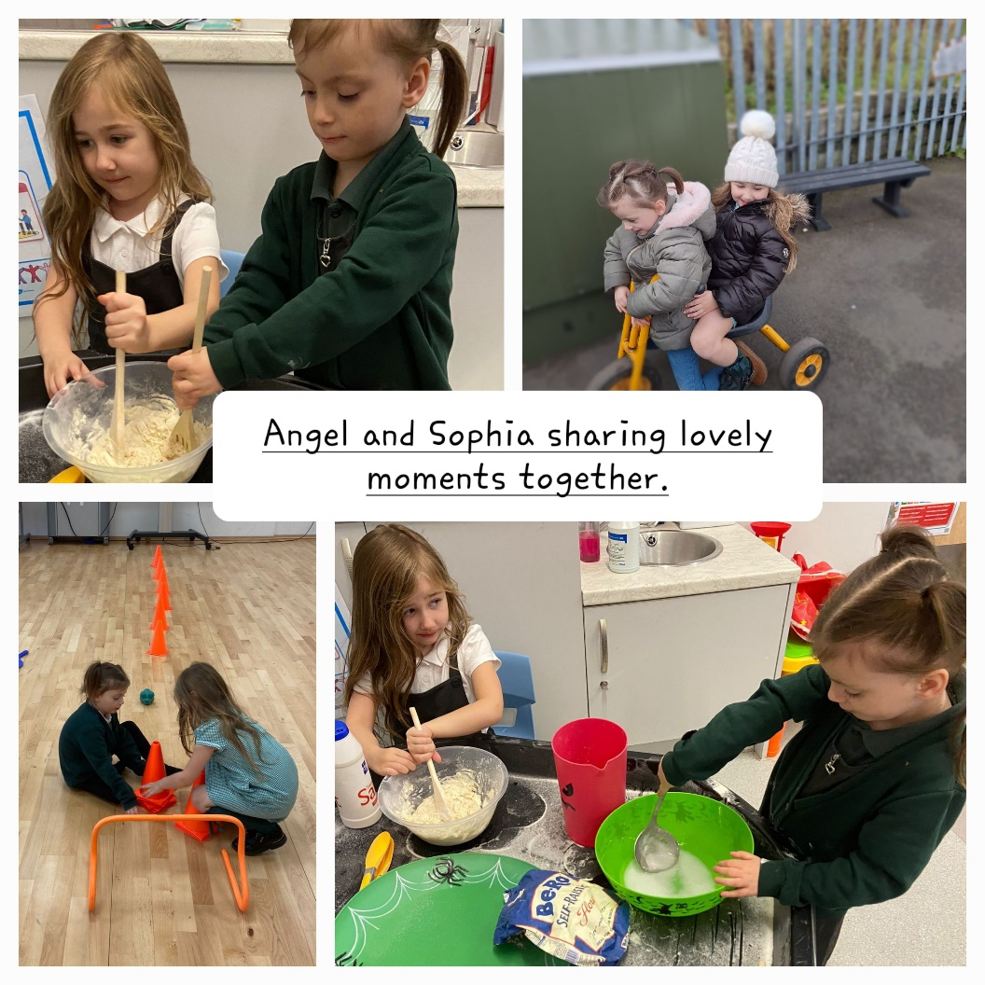
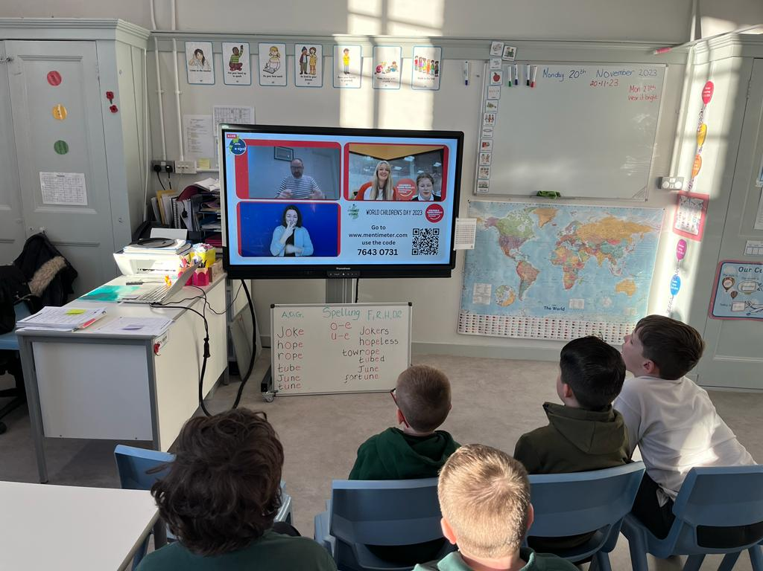
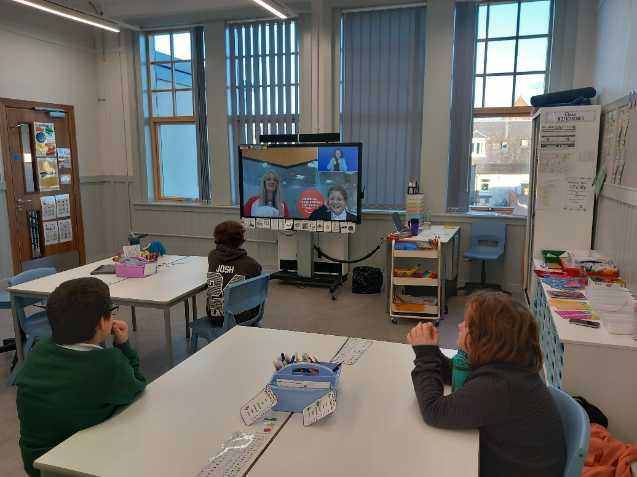
OUTCOME 3 - continued

Slide 12
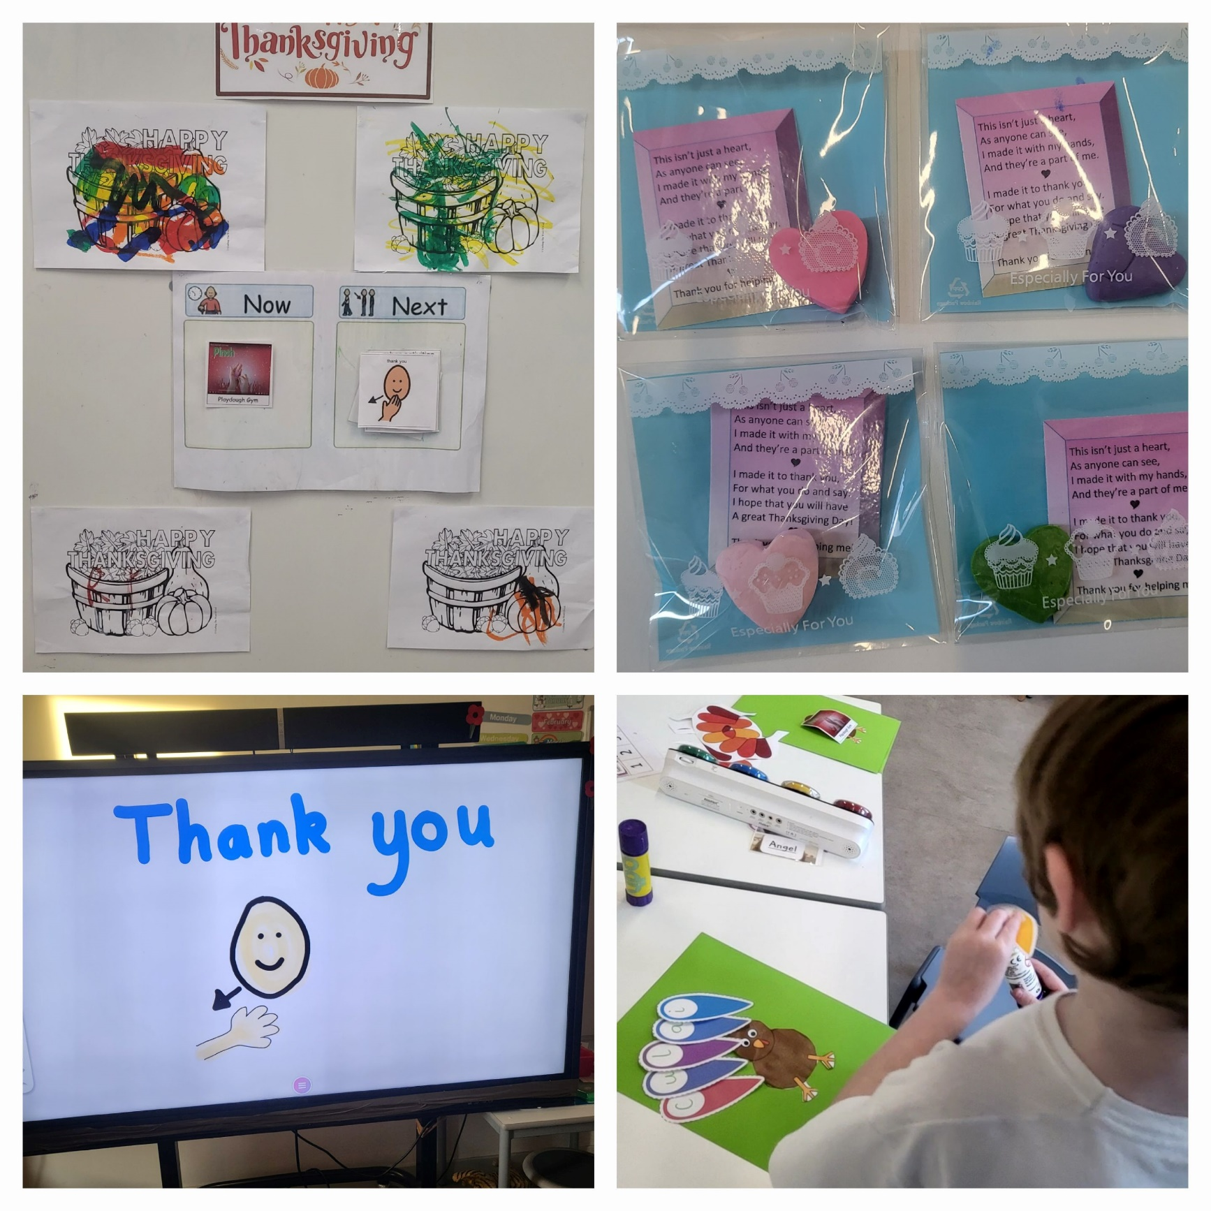
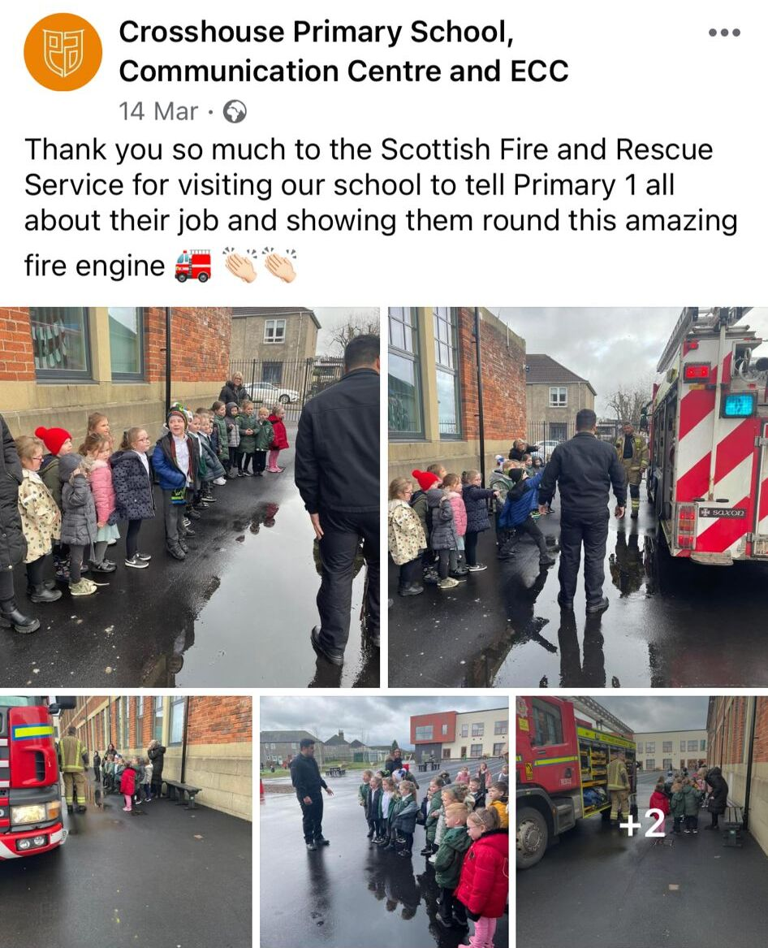
OUTCOME 4
Children and young people are safe and protected and know what to do if they need support.

Slide 13
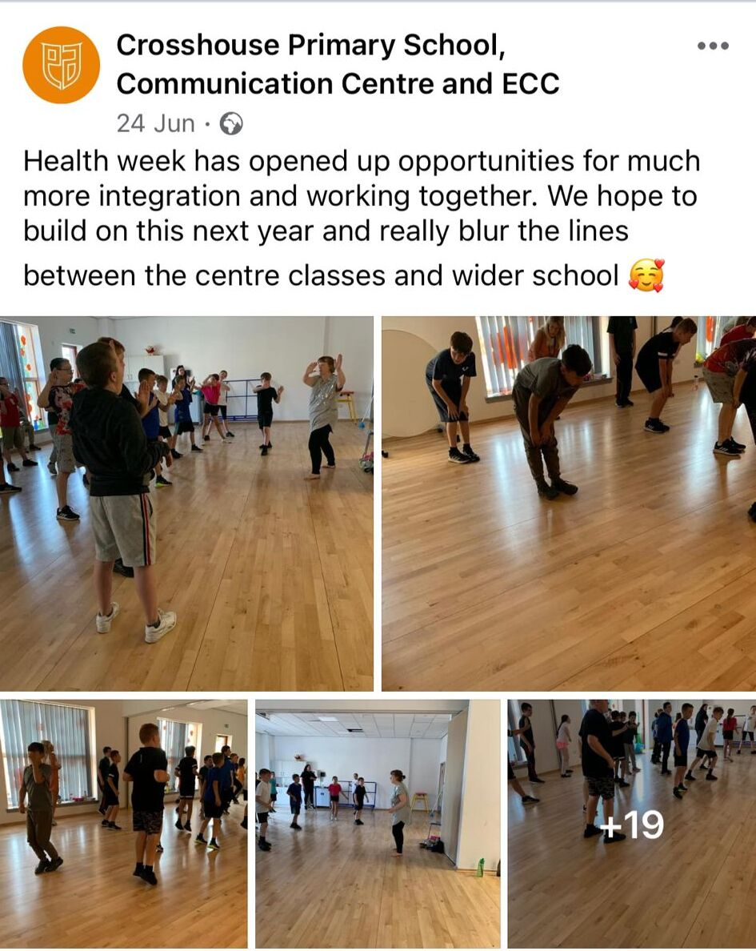
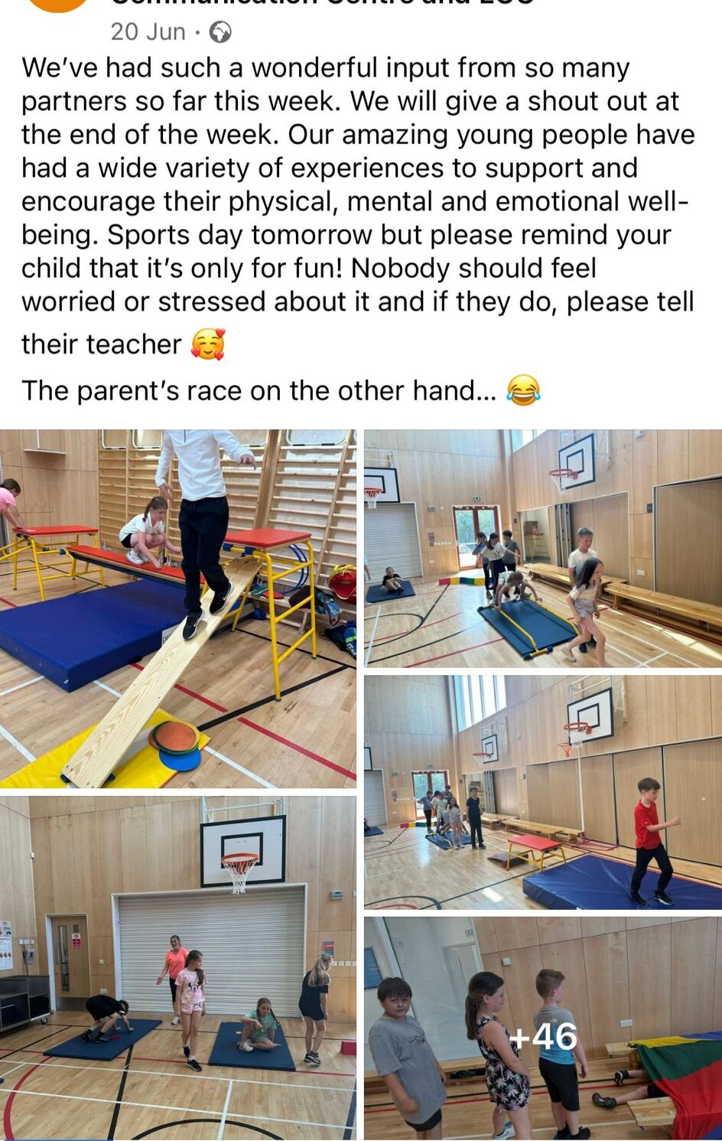
OUTCOME 5
Children’s social and emotional wellbeing is a priority. They learn to develop healthy lifestyles.

Slide 14
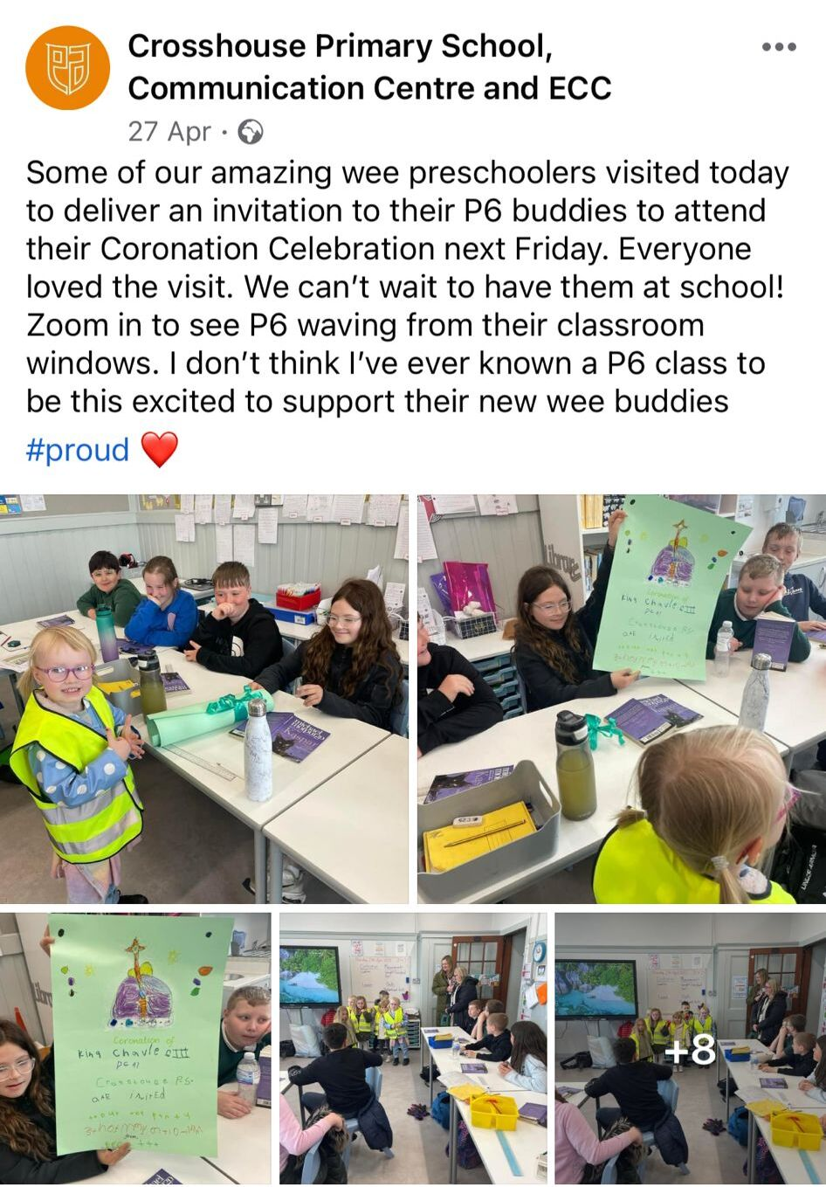
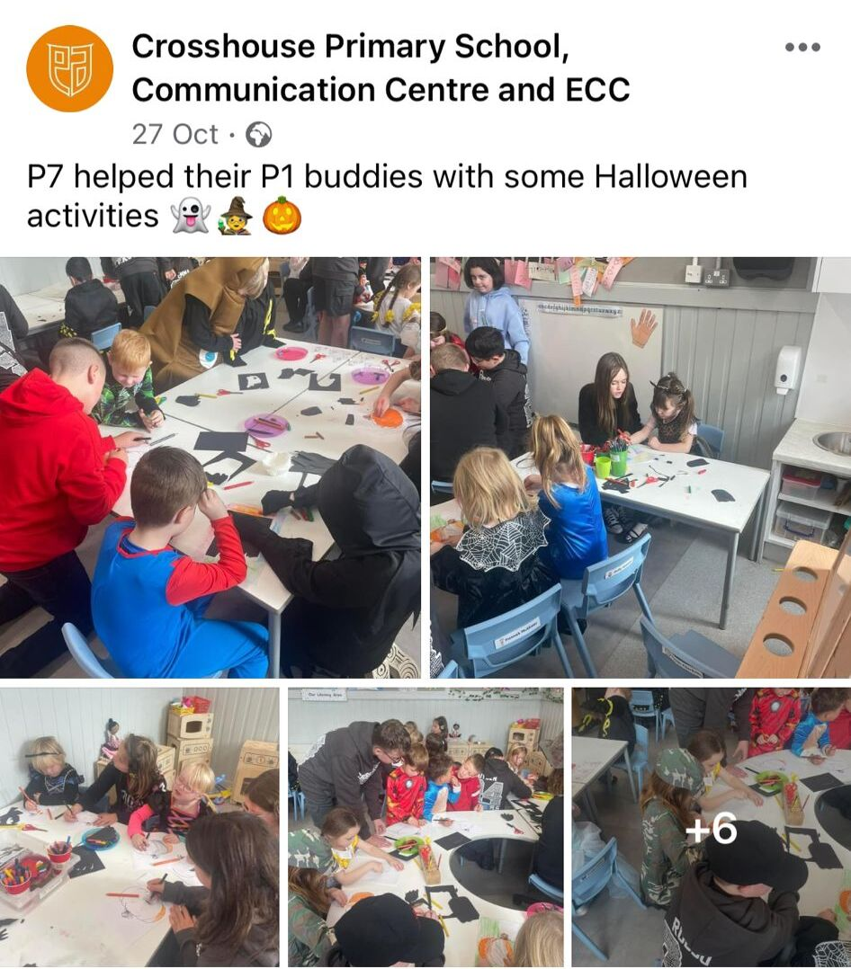
OUTCOME 5 - continued

Slide 15
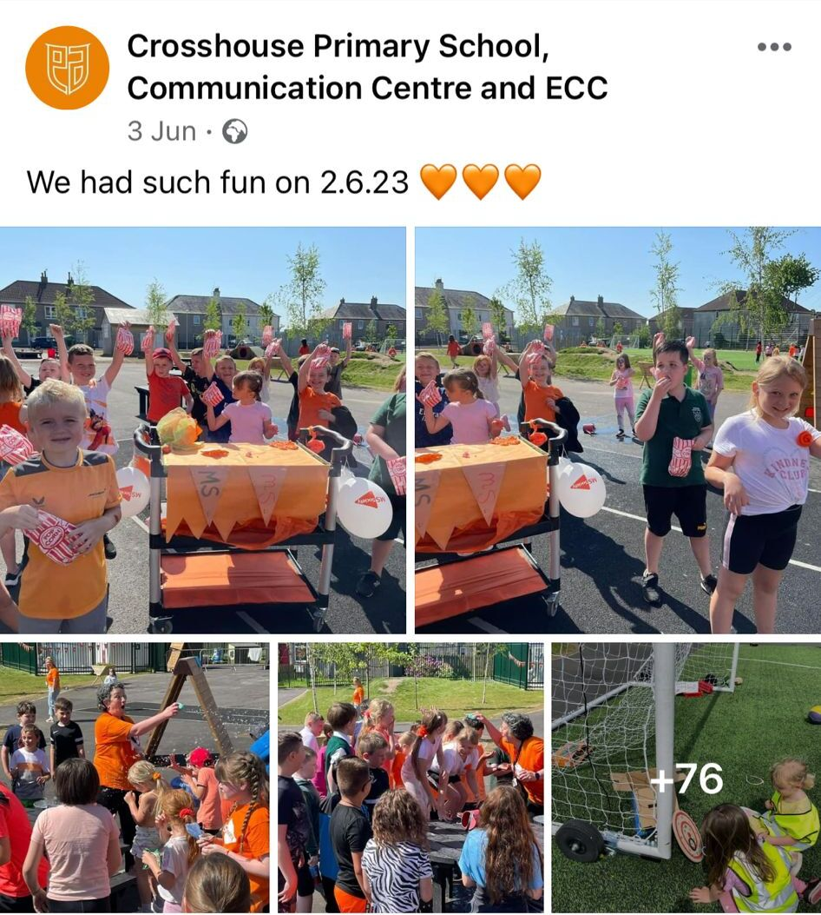
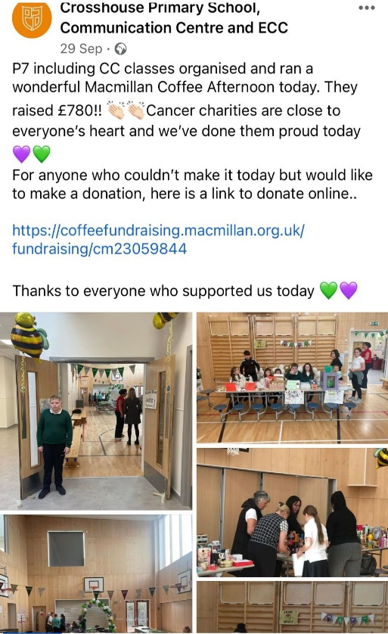
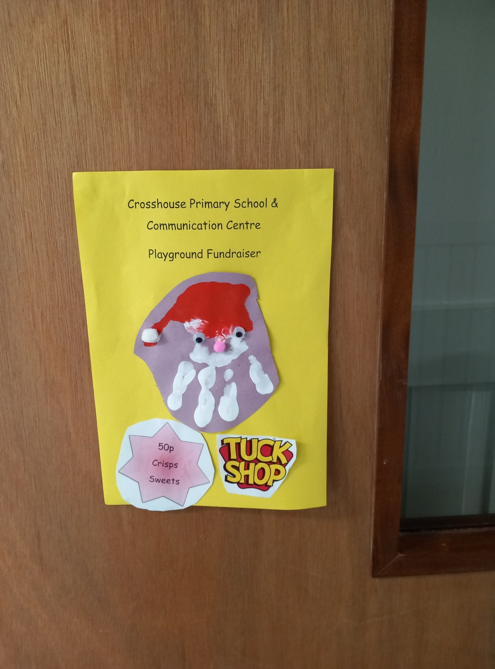
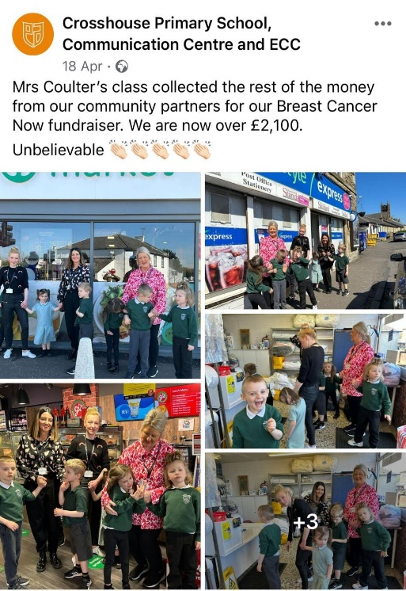
OUTCOME 6
Children and young people are included and valued as individuals.

Slide 16
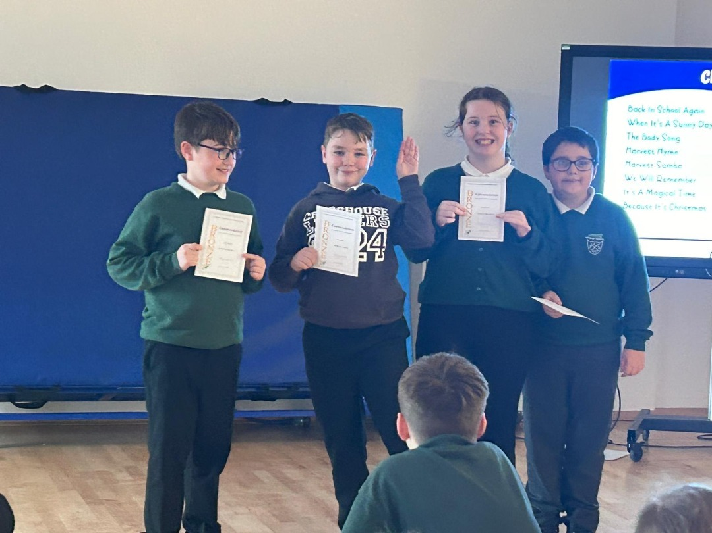
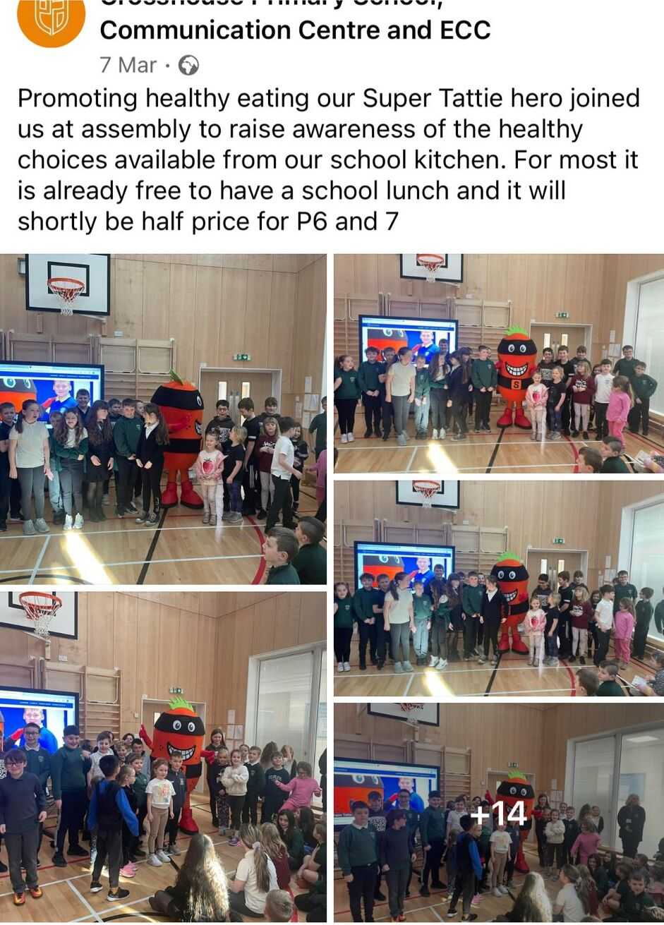
OUTCOME6 - continued

Slide 17
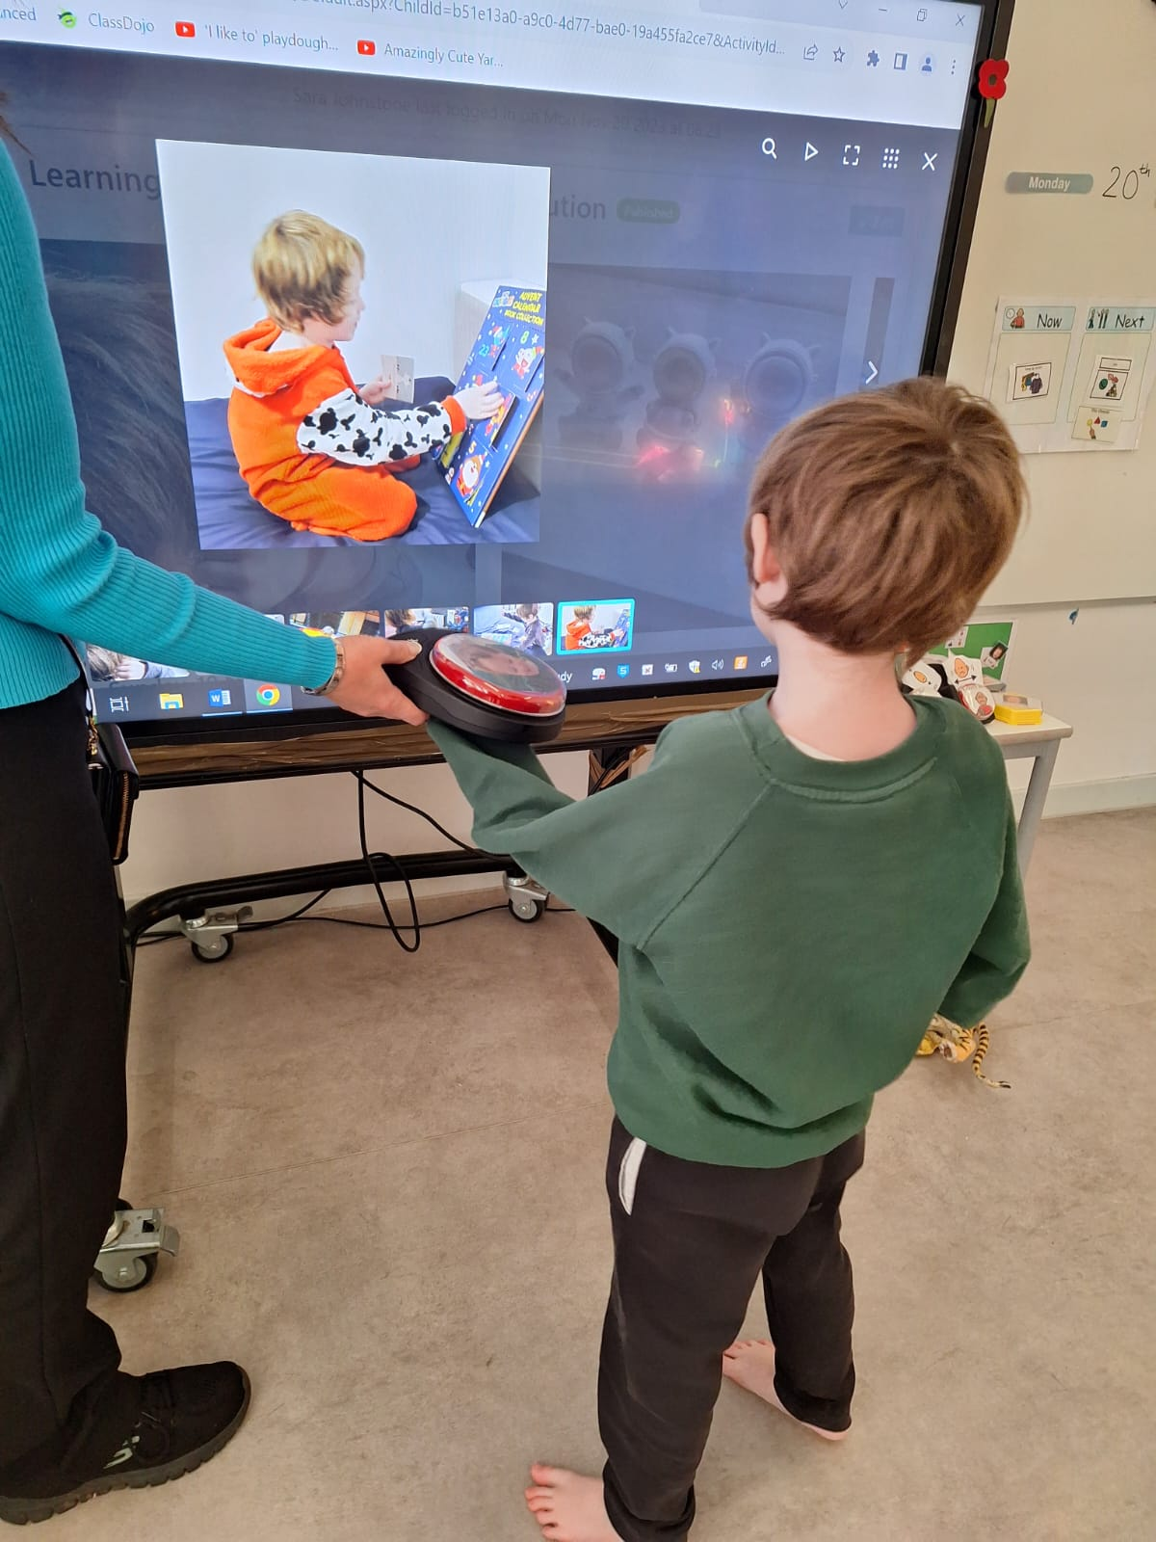
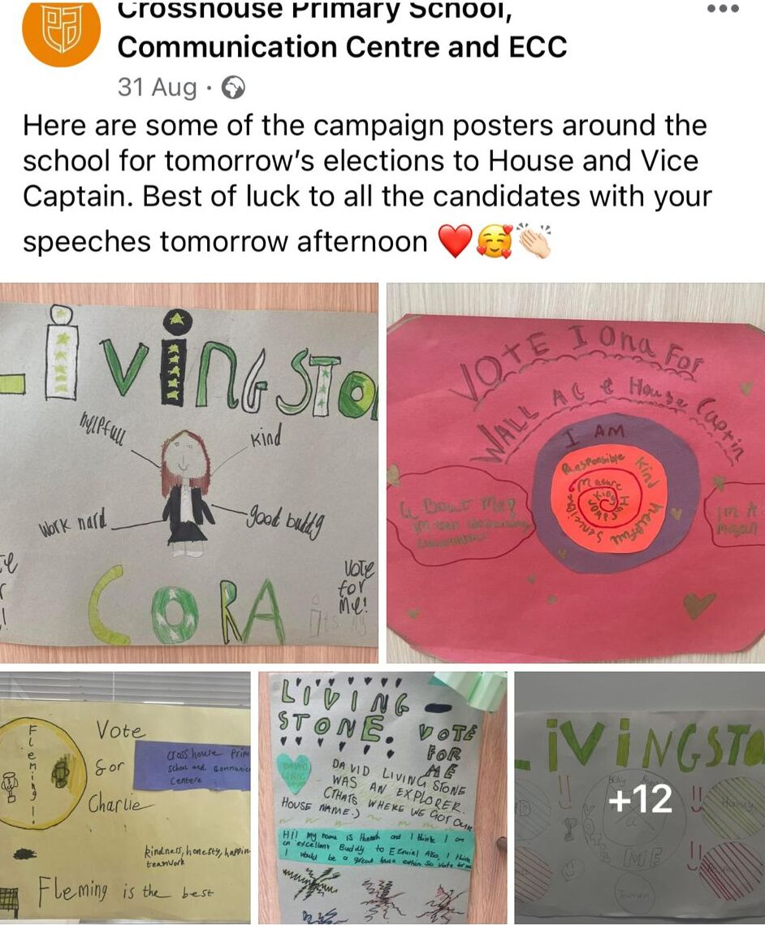
OUTCOME 7
Children and young people value education and are involved in making decisions about their learning.

Slide 18
Strand C – Teaching and Learning for Rights: participation, empowerment & action
Contents:
Pupil Voice in action
Examples of learning on Global campaigns
Photographs of events (campaigning and fundraising)

Slide 19
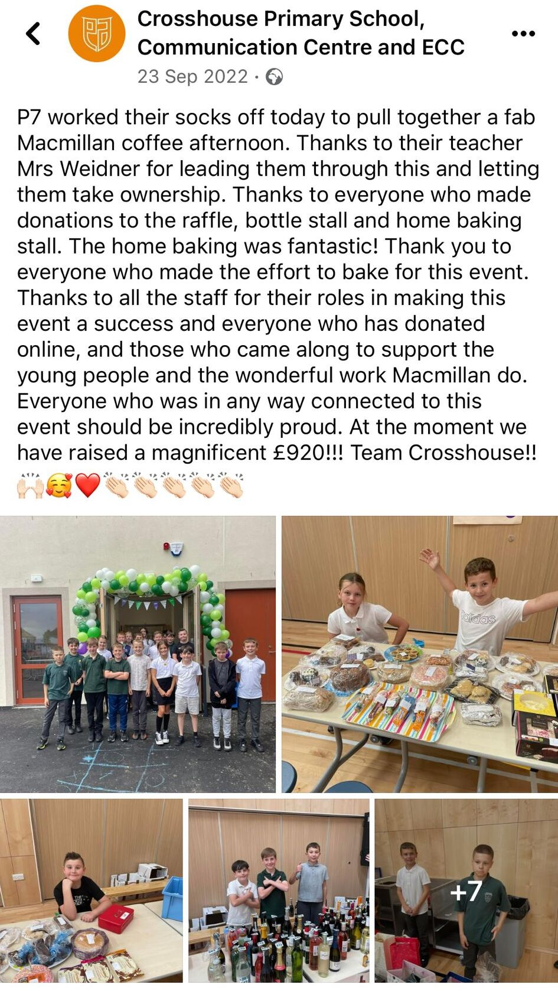
OUTCOME 8
Children and young people know that their views are taken seriously.

Slide 20
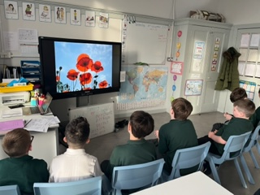
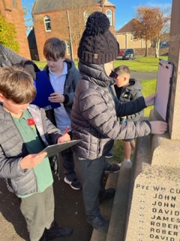
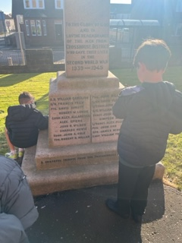
OUTCOME 9
Children and young people have taken action to claim their rights and promote the rights of others, locally and globally.

Slide 21
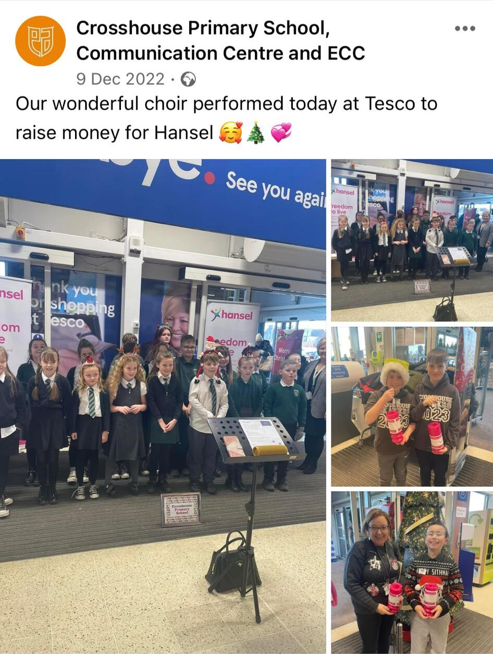
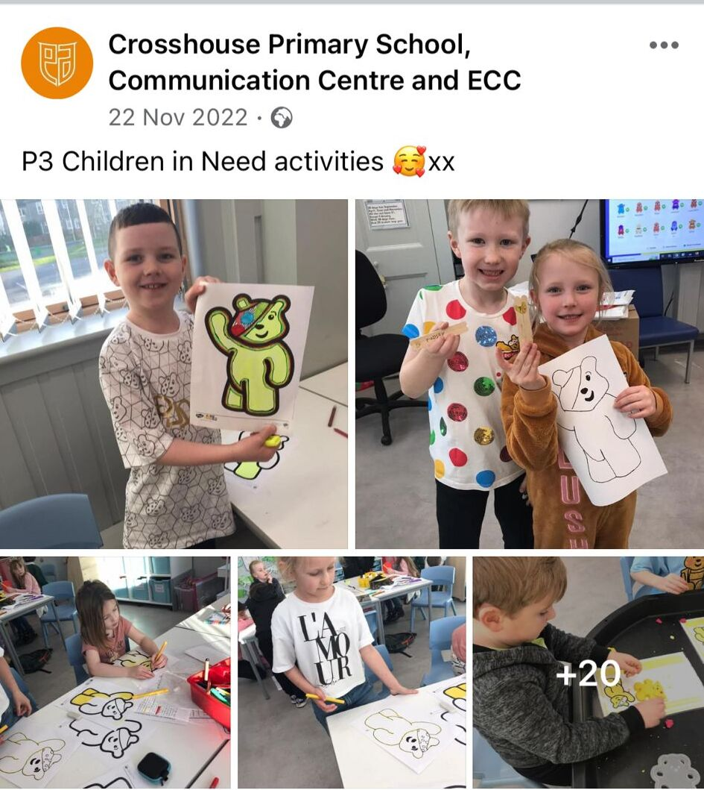
OUTCOME 9

Slide 22
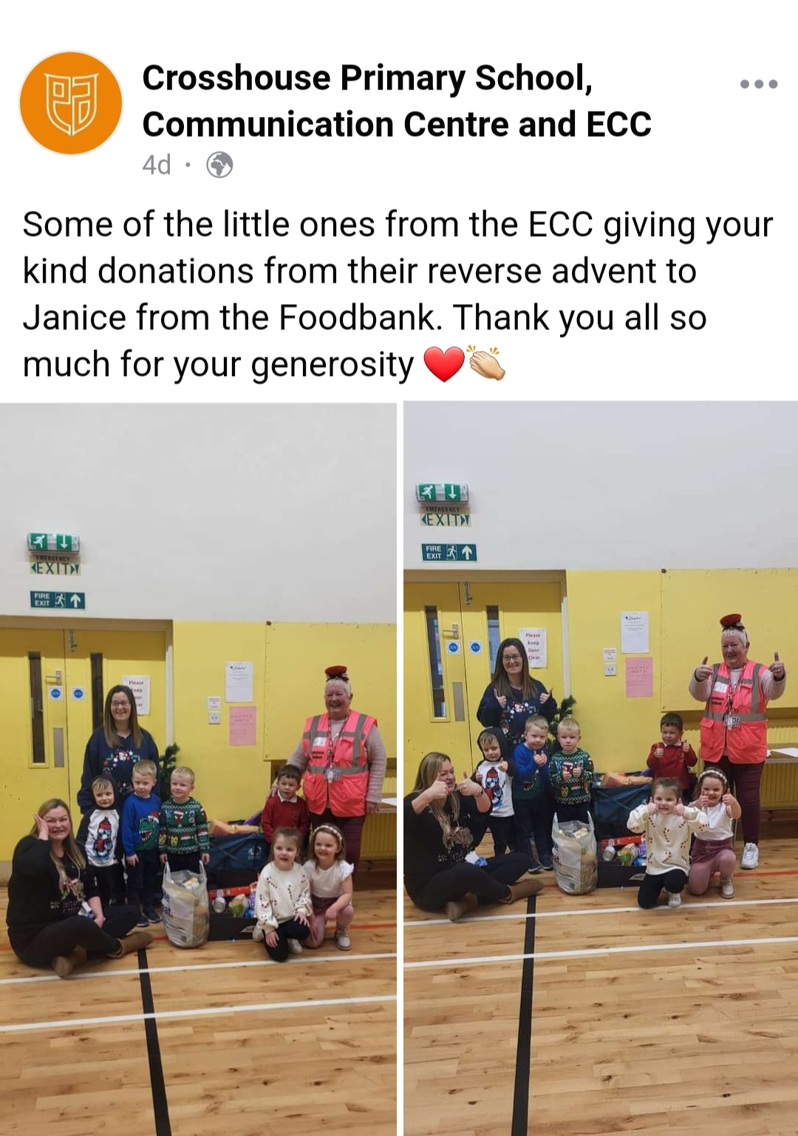
OUTCOME 9

Slide 23
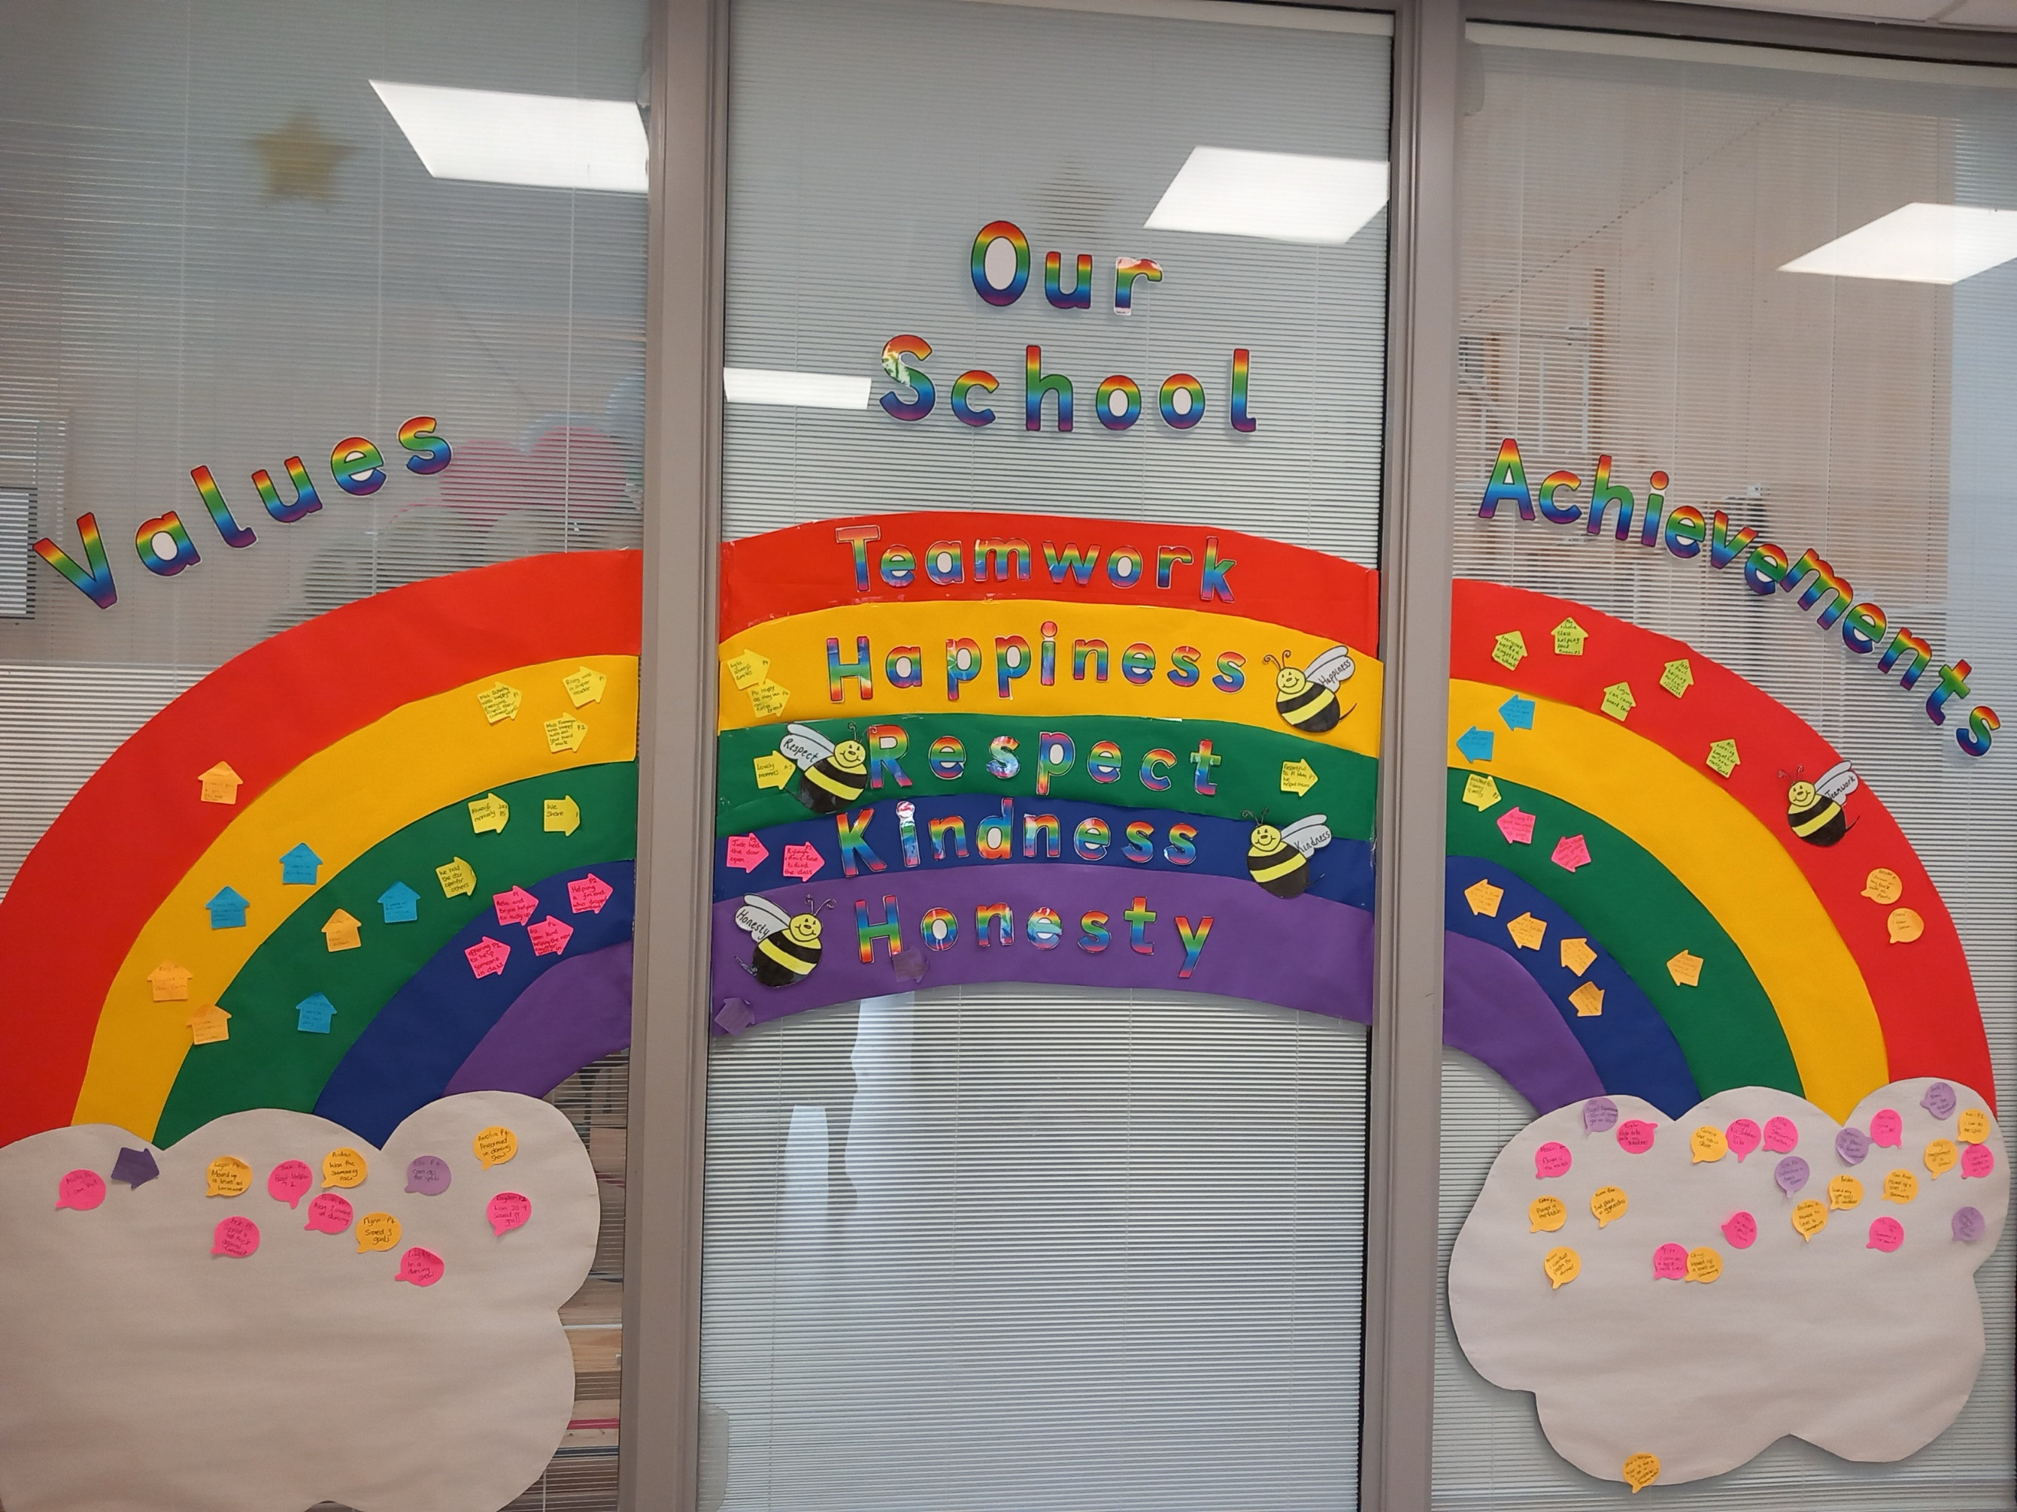
Other Evidence

