Slide 1
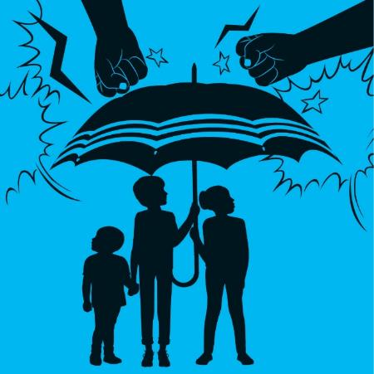
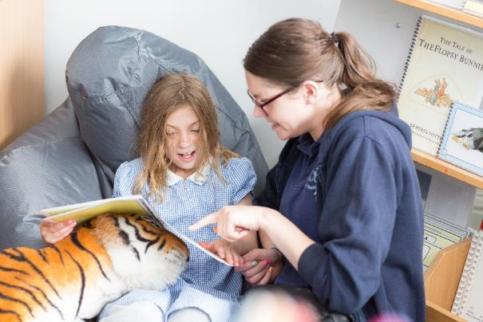
Guess the article
These pictures provide a clue to this week’s article.
What right is being shown in these pictures? Can you guess how they are linked together?
Write down your thoughts or discuss with someone in your home.
Unicef/Dawe

Slide 2
Introducing… Article 19
Martin introduces Article 19
Article 19 – Protection from violence, abuse and neglect
Governments must do all they can to ensure that children are protected from all forms of violence, abuse, neglect and bad treatment by their parents or anyone else who looks after them.
Watch Martin on YouTube

Slide 3
Exploring Article 19
What do people around you have to do to make sure you are safe and protected?
Write them down and then compare your answers with the next slide.

Slide 4
How many of these did you get?
Understanding what it means to be safe and protected
Knowing that people care about you
Being able to talk about your emotions and feelings
Finding out and learning about why some things are not safe
Knowing that there is an adult who will listen to you and take you seriously
Feeling looked after, valued, secure and respected
Having confidence to get help if you need it
Knowing how to be safe on line
What else did you think of?

Slide 5
Activity Time
Can you think of places or situations that have special rules about safety, such as a swimming pool or train station. Choose one and design a safety poster.
All these activities are related to…
Think about the feelings we have when we know we are safe and cared for. Draw a cloud and fill it with all the words you can think of.
Draw or list some of the people whose job it is to help you stay safe and protected.
Article 19 means that no child should be hurt, hit or treated badly. Find out about the punishments for children in schools in Victorian times.
You don’t need to do every single activity
but if you have time you can do more than one.
Primary

