Slide 1
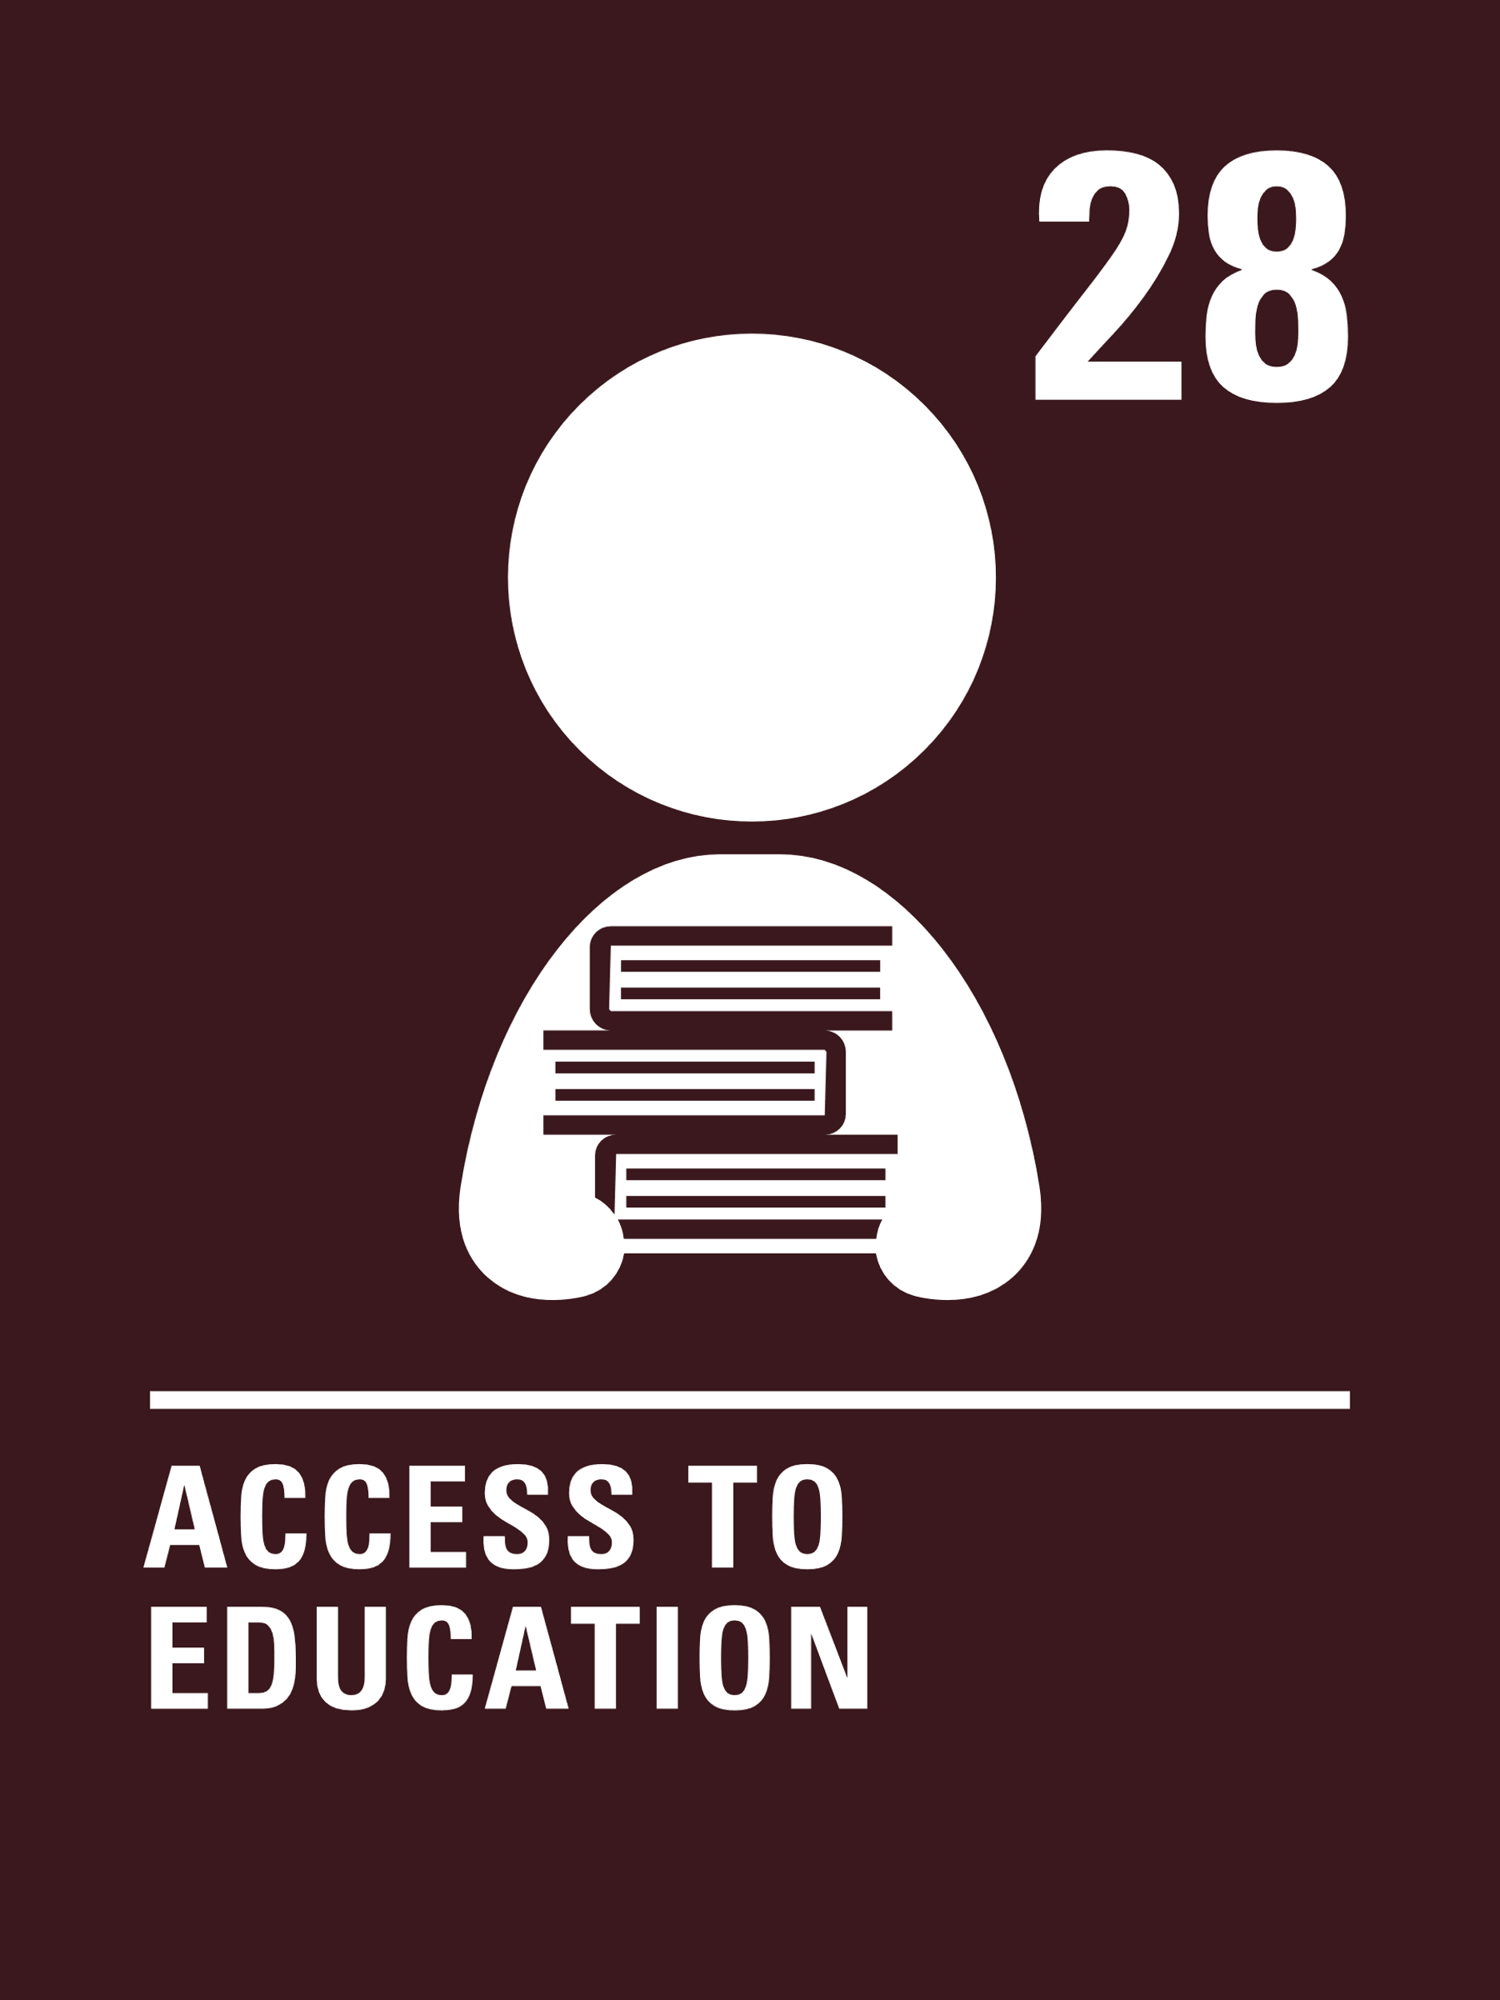
Introducing… Article 28
Jilly introduces Article 28
Article 28 – the right to education
Every child has the right to an education.
Primary education must be free and different forms of secondary education must be available to every child.
Discipline in schools must respect children’s dignity and their rights.
Richer countries must help poorer countries achieve this.
Watch Jilly on YouTube

Slide 2
Why is the right to education important?
Give yourself one minute to think of as many reasons as you can why education is important for children and young people.
You might like to ask someone else in your house to do this too. At the end of one minute share your thoughts and then compare with the ideas on the next slide.

Slide 3
How many of these did you get?
Education is important to children and young people because it will help them to:
have skills to improve things and help people
form opinions and views about things
learn things, gain knowledge and pass exams
know how to stay safe and healthy
learn how to respect other people’s ideas and get on with other people
get a job they enjoy and earn money
make informed choices
have more opportunities in life
learn about things that are important for the world
grow up to be responsible adults

Slide 4
Activity time
Create a lesson timetable for the day.
These activities will help you
understand how...
…can relate to your life.
You don’t need to do every activity, just do as many as you can.
We began by thinking about why the right to an education is important. Watch this video which explores this a bit further.
Create an image or word art that sums up what education means to you.
Draw your classroom or what you would like the classroom to look like.

Slide 5
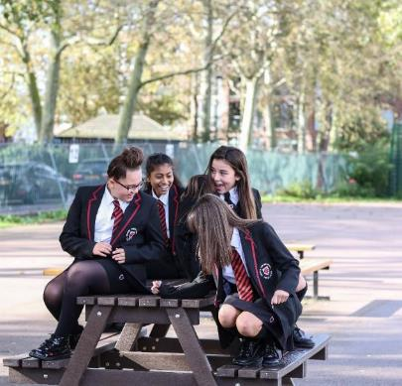
Reflection
Think about your own learning for a few minutes – your own learning in school and outside of school.
What do you love learning about the most?
What are you good at? Or would like to be better at?
How do you learn best?
UNICEF/Dejongh

