Slide 1
Can you solve the clues and use the picture to identify the creature on each slide?

Slide 2
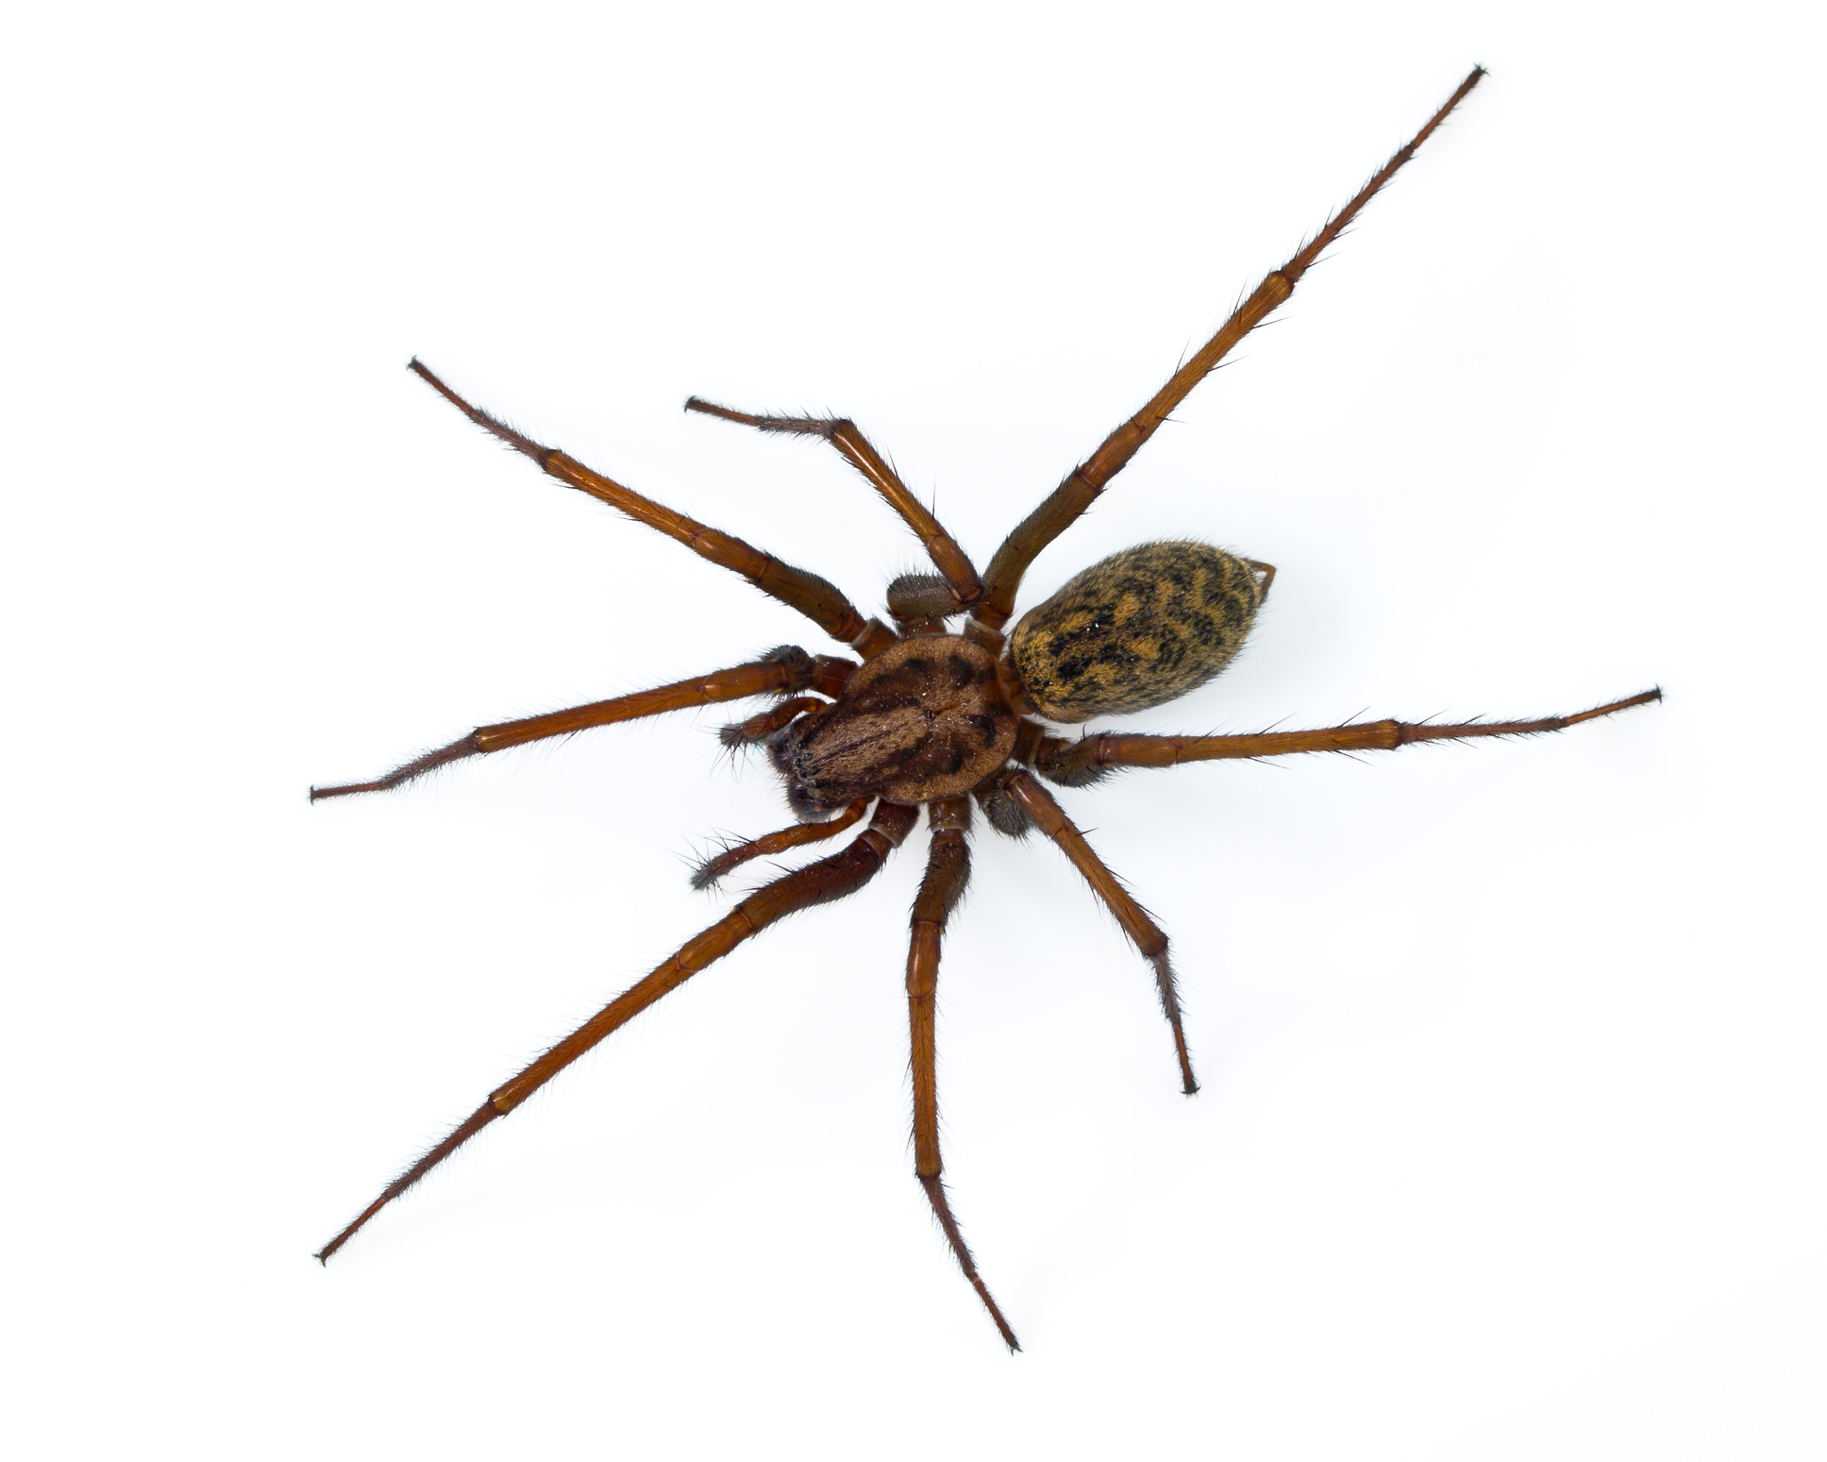
I have eight legs.
I have two main body parts.
I do not have wings.
I can spin a web.
Spider

Slide 3
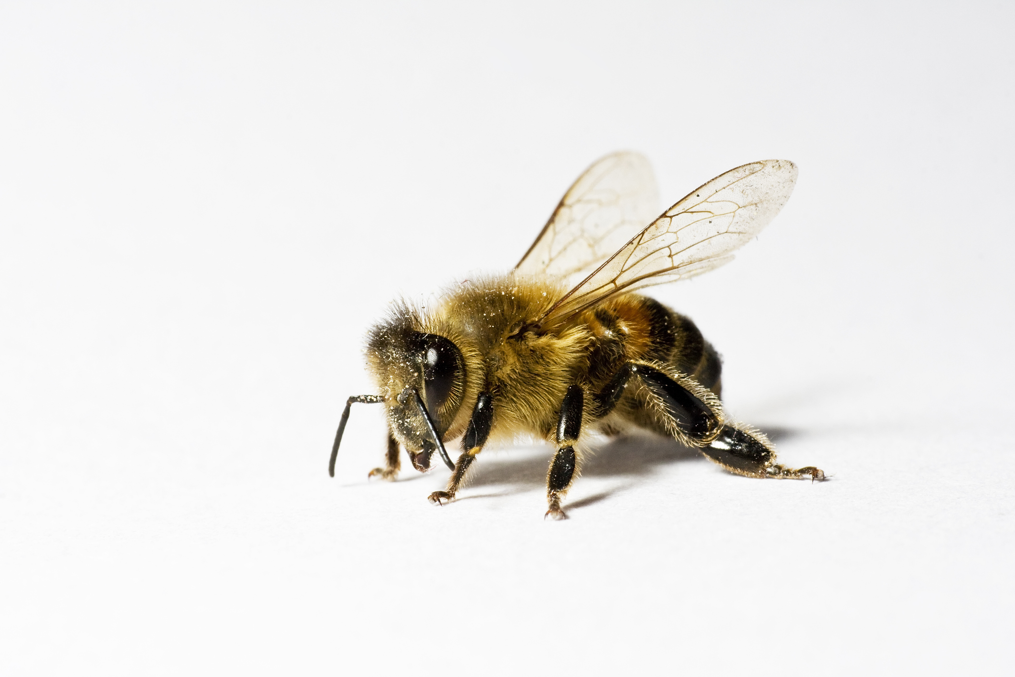
I have a striped abdomen.
I collect nectar.
I communicate with others by dancing.
I produce honey and beeswax.
Bee

Slide 4
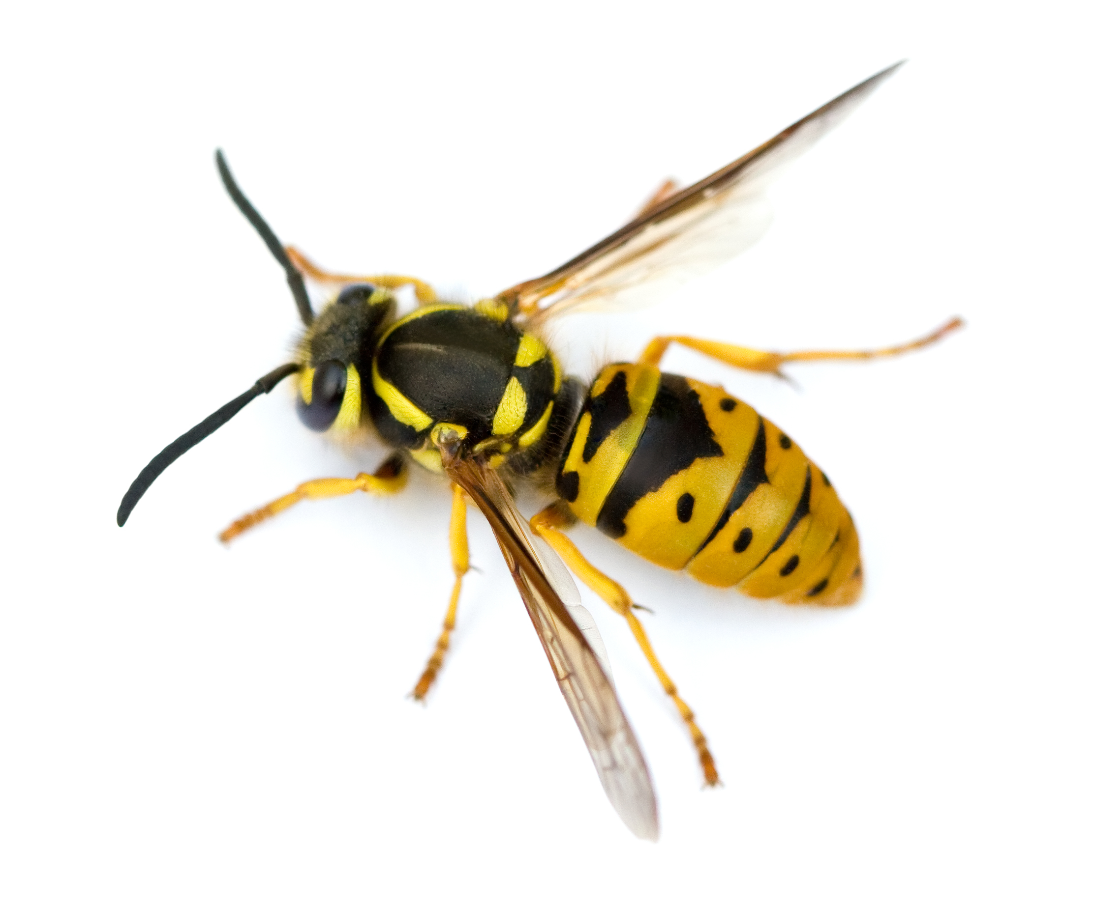
I have a striped abdomen.
I can use my sting more than once.
I do not swarm.
I live in a papery nest, made in a space like an old animal burrow or under a roof.
Wasp

Slide 5
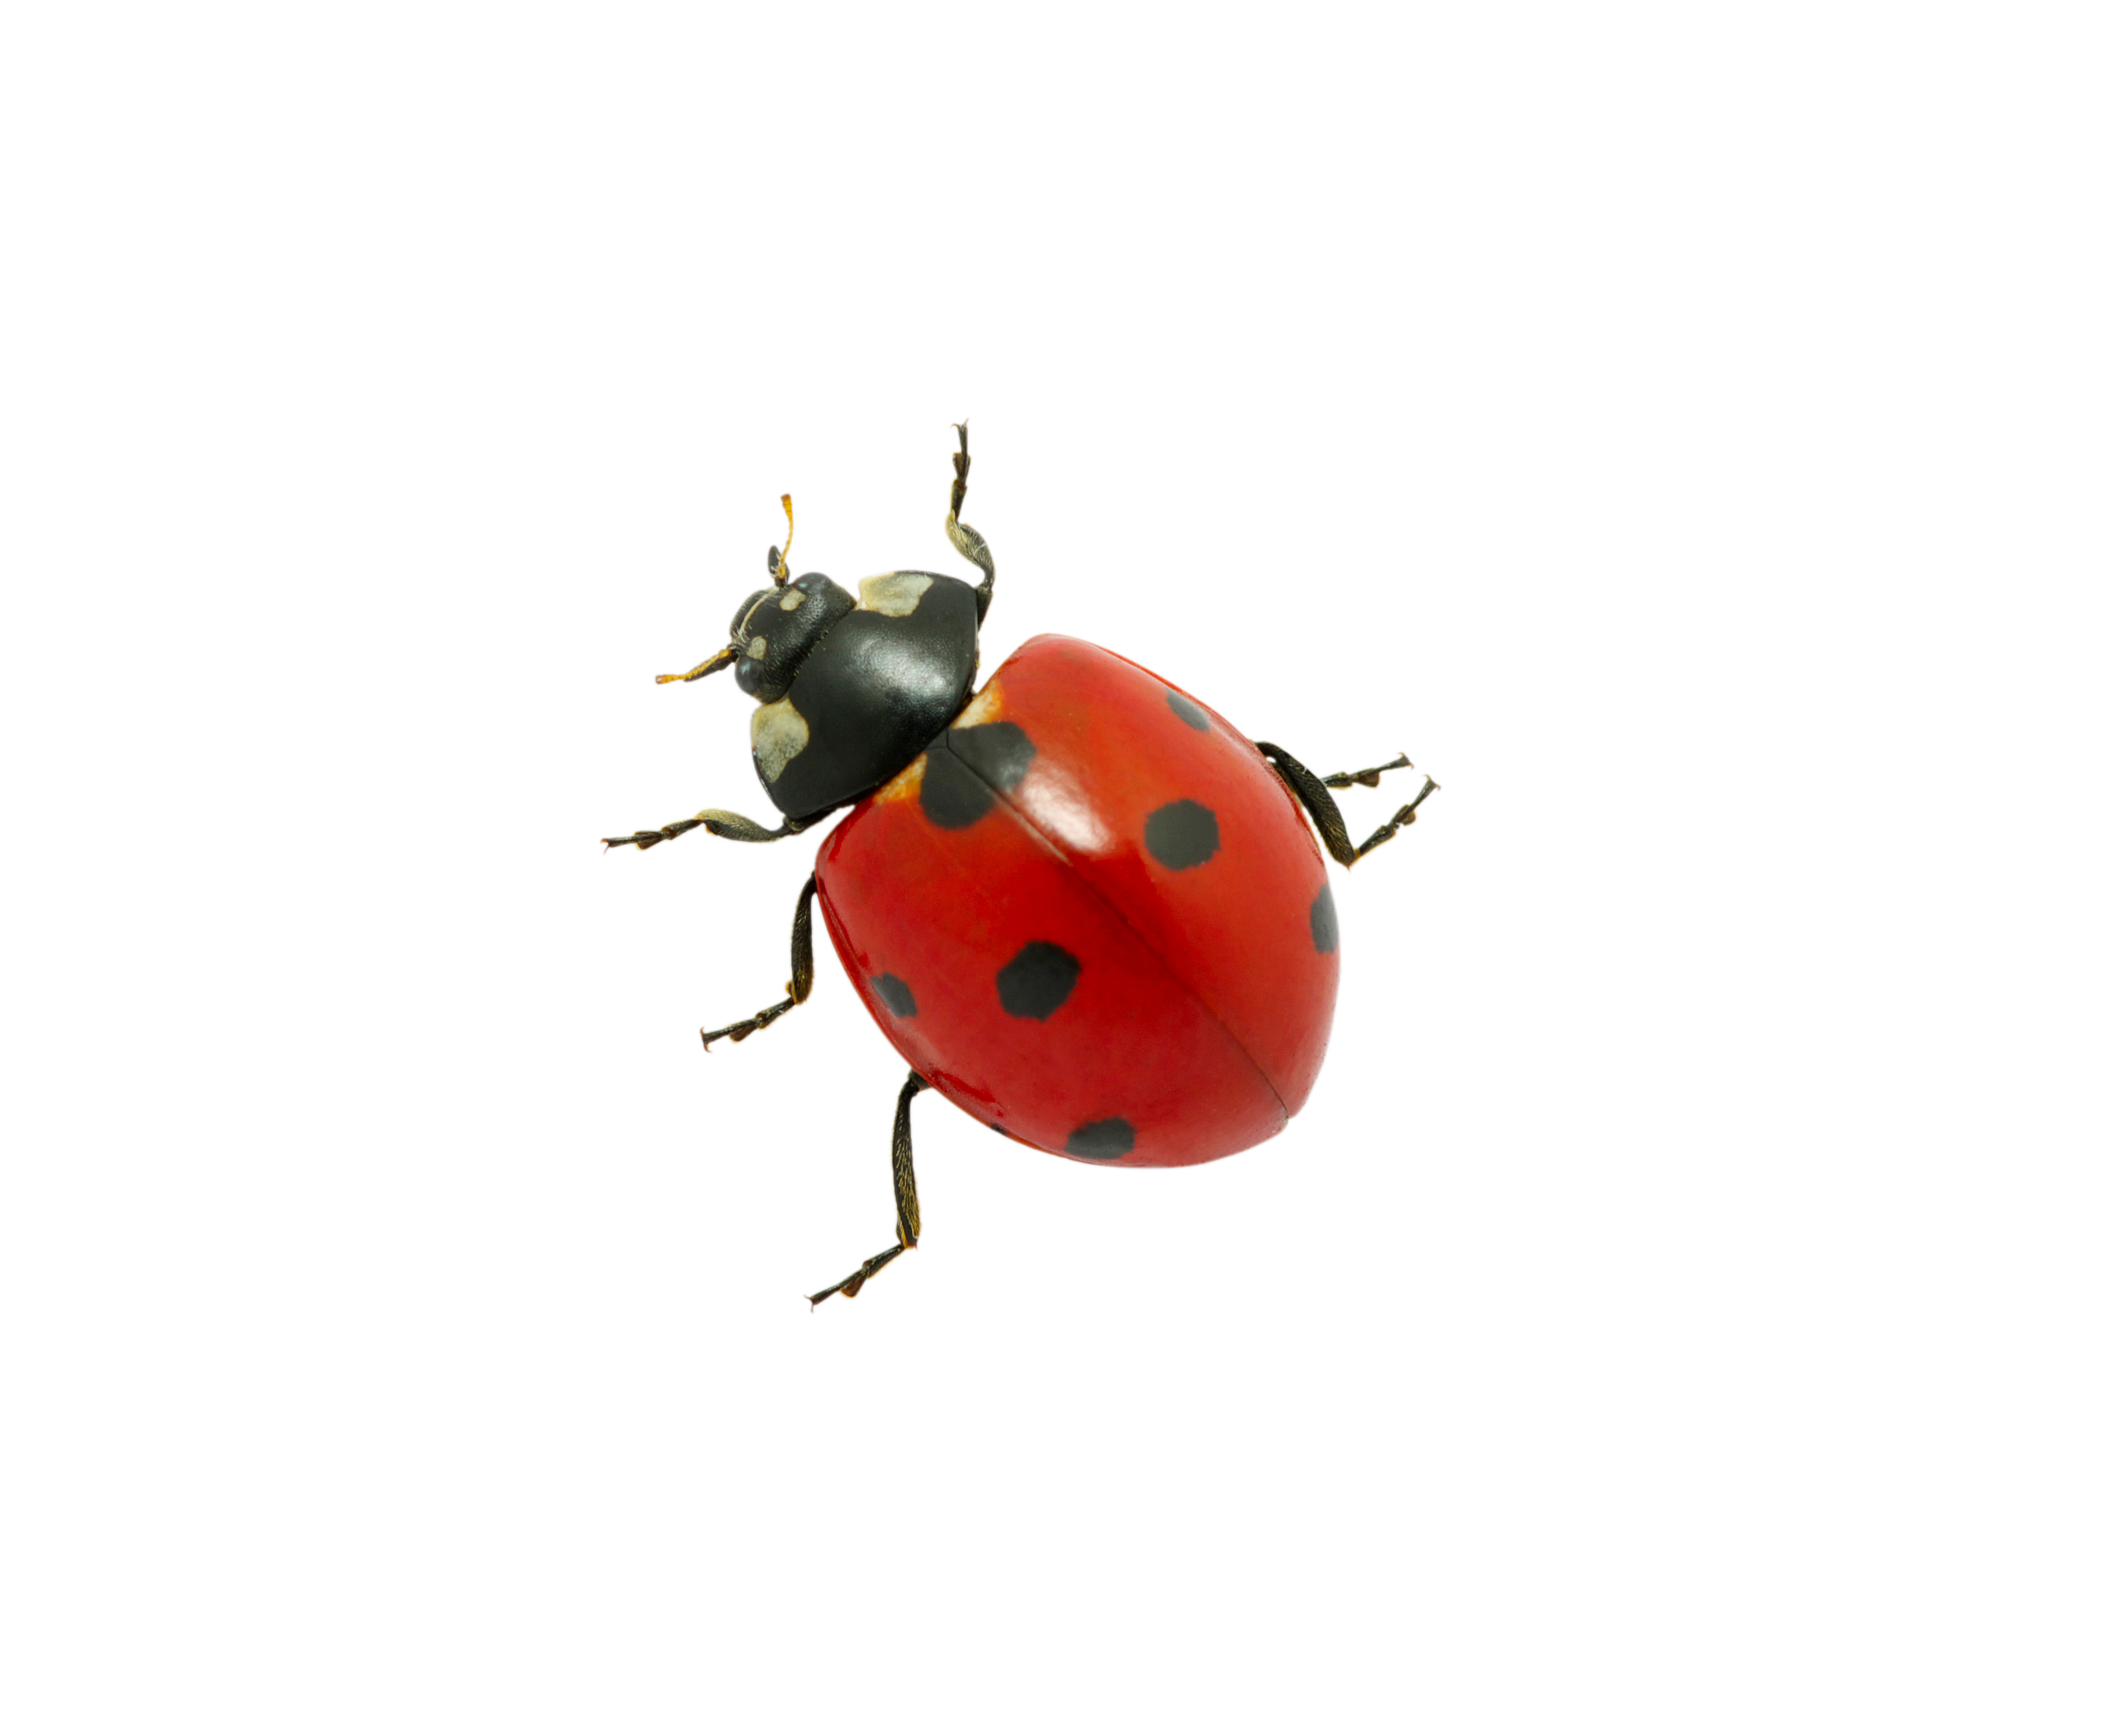
I hibernate.
I eat aphids.
I have brightly coloured wing cases, with spots.
My spots warn predators that I am not good to eat.
Ladybird

Slide 6
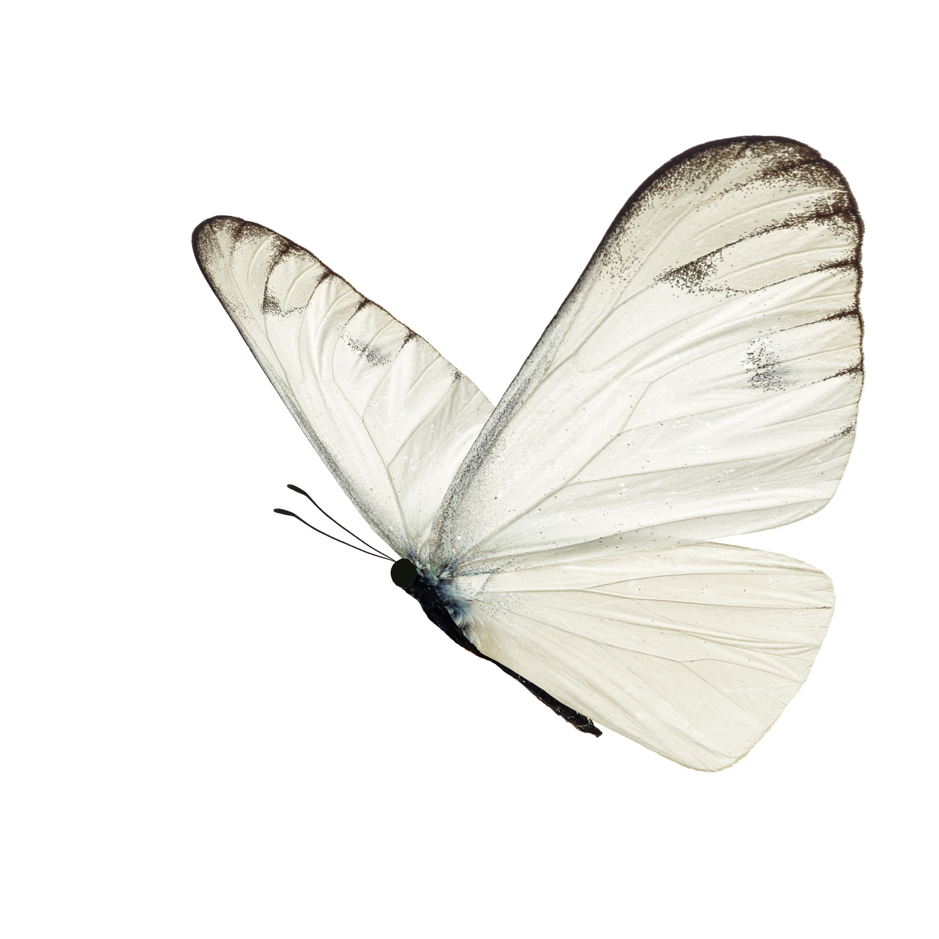
I feed during the day.
I have taste receptors on my feet.
I have a proboscis, for sucking up my food.
My shiny pupa is called a chrysalis.
Butterfly

Slide 7
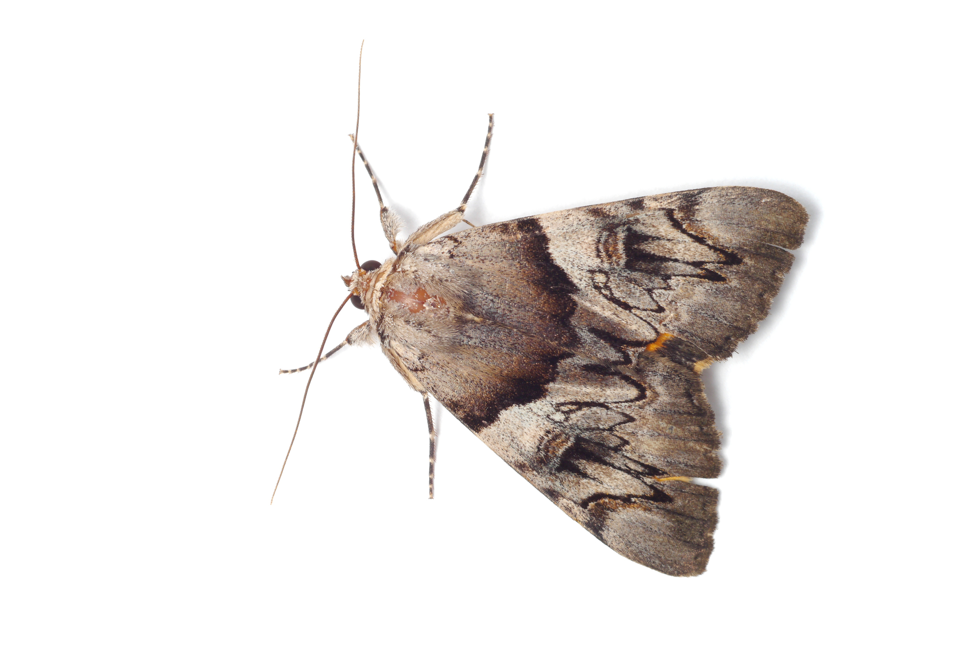
I am nocturnal.
I use my antennae to detect odour molecules.
I have a proboscis, for sucking up my food.
My silky pupa is called a cocoon.
Moth

Slide 8
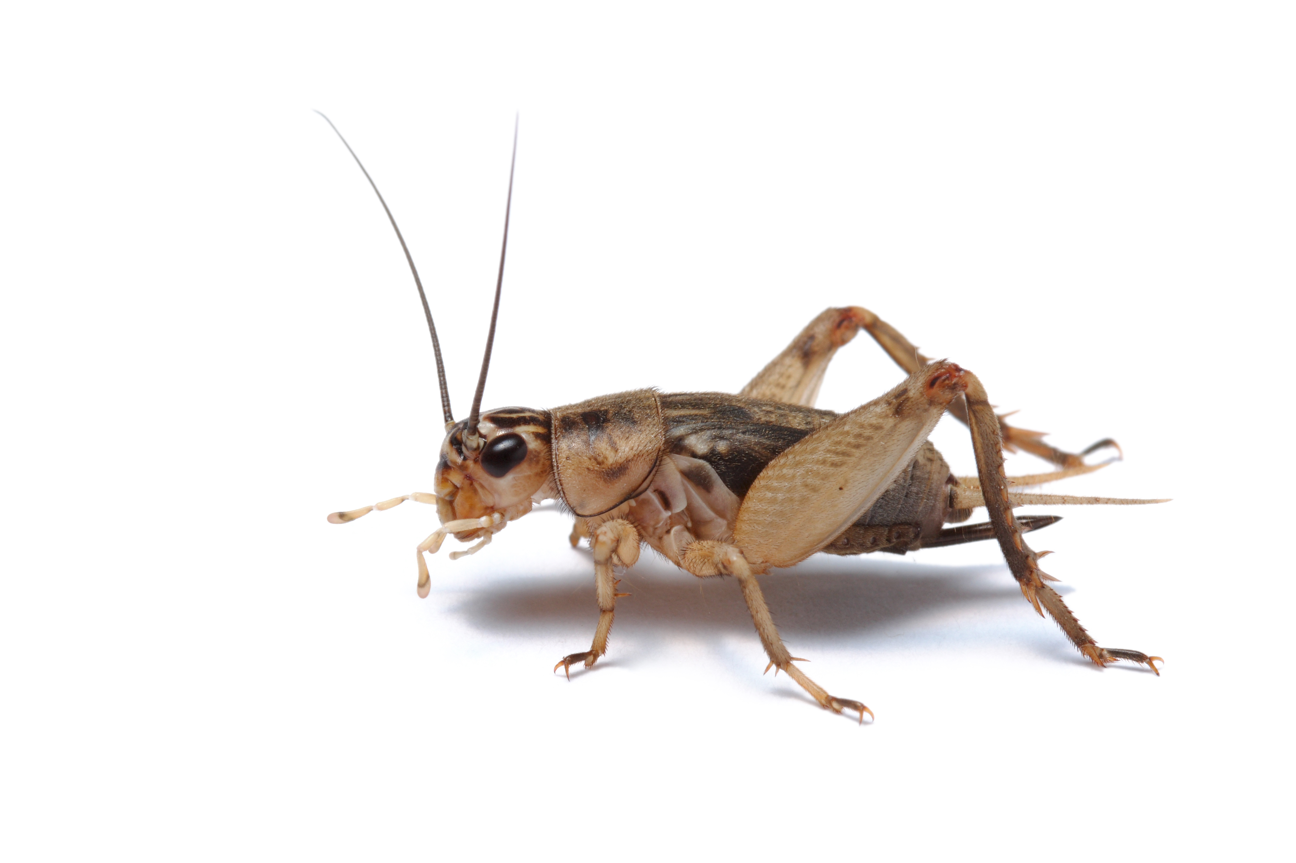
I have long antennae.
I make a chirping sound by rubbing my wings together.
The warmer it is, the faster I chirp.
My ears are in my front legs.
Cricket

Slide 9
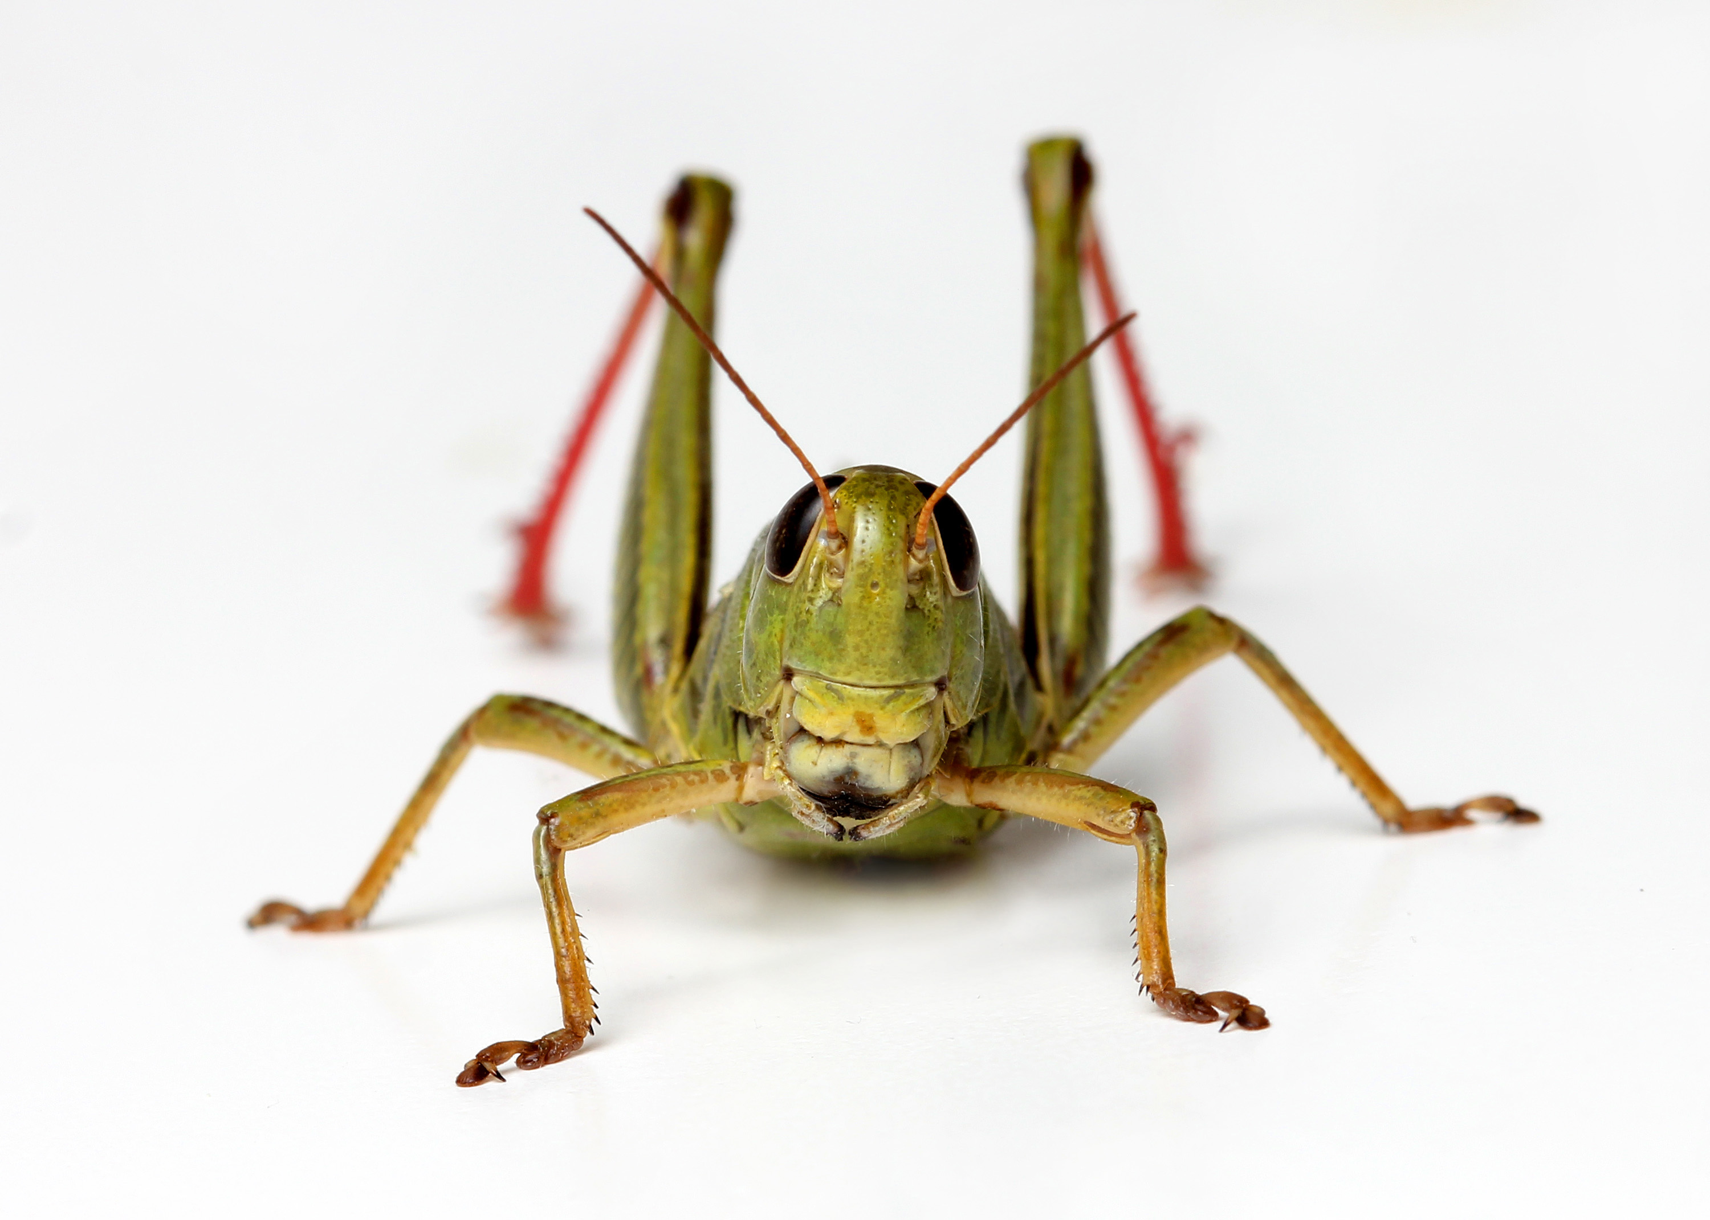
I have short antennae.
My ears are in my bottom.
I sing by rubbing my legs on my wings.
I have very strong legs that act like a catapult.
Grasshopper

Slide 10
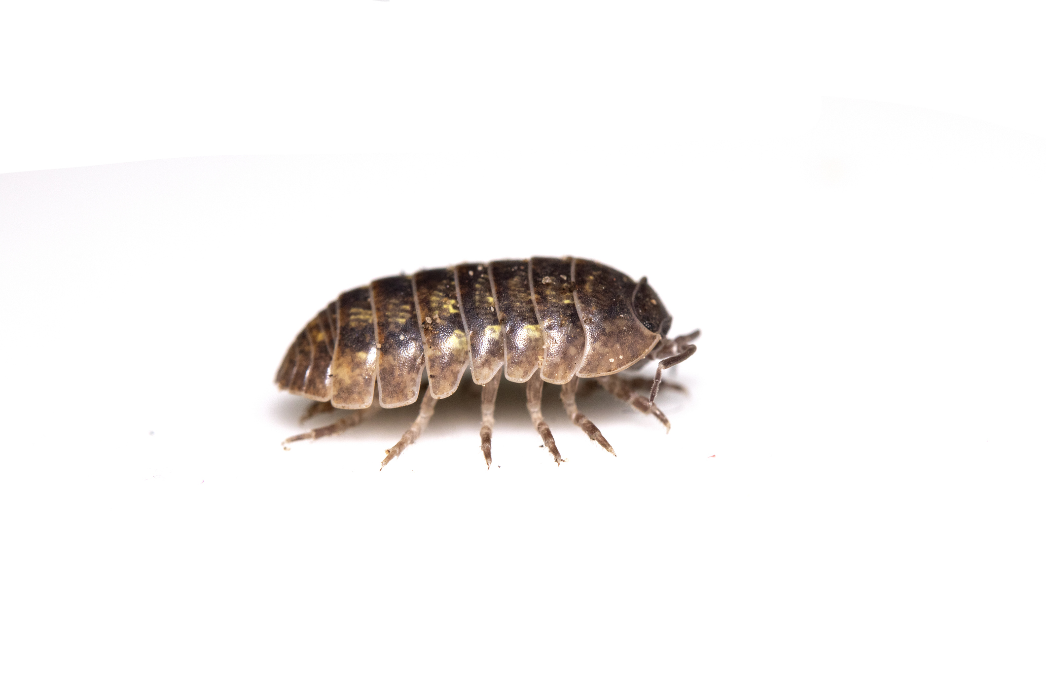
Females of my species can reproduce without a male.
I live in damp, dark places.
I am the only crustacean that lives on land.
I have seven pairs of legs.
Woodlouse

Slide 11
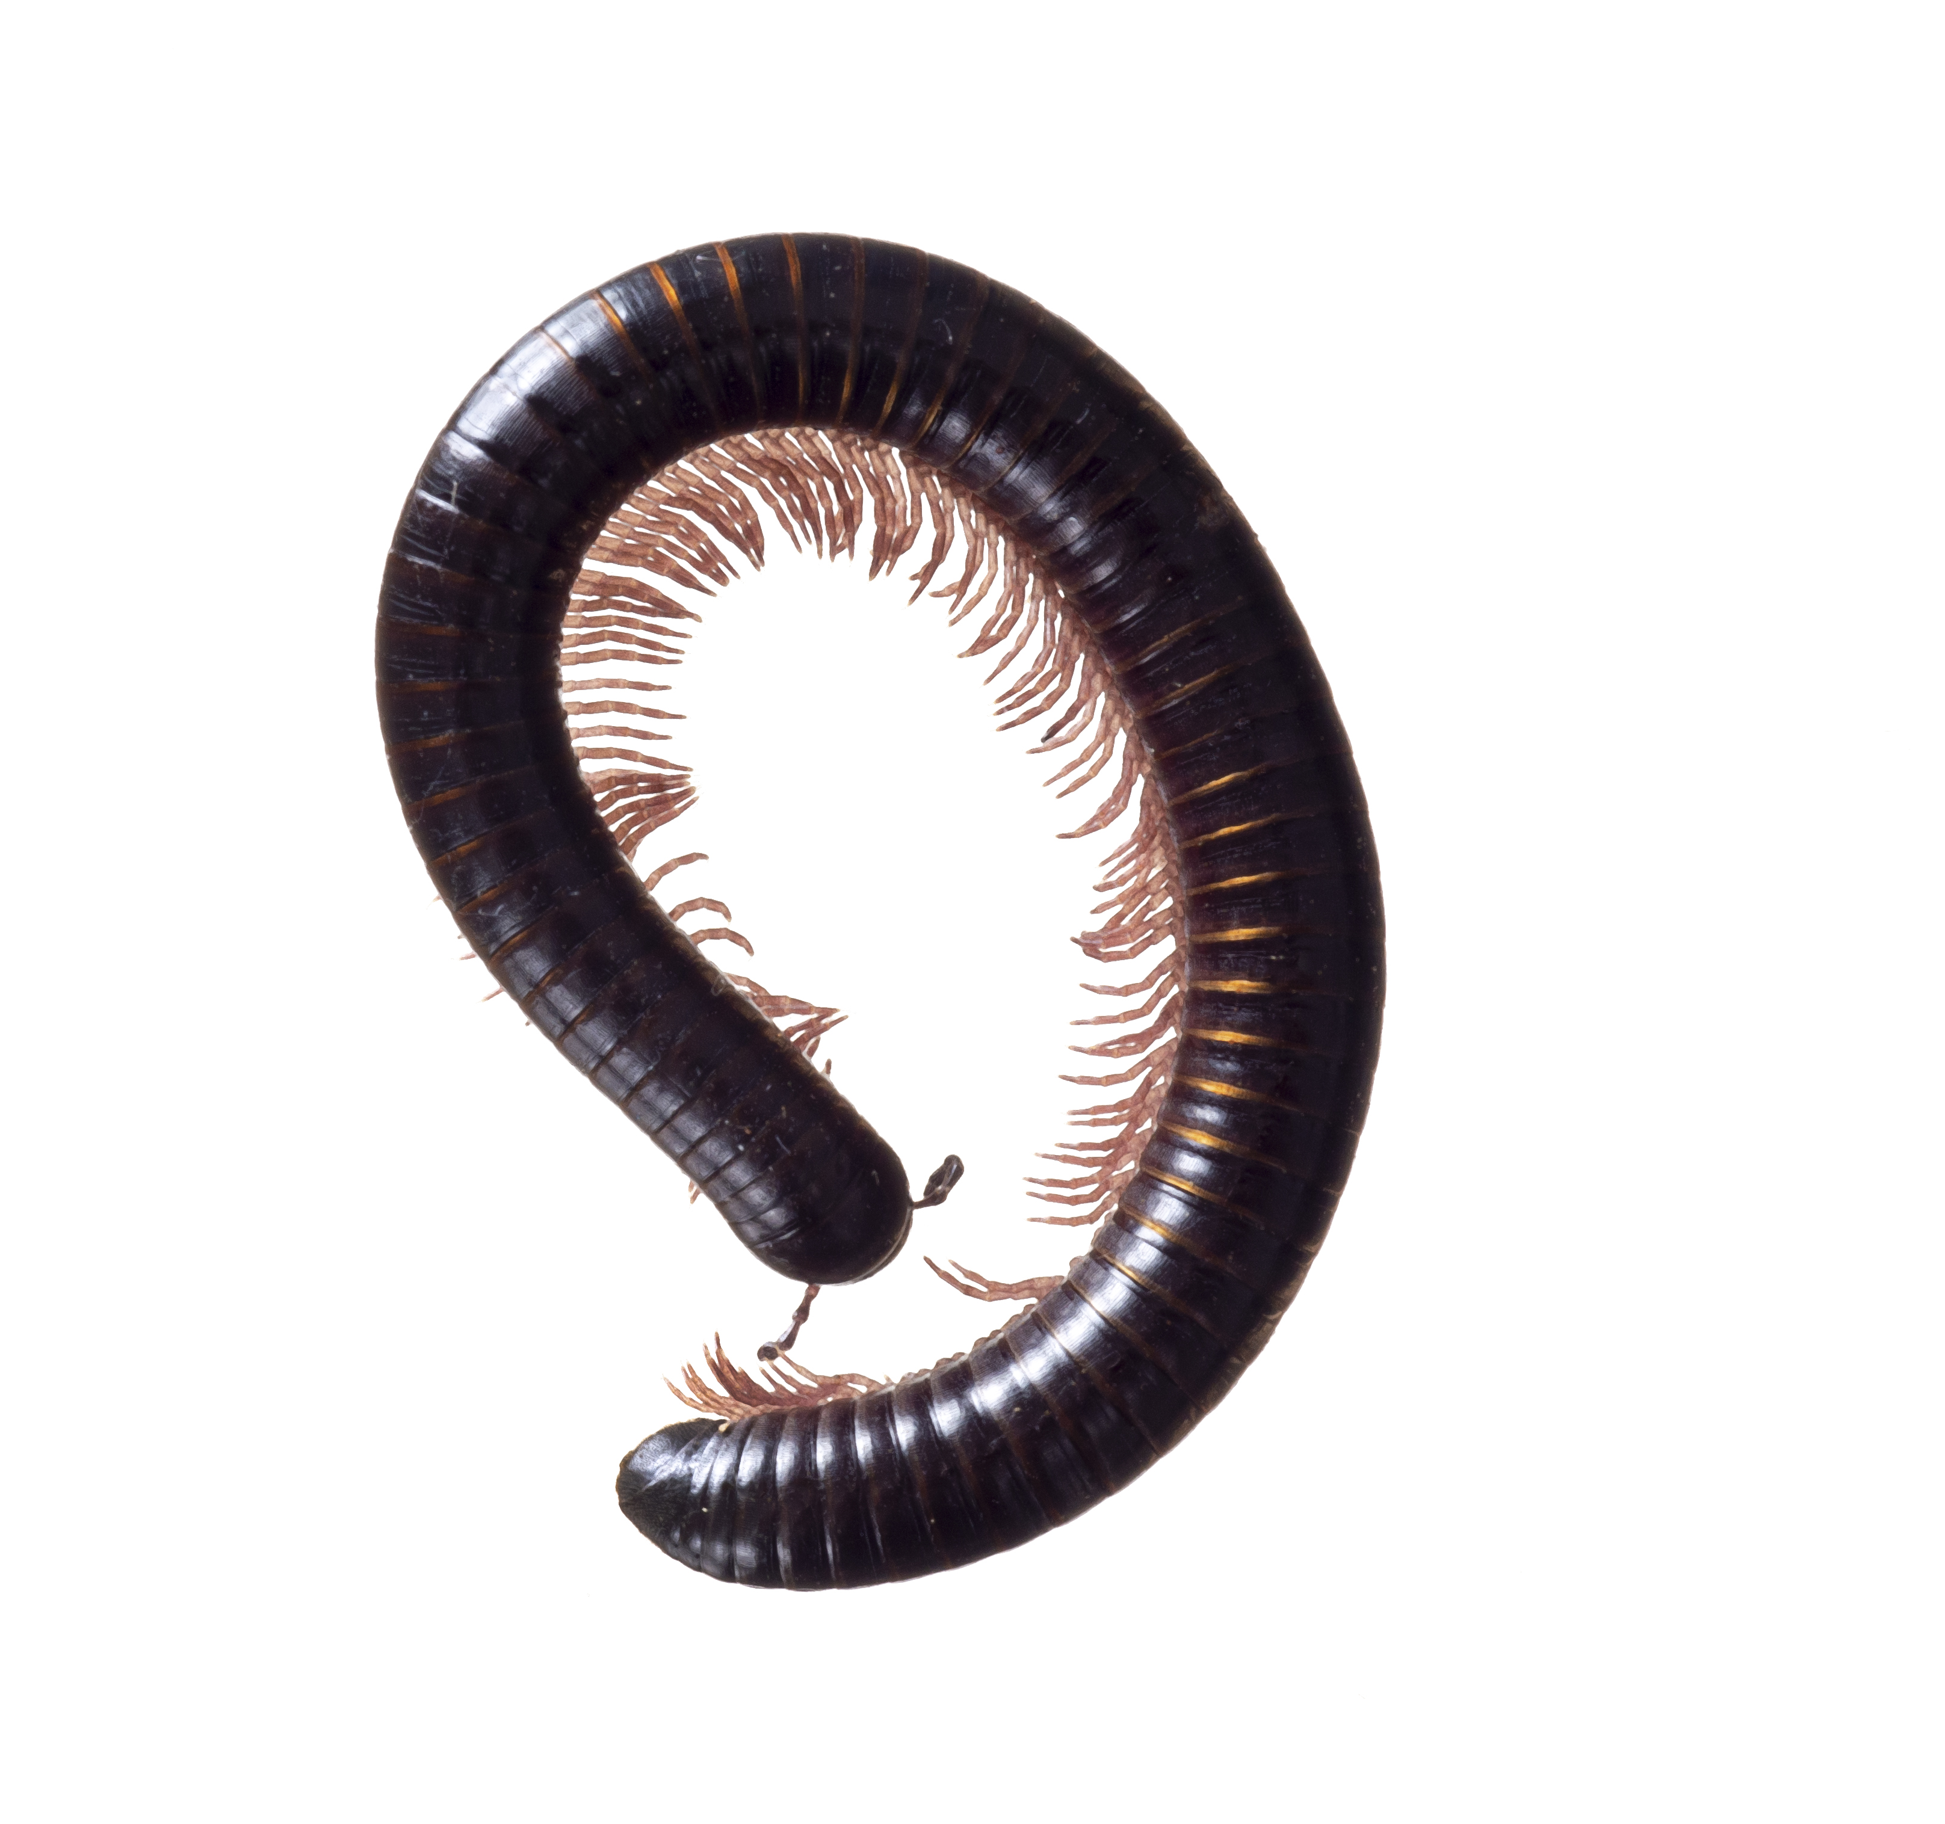
I have two pairs of legs on each body segment.
I move quite slowly, even though I have a lot of legs.
I eat decaying wood and vegetation.
I don’t have as many legs as my name suggests!
Millipede

Slide 12
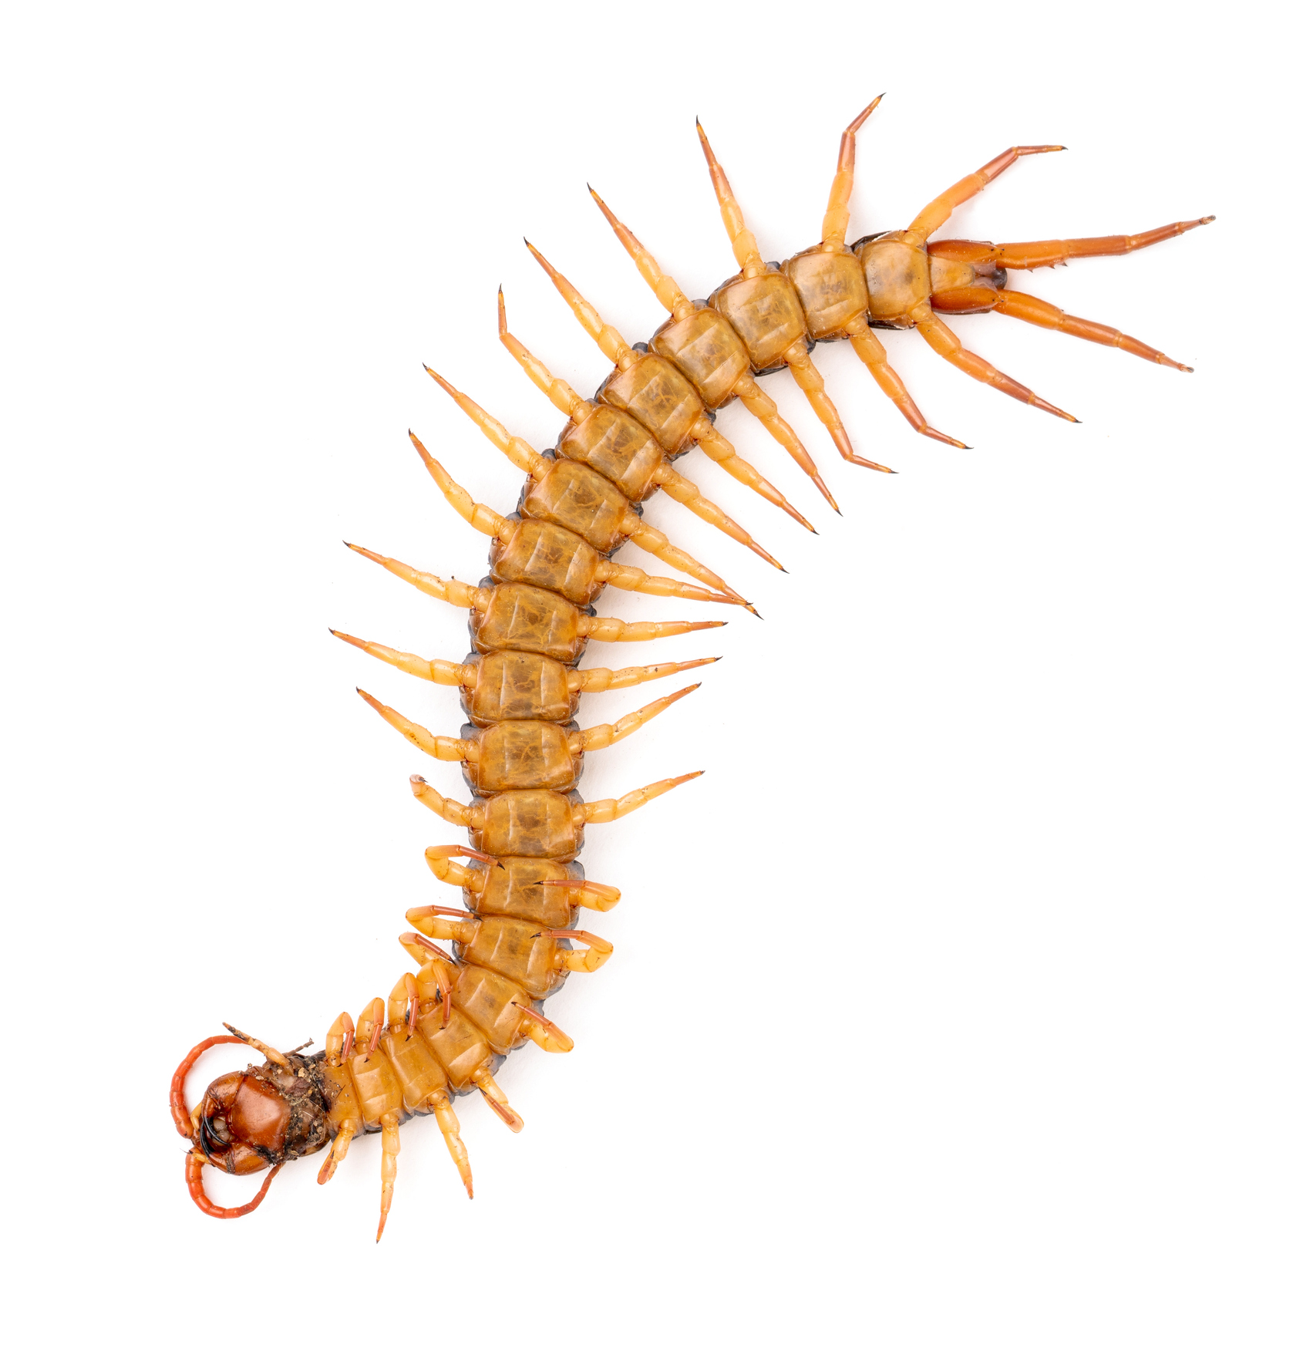
I can move backwards as quickly as I can move forwards.
I have one pair of legs on each body segment.
I use all my legs to move quickly.
I paralyse my prey with venom before I eat it.
Centipede

Slide 13
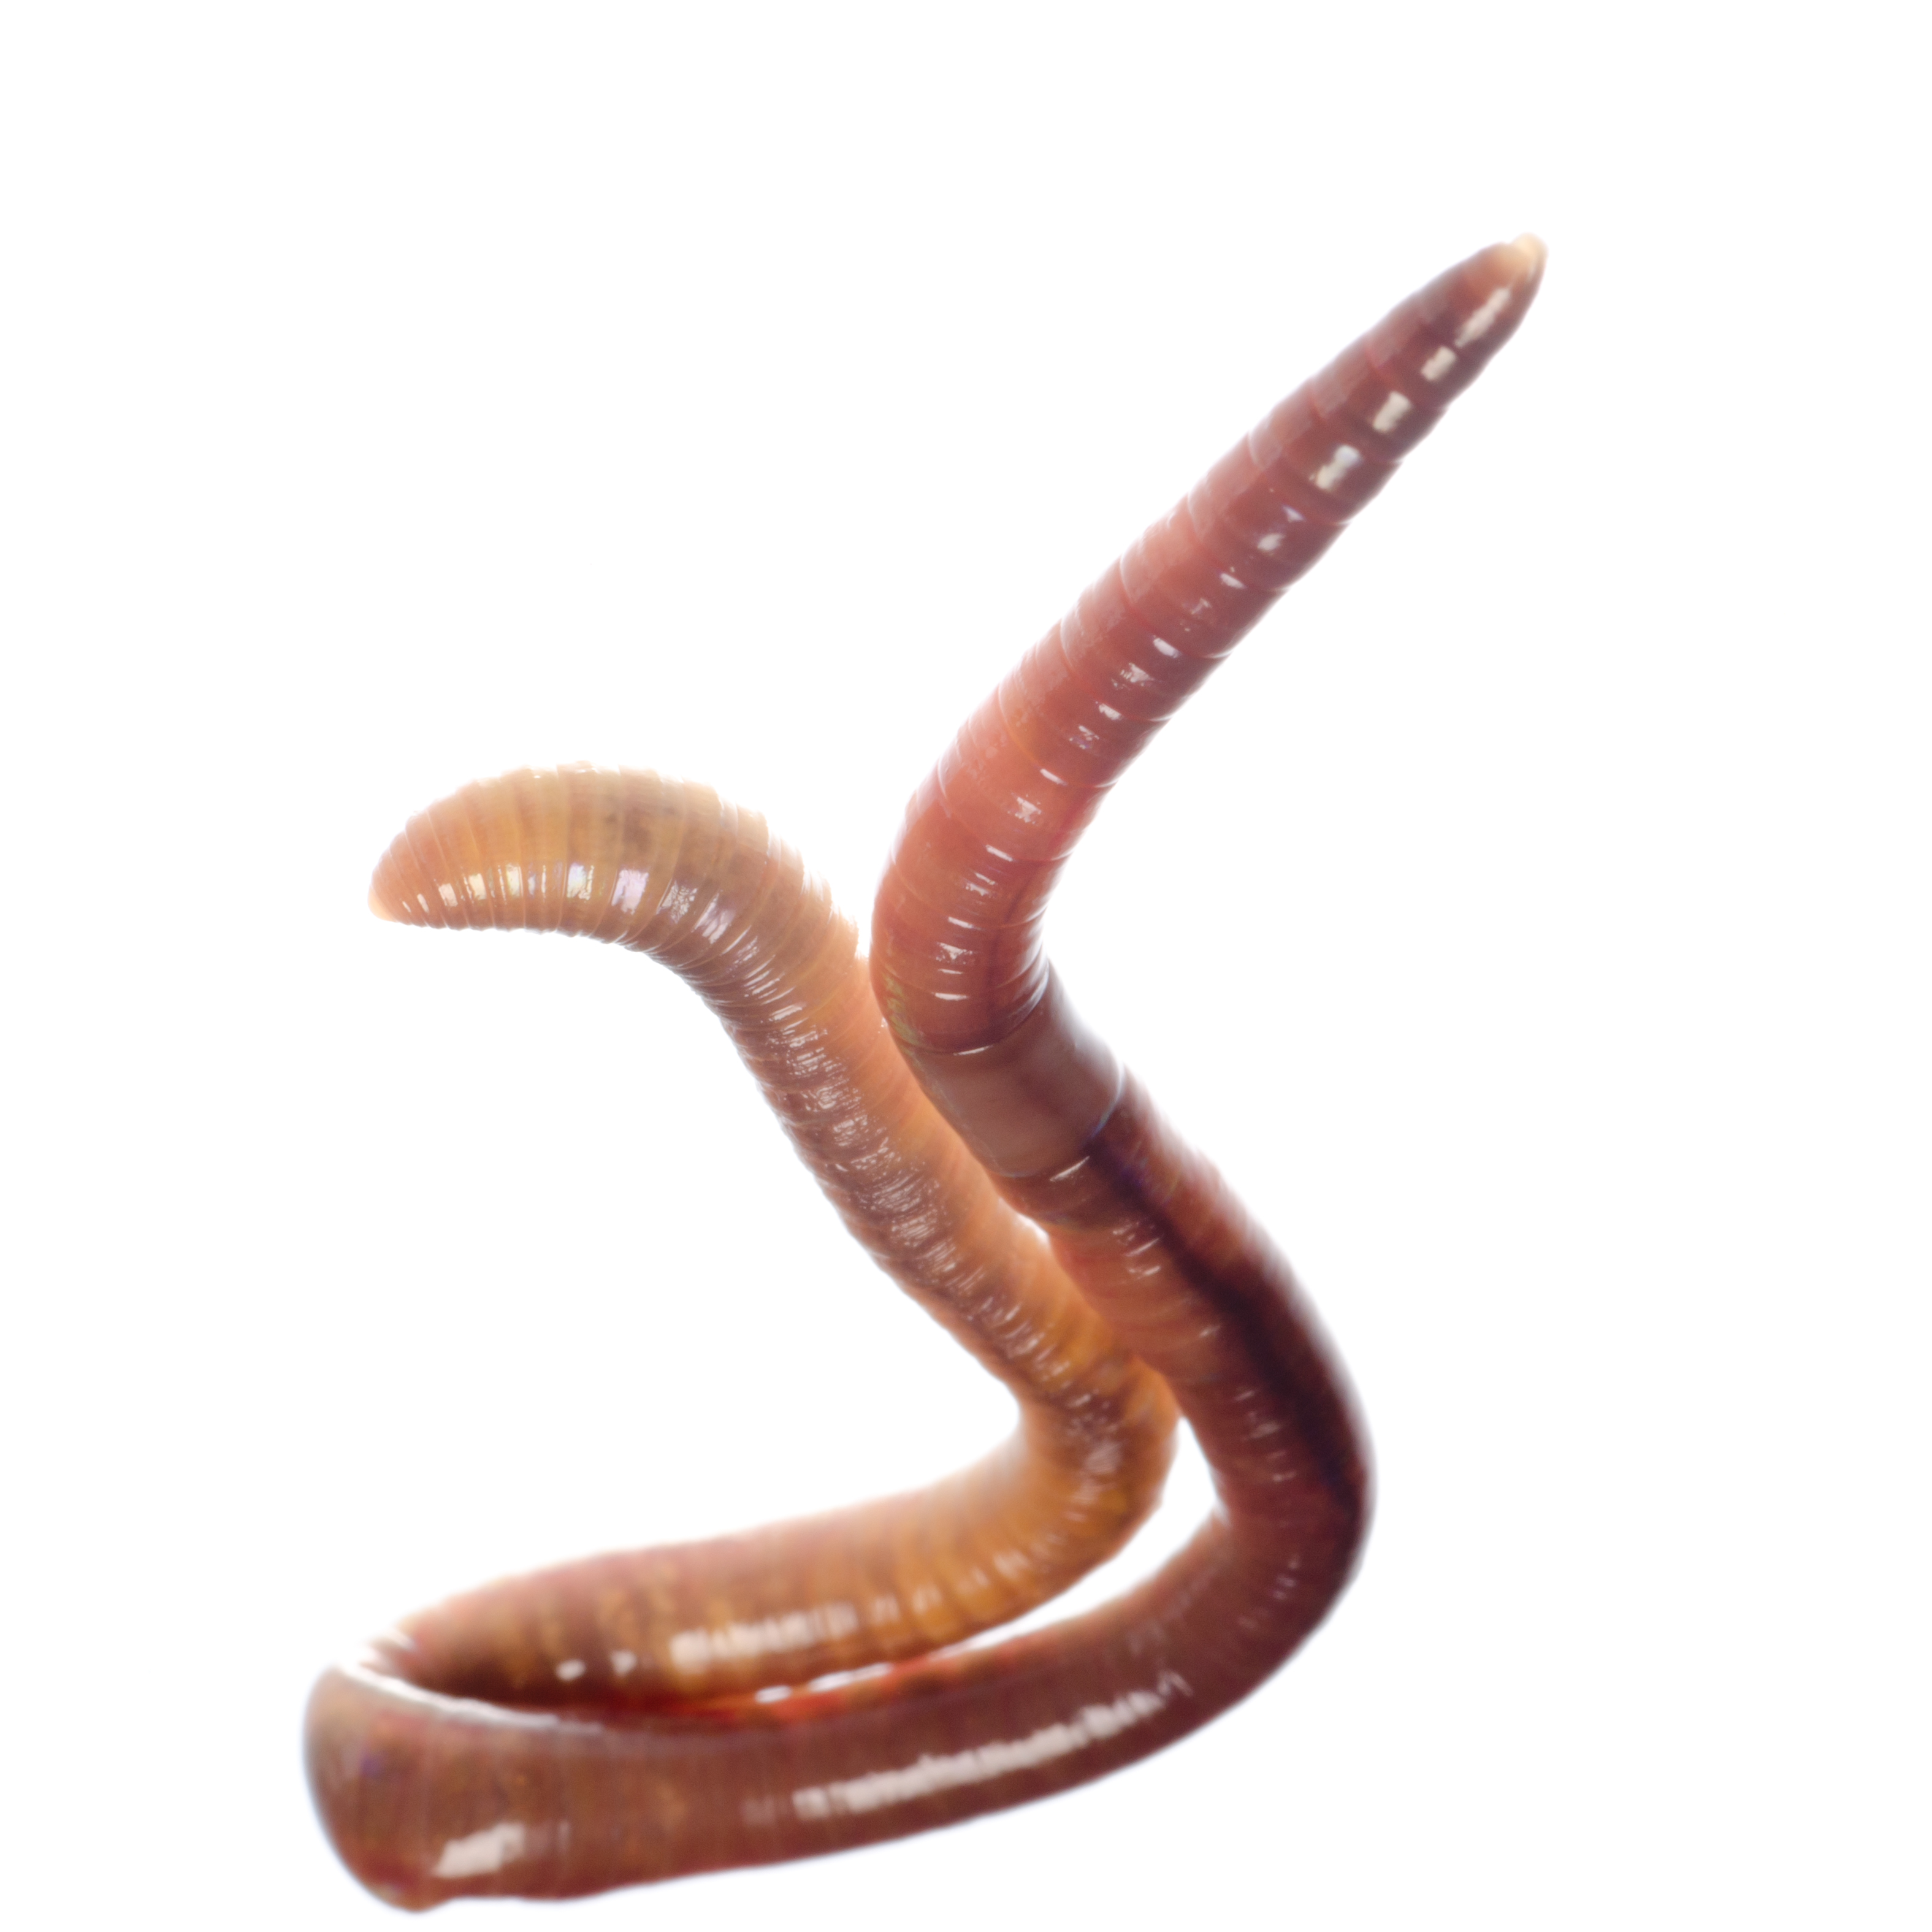
I am both male and female.
I aerate the soil.
My body is made up of segments.
If I am cut in half, the half with the saddle will survive.
Earthworm

Slide 14
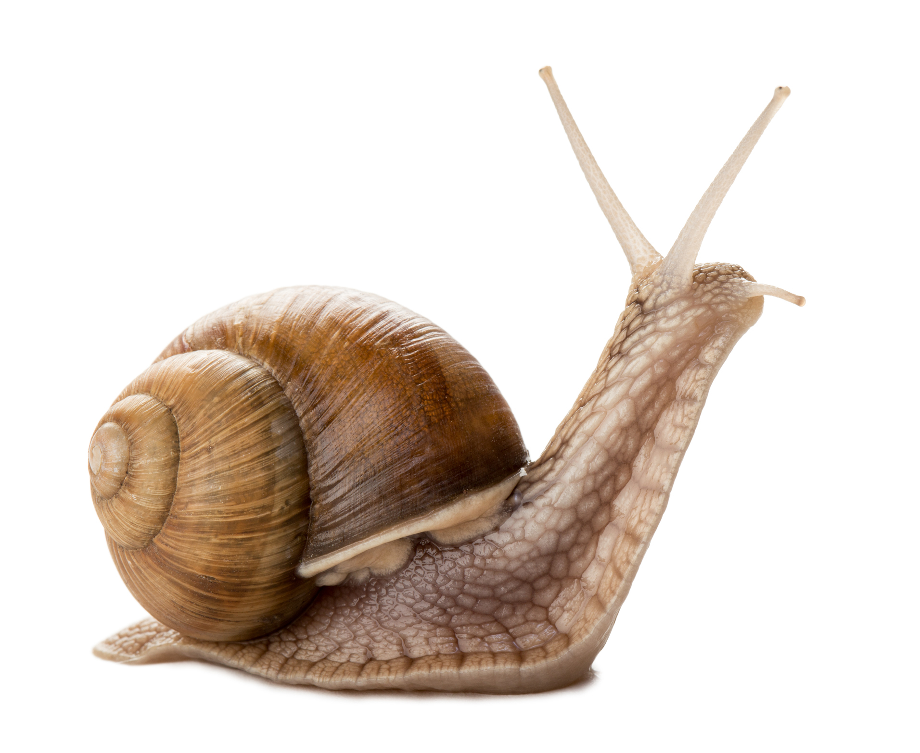
I have blueish blood.
I have a radula, a tongue-like structure covered in tiny teeth.
I secrete slime to help me move about.
I have a shell.
Snail

Slide 15
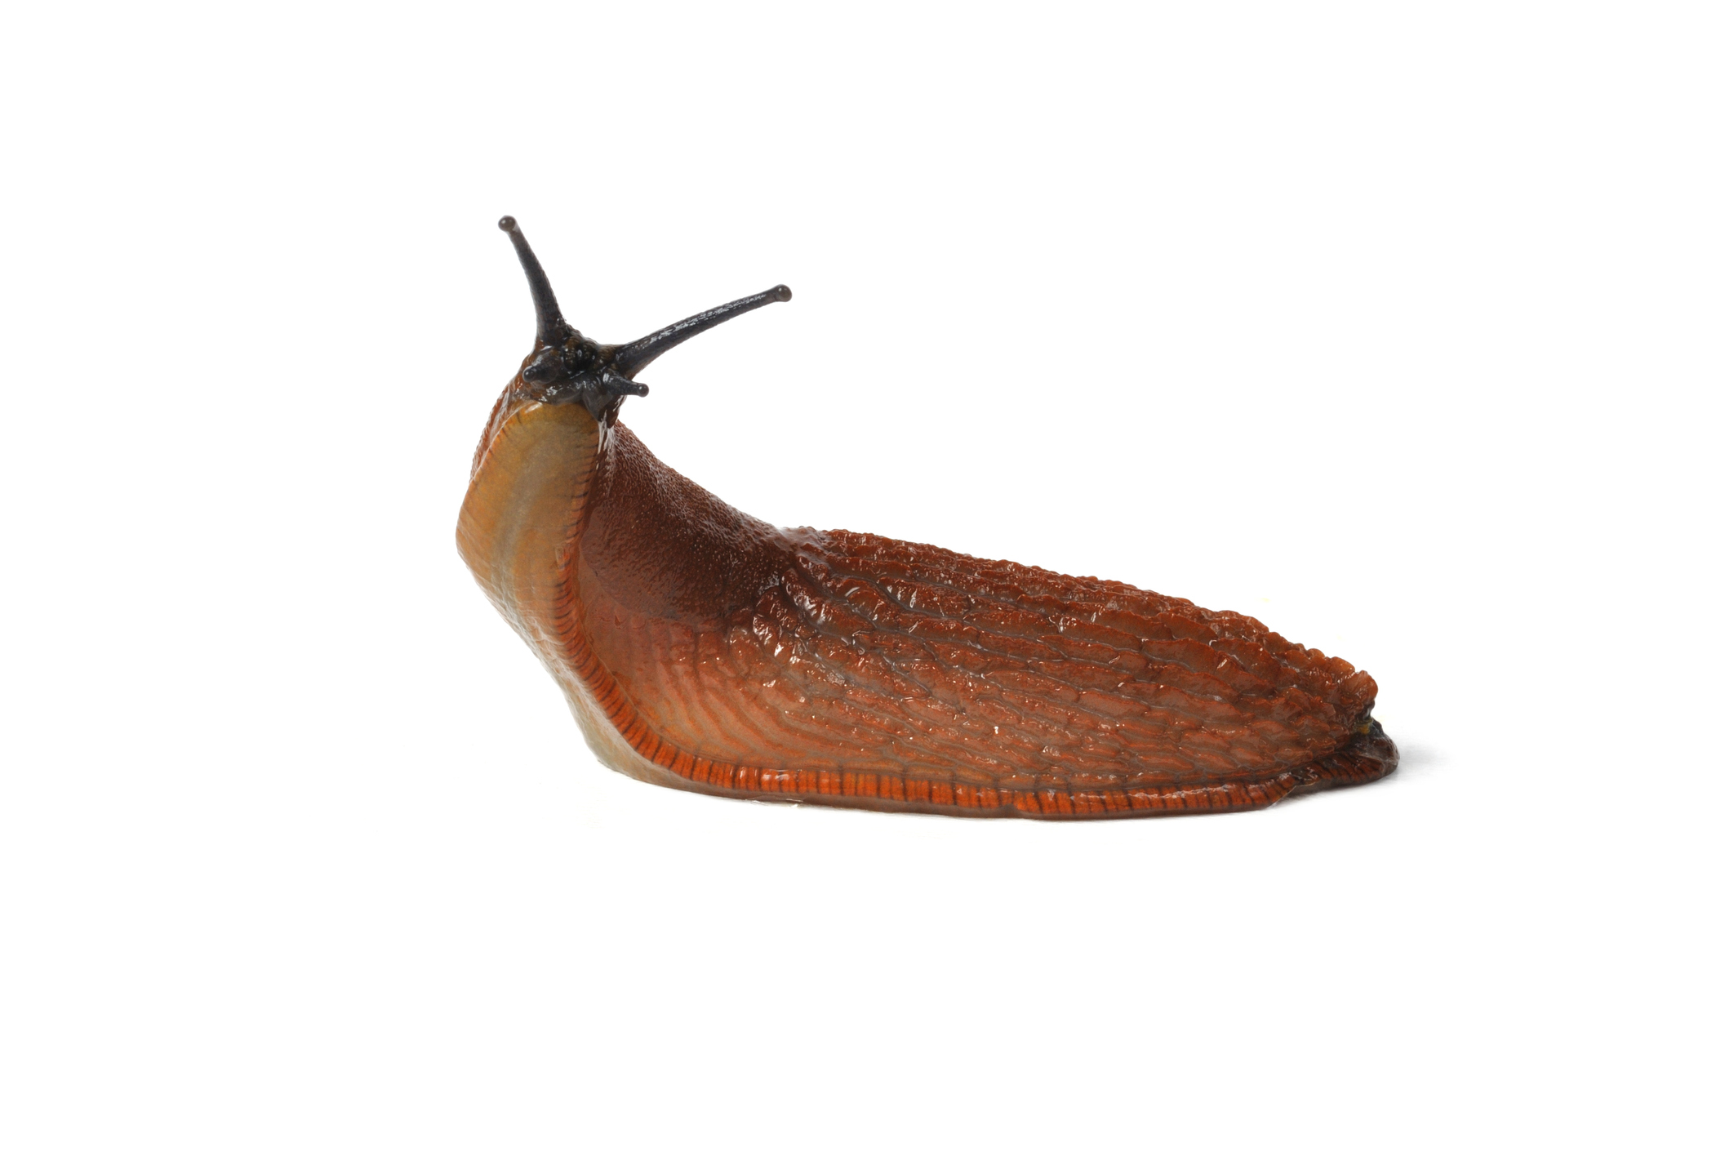
I have greenish blood.
I do not have a shell.
I have a radula, a tongue-like structure covered in tiny teeth.
I secrete slime to help me move about.
Slug

Slide 16
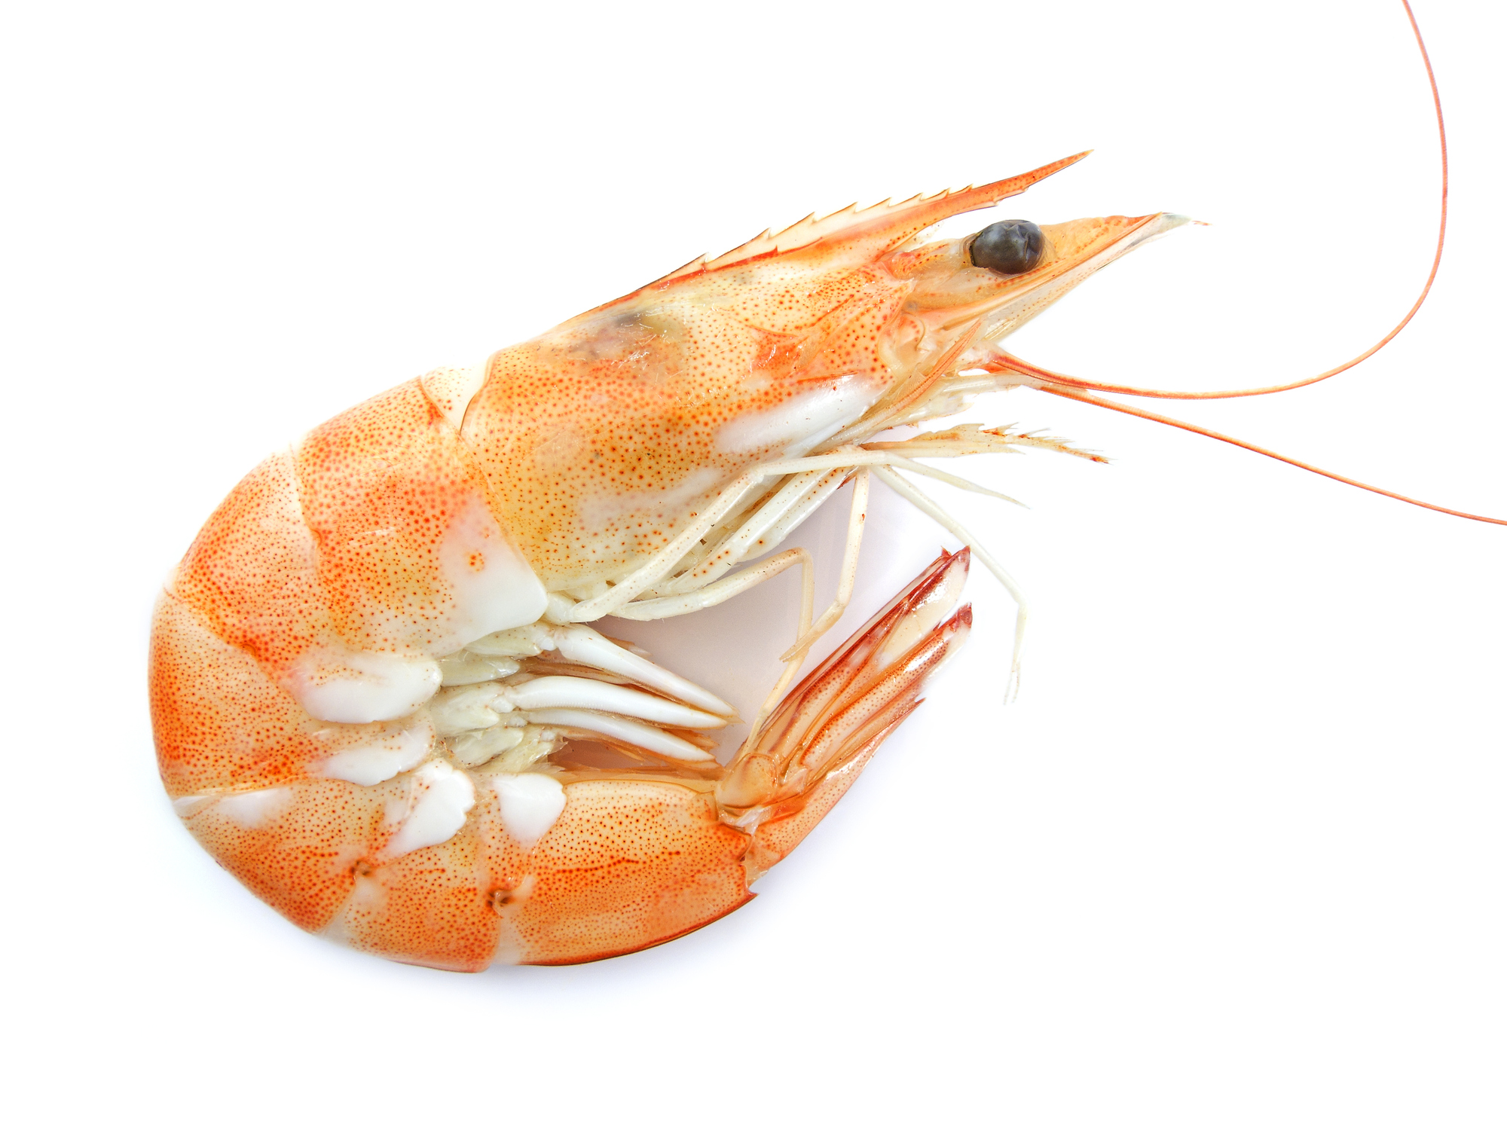
My eggs take between 3 and 10 weeks to develop.
I can change the brightness of my colour to fit in with my surroundings.
I swim backwards by flexing my abdomen and tail.
I have five pairs of legs for walking, five for swimming and three for eating!
Shrimp

Slide 17
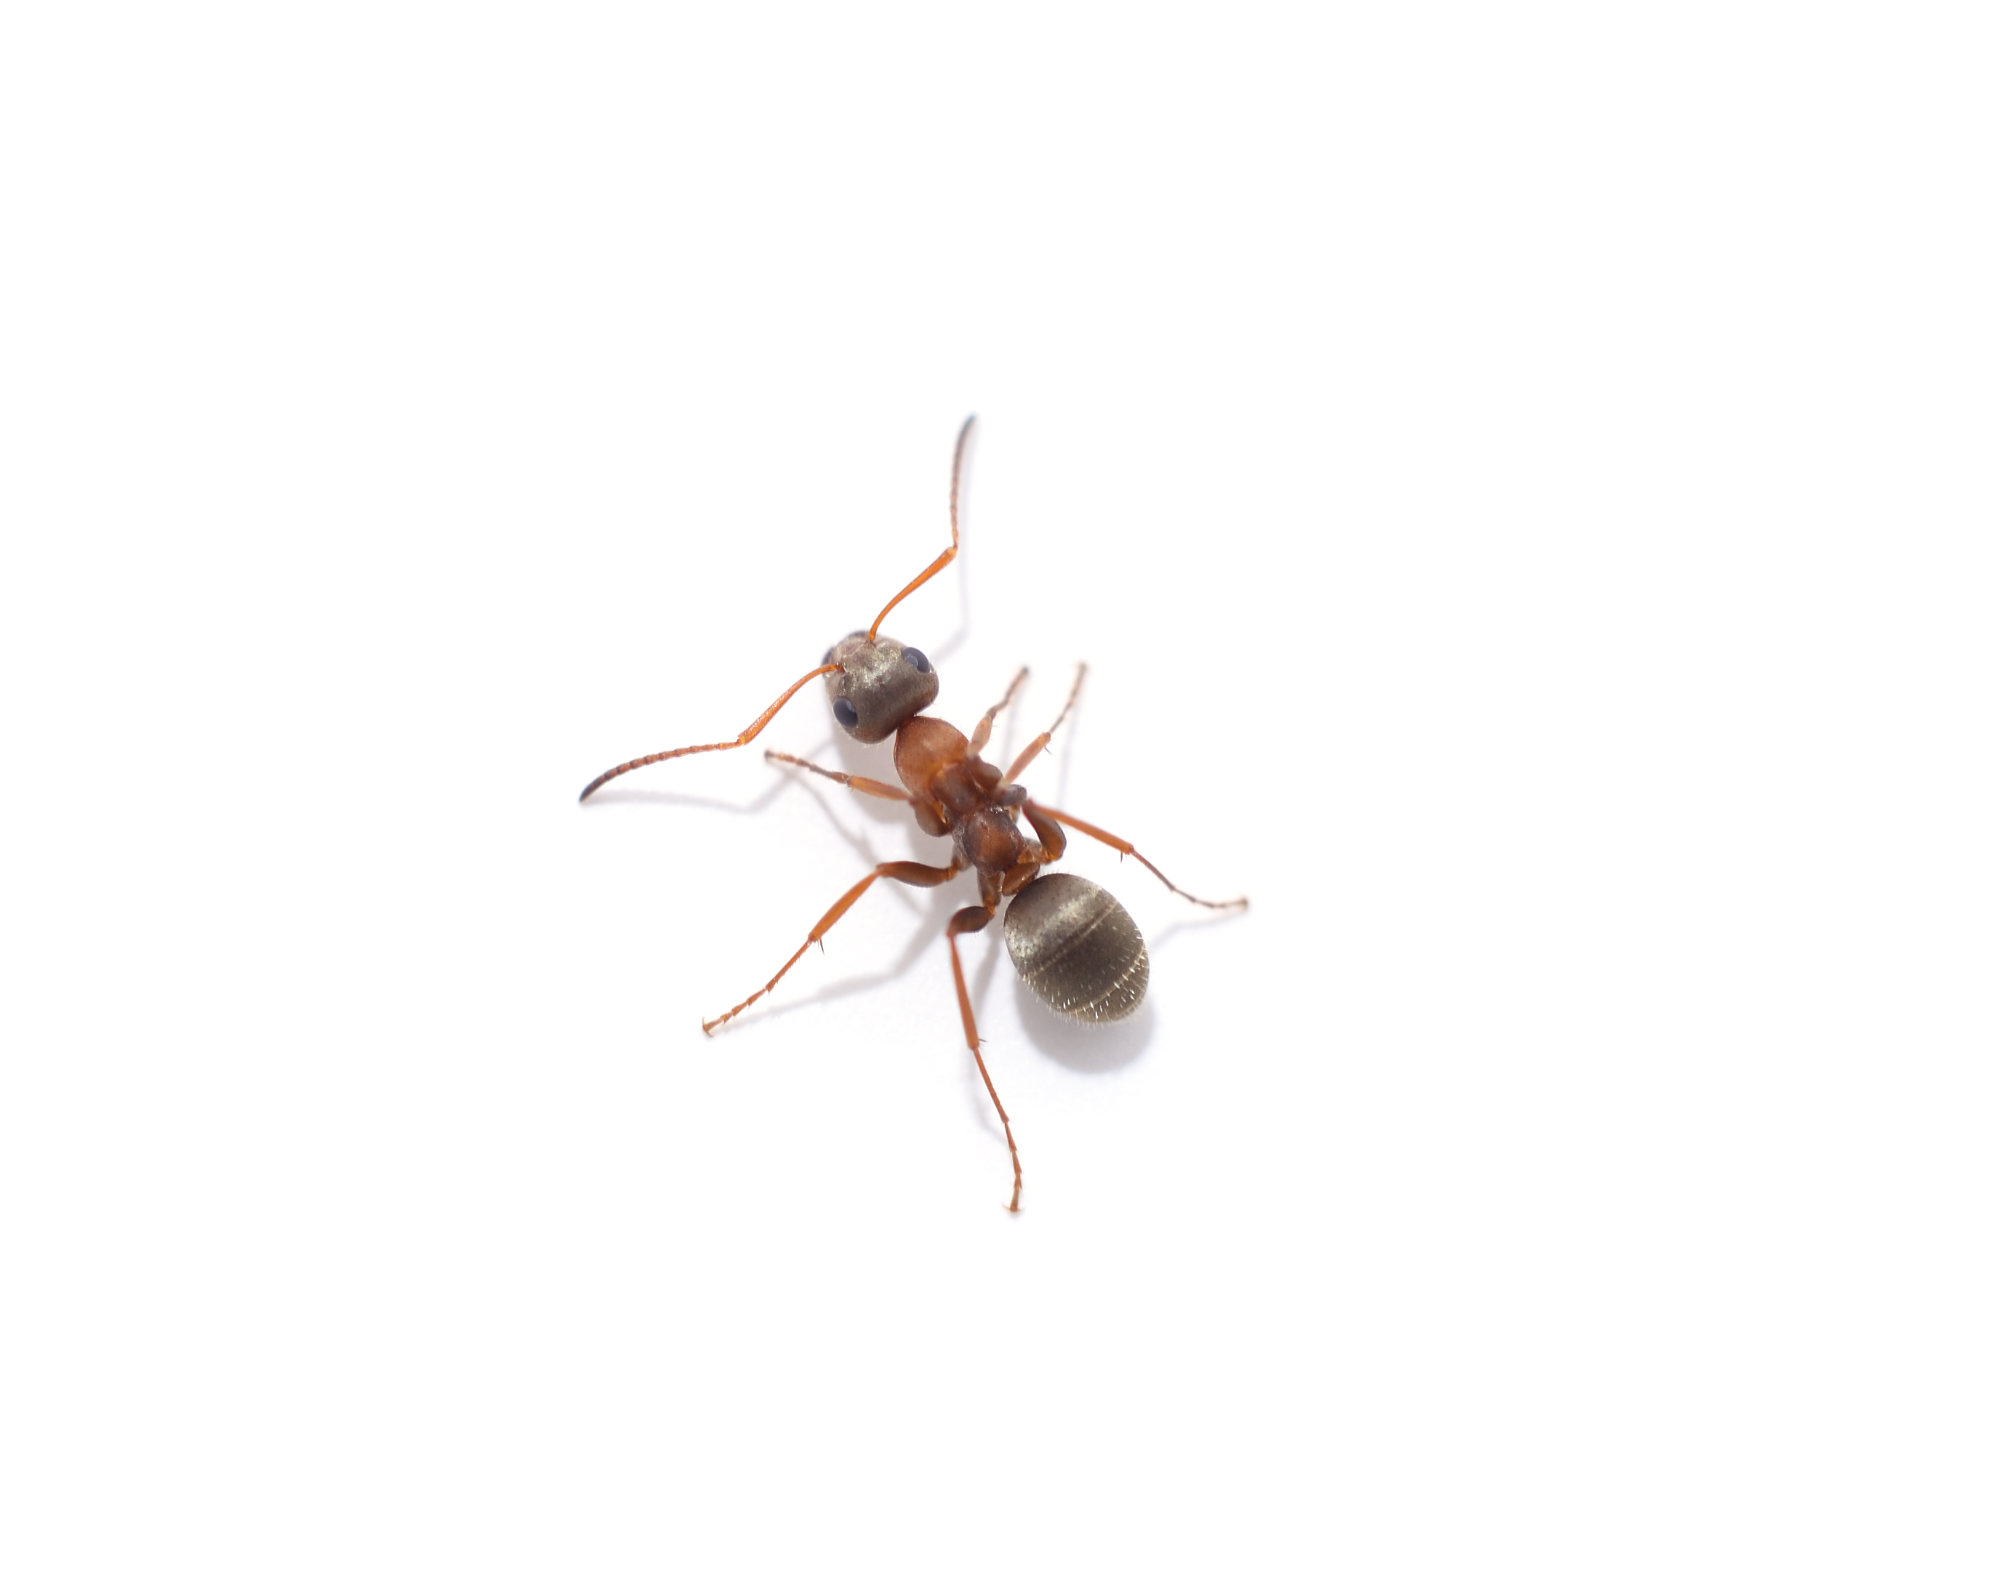
I have three main body parts.
I live in a colony with thousands of others.
I can lift things several times my own weight.
My colony has a queen.
Ant

Slide 18
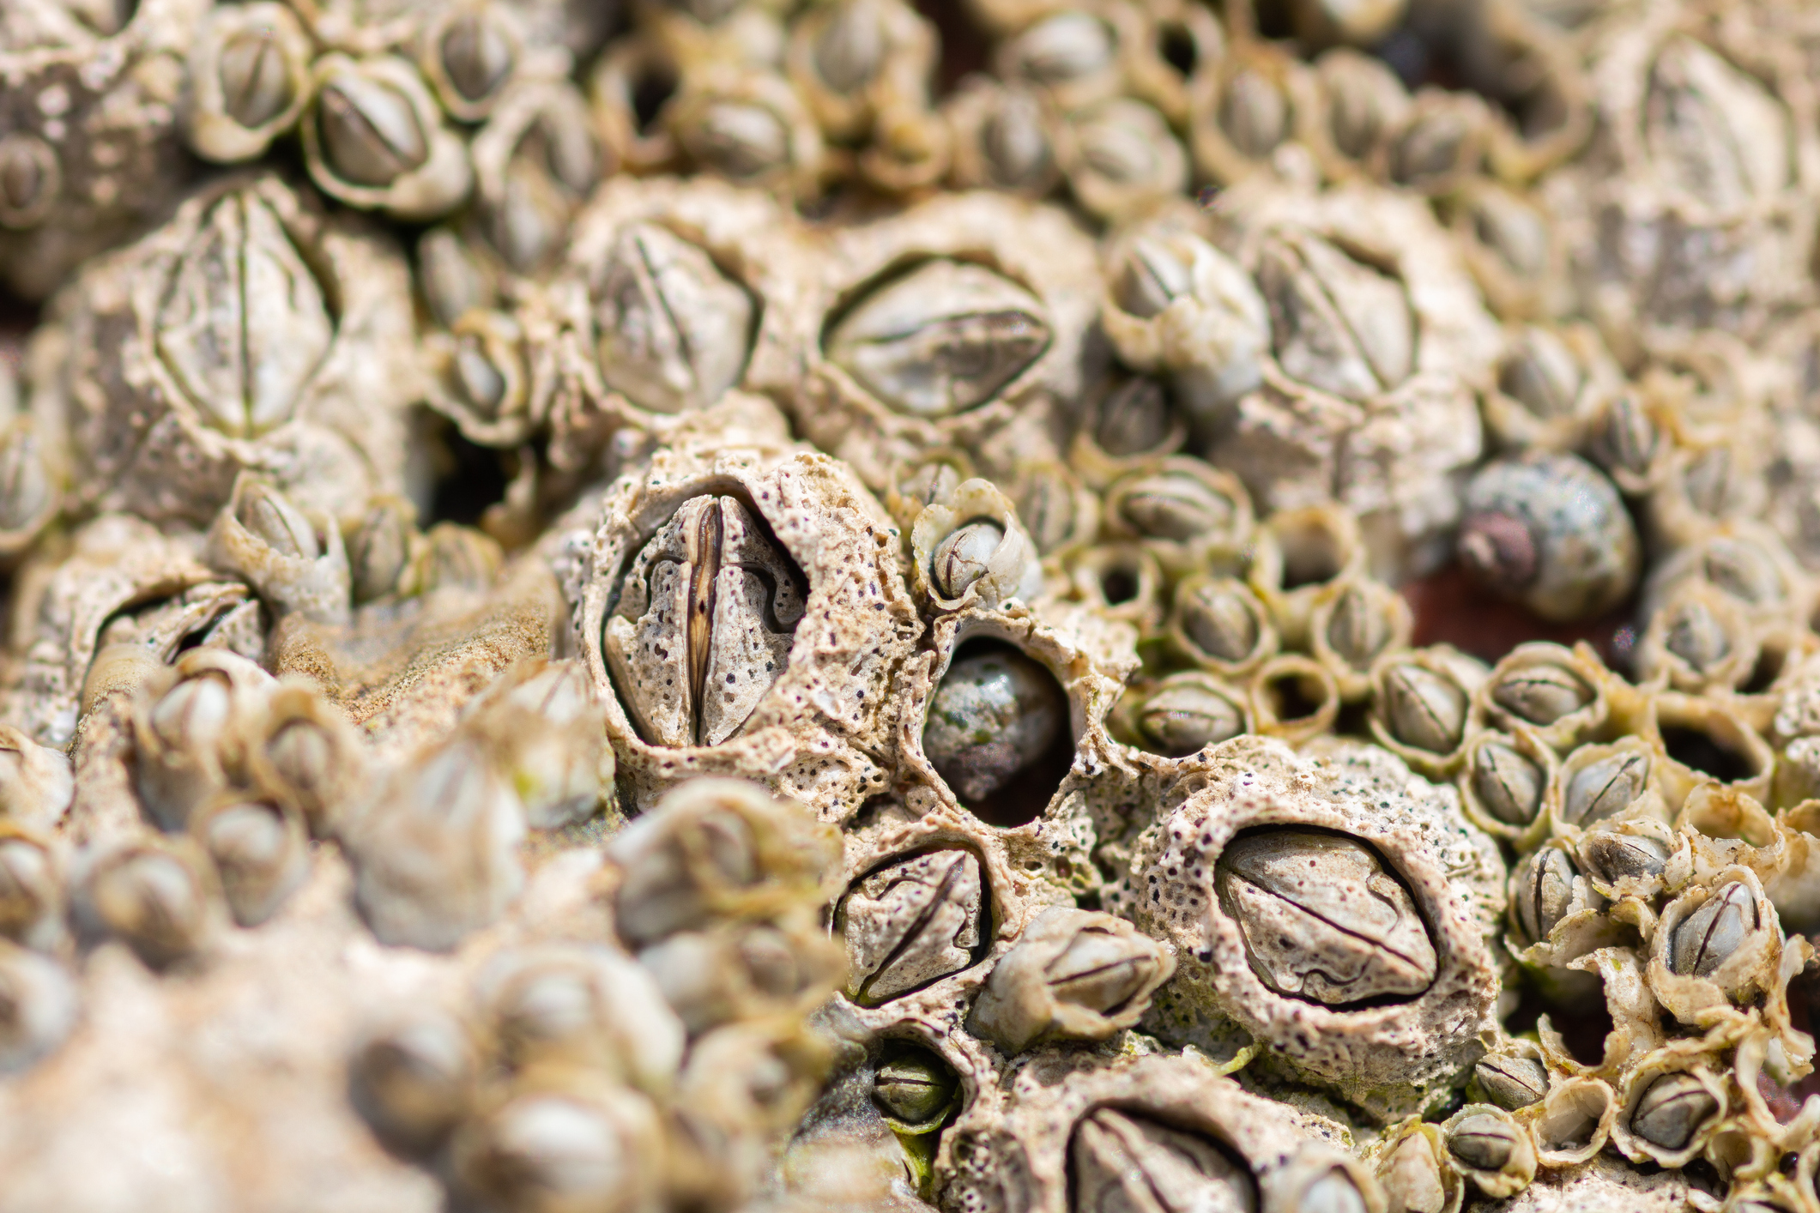
I undergo metamorphosis but I am not an insect.
My larvae has three pairs of legs, one pair of antennae and one eye.
I form a kind of cocoon, called a cypris.
I cling on to rocks.
Barnacle

Slide 19
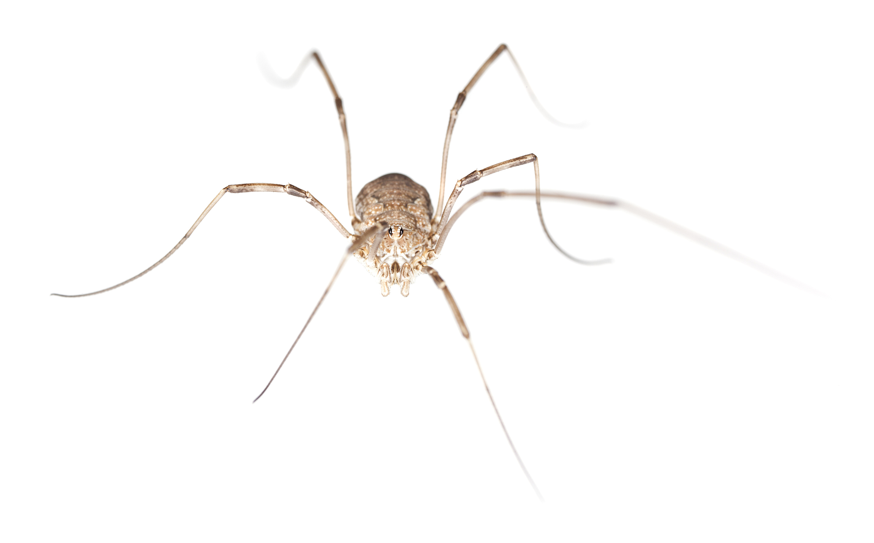
My larvae live underground and eat plant roots.
I have three body segments and four pairs of legs.
I am often mistaken for a spider.
I do not spin webs.
Daddy Long Legs (Harvestman)

Slide 20
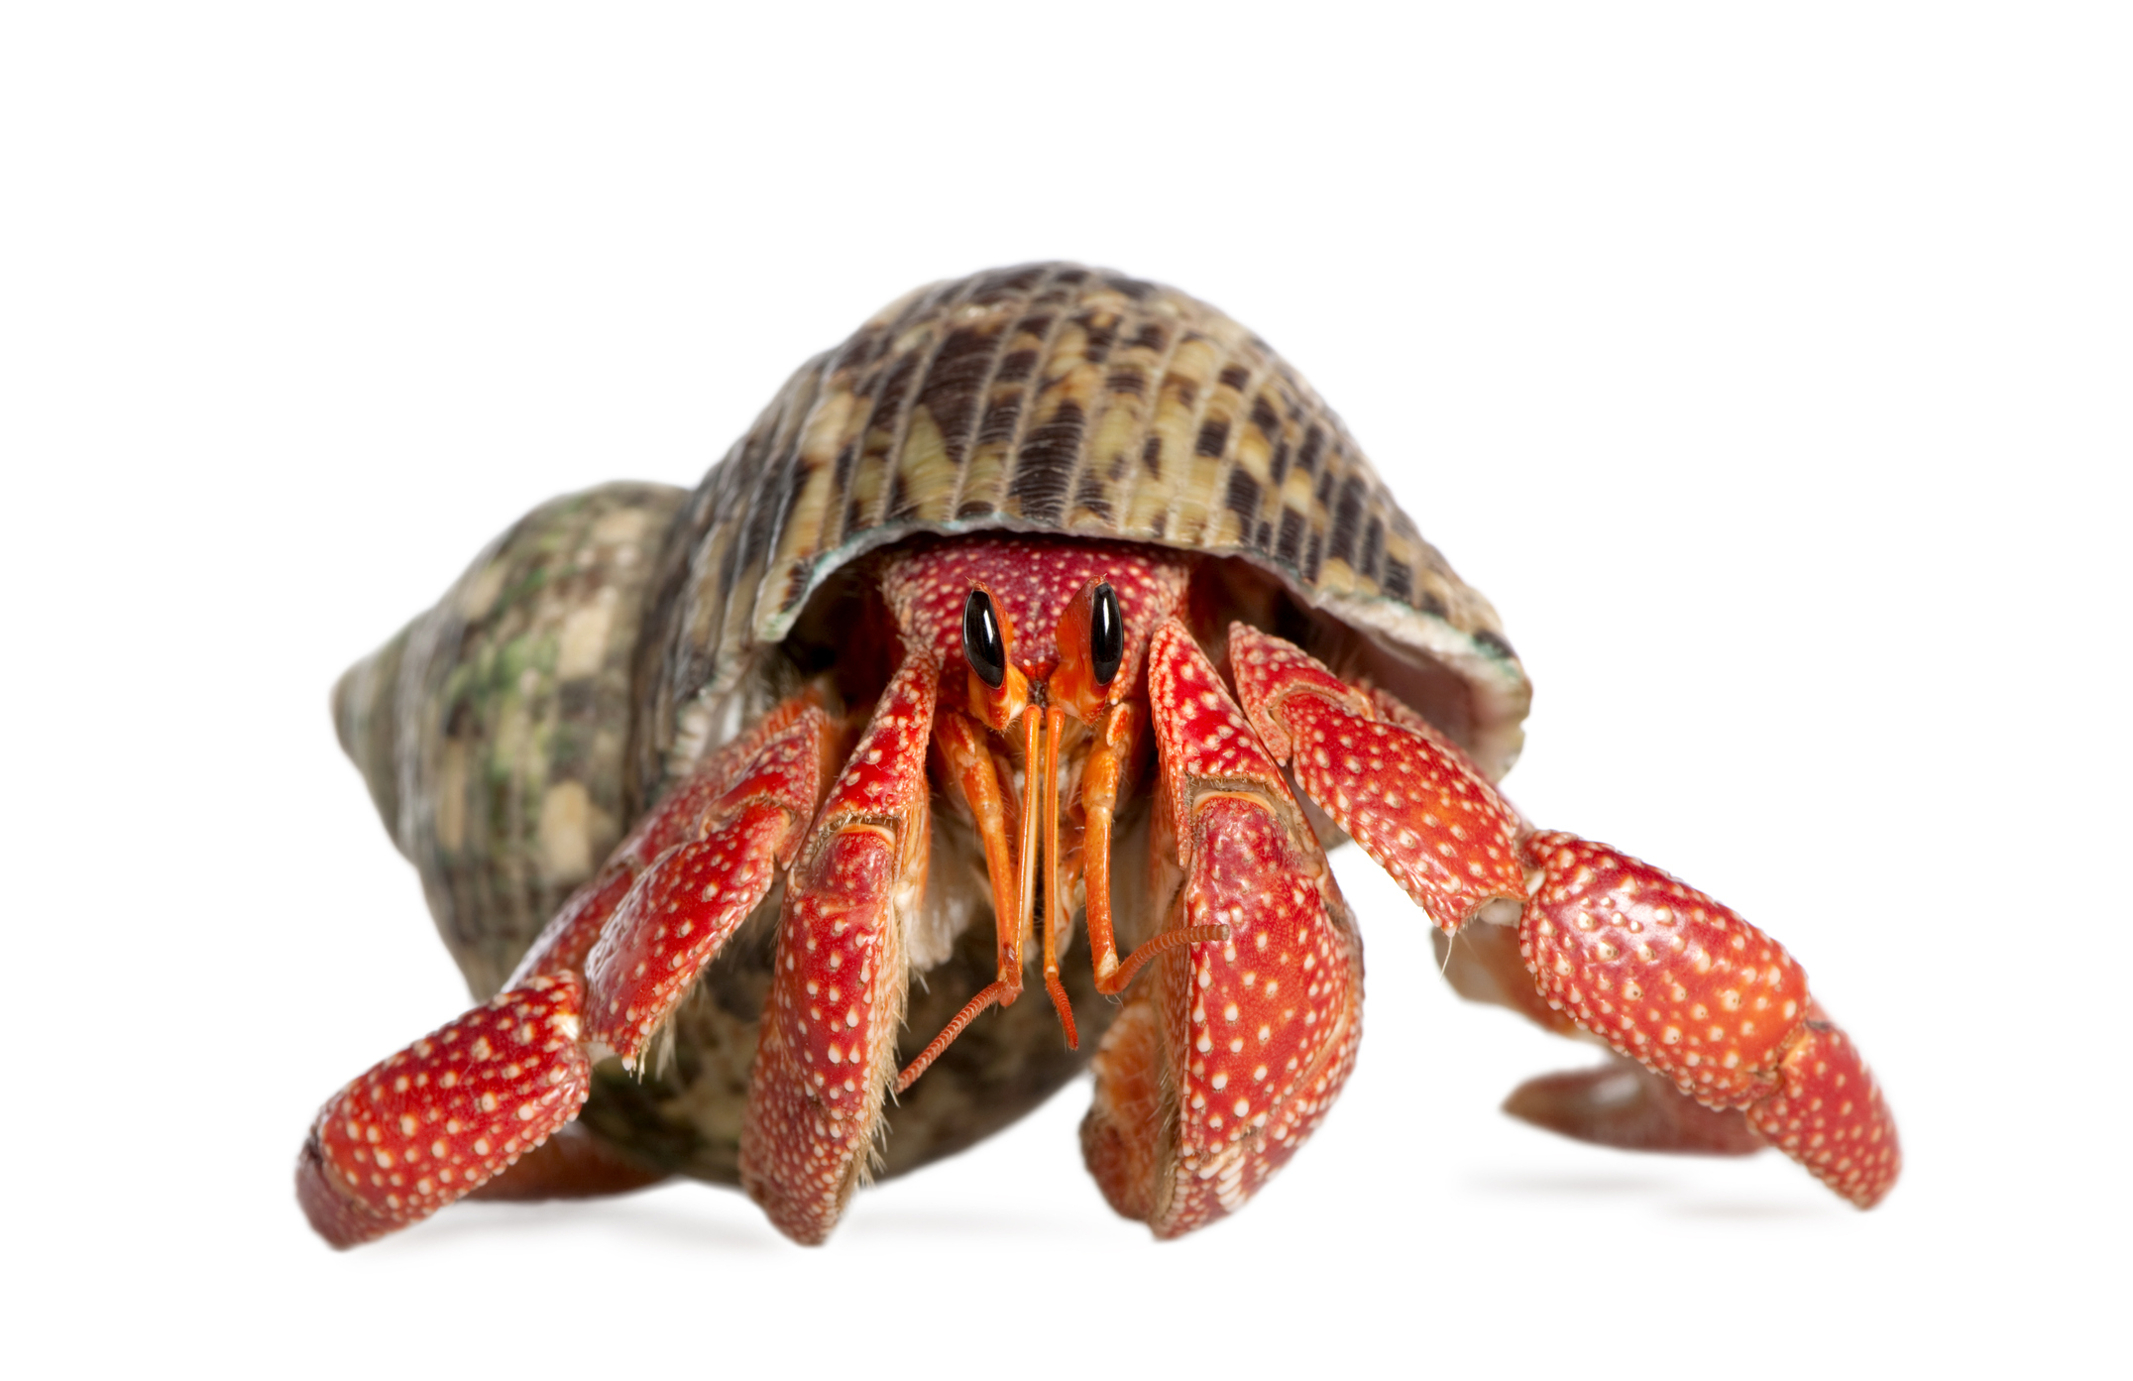
When I grow out of my shell, I have to find a new one.
If I meet another of my species, I might try to steal their shell!
My tail has a hook on the end, to hold on to my shell.
I need a shell but I don’t grow my own; I use empty shells from other animals.
Hermit Crab

Slide 21
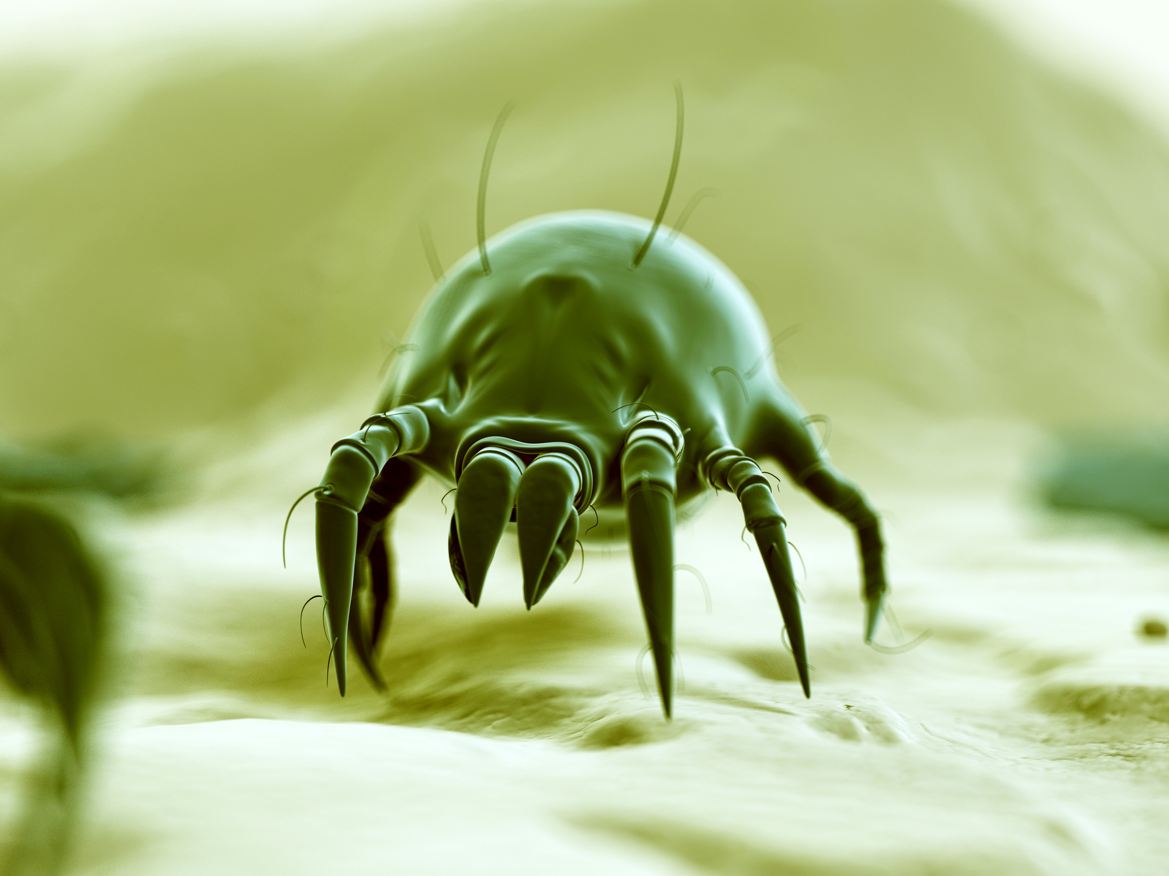
Lots of people are allergic to me.
I eat my own droppings.
I eat dead skin cells.
I am microscopic.
House Dust Mite

Slide 22
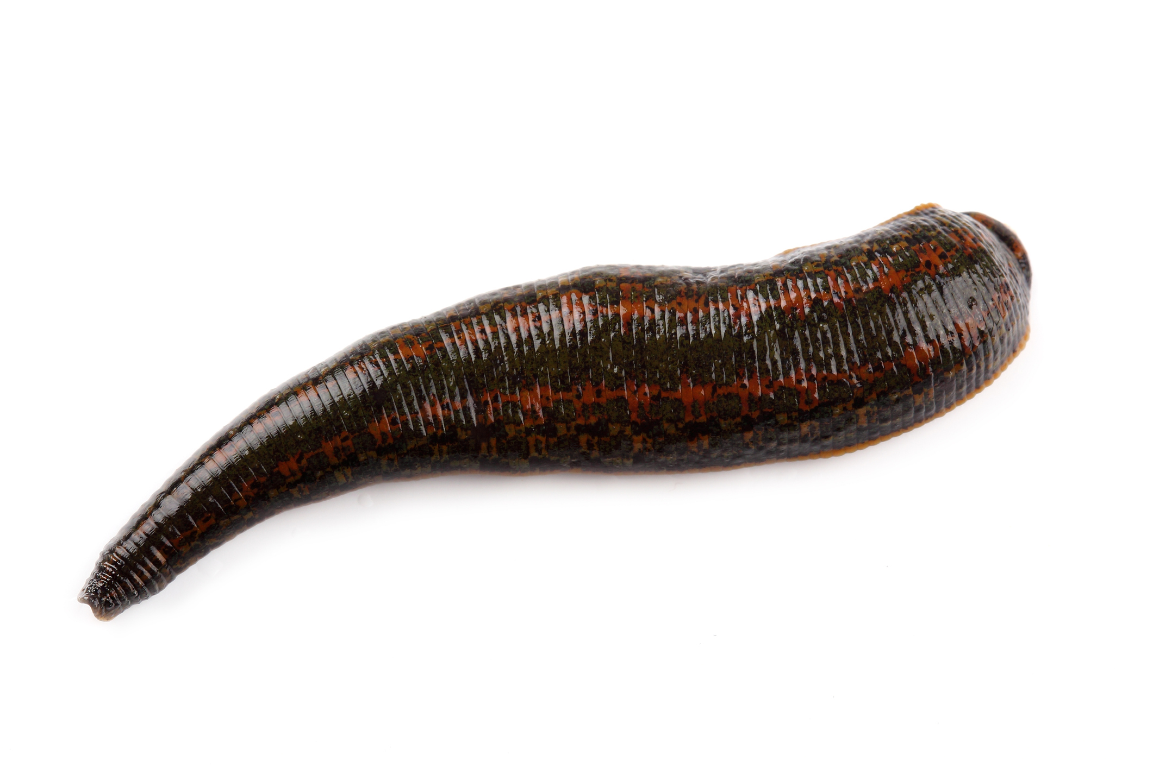
I live in water.
I am an annelid.
I have been used in medicine for thousands of years.
I am used in surgery because an enzyme in my saliva helps blood to flow and skin to heal.
Leech

Slide 23
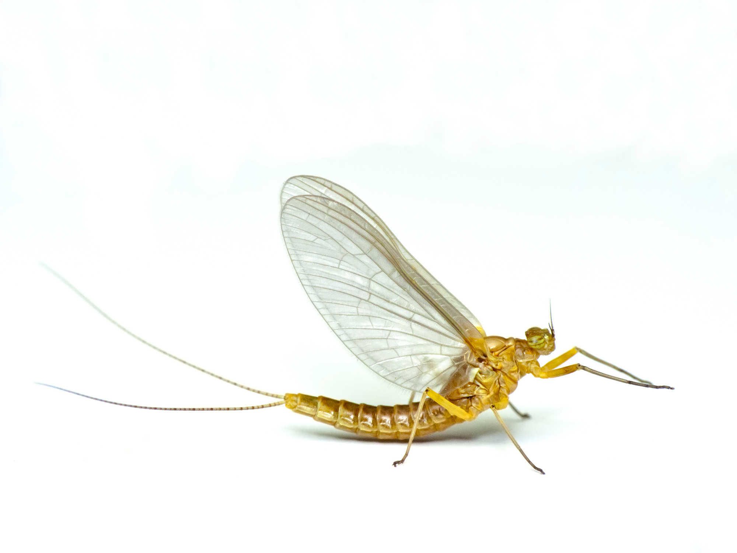
I spend most of my life as a nymph (larvae).
As an adult, I do not feed.
As an adult, I only live for a day or two.
I live near ponds, rivers and streams.
Mayfly

Slide 24
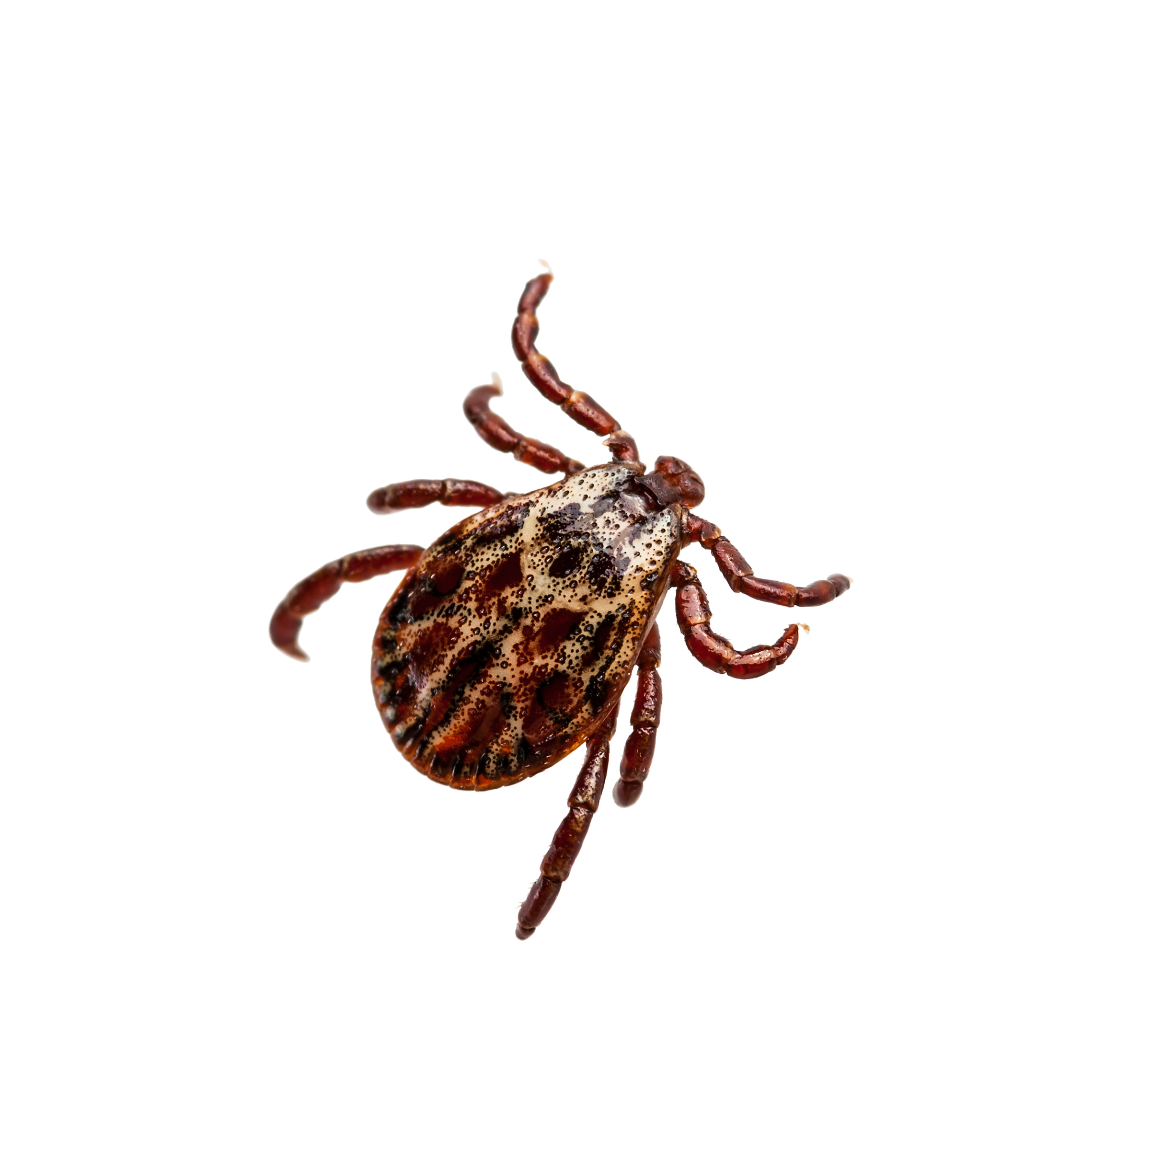
I am a parasite.
I am an arachnid.
I fill up with blood from my host.
I carry diseases.
Tick

Slide 25
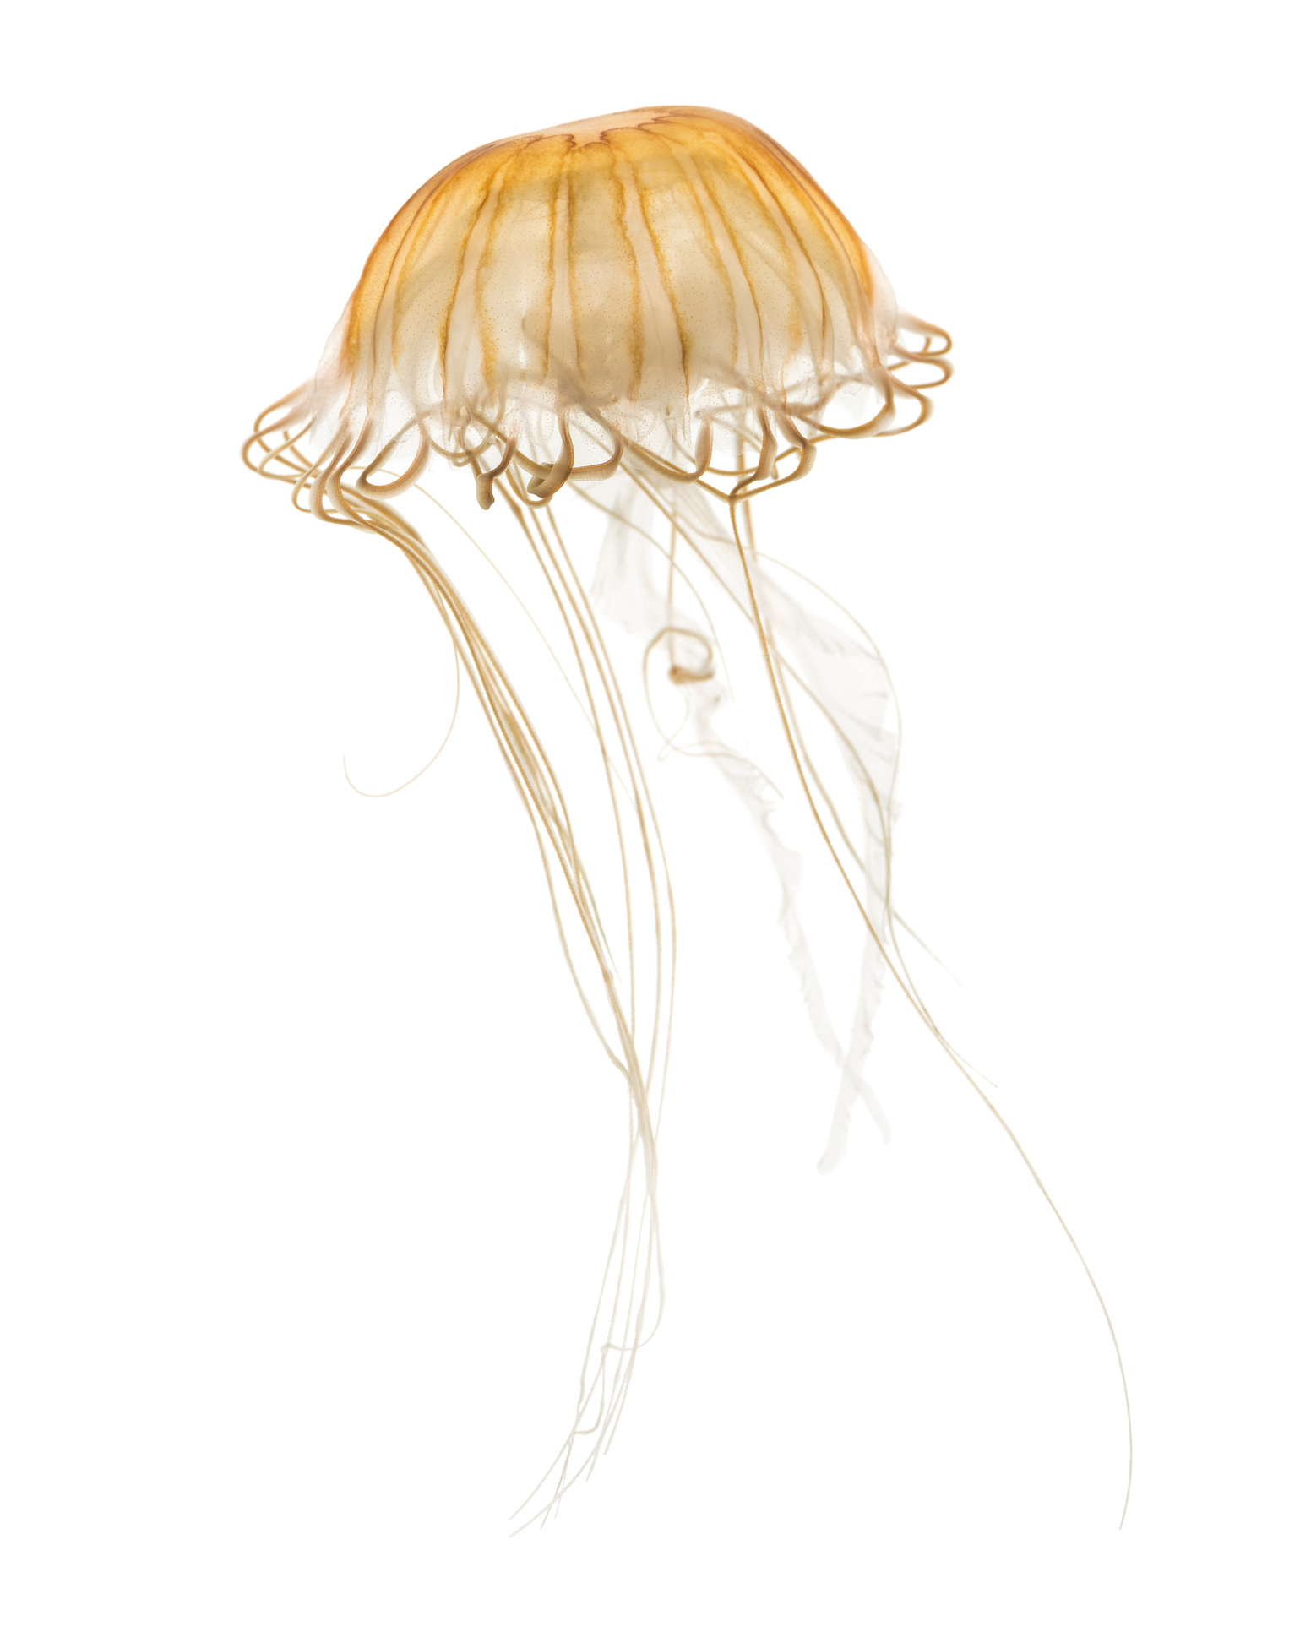
I live in coastal waters.
I do not have a heart.
I can only travel upwards on my own. I rely on the sea to move me.
I feed by stinging my prey.
Jellyfish

