Slide 1


Symmetry is where one half of a shape, object or picture matches the other like a reflection in a mirror.
In the picture below, the arrow on one side of the line is reflected onto the other side.
The arrows are symmetrical.
Can you see that my wings are symmetrical too?

Slide 2
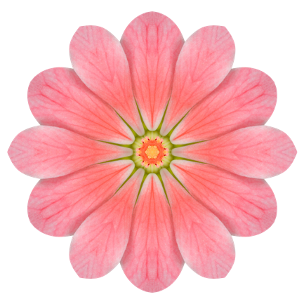
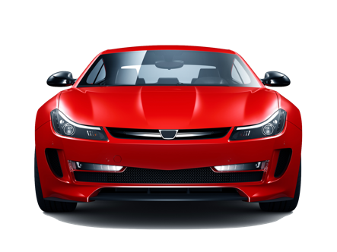
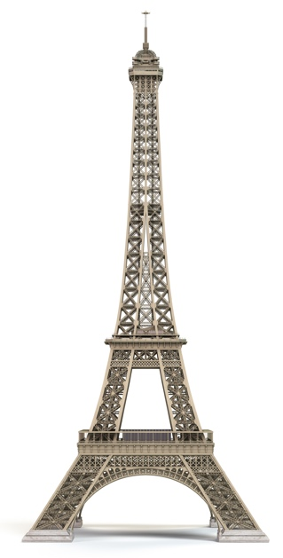
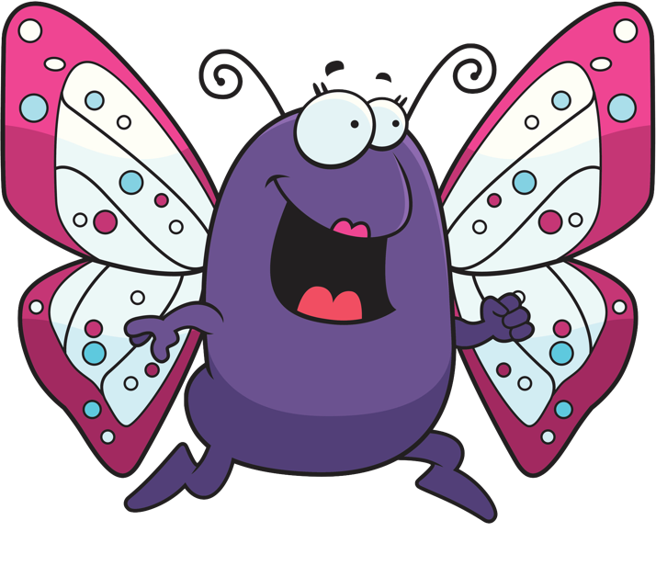

We can see symmetry all around us. Here are some examples...
This car has been designed so that it looks symmetrical from the front.
The petals on this flower are arranged symmetrically.
The Eiffel Tower is symmetrical too!
Look at the symmetrical wings on this ladybird!

Slide 3




The line that divides a shape into two matching parts is called the mirror line or the line of symmetry.
If you were to fold this triangle along the mirror line, the two halves would fit together exactly.
If you place a mirror on top of the mirror line, the reflection can help you to draw the complete shape.
Mirror Line

Slide 4
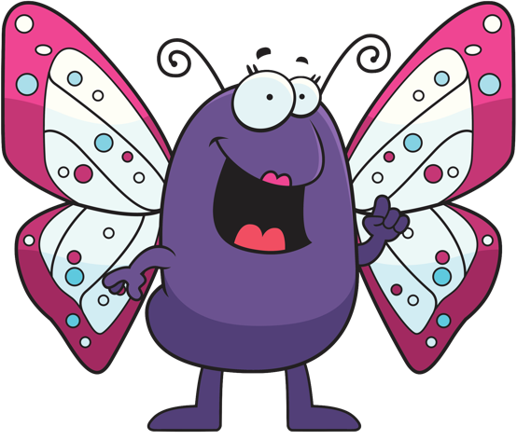

Mirror lines can be in any direction, including horizontal, vertical and diagonal.
Horizontal
Vertical
Diagonal
This is called line symmetry or reflective symmetry.

Slide 5

Many shapes are symmetrical and some of them have more than one line of symmetry.
This arrow has one line of symmetry.
This rectangle has two lines of symmetry.
This triangle has three lines of symmetry.
This square has four lines of symmetry.
This irregular hexagon does not have any lines of symmetry.
Do any of the letters in your name have lines of symmetry?
A circle has an infinite number of lines of symmetry.
Any line that goes through the centre of the circle is a line of symmetry!

Slide 6
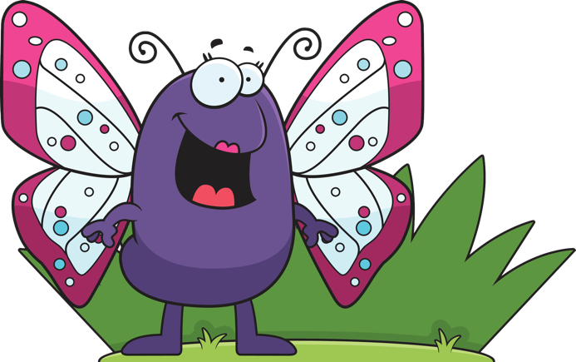
You may be asked to reflect a pattern on a grid. Make sure that each part of the pattern is the same distance from the mirror line as the reflected image.
TEXT
Can you see that the coloured squares on the bottom row are both three squares away from the vertical mirror line?
Here is another example with a horizontal mirror line.
If you have a diagonal mirror line, try turning the paper to help with the reflection!

Slide 7

You might also have to reflect a shape on a grid.
Work out the reflection of one vertex (or corner) at a time and then join them together.
When you have finished, use a mirror to check the reflected image if you can!

Slide 8
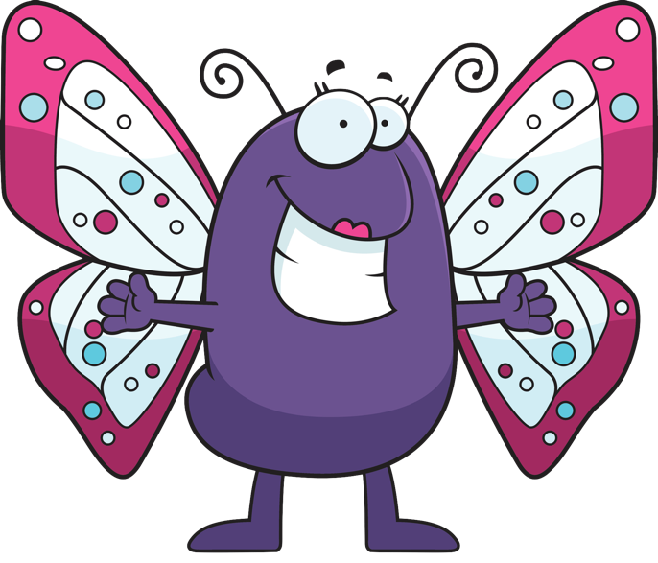
You may have to reflect points and shapes on a coordinate grid.
The mirror line may be along one of the axes but it could be somewhere else!
In this coordinate grid, the mirror line is on the x-axis.
y
4
3
2
1
x
-4
-3
-2
-1
1
2
3
4
-1
-2
-3
-4
Can you work out the coordinates for the reflection of the red circle?

Slide 9



Rotational symmetry is another kind of symmetry.
If you can turn (or rotate) a shape and it looks the same before you get back to the starting point, it has rotational symmetry.
This square matches itself four times in a complete turn,
so it DOES have rotational symmetry.
This arrow will only match itself once in a complete turn.
It does NOT have rotational symmetry.
The dot is called the centre of rotation.

Slide 10

The number of times a shape can look the same after one full rotation is called the order of rotational symmetry.
TEXT
This hexagon has rotational symmetry of order 6.
This rectangle has rotational symmetry of order 2.
This star has rotational symmetry of order 5.

