Slide 1
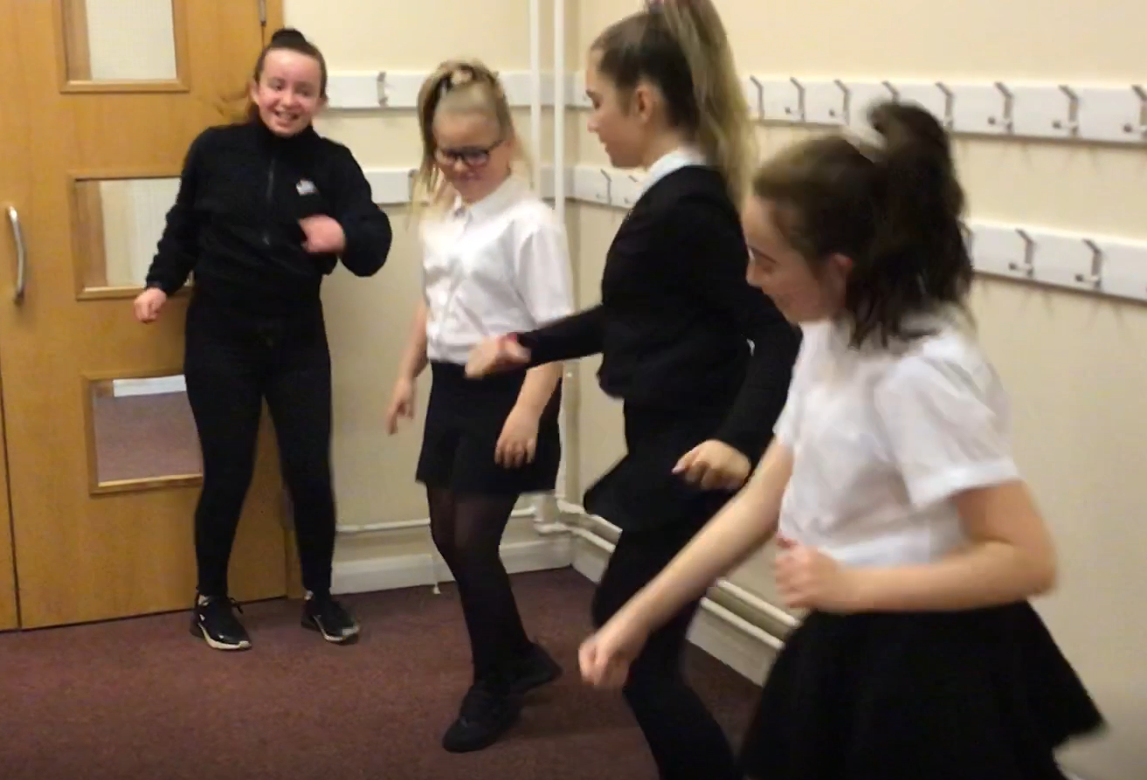
1920’s dance
Erin, Brooke, Maci and Eve.
Comng to a screen near you!

Slide 2
1940’s dance
Paige, Shannon,
Ellie and Nicole.

Slide 3
1940’s Sports Report
Ella & Ava

Slide 4
1950’s dance
Nicole and Aaliyah
Lexi and Evie

Slide 5
1950’s interview with Roger Bannister
Brooke, Erin & Eve

Slide 6
1960’s dance
Ella, Poppy
Isla & Ava

Slide 7
1970’s dance
Ben, Lyle,
Danyl & Leighton

Slide 8
1980’s dance
Michelle, Alex
John & Alexander

Slide 9
1990’s dance
Rhys, Daniel.
Jayden & Liam

