Slide 1
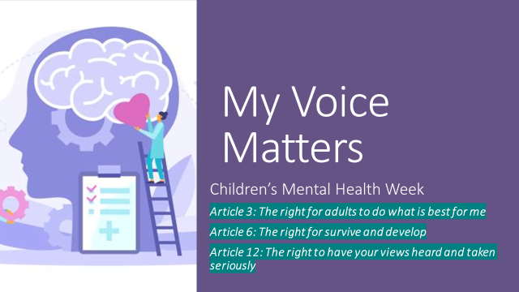

Slide 2
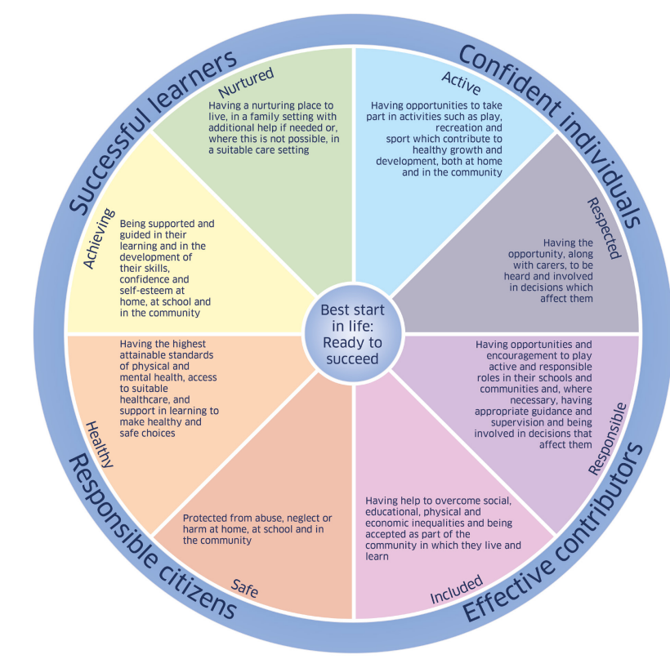
SHANARRI
Respected
Included
Sid & Shanarri (sidandshanarri.co.uk)

Slide 4
Mental Health Video
https://youtu.be/oz1S66_pYTw

Slide 6
Small Feelings
Small feelings can feel very strong at times, but these are feelings that don’t become a problem to us, like big feelings do. • Can you think of any other small feelings that come and go?

Slide 8
Big Feelings
Big feelings can change how we behave, how we see the world and how we get on with other people.
They can affect our mental health.
Some of us might never experience these big feelings but for other people these big feelings can be really serious.
It can be difficult to understand how we are feeling and to tell the difference between our big and small feelings. Who could help us?

Slide 11
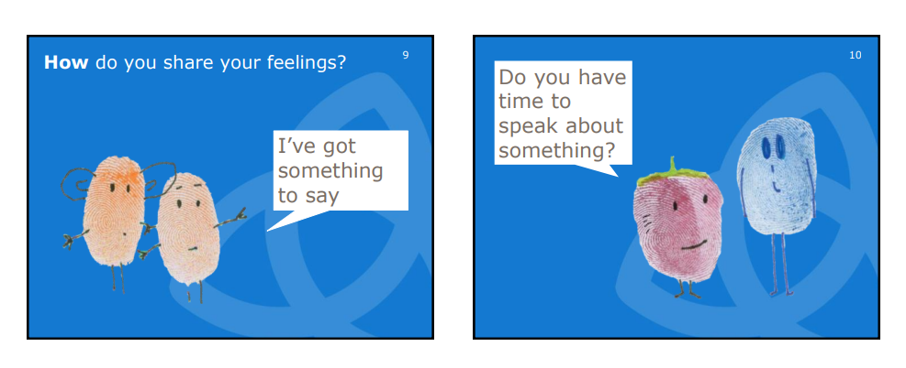

Slide 12
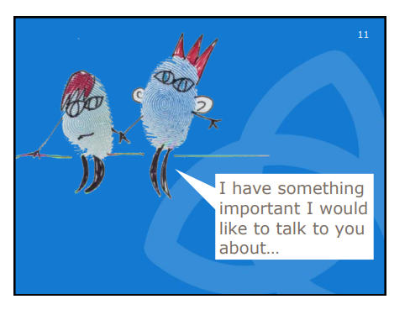

Slide 17
What shakes our branches?
Roots – what are the things in our lives that help to make us feel safe and secure?
These might include:
families, people in our community, friends, our bedroom, a soft toy, pet dog.
Write examples on the roots

Slide 18
Tree Trunk
Represents our School
What are our strengths as a school?
What do we do well/ are good at?
What makes our school a safe place to be?

Slide 19
What shakes our branches?
Sometimes things are going well and then suddenly something changes and our branches don’t feel so steady and strong.
Talk about what kind of changes might happen in our lives and upset us or make us anxious.
Falling out with friends, an illness in the family, moving house, starting a new school, being bullied.
Write these on the leaf shapes and attach them to the branches

