Slide 1
Desert
Survival
Product Design

Slide 2
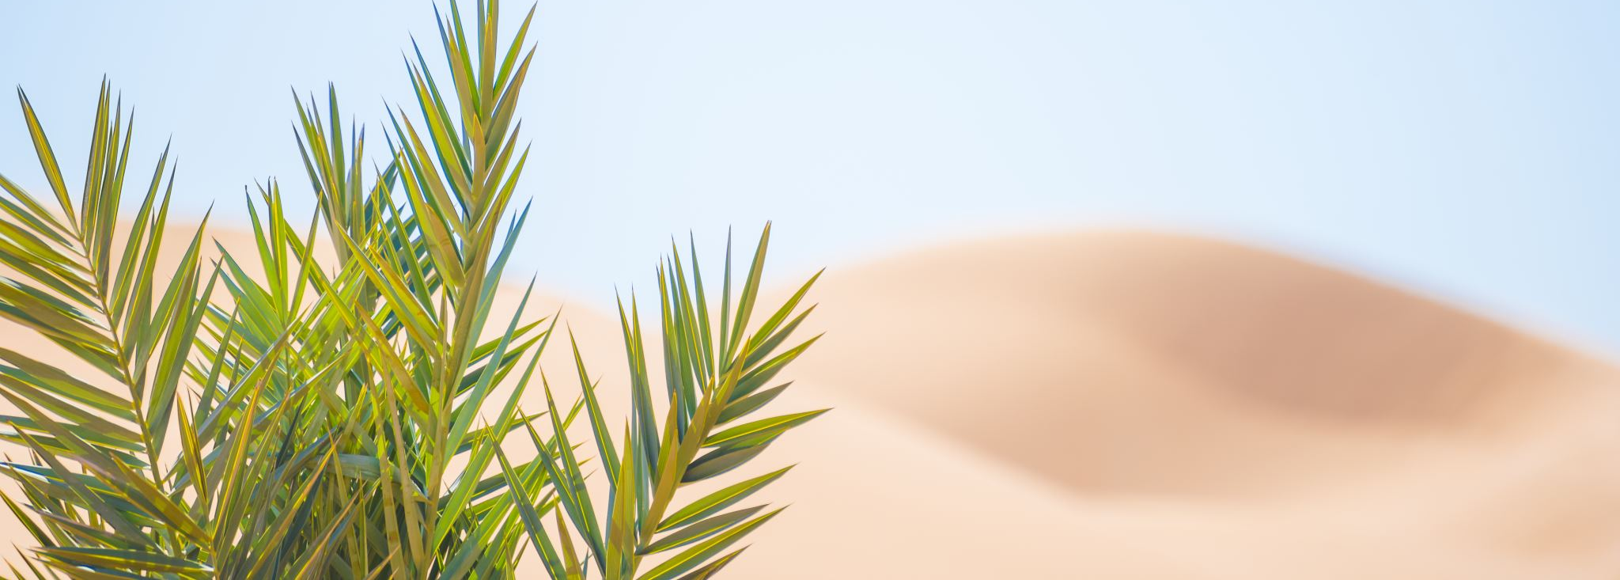
Why did we make this product?
. To help people survive in the desert for climate and weather for the future
. For people to store products of use in the desert such as: water and food
.For our prediction of the world becoming 70% (or more) to be covered in the desert biome

Slide 3
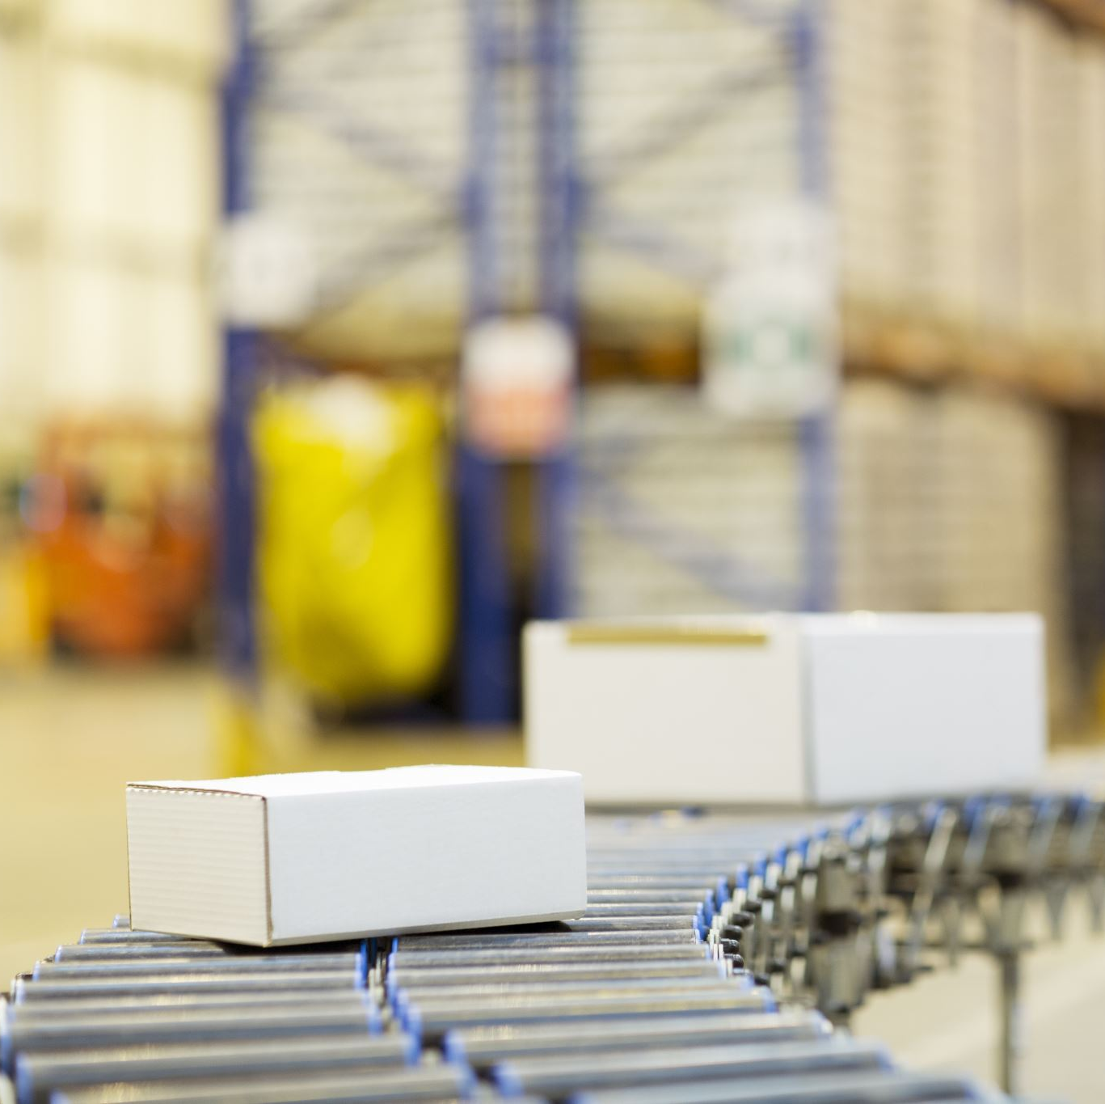
What does it do?
It is a fridge which is around 6ft tall so a human can fit in at night for a safe sleep and so they don’t die to hyperthermia in there sleep.
there is a small heater at the side that has a button to be turned off and on.
It also utilizes the sun, instead of a wire for power, it uses solar panels which are located at the top of it.

Slide 4
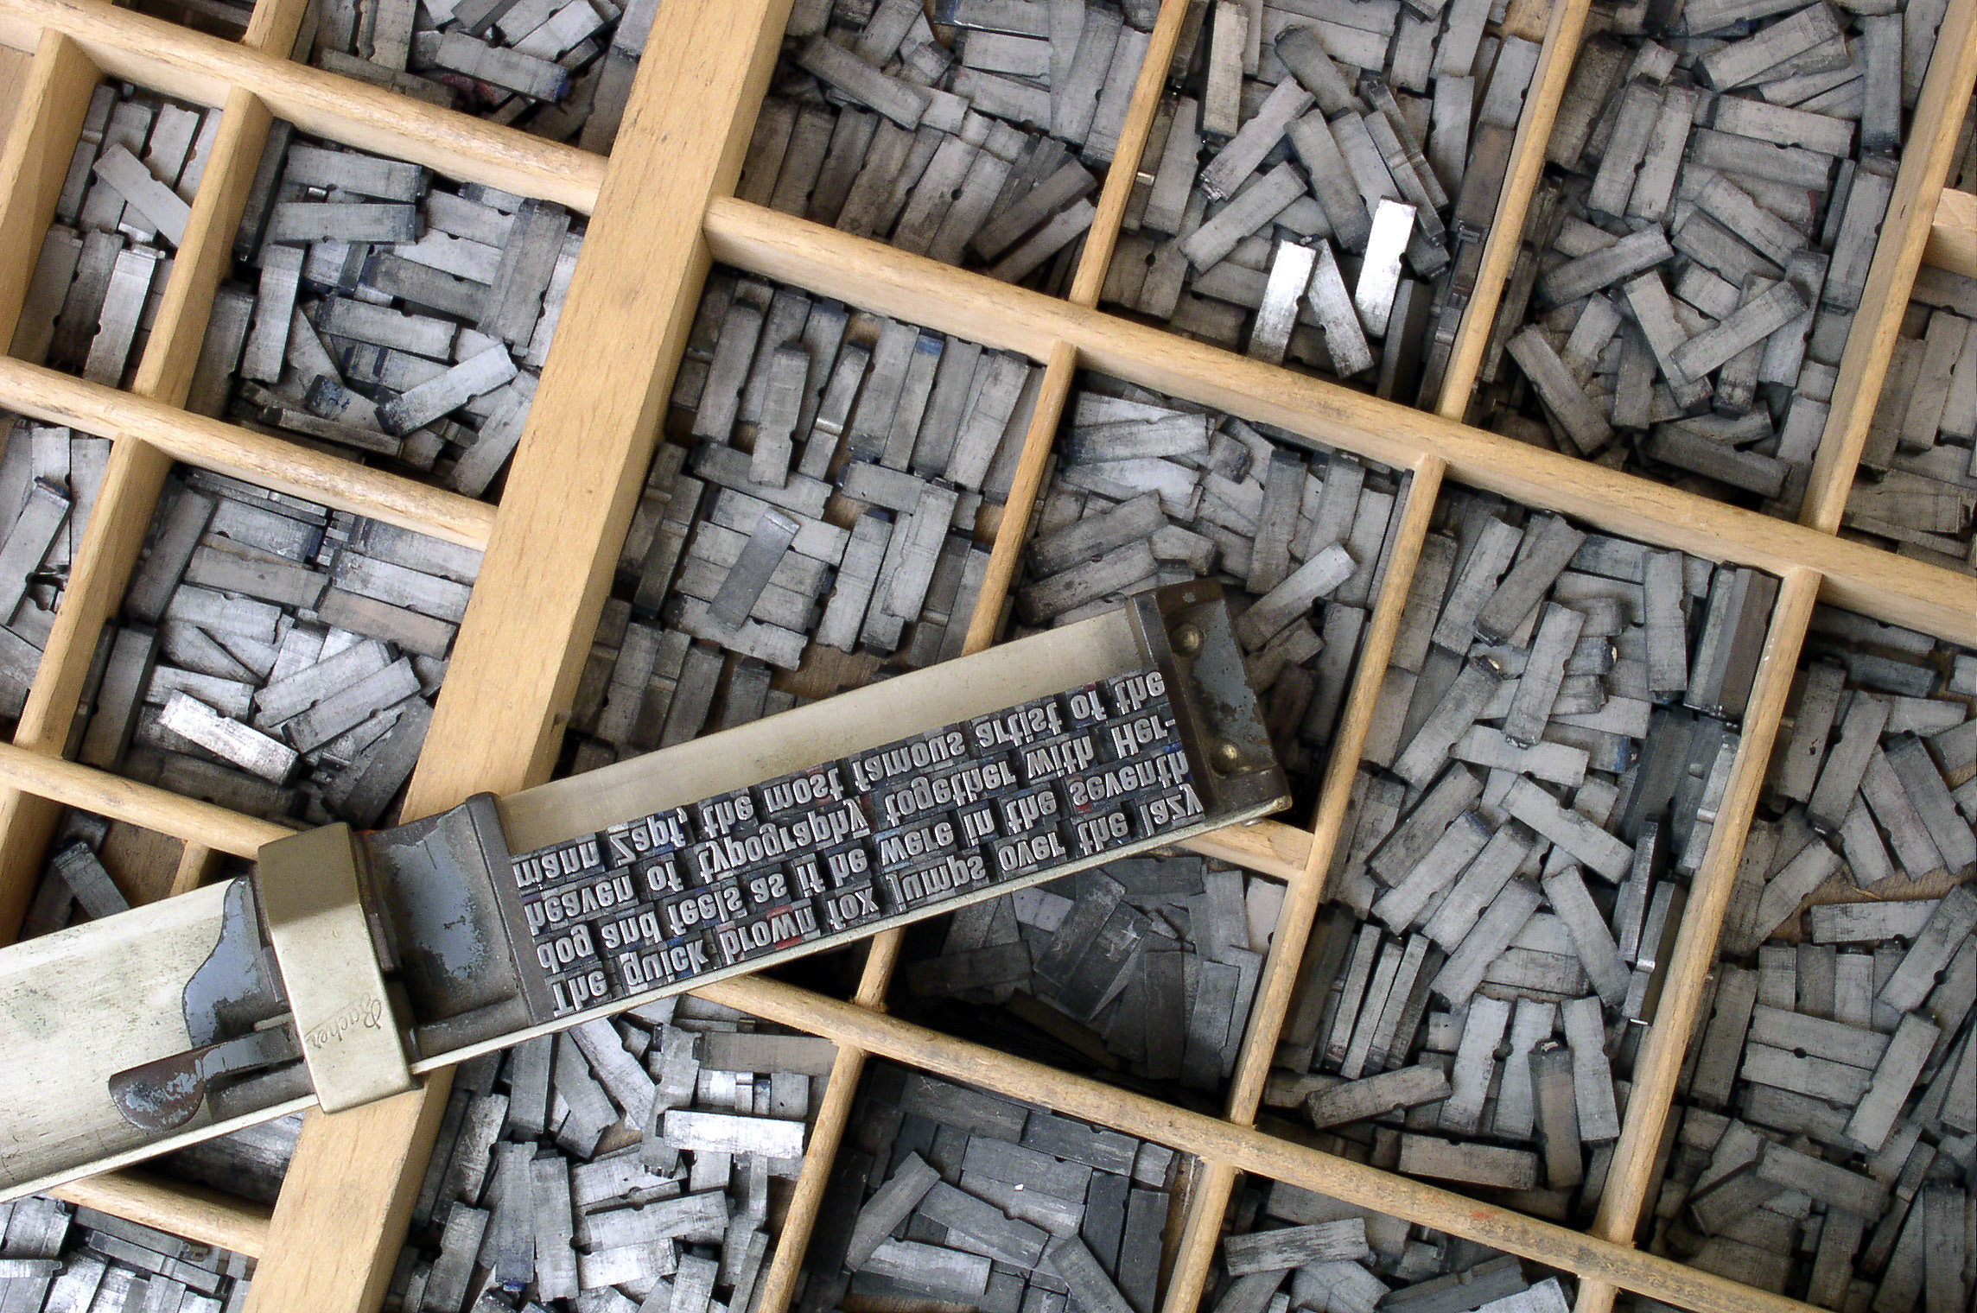
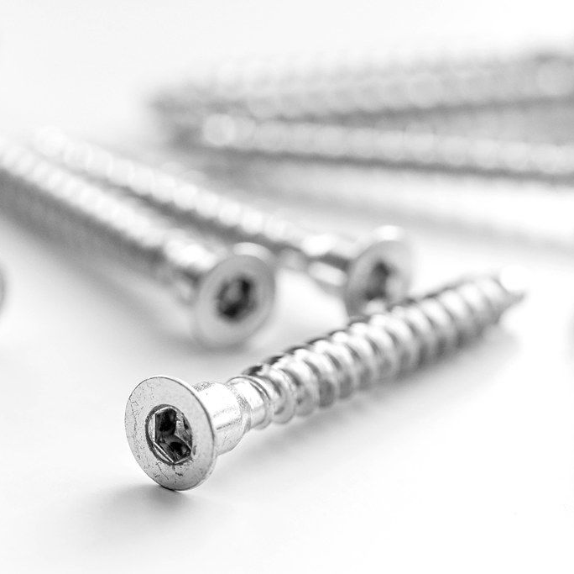
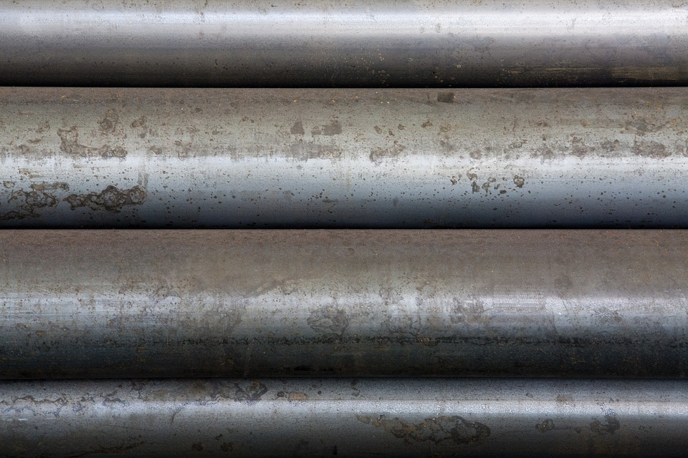
About the product
I think to build this product is to not use a sun absorbent material like metal.It should be a hard plastic that’s very hard to break,also a bit of rope to drag it around
Also, glass or silicon for the solar panles above the fridge
I would think this would range in prices from £1500-£3500.
ThePhoto by PhotoAuthor is licensed under CCYYSA.

Slide 5
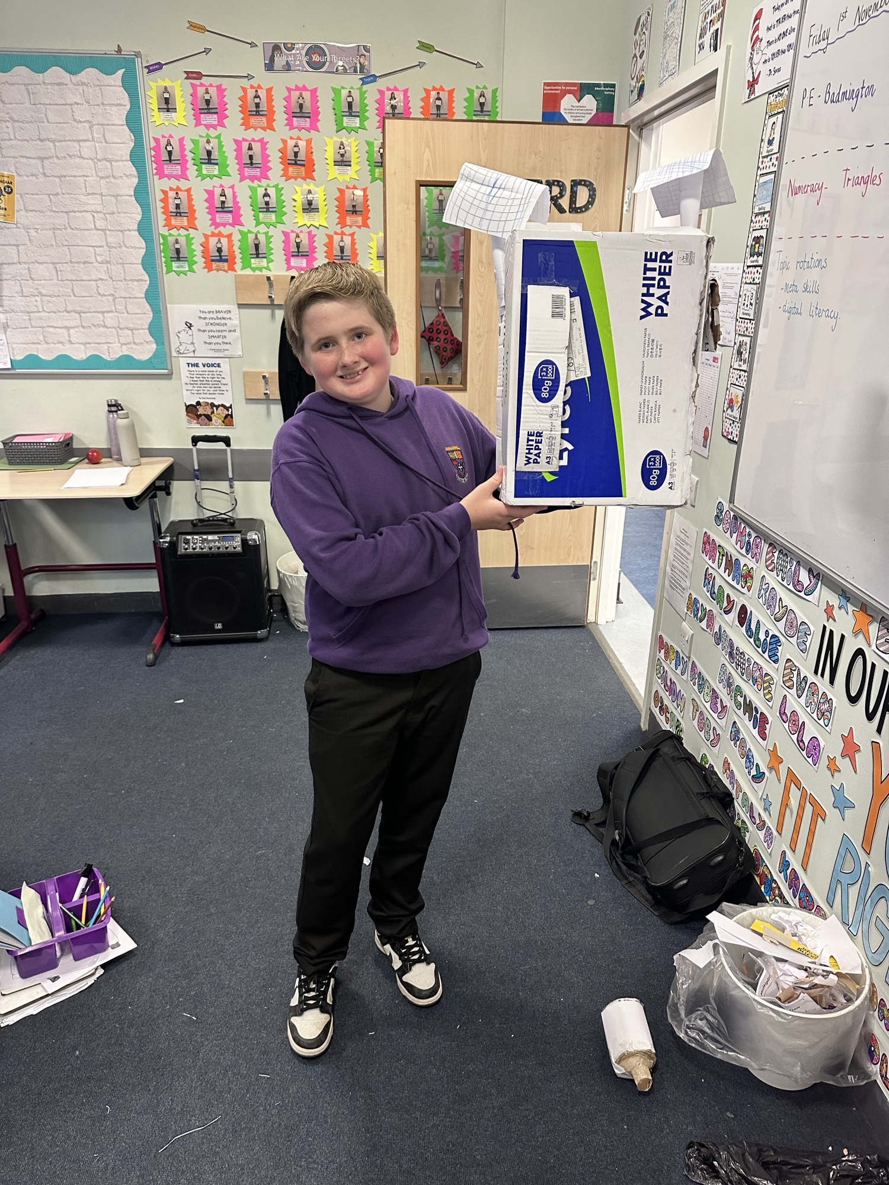
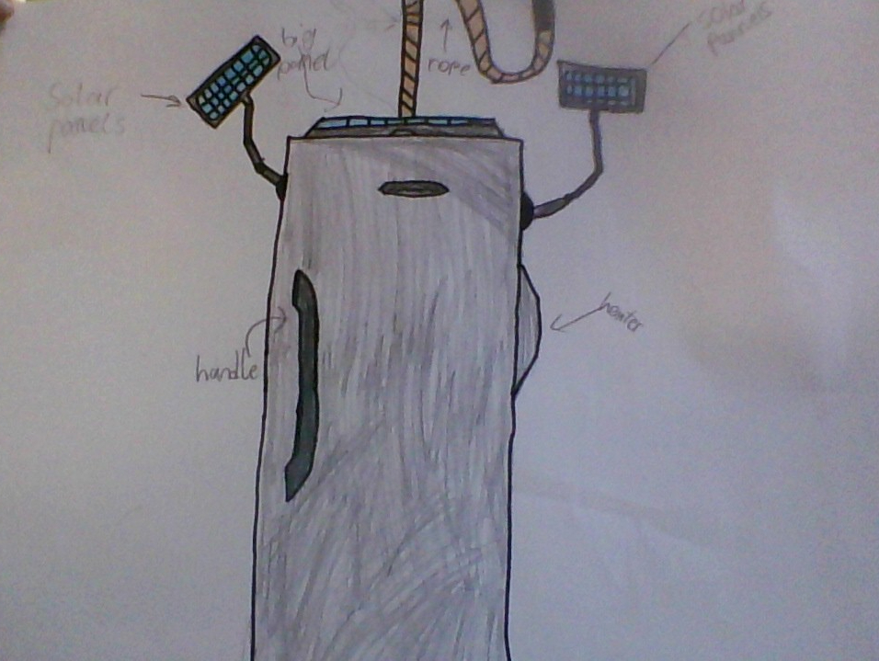
Our Prototype:

