Slide 1
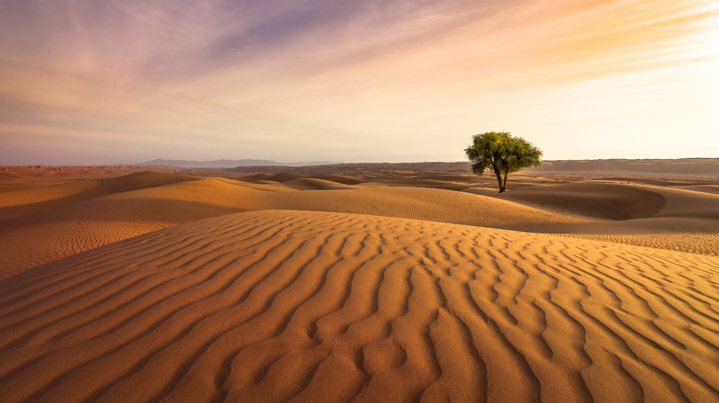
Desert survival
Product design
By Ashton and Toby

Slide 2
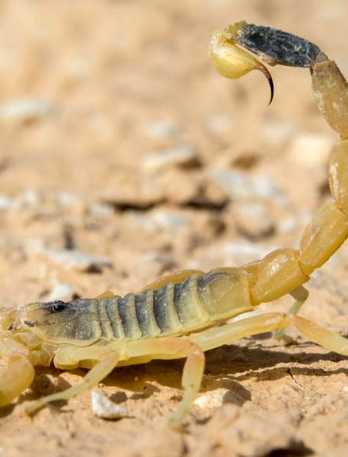
Why did we make this product?
We designed this product to help humans to survive on a climate where every area of land has become a desert.
This product covers: the human essential needs, the dangers of being in a desert and, the climate of the desert.

Slide 3
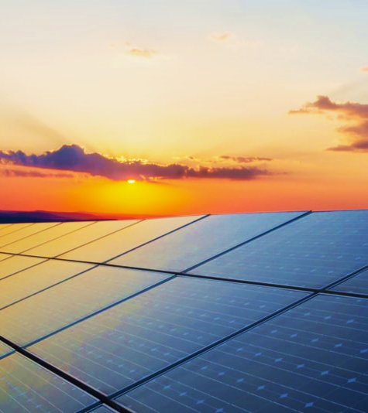
About the product.
This product design is a solar powered hat.
It can be used as a self-defense weapon, or if you are building a shelter it helps to build it, as it has a blade on the tip of it.
And because it’s a hat it provides protection from the sun.
It has antennas to help so you get better signal for any technology, to get urgent help if your in an emergency.

Slide 4
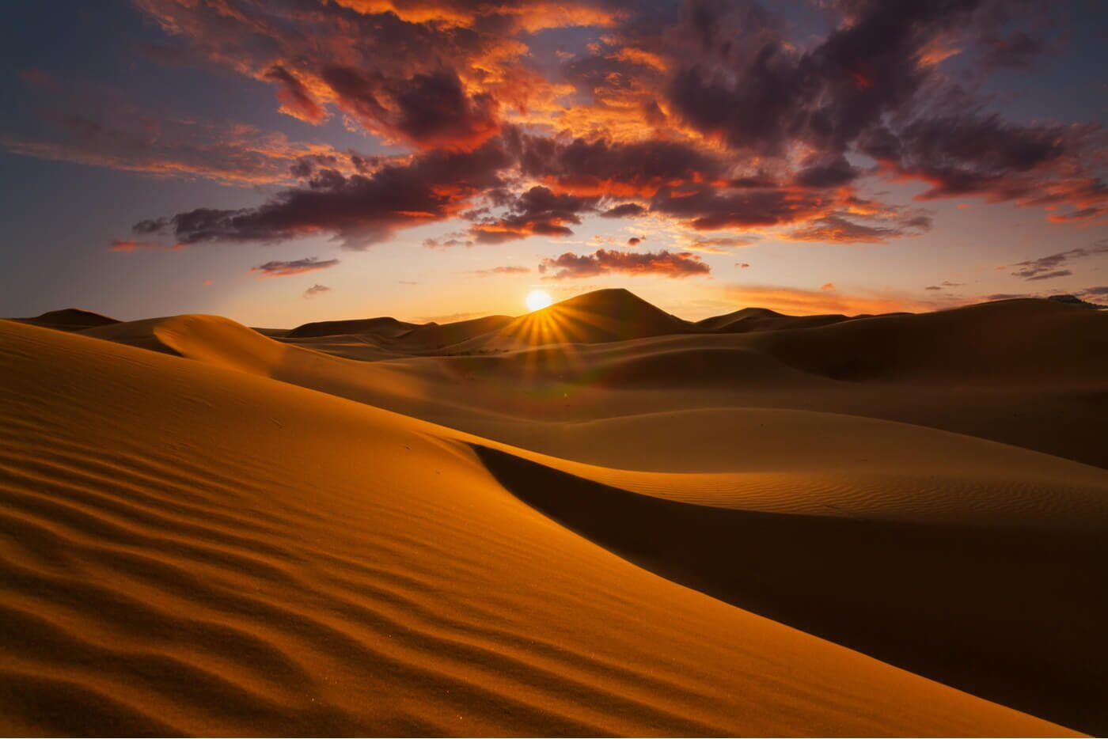
How does it work?
This hat is solar powered which means it uses power from the sun.
It also has a USB slot to charge your piece of technology.
This power that it gathers from the sun can be used for a lot of different things such as: giving signal to your phone and, giving power to the USB so it can work.

Slide 5
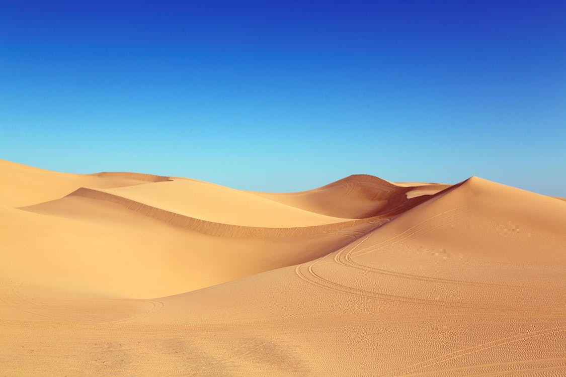
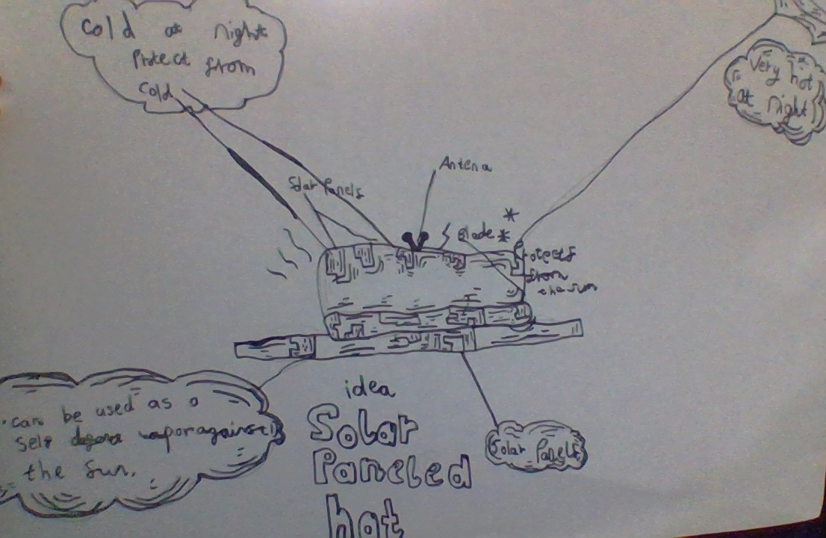
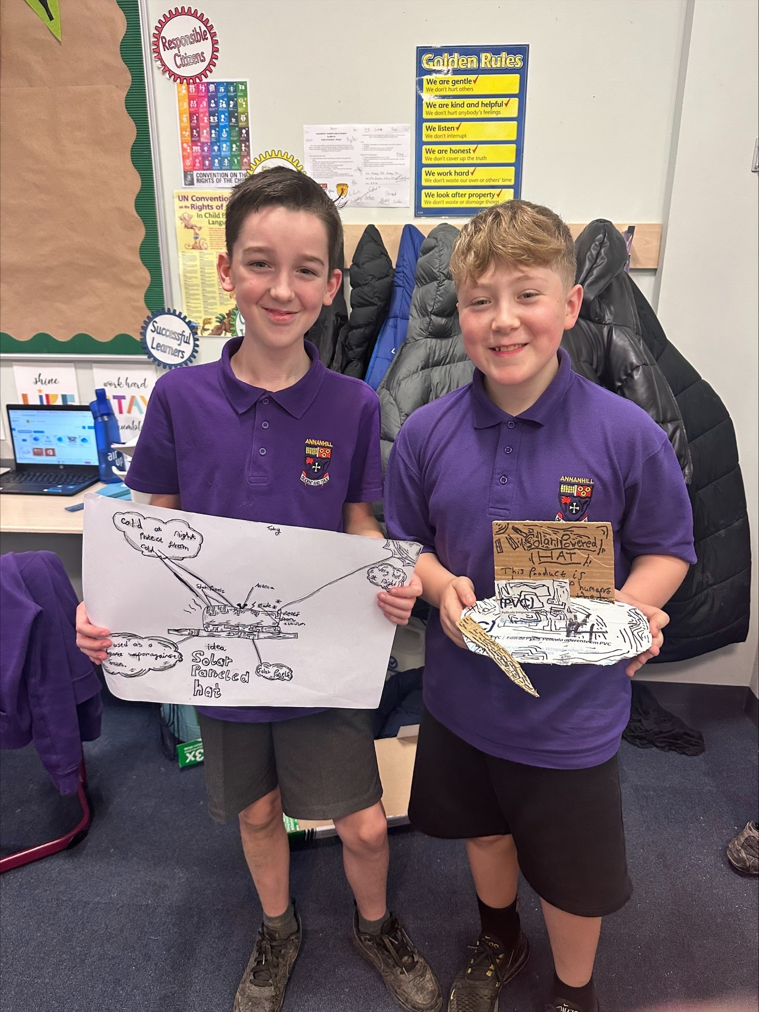

Slide 6
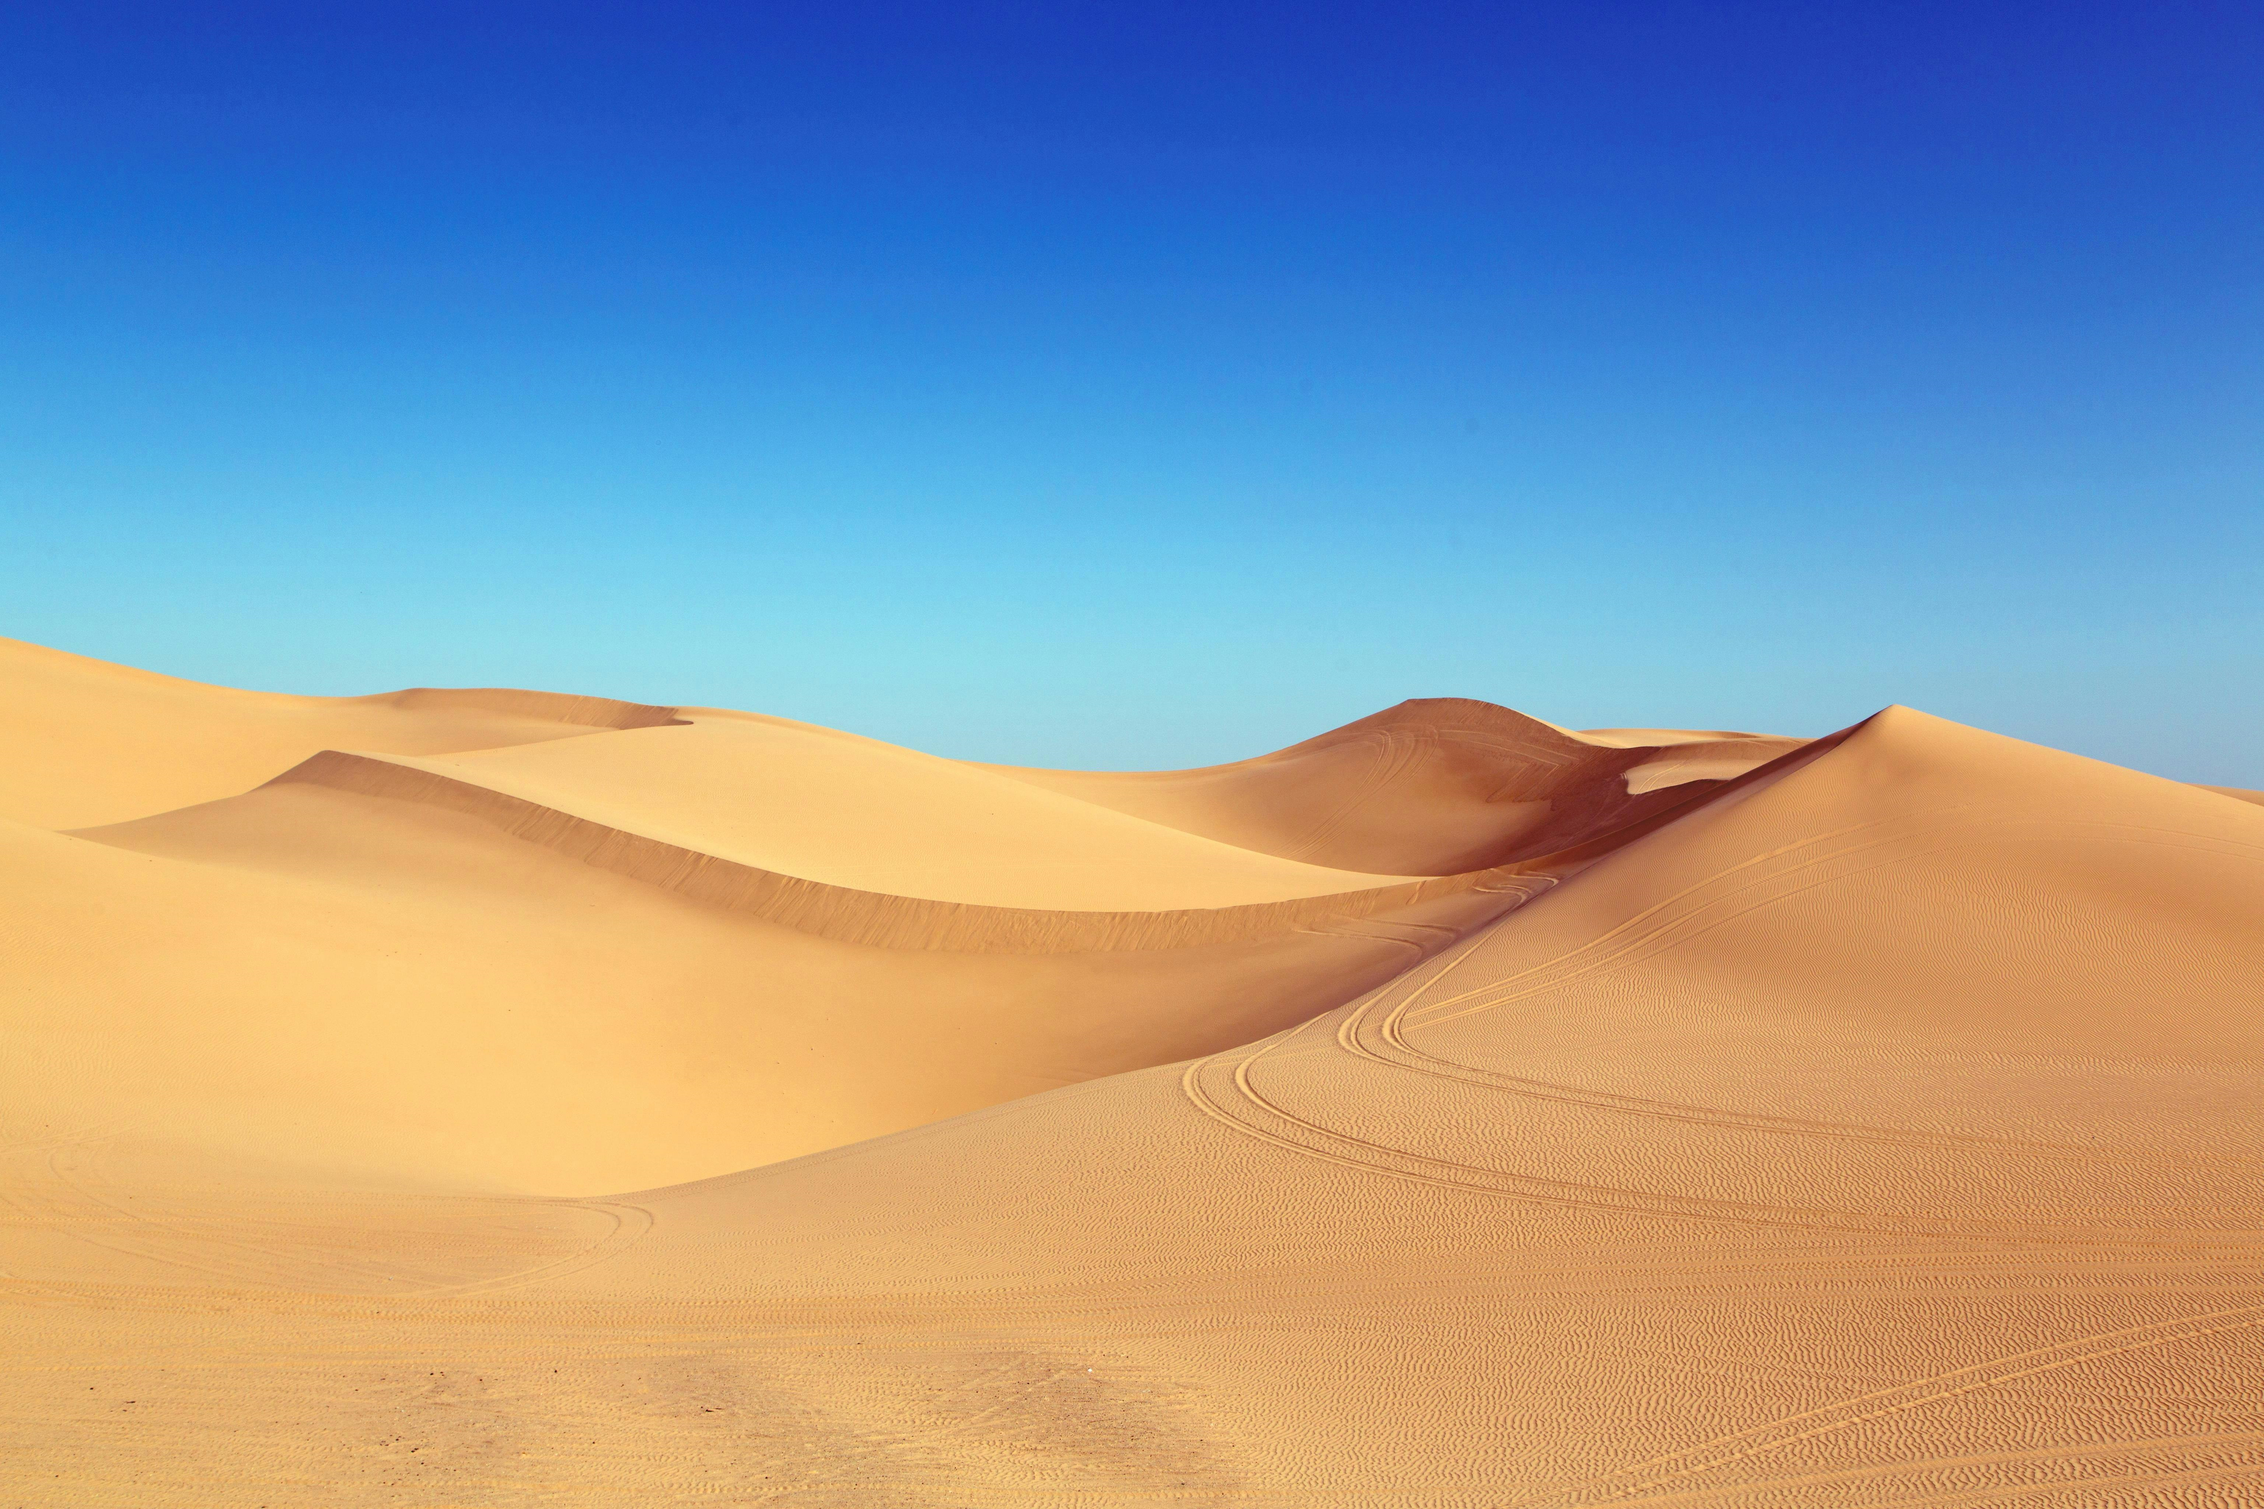

Thank you for listening.

