Slide 1
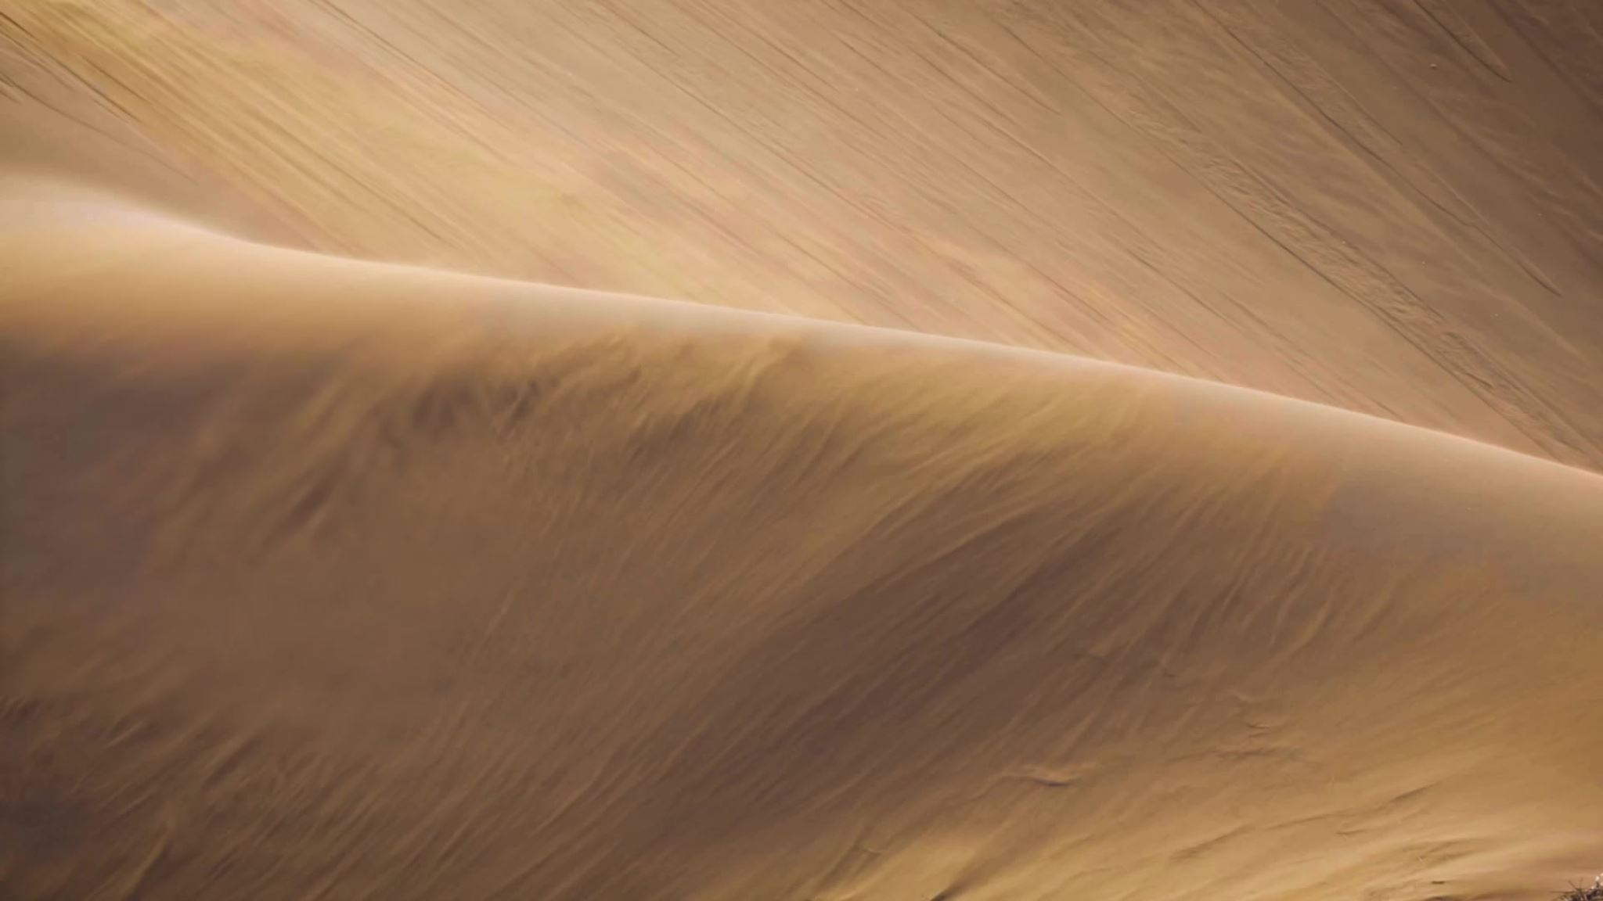
Desert survival
Product design
By Eve stalker

Slide 2
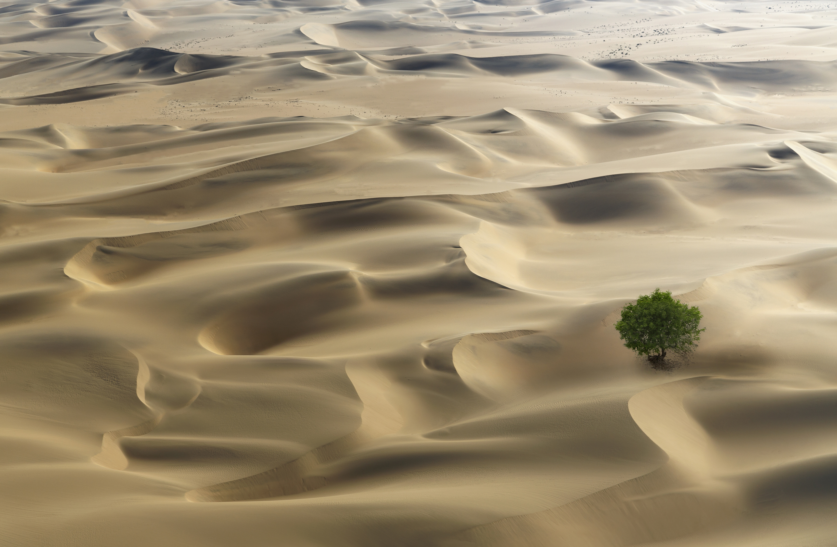
Why I made this product
I made this product because I thought it could help with a few things in the desert like cooling it down,letting animals go in for shade, and making plants or getting clean water to drink.

Slide 3
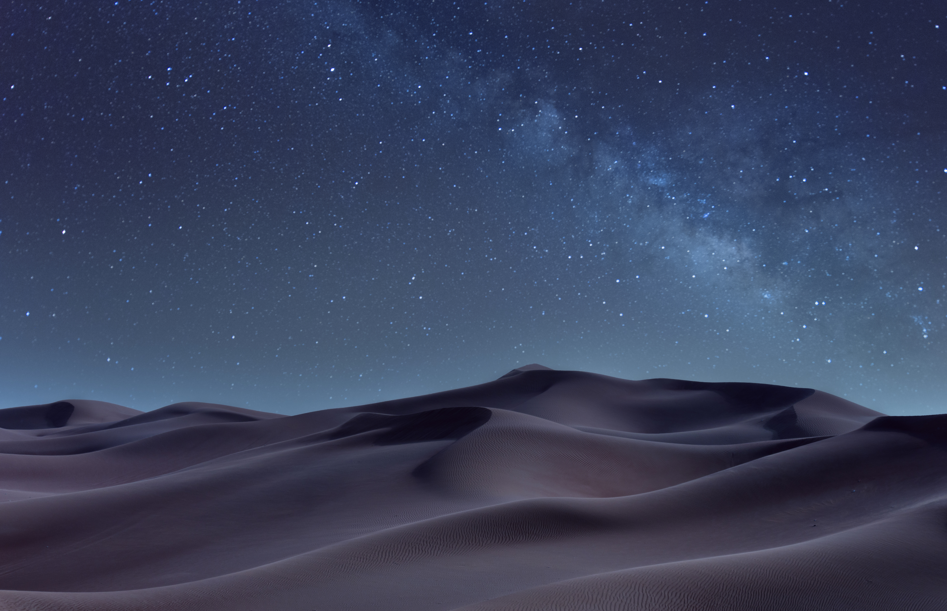
About my product
My product is to help the desert, animals, cool down the desert, and spray water to make plants like fruit and veggies to eat.It has a fan to cool down the desert and to blow the water around the desert. Next there are holes for the water to come out. lastly there is an entrance/exit for animals to go in and out of.

Slide 4
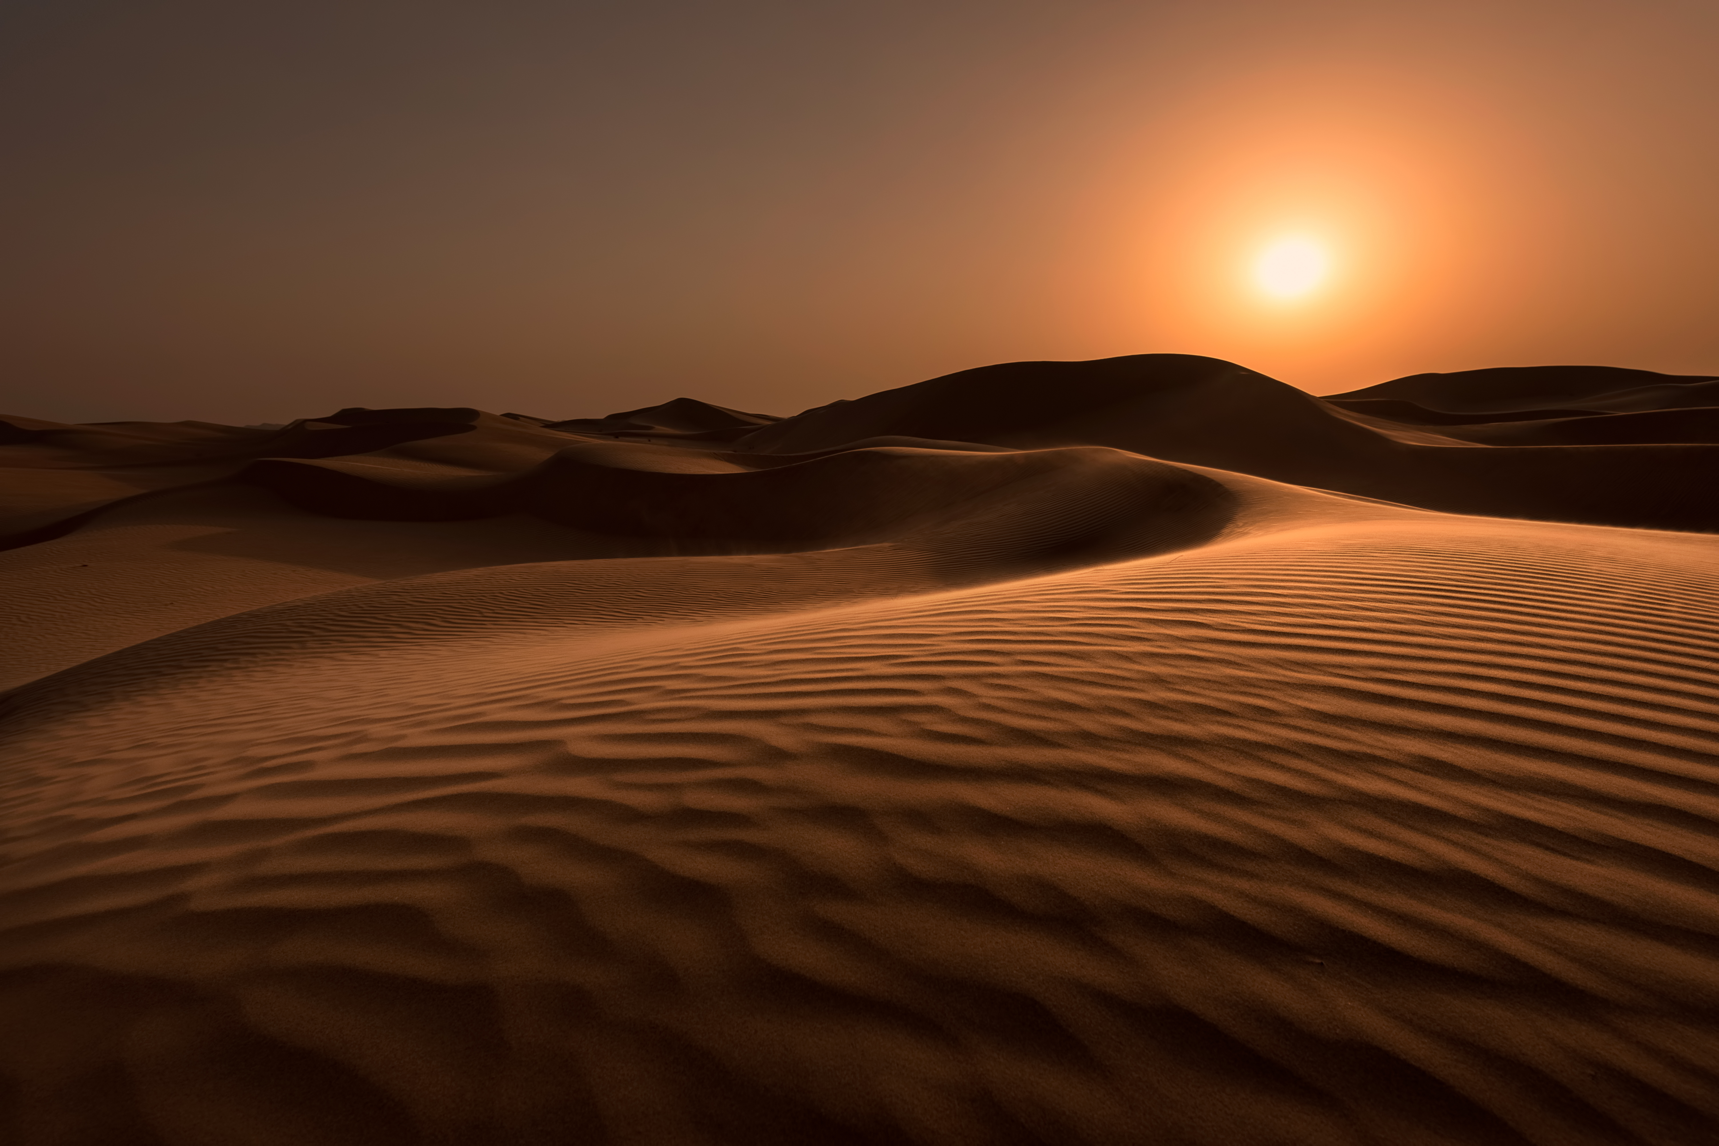
How does it work?
Well it works by having a pump in the middle that pumps the water out to go through the holes and the fan is portable so u would just need to change the batteries once and a while. Then the animals would go in and out through the bottom and a little door comes down when the water starts to spray out in the desert.

Slide 5
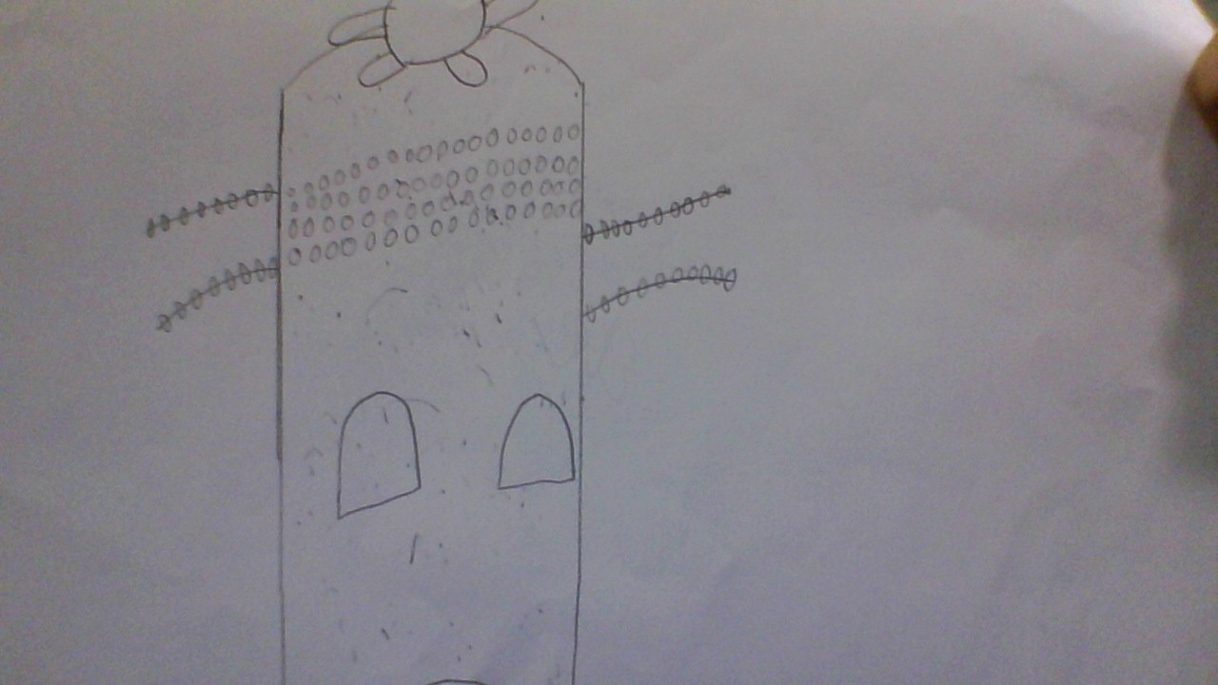
This is my picture of my product.it is called desert fan

Slide 6

Any questions
.

