Slide 1
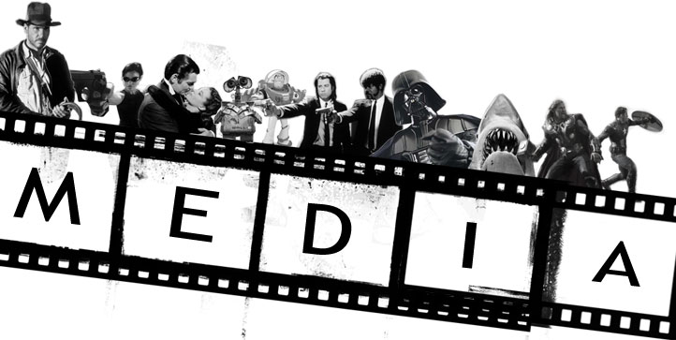

Slide 2
There are 7 sections altogether that you will speak about in the exam and folio. These are:
Categories
Language
Narrative
Representation
Audience
Institutions
Technologies

Slide 3
We’re going to start by looking at Categories:
Categories is broken down into:
Medium - film, social media, radio, tv
Purpose – persuade, inform, entertain, profit, educate
Form – feature film, series, trilogy, documentary, tutorial
Genre – comedy, romance, sci-fi, fantasy, horror
Tone – serious, comic,
Style – realist, expressionist, traditional, modern

Slide 4
Title | Medium | Purpose | Form | Genre | Tone | Style
GoT
Jamie Genevieve
Hollyoaks
Tomb Raider
Desert Island Discs
Gossip Girl

Slide 5
Language Codes
Cultural Codes – embedded signs that we share in a culture. i.e. roses, a red stop sign, a box of chocolates, blue and white warning tape,
Technical Codes – the way a film is edited to show us specific details.

Slide 6
FRAMING
1. EXTREME LONG SHOT: taken from far away, usually for external shots that set the scene.
2. LONG SHOT: generally shows a full body.
3. MEDIUM SHOT: shows a figure from the waist up.
OVER-THE-SHOULDER-SHOT: showing the back of one speaker and the front of another.
4. CLOSE-UP: concentrates on either a face or a detail of mise en scene used to reveal important details.
5. EXTREME CLOSE-UP: An extreme version of the close-up, magnifying what we would experience in reality

Slide 7
ANGLE
1. BIRDS-EYE VIEW: A scene shown from directly overhead.
2. HIGH –ANGLE: The camera is elevated above the action. This can make the objects photographed seem smaller or insignificant.
3. EYE LEVEL: A fairly neutral shot, taken from natural human level of about five to six feet from the ground.
4. LOW ANGLE: These increase height and give a sense of speeded motion. They can also give a sense of powerlessness to the viewer.
5. OBLIQUE/ CANTED ANGLE: Sometimes the camera is tilted to suggest imbalance, transition and instability.

Slide 8
CAMERA MOVEMENT
1. PANS & TILTS: A movement which scans a scene horizontally or vertically
2. DOLLY SHOTS: Also called TRUCKING or TRACKING shots, the camera is placed on a vehicle and moves alongside the action.
3. HAND-HELD SHOTS: creates a jerky effect as the camera is strapped to a person to follow the action.
4. CRANE SHOTS: A DOLLY shot taken from the air using a crane.
5. ZOOM LENSES: Used to zoom in or out of a shot.
6. THE AERIAL SHOT: Usually taken from a helicopter.

Slide 9
SOUNDTRACK
Diegetic music (in the film – characters can hear)
Non-diegetic music (music that characters cannot hear – not part of the film’s ‘reality’)
Parallel sound (when the soundtrack matches the action on screen. i.e. tense music to a horror scene)
Contrapuntal sound (when the soundtrack doesn’t match the action. i.e. fast music to playing children).
LIGHTING
Low, high, natural – all done to affect the mood.
MIS EN SCENE
Everything else we can see on screen – props, costume, sets

Slide 10
EDITING
Cut: A visual transition created in editing in which one shot is instantaneously replaced on screen by another.
continuity editing: Editing that creates action that flows smoothly across shots and scenes without jarring visual inconsistencies. Establishes a sense of story for the viewer.
cross cutting: Cutting back and forth quickly between two or more lines of action, indicating they are happening simultaneously.
Dissolve: A gradual scene transition. The editor overlaps the end of one shot with the beginning of the next one.
errors of continuity: Disruptions in the flow of a scene, such as a failure to match action or the placement of props across shots.
establishing shot: A shot, normally taken from a great distance or from a "bird's eye view," that establishes where the action is about to occur.
eyeline match: The matching of eyelines between two or more characters. For example, if Sam looks to the right in shot A, Jean will look to the left in shot B. This establishes a relationship of proximity and continuity.
Fade: A visual transition between shots or scenes that appears on screen as a brief interval with no picture. The editor fades one shot to black and then fades in the next. Often used to indicate a change in time and place.
final cut: The finished edit of a film, approved by the director and the producer. This is what the audience sees.
Iris: Visible on screen as a circle closing down over or opening up on a shot. Seldom used in contemporary film, but common during the silent era of Hollywood films.
jump cut: A cut that creates a lack of continuity by leaving out parts of the action.
matched cut: A cut joining two shots whose compositional elements match, helping to establish strong continuity of action.
Montage: Scenes whose emotional impact and visual design are achieved through the editing together of many brief shots. The shower scene from Psycho is an example of montage editing.
rough cut: The editor's first pass at assembling the shots into a film, before tightening and polishing occurs.
sequence shot: A long take that extends for an entire scene or sequence. It is composed of only one shot with no editing.
reverse shot cutting: Usually used for conversation scenes, this technique alternates between over-the-shoulder shots showing each character speaking.

Slide 11
Think about the technical codes you have just gone over and then watch these two Miley Cyrus videos. Think about what they are trying to show through the technical codes.

Slide 12
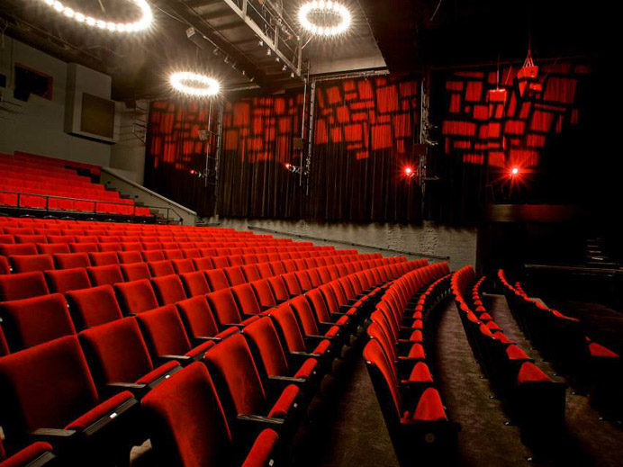
Narrative Theories
Make notes on the following and then link them into the film:
Propps Theory
Todorov’s Theory
Levi-Strauss Theory

Slide 13
PROPP’S THEORY
The villain — an evil character that creates struggles for the hero.
The dispatcher — the person who sends the hero on his quest.
The helper — a typically magical entity that comes to help the hero in their quest.
The princess or prize — the hero deserves her but is unable to marry her
The donor — a character that prepares the hero or gives the hero some magical object, often after a test.
The hero — he (or she) thwarts the villain, resolves any lacking or wronghoods and weds the princess.
The false hero — takes credit for the hero's actions or tries to marry the princess

Slide 14
TODOROV’S THEORY
Todorov's narrative theory suggests that all narratives follow a three part structure where they begin with equilibrium, where everything is balanced, progress as something comes along to disrupt that equilibrium, and finally reach a resolution, when equilibrium is restored.

Slide 15
LEVI-STRAUSS’S THEORY
Everything is in binary opposition. Therefore you cannot have good without bad. Hence Harry Potter has Lord Voldemort, Star Wars has both Jedi and Sith, Lord of the Rings has Gandalf and Nasgul

Slide 16
STORY TYPES
There are a number of other story types as well. Look at the table below and identify what each of the films you have looked at fit into.
The Classic Hollywood | Events occur in the order they happen (chronological). Plot begins with normality being shown. Normality is then disrupted and the characters need to overcome this disruption. A happy ending where all problems are resolved.
Flashback/Flashforward | Events are not shown chronologically, but the text jumps back and/or forward in time to show events from the past and/or future.
Investigative Narrative | Contains interviews and observations, with a summary of findings/opinions
Multiple plotlines | Various different plots are happening at the same time, with the text jumping between these plots. Often, these plots are interwoven – they relate to each other.
Fragmentation | A narrative that is mixed up and not in any sensible order. It requires the reader to construct order/meaning.
Episodic Narrative | Short, self-contained plots within something larger. Situation comedies and soaps have episodic narratives.

Slide 17
REPRESENTATION
Think about how a character is represented in a film you like. Think about how the character’s:
Culture,
class,
ethnicity,
gender,
age,
Played into how they were represented.
Try this with another film character.

Slide 18
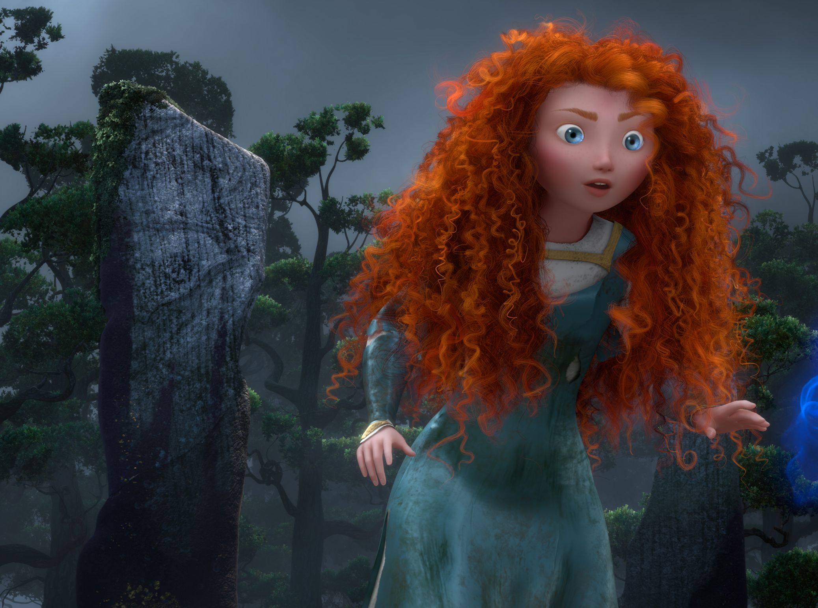
Genre and Audience Targeting with Trailers
What genre is this film and how can we tell?
Who is it aimed at? Think about age group, class, gender, identification, ethnicity etc.

Slide 19
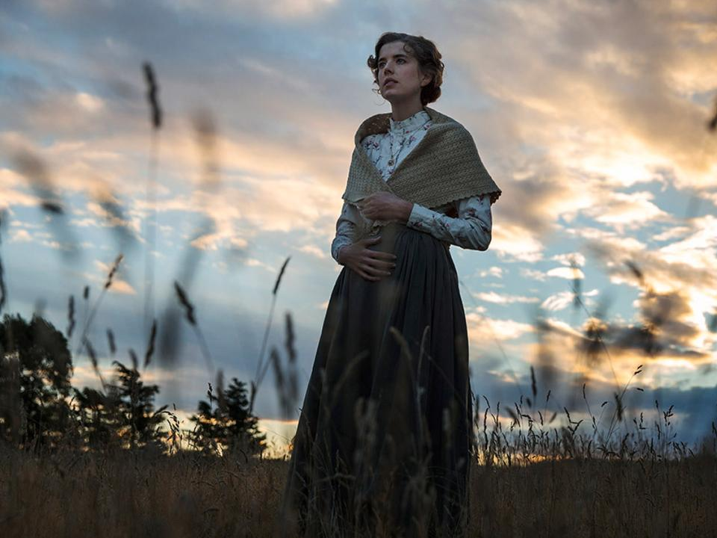
Genre and Audience Targeting with Trailers
What genre is this film and how can we tell?
Who is it aimed at? Think about age group, class, gender, identification, ethnicity etc.

Slide 20
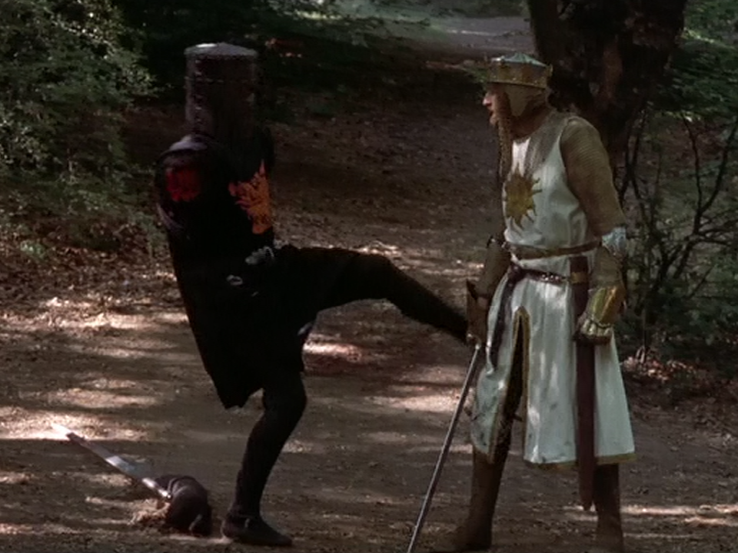
Genre and Audience Targeting with Trailers
What genre is this film and how can we tell?
Who is it aimed at? Think about age group, class, gender, identification, ethnicity etc.

Slide 21
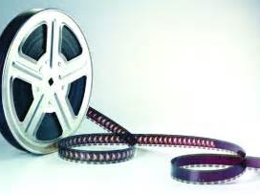
INSTITUTIONS
Name four films.
Think about the age rating they received.
Think about why they received this.

Slide 22
TECHNOLOGY
We’re going to talk through the production process.

