Slide 2
Walk to School Week 2018
Walk to School week 2018
Primary and Early Childhood Centres pupils from across East Ayrshire will wave goodbye to the car and put their best feet forward to join the national Walk to School Week initiative 21th-24th May.
The annual event encourages parents and pupils to leave the car at home for school journeys and be healthy and walk to school. It also helps to highlight the importance of road safety issues for road users and pupils alike

Slide 3
Walk to School Week 2017
For parents and pupils who live a good distance school , a Park and Stride approach is encouraged-by parking the car away from the school walking the rest of the way.
In addition Walk to School Week also helps to ease some of the congestion caused by cars in and around school area, as more walkers mean fewer motorists and less traffic, less pollution -as well as improved road safety.

Slide 4
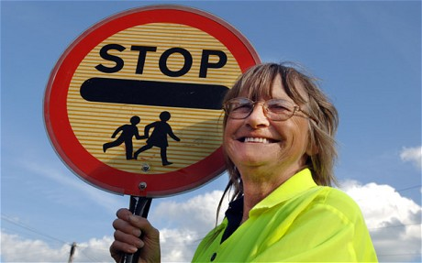
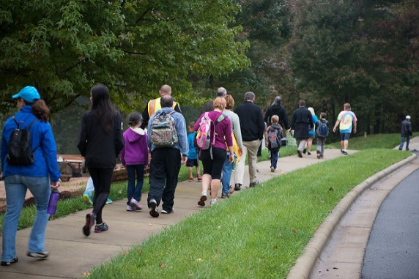
Walk to School Week 2018
The annual event encourages parents and pupils to leave the car at home for school journeys and be healthy and walk to school.
Walking to school means :-
Fewer cars arriving at the start and end of the school day means less pollution and congestion at the school gates
Parents and pupils have an opportunity to practise road safety skills
Its an easy way to exercise each day

Slide 5
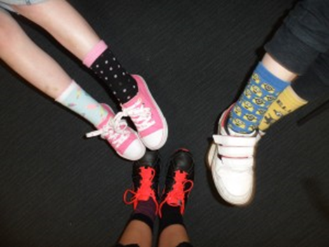
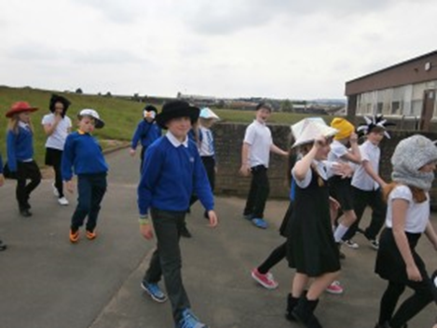
Walk to School Week 2018
The daily fun theme for 2018 to help encourage more pupils to walk to school is :-
Monday - Walk to school wearing sunglasses
Tuesday - Walk to school wearing happy shoes
Wednesday - Walk to school wearing odd socks
Thursday - Walk to school with crazy hair

Slide 6
Walk to School Week 2018
Let your feet do the walking and have a great Walk to School Week

