Slide 1
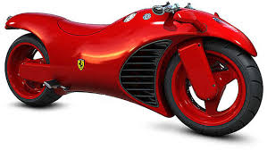
Question 1 4 marks
Aesthetics is an important aspect to consider when designing new products. What aesthetic factors would a design team have considered when designing this bike?

Slide 2
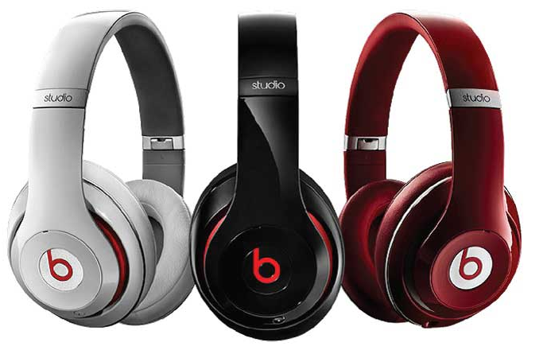
Question 2 1 mark
State a suitable material for the manufacture of these beats headphones.
Question 3 4 marks
Describe the properties that would make this material a suitable choice.

Slide 3
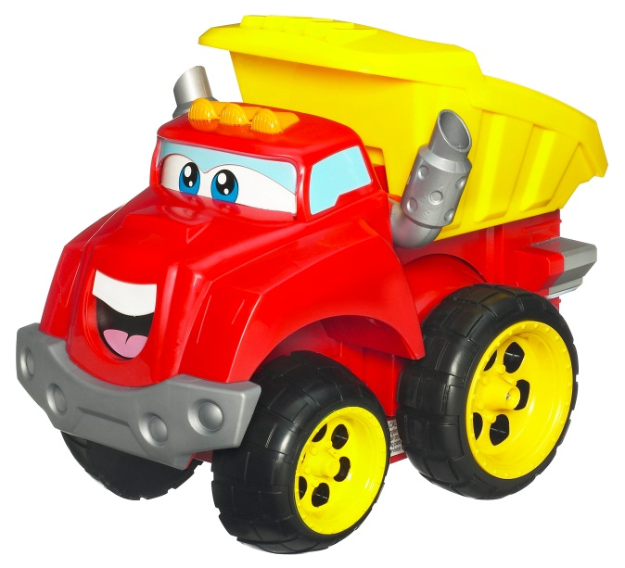
Question 4 1 mark
State the process that this toy would have been manufactured by.
Question 5 6 marks
Explain why this manufacturing process is suitable for the toy.

Slide 4
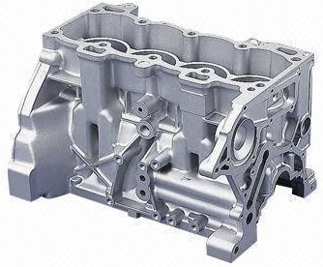
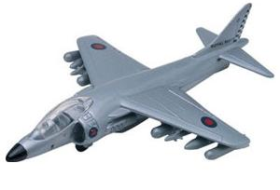
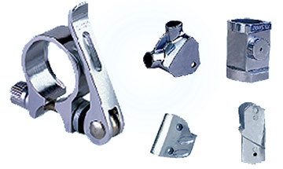
Question 6 1 mark
State the process used to manufacture these products.
Question 7 2 marks
Name two materials suitable for this process

Slide 5
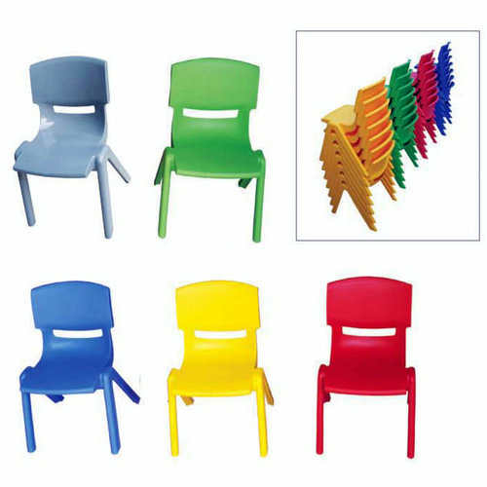
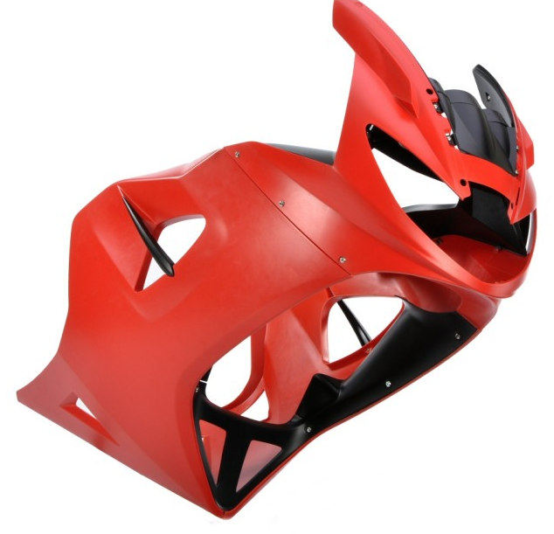
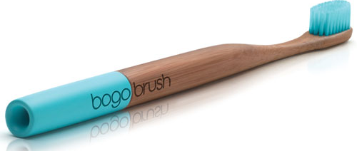
Question 8 4 marks
Describe performance considerations for the chairs.
Question 9 2 mark
State which manufacturing process is suitable for these products.

Slide 6
Question 10 4 marks
Explain ways in which designers can reduce the environmental impact of their products.
(You may wish to refer to products with which you are familiar.)

Slide 8
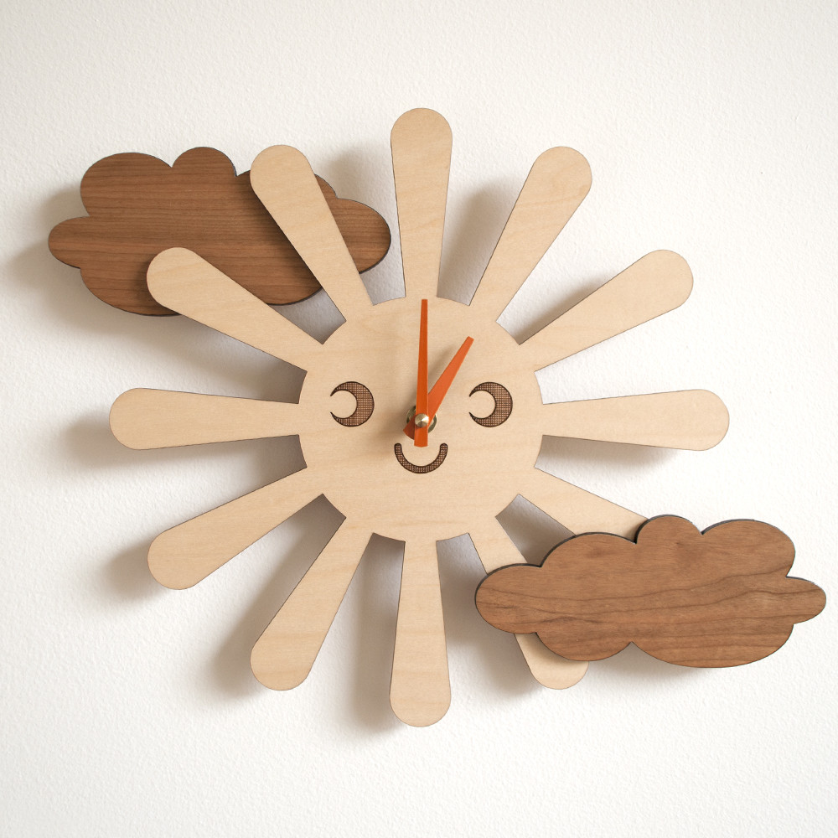
Total 11 marks
Question 11 1 mark
State a suitable hardwood for the clouds.
Question 12 2 marks
Why is this a suitable material.
Question 13 4 marks
Describe the stages for making the sun shape in the workshop.
(marking, cutting, shaping, assembling)
Question 14 4 marks
The clouds are identical components. Describe two methods a student could use to ensure this accuracy.

Slide 9
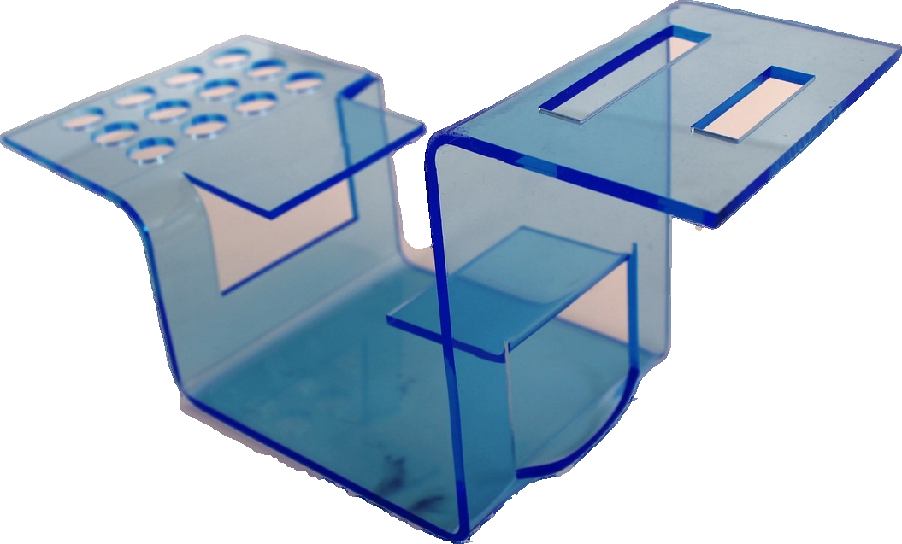
Total 11 marks
Question 15 1 mark
State a suitable material for the workshop manufacture of this product.
Question 16 3 marks
Explain why your choice of material would be suitable.
Question 17 1 mark
The desk tidy has been shaped and bent into this profile. Name a piece of workshop equipment used for this process.
Question 18 6 marks
Describe the stages for marking out, heating and shaping.

Slide 10
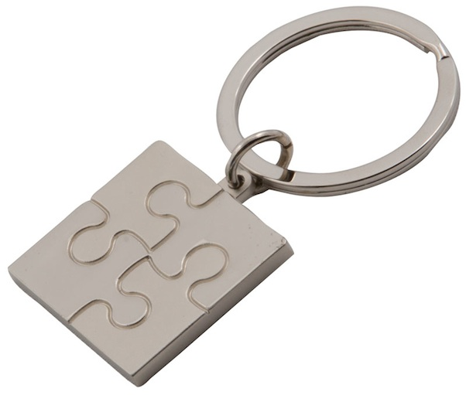
Total 12 marks
Question 19 3 marks
Which properties make aluminium a good material choice for this keytag.
Question 20 2 marks
Describe how to mark out the design and shape of this aluminium keytag.
Question 21 5 marks
Outline the stages to be carried out when cutting and shaping this keytag from a sheet of aluminium.
Question 22 1 mark
State a piece of equipment suitable for creating the puzzle design.
Question 23 1 mark
Suggest a commercial manufacturing process that could create this keytag?

