Slide 1
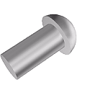
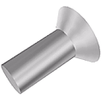
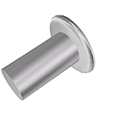
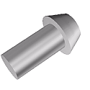
Types of rivets
Solid Rivets
Snap head rivet
These round-headed rivets were commonly used in large structural work where strength is needed. In traditional boiler-making, ship building and bridge girder construction for example, large iron Snap Head Rivets were passed through the plates to be joined and hammered over whilst red hot. This not only made the hammering over easier but, as the iron rivet cooled, the joint tightened due to its contraction. Much of this type of work is now welded rather than riveted.
Countersunk head rivet
Abbreviated to Csk.Hd Rivets, these are seated within a countersunk hole and used where a flush finish is required but, as a consequence, they support lower loads.
Flat head rivet
These are a compromise in that they are useful where a large protrusion might be an issue and can carry higher loads than Csk.Hd. Rivets. They useful for sheet metalwork structures where the thickness of sheet precludes countersinking.
Pan head rivets
Used in a similar way to Snap Head Rivets but chosen where maximum strength is needed.

Slide 2
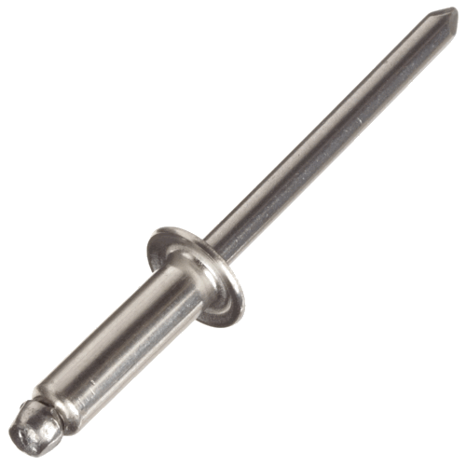
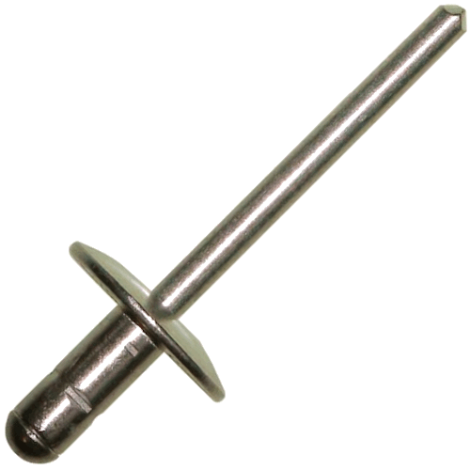
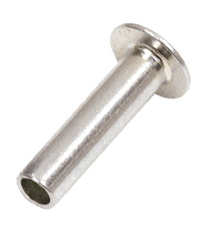
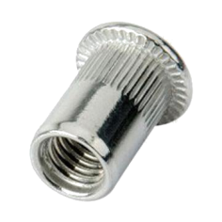
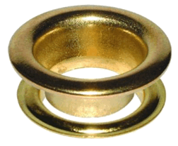
Types of rivets
‘Pop’ Rivets
Domed head ‘pop’ rivets
Also known as Blind Rivets these have the advantage of being able to be applied from just one side of the material by squeezing them with Rivet Pliers or Tongs.
Large flange ‘pop rivets
A large head variation, useful when riveting together softer materials. They are often used with a Backing Washer on the reverse side if very soft materials are to be joined.
Specialised rivets
Hollow rivet The hollow end of these rivets means they can be closed with much less force and therefore used for lighter constructions in softer materials
Rivet Nut
These provide a means of inserting a threaded hole into thin sheet materials. They are first screwed on to an adapter, on a Mandrel then fixed in a similar manner to 'Pop' Rivets
Eyelet Although not a rivet as such, these are applied in much the same way using a punch and die. They are often used to thread fixing cords or ropes to the edge of fabrics (e.g. for car trailer and boat covers)

