Slide 1
National 5
Practical Metalworking
During the Practical Metalworking course you will develop skills, knowledge and understanding of:
Safe working practices in workshop environments
Metalworking Techniques
Measuring and marking out metal sections and sheet materials
Practical creativity and problem-solving skills
Sustainability issues in a practical metalworking context
Areas of study: Bench Skills / Machine Processes / Fabrication & Thermal Joining
Notes:
A short word on the course structure and areas of study.
Point out key knowledge and understanding A3 sheets on wall.

Slide 2
Practical Metalworking
National 5
Finishing Metal
Paint
Dip Coating

Slide 3
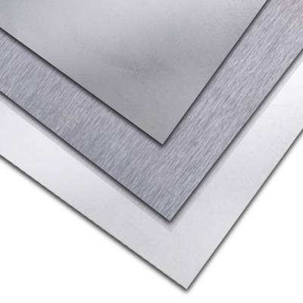
Finishing metal
Metal finishes are used to treat the exterior of a metal product, sometimes by applying a thin complementary layer to its surface. There are numerous types of metal finishing processes that can be used for a variety of purposes. Some of the general advantages of applying finishes to metal include: Increased durability, Improved decorative appeal, enhanced electrical conductivity, higher electrical resistance, higher chemical resistance or higher tarnish resistance.

Slide 4
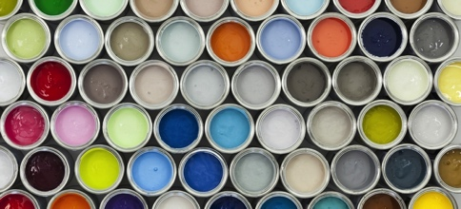
Finishing metal
Paint can be used to create an aesthetically pleasing finish and to protect metal. Today there are many advanced paints that have specific properties to enhance your metal product. Paint is the most commonly used material to protect steel. Paint systems for steel structures have developed over the years to comply with industrial environmental legislation and in response to demands from bridge and building owners for improved durability performance.
Paint easily flakes off of metal if applied directly to the surface. To prevent this, primer is used. It is like paint except it is designed to fill in the microscopic gaps in the material and stick to it. Applied over primer, paint adheres much better.
Primer also works as a protective agent. It resists moisture for materials that have no inherent water resistance. With most metals, without primer, oxidation would immediately begin once exposed to moisture.

Slide 5
Finishing metal
Dip Coating can be used

