Slide 1
National 5
Practical Metalworking
During the Practical Metalworking course you will develop skills, knowledge and understanding of:
Safe working practices in workshop environments
Metalworking Techniques
Measuring and marking out metal sections and sheet materials
Practical creativity and problem-solving skills
Sustainability issues in a practical metalworking context
Areas of study: Bench Skills / Machine Processes / Fabrication & Thermal Joining
Notes:
A short word on the course structure and areas of study.
Point out key knowledge and understanding A3 sheets on wall.

Slide 2
Practical Metalworking
National 5
Unit 3: Thermal Joining & Fabrication
Arc Welding
Safety Rating: (High)

Slide 3
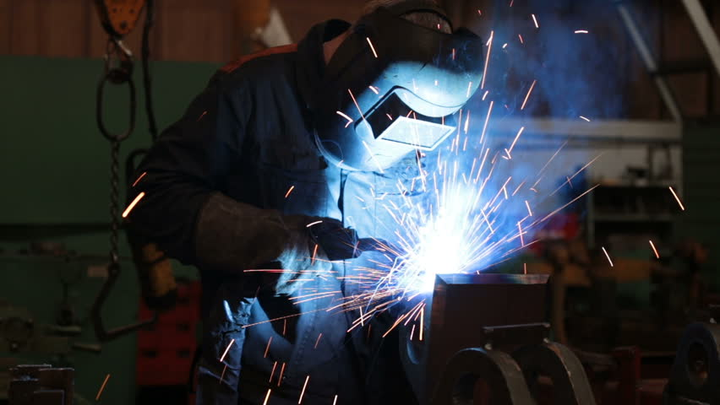
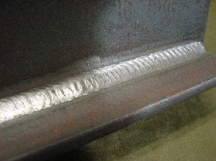
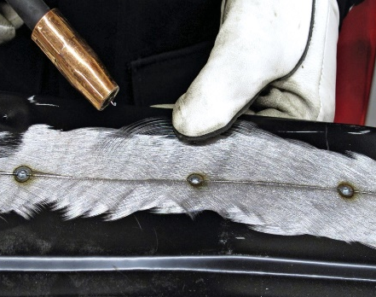
Thermal Joining & Fabrication
Arc Welding
Arc welding is a process that is used to join metal to metal by using electricity to create enough heat to melt them together. It is a type of welding that uses a power supply to create an electric arc between an electrode and the base material to melt the metals at the welding point. The welding region is usually protected by some type of shielding gas. Arc welding processes may be manual, semi-automatic, or fully automated.
The most common welding processes used for fabricating metals are; Gas Metal Arc welding (MIG), Flux Cored welding, Gas Tungsten Arc welding (TIG) and Shielded Metal Arc welding (stick electrode).

Slide 4
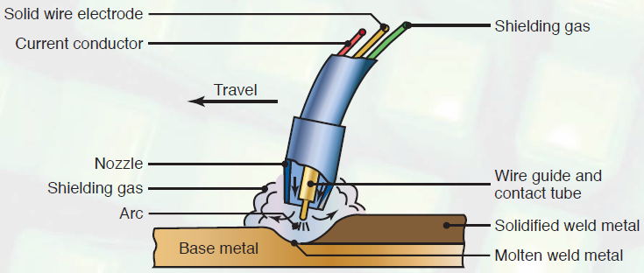
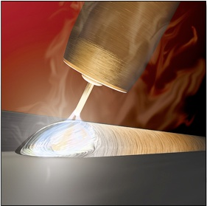
Thermal Joining & Fabrication
MIG Welding
The type of welding commonly used in a school workshop is a Gas Metal Arc Welding process called (MIG) welding. MIG stands for Metal Inert Gas. This process consists of feeding a bare metal filler wire in conjunction with a shielding gas through a hand held torch unit. The welding wire picks up electric current supplied by a power source. On contact, it creates an arc that does the welding.

Slide 5
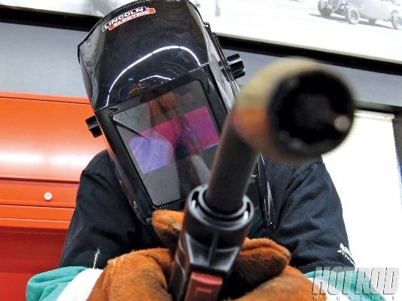
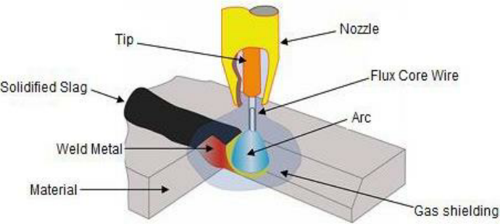
Thermal Joining & Fabrication
Flux Core Welding
A very similar type of welding, due to it using the same constant current equipment as MIG, is Self-shielded flux-cored welding. This is the type of welding we will be doing in the school workshop. This is also a wire welding process like MIG in which a continuous wire electrode is fed through the welding gun into the weld joint.
Self-shielded flux-cored welding differs from MIG welding in that it doesn’t require an external shielding gas in order to protect the weld pool from contamination. Instead of an external shielding gas, a flux compound contained within a hollow wire reacts with the welding arc to form a gas that protects the weld pool.

Slide 6
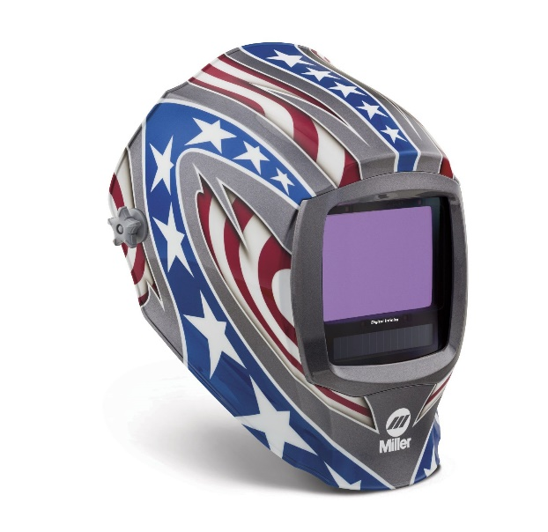
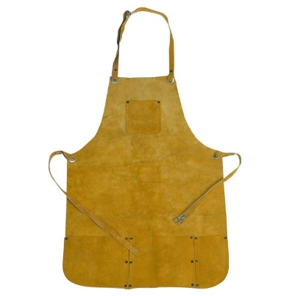
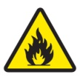
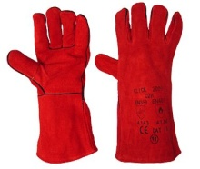
Thermal Joining & Fabrication
Safety / PPE
There are many health and safety issues to consider before setting up and using a welding rig. These include; ventilation, arc rays, spatter and electric shock.
Arc Rays are bright bursts of light that come from the welding arc and must not be directly looked at. The arc rays can cause retinal burning in the eye or ‘arc eye’. An automatic darkening mask must be worn to protect from these harmful rays.
When welding we must also wear a leather apron and leather Gauntlets to protect from spatter (small droplets of molten material). It is also advised that the welder wear toe-capped boots or leather footwear.

Slide 7
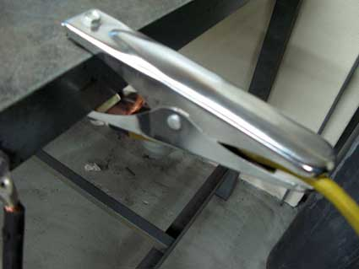
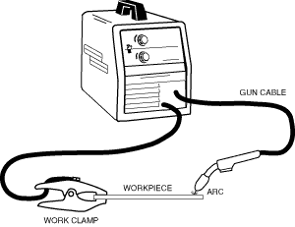
Thermal Joining & Fabrication
Safety / PPE
Before welding you must also ensure the earth clamp (shown below) is secured to the work piece to be welded. The metal should be free from any paint, dirt or grease. This will ensure a good welding circuit.

Slide 8
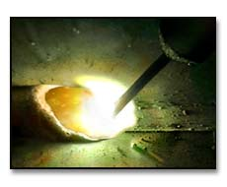
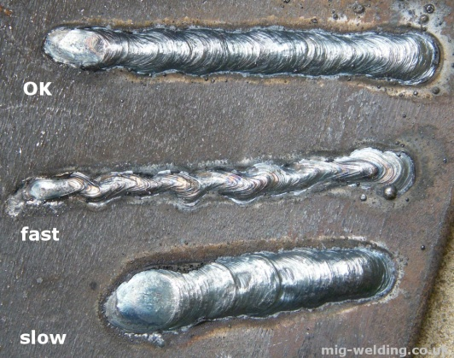
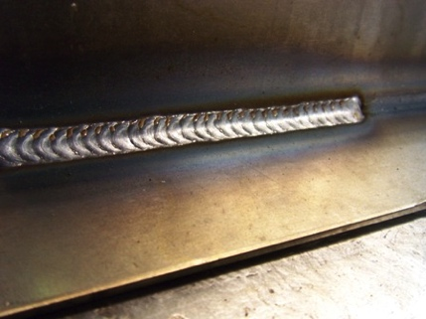
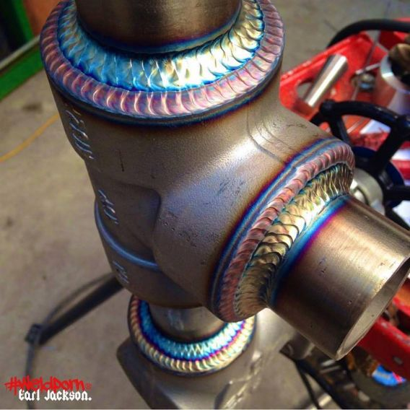
Thermal Joining & Fabrication
The Weld – Practice Makes Perfect!
Welding is a process that takes a lot of practice to perfect. Once the power and feed setting are right, it is all about experience and technique. Ideally, the arc should be slightly moved back and forth across the seem to be welded. The most attractive welds are likened to a stack of pennies.

Slide 9
Quiz Questions 13
Record answers in your notes jotter
Name two common welding processes?
Name the type of welding process we will be using in the workshop?
What Personal Protective Equipment must be considered when welding?
4. Why is a shielding gas used with arc welding?
5. Why is it important to clean metal from paint, dirt and grease before welding?
6. What does MIG stand for?

Slide 10
Quiz Questions 13
Record answers in your notes jotter
Name two common welding processes?
MIG and TIG welding
2. Name the type of welding process we will be using in the workshop?
Flux Cored Welding
What Personal Protective Equipment must be considered when welding?
Welding mask, Leather apron, Gauntlets
4. Why is a shielding gas used with arc welding?
To protect the weld pool
5. Why is it important to clean metal from paint, dirt and grease before welding?
To ensure a good weld circuit
What does MIG stand for?
Metal Inert Gas

