Slide 1
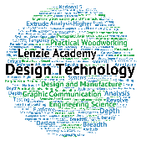
National 5
Practical Metalworking
During the Practical Metalworking course you will develop skills, knowledge and understanding of:
Safe working practices in workshop environments
Metalworking Techniques
Measuring and marking out metal sections and sheet materials
Practical creativity and problem-solving skills
Sustainability issues in a practical metalworking context
Areas of study: Bench Skills / Machine Processes / Fabrication & Thermal Joining
Notes:
A short word on the course structure and areas of study.
Point out key knowledge and understanding A3 sheets on wall.

Slide 2
Practical Metalworking
National 5
Unit 2: Machine Processes
- Alternative Cutting Processes

Slide 3
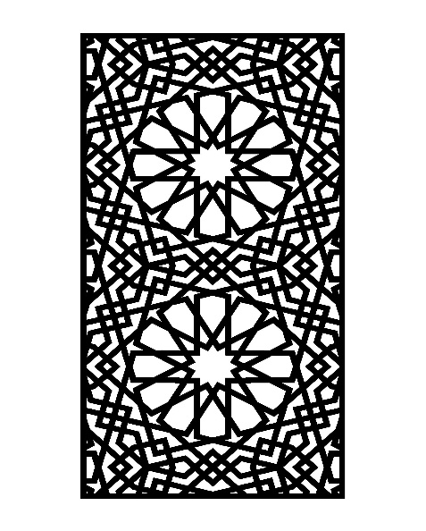
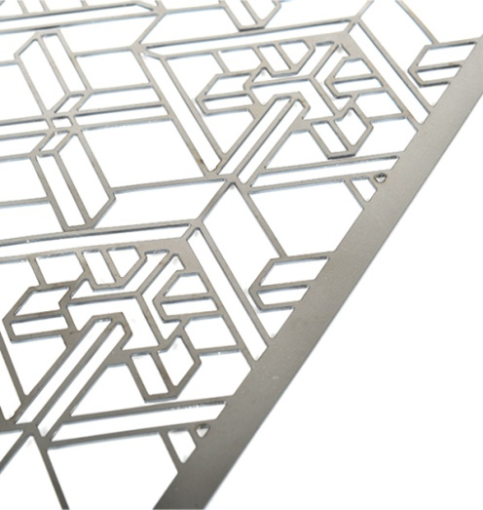
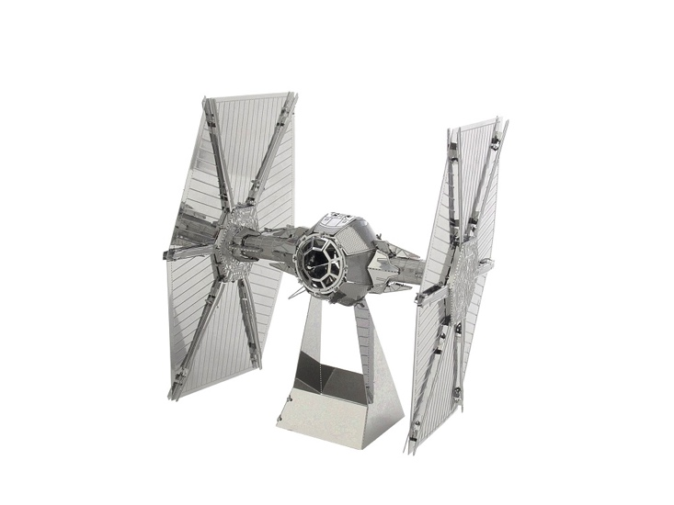
Machine Processes
Alternative Cutting Methods
As you now know, cutting is one of the most important processes for metal fabrication. In most cases, it is also the first process to consider. In order to produce a quality product, metal needs to be cut with precision and expertise. Not all jobs are the same and of course different metals differ in quality and properties and therefore different cutting methods are sometimes required to cut them.

Slide 4
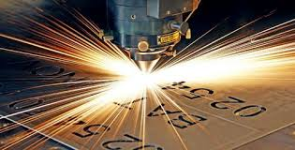
Machine Processes
Laser Cutting
Today laser cutting is a very popular way of cutting metal due to it’s accuracy of cut and relatively quick production time. High powered and concentrated beams of light facilitate the cutting of the metal with the help of a focus lens.
Laser cutting is an automated process where the design is uploaded to the laser cutter via a paired computer software package. Most software used in conjunction with laser cutting equipment is easy to setup and use. Laser cutting is a consistent and precise process for detailed work.

Slide 5
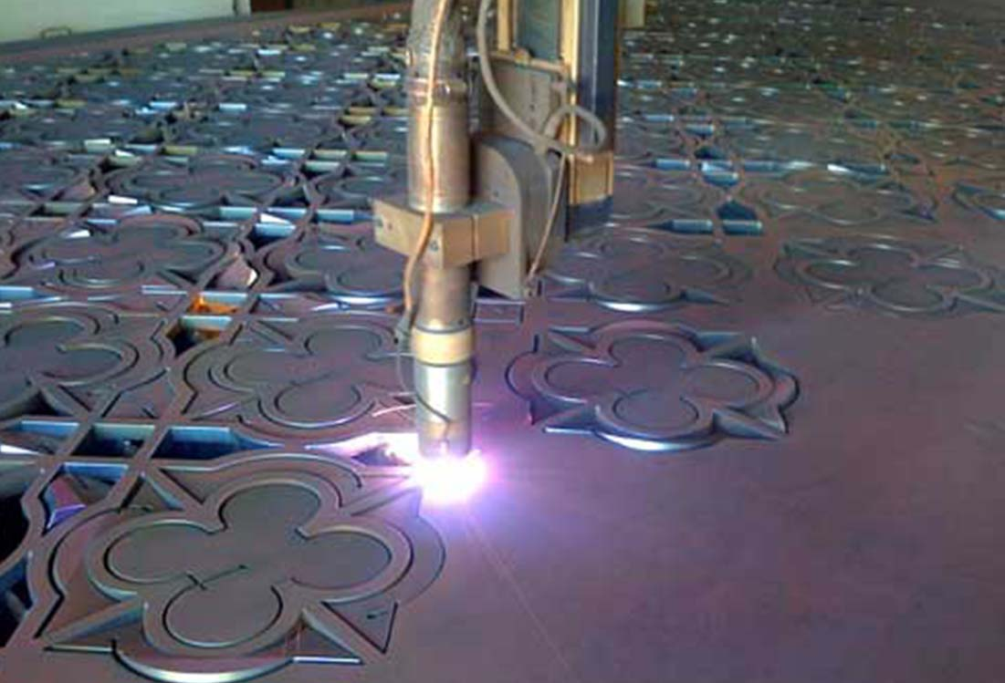
Machine Processes
Plasma Cutting
Another accurate metal cutting process is Plasma (arc) cutting. Plasma cutting was developed in the 1950s for cutting of metals that could not be flame cut, such as stainless steel, aluminum and copper.
The plasma arc cutting process uses electrically conductive gas to transfer energy from a power source through a plasma cutting torch to the material being cut. The temperature of the plasma arc melts the metal and pierces through the workpiece while the high velocity gas flow removes the molten material from the bottom of the cut, or the kerf.

Slide 6
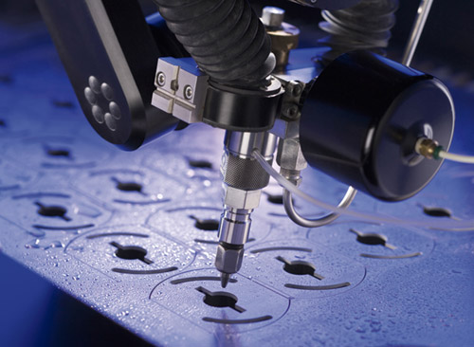
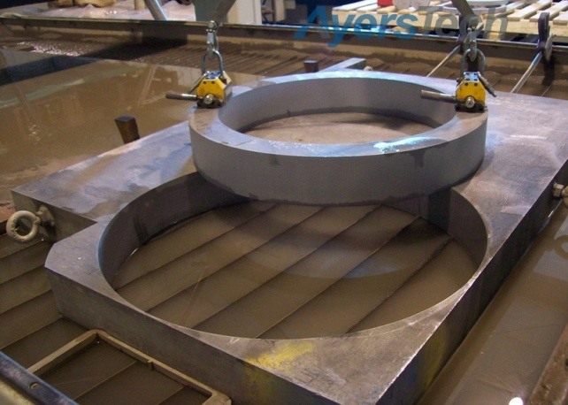
Machine Processes
Water Jet Cutting
Water jet cutting is another automated process used to cut materials using a jet of pressurized water as high as 60,000 pounds per square inch (psi). Often, the water is mixed with an abrasive like garnet (a type of gemstone) that enables more materials to be cut cleanly and with a very good edge finish. Water jets are capable of cutting many industrial materials including stainless steel, titanium, aluminium, tool steel, granite, and armor plate. Although this is another very accurate process, it does generate significantly more noise than other cutting processes.

Slide 7
Research Task
Look at other options for cutting metal in an industrial setting.
What are the advantages and disadvantages of these?
What environmental/sustainability issues may surround these?

