Slide 1
National 5
Practical Metalworking
During the Practical Metalworking course you will develop skills, knowledge and understanding of:
Safe working practices in workshop environments
Metalworking Techniques
Measuring and marking out metal sections and sheet materials
Practical creativity and problem-solving skills
Sustainability issues in a practical metalworking context
Areas of study: Bench Skills / Machine Processes / Fabrication & Thermal Joining
Notes:
A short word on the course structure and areas of study.
Point out key knowledge and understanding A3 sheets on wall.

Slide 2
Practical Metalworking
National 5
Unit 2: Machine Processes
Lathe
Safety Rating: (High)

Slide 3
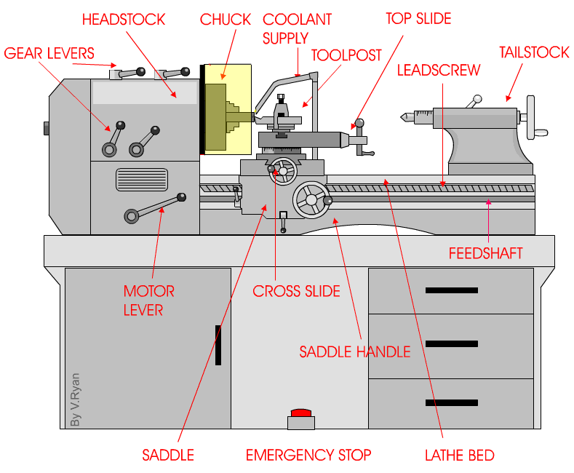
Machine Processes: Lathe
The Lathe
The purpose of a metal lathe is to shape metal bar into various desired shapes. The work piece (metal bar) is secured to a rotating three jaw chuck. The cutting tools which are made from High Speed Steel (HSS) are then secured in the tool post. An electric motor spins the work piece to which the cutting tools are then brought into contact with.
COMPOUND SLIDE

Slide 4
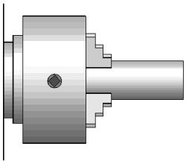
Safety Checks: Lathe
The Lathe
When using the Centre Lathe it is important to run through some safety checks before any operations are started. Listed below are standard checks that MUST be carried out by all pupils:
Always ensure work piece is secure in chuck
Always ensure the chuck key is removed from chuck
Ensure that guards are in place before operation
Check that cutting tools are in good condition and aligned properly

Slide 5
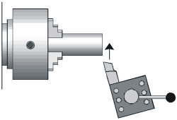
Machine Processes: Lathe
The Lathe
CHUCK
CENTRE
AXIS
Work piece secured in THREE JAW CHUCK. If turning flat bar a FOUR JAW CHUCK would be used.
Before starting to shape the metal bar it is essential to FACE OFF the end of the bar. This basically means to make the end of the bar perfectly square to the sides of the bar.
WORK PIECE
TOOL POST
When facing off a piece of round bar it is essential to ensure the cutting knife is lined up centrally to the bar. If it is not a PIP will develop which means the face of the bar will not be truly flat.
PIP

Slide 6
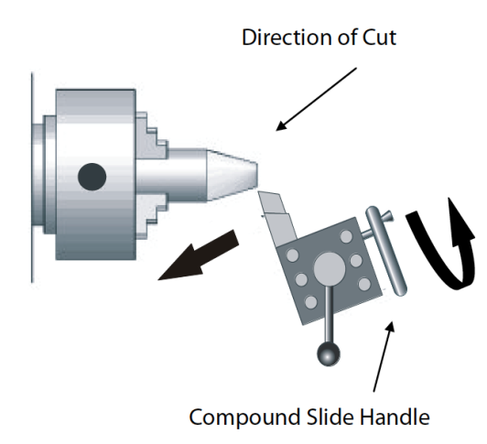
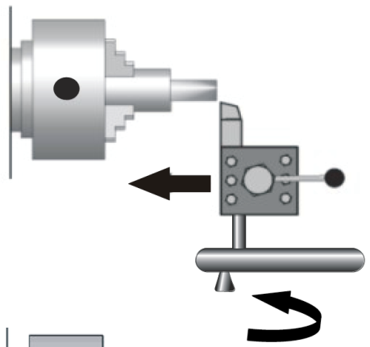
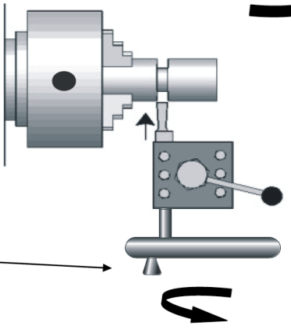
Machine Processes: Lathe
The Lathe
TAPER TURNING is where the tool moves along the bar at an angle moving further away from the centre axis of the bar.
DIRECTION OF CUT
PARALLEL TURNING is a technique that moves the tool parallel to the centre axis of the bar.
COMPOUND SLIDE HANDLE
PARTING OFF is when all turning work has been completed and the final task is to ‘Part Off” (remove the turned piece from the bar secured in the three jaw chuck).
SADDLE HANDLE

Slide 7
Machine Processes: Lathe
Shown below are commonly used metal lathe cutting tools.
PARTING TOOL
ROUND NOSE
TOOL
RH KNIFE
LH KNIFE
The best lathe cutting tools are made from high speed steel. Diagram A shows a typical solid lathe tool. The shank is clearly shown, this is the part that is fixed into the toolpost. Diagram B shows another type. This is a tool holder. A small lathe tool made of high speed steel is tightened into the cast steel tool holder. The advantage of this type is that the smaller tools are cheaper to buy.

Slide 8
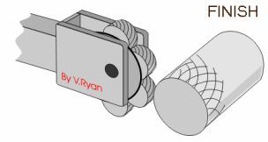
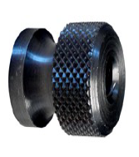
Machine Processes: Lathe
Knurling Tool
The ‘Knurling tool’ is used to cut a straight or diamond pattern into the metal bar. The process is usually done to provide a hand grip.
Knurled Bar
A ‘Knurled bar’ shown opposite is a bar which has been knurled with a diamond pattern.

Slide 9
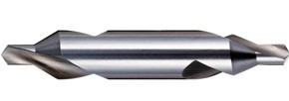
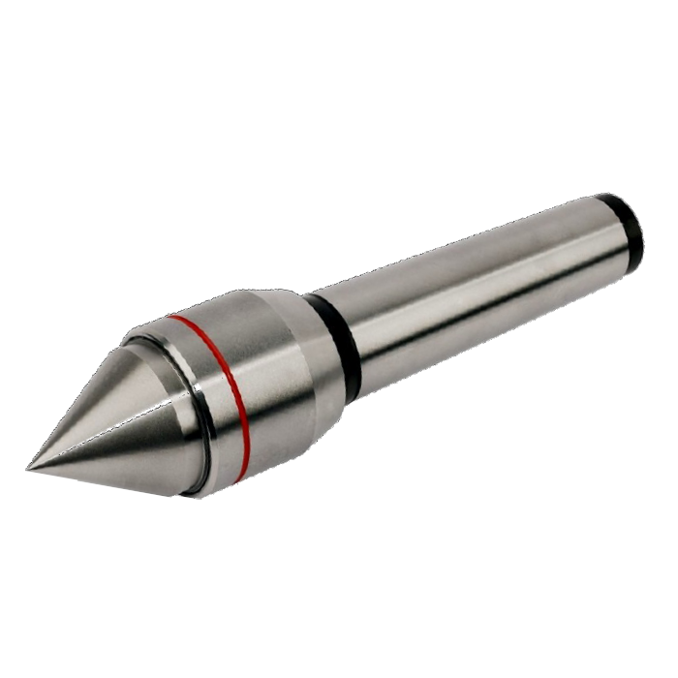
Machine Processes: Lathe
Slocombe Or Centre Drill
This is a drill and countersink combined. It is used to drill a hole in one end of a piece of bar so as to accommodate the revolving centre as shown below. As it is not possible to punch holes prior to drilling.
Revolving Centre
The revolving centre is secured in the tailstock. The bar to be turned is secured at one end by the chuck and held in place at the other end using the revolving centre. The revolving centre allows the bar to rotate freely allowing turning between centres.

Slide 10
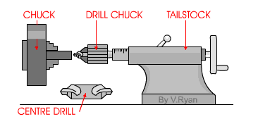
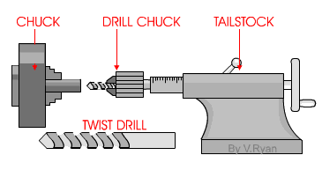
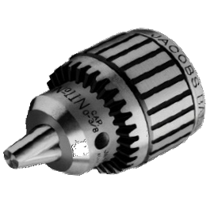
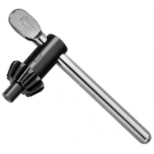
Machine Processes: Lathe
Drilling on the Lathe
The starting point for drilling with a lathe is to use a centre drill bit. This is used to drill slightly into the material and creates a starting point for other drills that are going to be used. Attempting to drill with a traditional drill bit without countersinking first will lead to the drill bit slipping. It is not possible to drill a hole successfully or safely without using a centre drill first.
Jacobs Chuck
This tool is placed in the tailstock of the centre lathe and is used to hold drill bits. The drill bit is secured or removed using a special key called a ‘Chuck Key’.

Slide 11
Quiz Questions 9.0
Record answers in your notes jotter
1. What two types of slide are mounted to the saddle of the Lathe?
2. What part of the Lathe do you secure your work piece in?
What happens to the end of the bar if the cutting knife is not lined up correctly?
4. What are the four most common cutting tools?
Name the tool I can use to mark a hand grip on a length of bar?
6. What is the other name given to the Slocombe bit?
7. Why is it important to use this?
8. What part of the lathe would the Jacobs Chuck be fitted to?

Slide 12
Quiz Questions 9.0
Record answers in your notes jotter
1. What two types of slide are mounted to the saddle of the Lathe?
Cross and Compound slide
2. What part of the Lathe do you secure your work piece in?
The Chuck
What happens to the end of the bar if the cutting knife is not lined up correctly?
Develops a ‘Pip’
4. What are the four most common cutting tools?
Parting / Round Nose / LH Knife / RH Knife
Name the tool I can use to mark a hand grip on a length of bar?
Knurling Tool
6. What is the other name given to the slocombe bit?
Centre Drill Bit
7. Why is it important to use this?
Too ensure the Twist drill does not slip off centre when drilling
8. What part of the lathe would the Jacobs Chuck be fitted to?
Tailstock

