Slide 1
National 5
Practical Metalworking
During the Practical Metalworking course you will develop skills, knowledge and understanding of:
Safe working practices in workshop environments
Metalworking Techniques
Measuring and marking out metal sections and sheet materials
Practical creativity and problem-solving skills
Sustainability issues in a practical metalworking context
Areas of study: Bench Skills / Machine Processes / Fabrication & Thermal Joining
Notes:
A short word on the course structure and areas of study.
Point out key knowledge and understanding A3 sheets on wall.

Slide 2
Practical Metalworking
National 5
Unit 1: Bench Skills
-Internal & External Threads

Slide 3
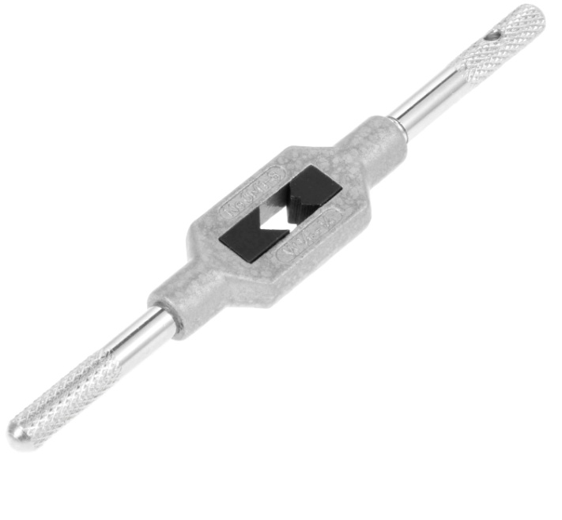
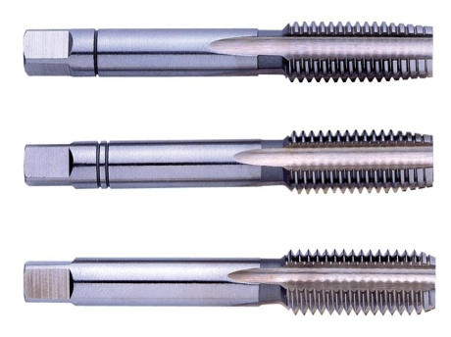
Bench Tools: Cutting
Tapping Internal Threads
To achieve an internal screw thread, a hole has to be drilled first and then a tool called a ‘TAP’ is used to cut a thread within the hole. Taps are made from high speed steel (HSS). The top of the tap is square which enables the tap to be held securely in a ‘TAP WRENCH’, which can be seen below.
Taps are generally available in sets of three and are used in the following order: -
Taper
Second
Plug

Slide 4
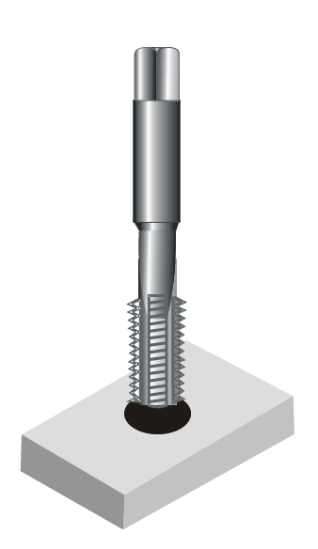
Bench Tools: Cutting
Tapping Internal Threads
In order to cut a clean internal thread, taps are used in sequential order. The Taper tap has much smaller teeth at the bottom than the Second or the Plug taps. This allows the taper tap to get started by making a shallower thread cut.
The taper cut is followed by the second tap which has slightly more teeth. Finally, the Plug tap is used which will make the full thread cut.
It is also important to use a suitable lubricant when cutting a thread.

Slide 5
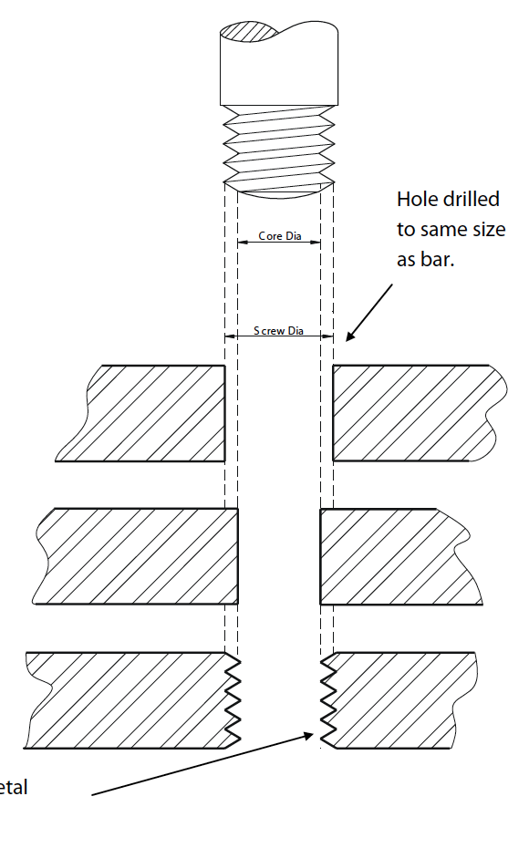
Bench Tools: Cutting
Tapping Internal Threads
When tapping a thread in an internal hole the actual diameter of the hole to be drilled must be smaller than the actual overall size of the thread to be cut. An explanation of this is shown in the sketch opposite.
The drawing shows that if a hole was drilled which was the same size as the threaded bar, the bar would just fall through. The hole which must be drilled must therefore be smaller in diameter so as to allow the TAP to cut the threads.
HOLE DRILLED TO
SAME SIZE AS BAR
THREADS CUT INTO METAL

Slide 6
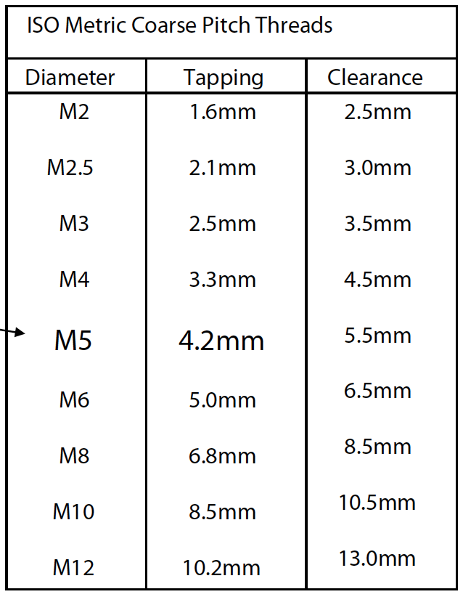
Bench Tools: Cutting
Tapping Internal Threads
The table opposite shows the diameter of hole which would be required to be drilled prior to tapping. E.g. if an M5 (Metric 5mm) thread has to be cut, the size of hole to be drilled will be 4.2mm.

Slide 7
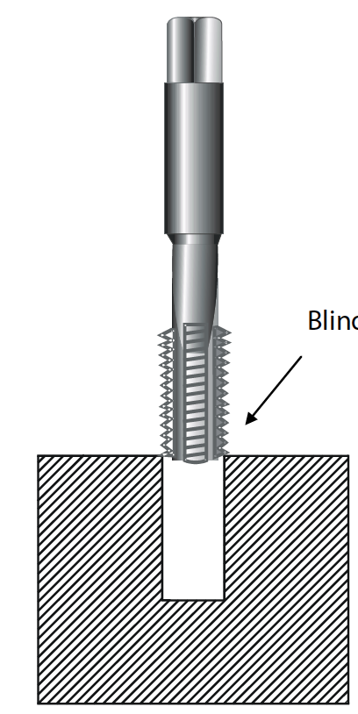
Bench Tools: Cutting
Tapping Internal Threads
Blind Hole:
A blind hole is a hole which has a bottom to it. If a blind hole is to be threaded it is very important to ensure that the depth of the hole is established before commencing to thread the hole. If this is not established it would be very easy to break the taps. A piece of tape attached to the tap indicating the depth is an ideal way of avoiding the tap from being broken by being forced into the bottom of the hole.
BLIND HOLE

Slide 8
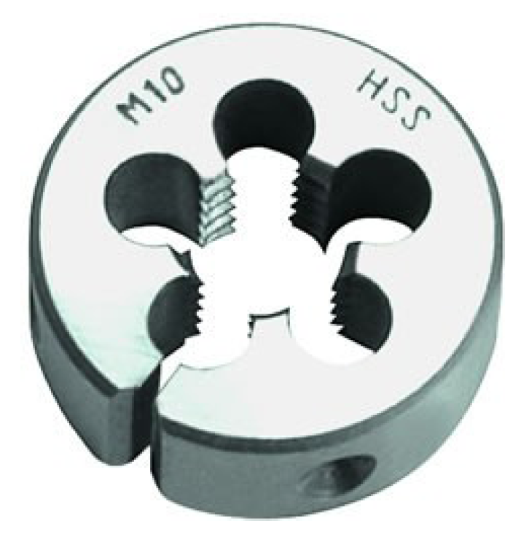
Bench Tools: Cutting
Cutting External Threads
To cut an external thread on a metal rod a tool called a ‘DIE’ is used. The picture opposite shows a split die, this is the most common type of die used in the school workshop. These are used for cutting external threads. The die is made from high speed steel (HSS).
To assist in starting the thread cut, the split die has a split which enables the die to be opened slightly thus cutting a shallower cut.
Circular Split Die

Slide 9
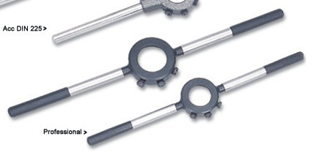
Bench Tools: Cutting
Cutting External Threads
The circular split die fits into a ‘DIE STOCK’ with the tapered side of the thread (shown by the writing on the die). The split in the die fits opposite the centre screw to allow the opening and closing of the die. The two screws at the side hold the die in the stock. To ensure the die can start to cut a thread on the rod the rod must firstly be chamfered at the end.

Slide 10
Quiz Questions 7.0
Record answers in your notes jotter
1. What tool do we use to cut an internal thread?
2. What must we also use when we are cutting a thread?
3. What three types of tap are used when cutting internal threads?
4. What is a blind hole?
What tool do we use to cut an external thread?
What do we use to hold this tool?
What must we do to prepare the bar before cutting the external thread?
What will happen if we tighten the centre screw?

Slide 11
Quiz Questions 7.0
Record answers in your notes jotter
1. What tool do we use to cut an internal thread?
A Tap
2. What must we also use when we are cutting a thread?
A Lubricant. Oil/Grease
3. What three types of tap are used when cutting internal threads?
Taper, Second and Plug
What is a blind hole?
A hole of a certain depth. Not right through
What tool do we use to cut an external thread?
A Die
What do we use to hold this tool?
A Die Stock
What must we do to prepare the bar before cutting the external thread?
Chamfer
What will happen if we tighten the centre screw?
Reduce the depth of cut/thread

