Slide 1
National 5
Practical Metalworking
During the Practical Metalworking course you will develop skills, knowledge and understanding of:
Safe working practices in workshop environments
Metalworking Techniques
Measuring and marking out metal sections and sheet materials
Practical creativity and problem-solving skills
Sustainability issues in a practical metalworking context
Areas of study: Bench Skills / Machine Processes / Fabrication & Thermal Joining
Notes:
A short word on the course structure and areas of study.
Point out key knowledge and understanding A3 sheets on wall.

Slide 2
Practical Metalworking
National 5
Unit 1: Bench Skills
- Riveting
Safety Rating: (Low)

Slide 3
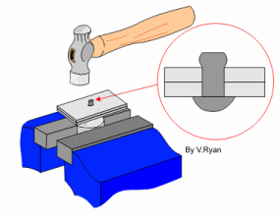
Bench Skills: Riveting
Riveting is the process of joining two or more pieces of metal together permanently. The process uses metal plugs, more commonly known as rivets. To form the joint, the shank of the rivet is passed through a previously drilled hole in the components to be joined, it is then cut to size and spread or shaped, thus preventing the parts from separating.

Slide 4
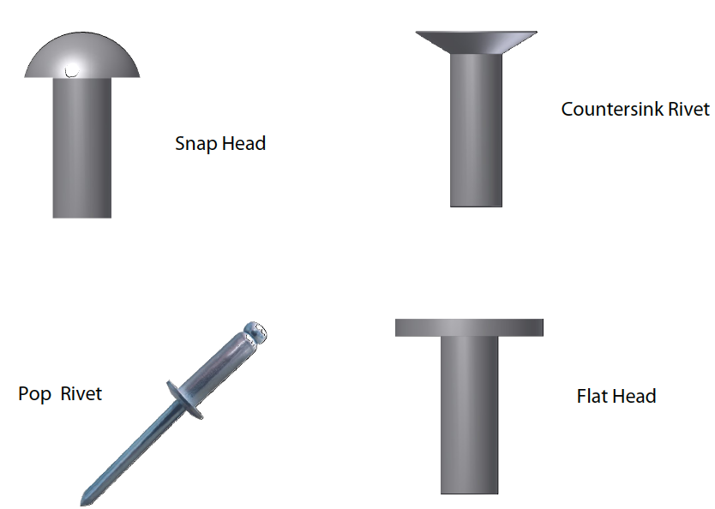
Bench Skills: Riveting
Rivets
Rivets are classified by the shape of the head, their diameter and length. Common rivet head shapes are round (or snap), countersunk, pan and flat. Other types of rivet you may find in the workshop are BIFURCATED and POP rivets. In general the type of work at hand will determine the type of rivet to use.
Rivets are made in most types of metal; e.g. mild steel, copper, stainless steel, brass, aluminium. When using a rivet always ensure that the rivet being used is the same material as the metals being joined or it can result in aggravated corrosion at the rivet site.
Notes:
Bifurcated rivets have a split shank that is opened out when inserted through plate. Like little gold paper fasteners used in schools!

Slide 5
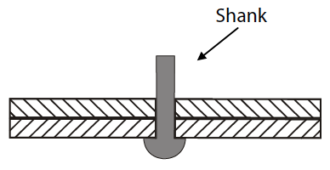
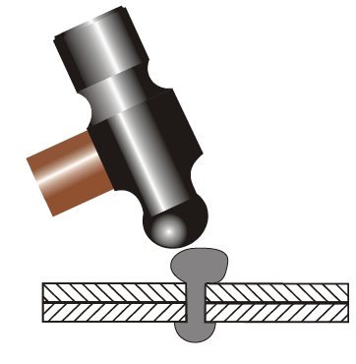
Bench Skills: Riveting
Snap Head Riveting Process
In the sketch shown opposite the rivet is placed through the two sheets of metal. The shank of the rivet is then cut to the desired length. This length is generally 1.5 times the diameter of the rivet. E.g. if the diameter of the rivet is 5mm then the length to be
measured above the sheet metal on the shank will be 5mm x 1.5 = 7.5mm.
The next stage of the operation is to shape the shank of the rivet to the approximate shape of the final head using the ball end of the Ball Pien hammer.

Slide 6
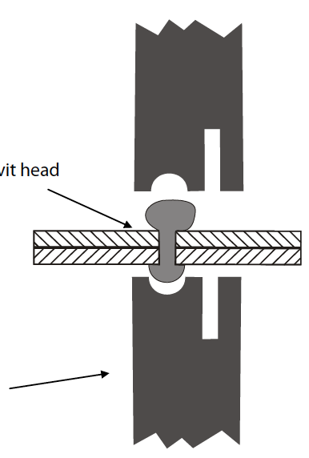
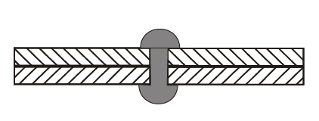
Bench Skills: Riveting
Snap Head Riveting Process
The final stage is to place one rivet set into an Engineers vice, place the rounded head of the rivet into the indent in the rivet set as shown. Next place the other half of the rivet set on top of the shaped head and hit it with a hammer until desired shaped has been achieved.
You should already be familiar with the rivet ‘Set & Snap’ from earlier lessons.
Shaped
rivet head
Rivet set secured
In Engineers vice
The sketch opposite shows the completed riveting of two sheets of metal using a snap head rivet.

Slide 7
Quiz Questions 5.0
Record answers in your notes jotter
Name four types of rivet.
What is the name given to the long part of the rivet?
What can happen if you select an unsuitable metal for your rivet?
4. What type of rivet has a split shank?
5. What tool should be used to initially form the head on a solid rivet?
6. What is the name of the tool(s) used when finishing the head on a solid rivet?

Slide 8
Quiz Questions 5.0
Record answers in your notes jotter
Name four types of rivet.
Flat, Pan, Snap, Pop
2. What is the name given to the long part of the rivet?
Shank
3. What can happen if you select an unsuitable metal for your rivet?
Aggravated corrosion
4. What type of rivet has a split shank?
Bifurcated rivet
5. What tool should be used to initially form the head on a solid rivet?
Ball Pien Hammer
What is the name of the tool(s) used when finishing the head on a solid rivet?
Rivet Set & Snap

