Slide 1
National 5
Practical Metalworking
During the Practical Metalworking course you will develop skills, knowledge and understanding of:
Safe working practices in workshop environments
Metalworking Techniques
Measuring and marking out metal sections and sheet materials
Practical creativity and problem-solving skills
Sustainability issues in a practical metalworking context
Areas of study: Bench Skills / Machine Processes / Fabrication & Thermal Joining
Notes:
A short word on the course structure and areas of study.
Point out key knowledge and understanding A3 sheets on wall.

Slide 2
Practical Metalworking
National 5
Unit 1: Bench Skills
- Filing Metals
Safety Rating: (Low)

Slide 3
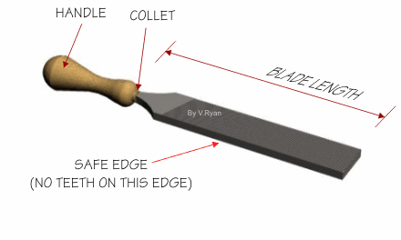
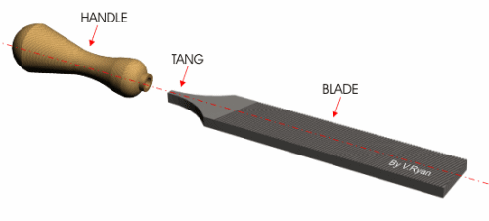
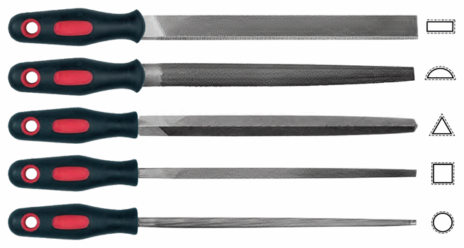
Bench Skills: Filing
The Anatomy of a File
The ‘File’ is used to cut, shape and finish metal.
The file comes in various shapes and cuts to suit different jobs.
FERRULE
Types of File
The ‘Tang’ secures the file into the handle and the ‘Ferrule’ (metal band at base of file handle) protects the handle from splitting. It is very important never to use a file with a damaged handle.

Slide 4
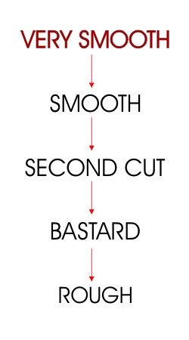
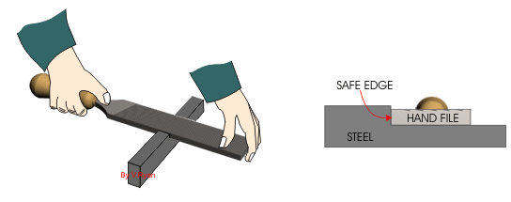
Bench Skills: Filing
Files are often graded according to the roughness/smoothness of cut. The file that has the least harsh teeth is graded as ‘very smooth’. The most abrasive of files is graded as ‘rough’. A file can have teeth cut once across the blade, this is called ‘single cut’. Therefore, ‘double cut’ as with most rough files, have teeth cut twice across the blade.
The safe edge of a file does not have teeth. This is extremely useful when filing in corners as shown in the diagram. The safe edge is placed into the corner and because it has no teeth it does not damage the surface.

Slide 5
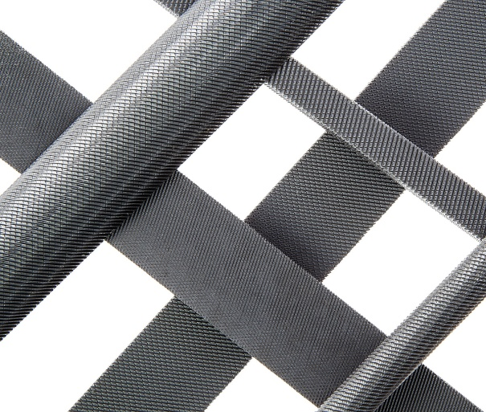
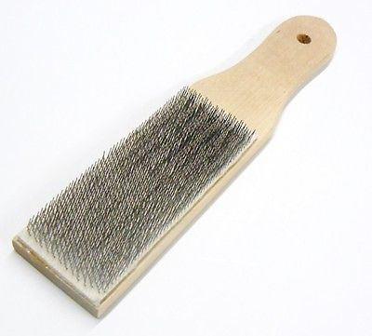
Bench Skills: Filing
The Filing Process
It is very important to first check your file and ensure the handle is secure and not damaged. Also, it is good practice to clean the file teeth of any metal debris with a ‘file card’.
It is also vital that you file your material following the very particular steps demonstrated by your teacher and outlined on the next slide. These will help with efficiency, productivity and also help to preserve the file itself.

Slide 6
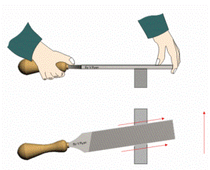
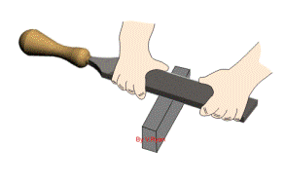
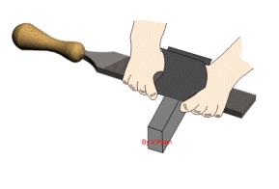
Bench Skills: Filing
The Filing Process
1. Files are normally held in both hands. The file is held flat against the surface it is to cut/smooth. The file is then pushed forward and it cuts on the forward stroke. To preserve teeth it is then lifted away and back to the starting point for the next push forward. This is called ‘cross filing’.
Cross Filing
2. The next stage is ‘draw filing’. The diagram shows how the file is held during this process. The file is held in both hands by the blade and pushed forwards and backwards along the material. This will further smooth the material.
Draw Filing
3. The third stage of filing a piece of metal is to use ‘emery cloth’. The emery cloth is held onto the blade of the file as shown in the diagram. When using emery cloth on steel a small amount of oil can be added which helps smooth the material even further.
4. Finally, finish/polish with ‘wet & dry’ paper.
Emery Cloth

Slide 7
Quiz Questions 3.0
Record answers in your notes jotter
1. What name is given to the handle insert on a file?
2. What can I use to clean the teeth on a metalwork file?
What is the name of the collar that protects a file handle from splitting?
4. What is the one thing I should do before I begin to file?
5. Name the type of vice that secures material when filing?
6. Name five different types of file?
7. What is the first stage of filing metal?
8. What is the name given to the cloth used to finish metal?

Slide 8
Quiz Questions 3.0
Record answers in your notes jotter
1. What name is given to the handle insert on a file?
Tang
2. What can I use to clean the teeth on a metalwork file?
File card
What is the name of the collar that protects a file handle from splitting?
Ferrule
4. What is the one thing I should do before I begin to file?
Check file for damage
5. Name the type of vice that secures material when filing?
Engineers Vice
Name five different types of file?
Flat, Half round, Round, Square, Triangular
7. What is the first stage of filing metal?
Cross filing
8. What is the name given to the cloth used to finish metal?
Emery cloth

