Slide 1
National 5
Practical Metalworking
During the Practical Metalworking course you will develop skills, knowledge and understanding of:
Safe working practices in workshop environments
Metalworking Techniques
Measuring and marking out metal sections and sheet materials
Practical creativity and problem-solving skills
Sustainability issues in a practical metalworking context
Areas of study: Bench Skills / Machine Processes / Fabrication & Thermal Joining
Notes:
A short word on the course structure and areas of study.
Point out key knowledge and understanding A3 sheets on wall.

Slide 2
Practical Metalworking
National 5
Theory:
- Metal Properties

Slide 3
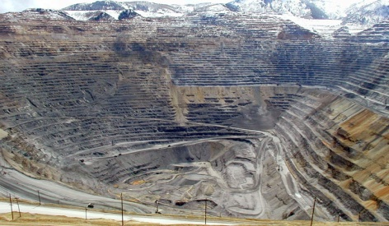
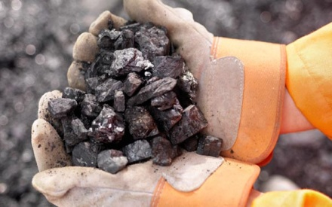
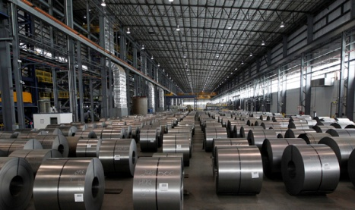
Where does metal come from?
Most pure metals come from the Earth’s crust. All metals in use today are either PURE metals or ALLOYS. Copper, iron, tin, lead, zinc, silver and gold are all examples of pure metals which are extracted from Ores (special rock containing elements and minerals) by a process called SMELTING. A metal made from a mixture of two or more metals is called an alloy.
Metals are divided into:
ferrous metals, which have iron in them (for example mild steel, high carbon steel and cast iron)
non-ferrous metals, which don’t have iron in them (for example copper, aluminium, tin and lead).

Slide 4
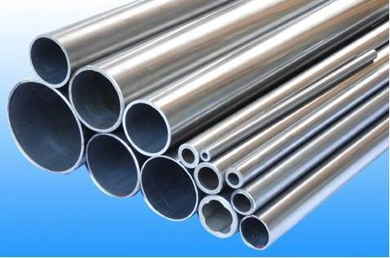
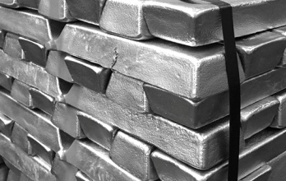
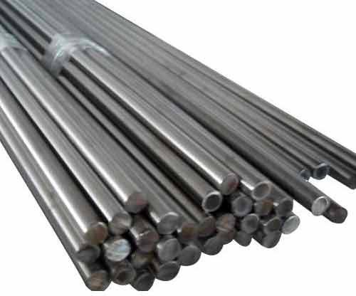
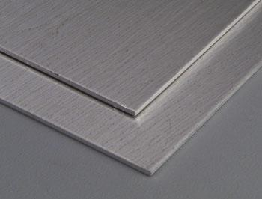
Various forms of metal
Metal can be supplied in various forms:
Wire
Bar (square, flat, round, hexagonal etc)
Tube
Angle Iron
Sheet – Tin plate, copper, brass, steel, aluminium
Ingots – large blocks of metal which are melted down to
use for moulding metals
Powder – fine metal powder is used for 3D printing.

Slide 5
Properties
The properties of metal vary depending on the type of material; each metal has its own unique set of properties. The properties of metal can include:
Brittle – cracks or breaks easily
Corrosion resistant – does not rust
Ductility – can be stretched out without breaking to make long, thin lengths of metal
Durability – the resilience of the material and its resistance to wear and tear
Thermal insulator – able to maintain temperatures
Electrical conductor – able to pass an electric current through the metal
Malleable – soft enough to be shaped by pressing or pushing without the metal breaking or springing back into shape
Elasticity – A metal is said to be elastic when it has the ability to regain its shape after being deformed
Hardness – The resistance to being scratched, cut or worn

Slide 6
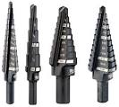
Ferrous Metals
Iron is the basis of ALL ferrous alloys. Pure iron is of little practical use as a material. Ferrous metals all contain iron and are therefore alloyed. In addition, Ferrous metals will contain other elements in varying quantities. The principle element which is mixed with IRON is CARBON. The percentage of carbon which is added to the iron will produce alloys of varying properties. High carbon steel is extremely strong and is used for items like high strength cables and springs. However, the high carbon content reduces weldability.
Ferrous metals are magnetic due to iron content.
Iron reacts with oxygen in the air and in water by developing iron oxide on the surface of the metal. This is known more commonly as rust. To avoid rusting, ferrous metals require a finish to protect the metal.
Cutting Tools
Car Bodies

Slide 7
Ferrous Metals
Name | Properties | Identifying features | Uses | Forms
Cast Iron (CI Alloy) | Excellent strength, tough, cannot be bent or forged. A hard outer skin | Usually painted to avoid rust, very dark grey to black with a matt texture | Fences, garden benches, pots, weights, drain covers. | Ingots, bar and pipe
Mild Steel (CI Alloy) | Ductile and malleable yet tough. Easy to weld. | Silvery grey with poor corrosion resistance. | Car bodies, nuts, bolts, nails, screws, wire fencing. | Ingots, wire, bar, pipe, sheet
High Carbon Steel (CI Alloy) | Malleable, can be hardened and tempered, easily forged. | Silvery grey. Can appear dull or shiny. | Files, chisels, saws, taps, dies, lathe tools etc. | Ingots, wire, bar, pipe, sheet.

Slide 8
Non-ferrous Metals
This group of metals do not contain iron and therefore will withstand moist conditions and are corrosion resistant.
Also they are NOT magnetic. Common examples are:
-copper, aluminium, tin and lead
-precious metals such as gold and silver
-metals used in small amounts (mercury, platinum, chromium)
-’new’ metals (vanadium, niobium, zircoium).
Non-ferrous metals can tarnish (dark coloured spots or smears appear on the surface) but this can be polished off most metals and it only occurs after many years.
Aluminium
Aluminium is the Earth’s most plentiful metal. Aluminium’s lightness and strength make it the most widely used non-ferrous metal.

Slide 9
Non-ferrous Metals
Name | Properties | Identifying features | Uses | Forms
Aluminium (Pure) | Good strength to weight ratio, malleable, conducts heat and electricity well, ductile. | Shiny silvery grey colour which polishes well. | Kitchen foil, drink cans, boat hulls, sport equipment. | Ingots, wire, bar, pipe, sheet
Tin (Pure) | Malleable, soft, weak, ductile, resistant to corrosion. | Bright silvery. | Usually used for coating steel to form tin plate. Also tin cans. Alloyed to make bronze. | Ingots, wire, bar, pipe, sheet
Copper (Pure) | Tough, ductile, malleable, conducts heat and electricity well, solders well. | Deep orange brown colour but tarnishes green with exposure to oxygen. | Electric wires, pipes, circuit boards, jewellery, roofing, cooking pans. | Ingots, wire, bar, pipe, sheet
Zinc (Pure) | Weak, ductile, malleable, poor strength to weight ratio, casts well. | Silvery grey. Tends to have a matt surface finish. | Guttering, roofing, coins, watering cans, bins. | Ingots, wire, bar, pipe, sheet. Coating (galvanising)

Slide 10
Alloys
Most metallic materials are alloys. Metals are alloyed to enhance their properties, such as strength, hardness or corrosion resistance, and to create new properties, such as superconductivity and shape memory.
Engineering metal alloys can be broadly divided into Ferrous Alloys and Non-ferrous Alloys.
Ferrous alloy steels contain low to high levels of elements such as chromium, vanadium and nickel. Stainless steels are highly corrosion resistant, ferrous alloys that contain chromium and/or nickel additions.
Also, as previously mentioned, Cast iron is a ferrous alloy and contains
high amounts of carbon.
Many non-ferrous metals are also alloyed to enhance their properties. Common non-ferrous alloys include: Brass (copper 65% and zinc 35%). Bronze (copper 90% and tin 9%). Duralumin (Alu 95% and copper 4%).

Slide 11
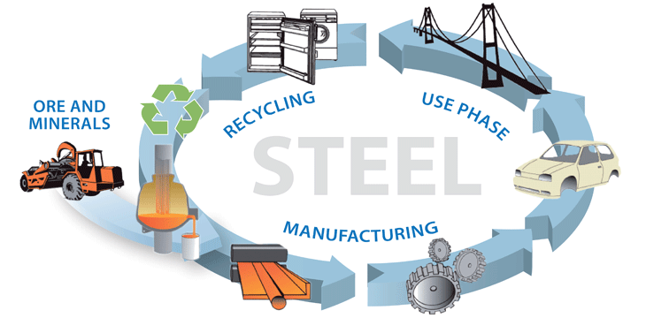
Recycling and Sustainability
Metal is a finite resource. However, metals are elements and cannot be destroyed. This means that metal can be recycled without loss of its properties and can be used again and again to form new products. Therefore, metal can be considered a permanently available resource and a true ‘cradle to cradle’ material. Steel is the most recycled material on the planet and today, thanks to technology transfer and new processes, the energy used to produce steel is also greatly reduced. Harmful gases produced can also now be captured and reused.
In the workshop we must always select the most appropriate materials for the job at hand. The manufacturing of components must also be considered to ensure the minimum amount of waste material. We will consider all waste material valuable. Waste metal that is produced in the school workshop, if not easily reused, will be safely stored and taken to a local recycling plant.

Slide 12
Quiz Questions 1.0
Record answers in your notes jotter
1. For convenience, metals are categorised as Ferrous and Non-ferrous.
Which of the two contains Iron?
2. What is an alloy?
3. What metal could be used in the manufacture of a twist drill bit?
4. Name one use for a metal that is ductile.
5. Name the type of rock that metal minerals are extracted from.
What is the principle element mixed with iron to produce alloys of
varying properties?
7. What material is considered the most recycled on the planet?

Slide 13
Quiz Questions 1.0
Record answers in your notes jotter
1. For convenience, metals are categorised as Ferrous and Non-ferrous.
Which of the two contains Iron?
Ferrous
2. What is an alloy?
Mixture of two or more metals
3. What metal could be used in the manufacture of a twist drill bit?
High Speed or High Carbon Steel
4. Name one use for a metal that is ductile.
Can be moulded, pulled etc. Any suitable answer
5. Name the type of rock that metal minerals are extracted from.
Ores
What is the principle element mixed with iron to produce alloys of
varying properties?
Carbon
7. What material is considered the most recycled on the planet?
Steel

