Slide 1
Prelim Prep
Extension- any past paper section 1 on SQA site.

Slide 2
Learning intentions
End of this period:
Have more knowledge of what Is expected within section 1 of prelim.
Build upon personal skill of writing answers for exam/understanding of question types.
Areas of focus for studying.

Slide 3
Breakdown
The exam paper is worth 45% of your final grade.
Exam is out of 80 marks.
Section 1 is 60 marks
Section 2 is 20 marks
Section 1 has two parts: It assesses a range of materials, hand tools and machinery and is based on a workshop-crafted product.
The remaining questions are worth 30 marks. The context of the questions is design work and products that focus on particular aspects of design.
Section 2 has 20 marks. This section assesses commercial manufacture and consists of four or five questions.

Slide 4
Terms and understanding
Name/State: Candidates must provide the answer in brief form/name. Candidates will normally be required to make the same number of statements as marks available in the question.
Outline: More than naming, but not a detailed description. Candidates will normally be required to make the same number of factual/appropriate points as marks available in the question
Describe: Candidates must provide a statement or structure of characteristics and/or features. This should be more than an outline or a list. Candidates may refer to, for instance, a concept, experiment, situation, or facts in the context of, and appropriate to, the question. Candidates will normally be required to make the same number of factual/appropriate points as marks available in the question.
Explain: Candidates must generally relate cause and effect and/or make relationships between things clear. This will be related to the context of the question or a specific area within a question.

Slide 5
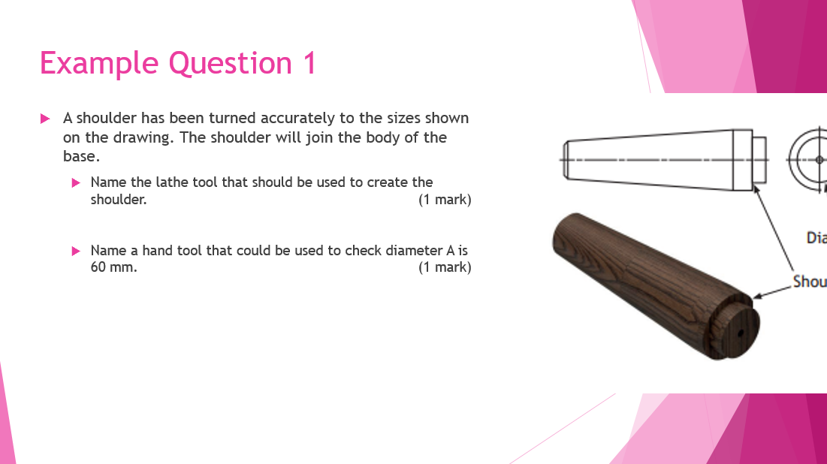
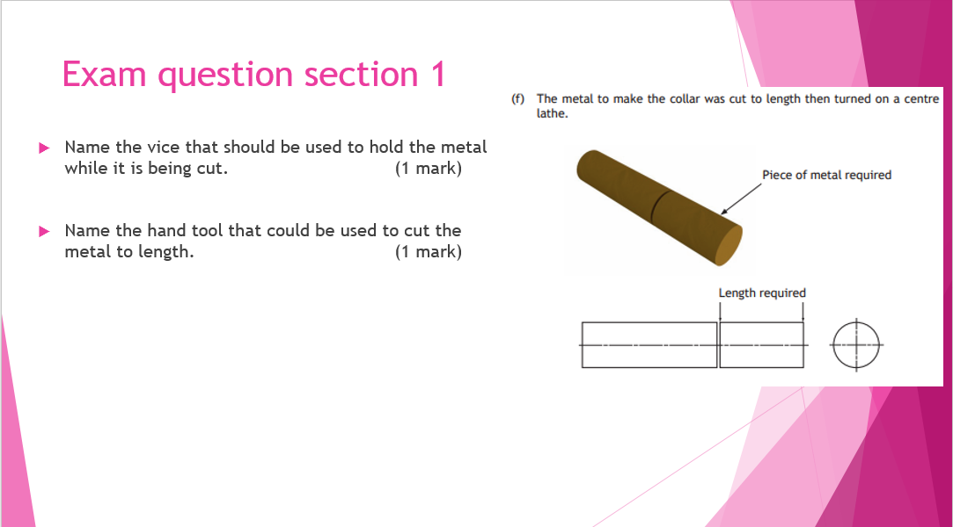
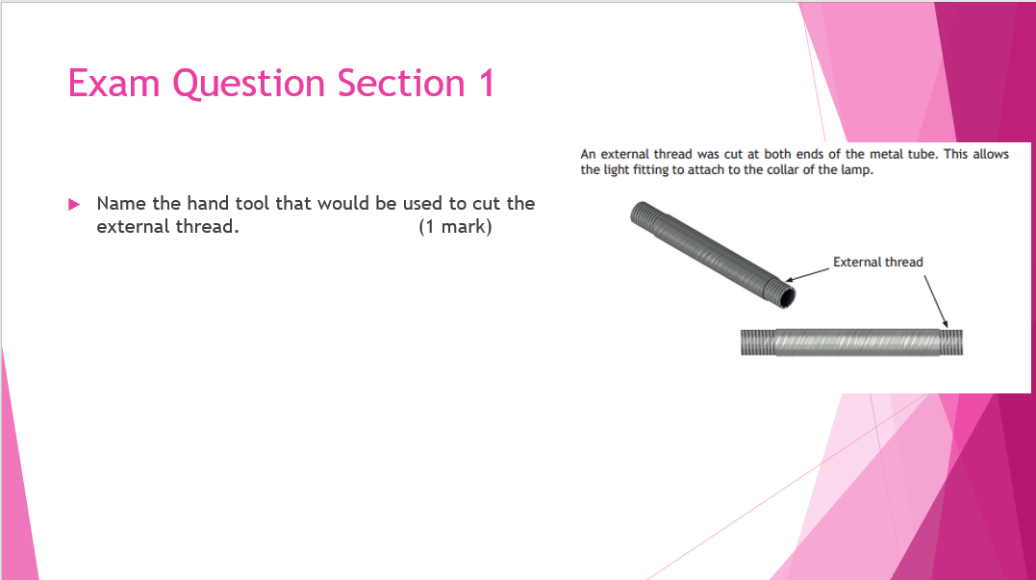
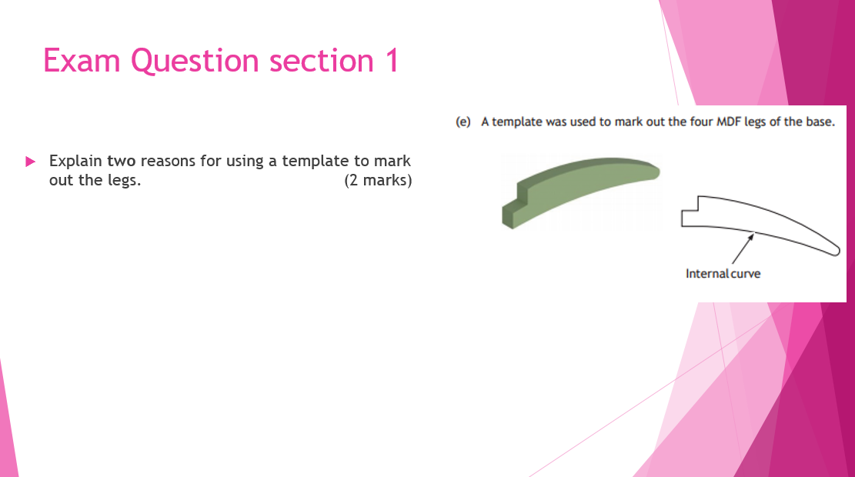
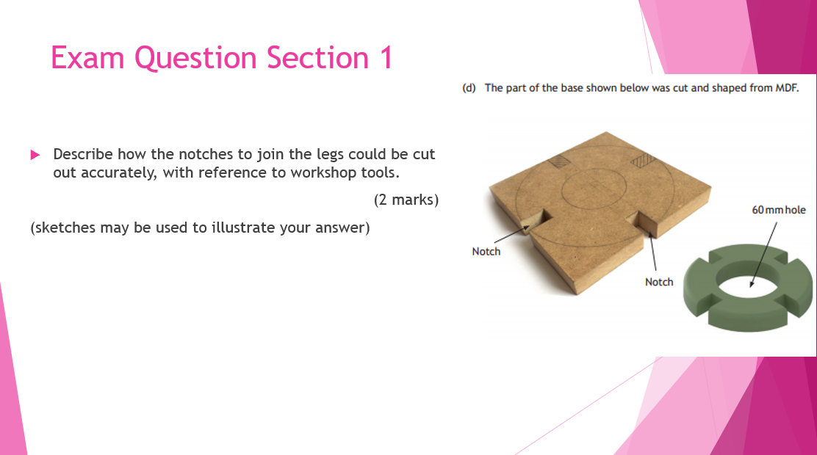
Section 1- 30 marks (workshop)
Refers to manufacture in the work shop
Broken into three areas: woodwork, metal work and plastic
You are given products scenarios to allow you to refer to them.
Common questions types
Being able to select/justify choice of material/tool/process.
Describing processes in detail.

Slide 6
Example Question Section 1
The lamp is made from different materials
Name a suitable dark coloured hardwood for the body of the lamp (1 mark)
Name a suitable yellow-coloured alloy for the metal collar, (1 mark)
The body of the lamp will be manufactured on a wood turning lather.
Outline 2 safety checks that must be carried out on the wood turning lathe before the body is manufactured. (2 marks)

Slide 7
Example Question Section 1
The lamp is made from different materials
Name a suitable dark coloured hardwood for the body of the lamp (1 mark)
1 worded answer required.
Mahogany, teak, cherry, walnut, sapele
Name a suitable yellow-coloured alloy for the metal collar, (1 mark)
1 worded answer required
Brass, Bronze
The body of the lamp will be manufactured on a wood turning lather.
Outline 2 safety checks that must be carried out on the wood turning lathe before the body is manufactured. (2 marks)
2 answers must be given to receive full marks.
Ensure blank is secured between two centres.
Make sure the tool rest is at the correct height.
***This needs to be focussed around the wood turning lathe and not on personal safety. Other answers include:
The blank is centred.
Tool rest secure
Clearance between tool rest and blank.

Slide 8
Example Question Section 1
A shoulder has been turned accurately to the sizes shown on the drawing. The shoulder will join the body of the base.
Name the lathe tool that should be used to create the shoulder. (1 mark)
Name a hand tool that could be used to check diameter A is 60 mm. (1 mark)

Slide 9
Example Question Section 1
A shoulder has been turned accurately to the sizes shown on the drawing. The shoulder will join the body of the base.
Name the lathe tool that should be used to create the shoulder. (1 mark)
1 worded answer required.
Parting tool
Name a hand tool that could be used to check diameter A is 60 mm. (1 mark)
1 Worded answer required.
Outside callipers
Vernier callipers

Slide 10
Exam Question Section 1
Name the drill bit that could be used to drill the 60 mm hole. (1 mark)
Name the hand tool that would be used to cut the internal curve. (1 mark)

Slide 11
Exam Question Section 1
Name the drill bit that could be used to drill the 60 mm hole. (1 mark)
1 worded answer required
Forstner bit.
Hole saw
Name the hand tool that would be used to cut the internal curve. (1 mark)
1 worded answer required
Coping saw

Slide 12
Exam Question Section 1
Describe how to mark out and remove the corners of the blank in preparation for turning. You must refer to workshop tools in your answer.
(sketches may be used to illustrate your answer.)

Slide 13
Exam Question Section 1
Describe how to mark out and remove the corners of the blank in preparation for turning. You must refer to workshop tools in your answer. (4 marks)
(sketches may be used to illustrate your answer.)
For this type of question you need to break down what the question is asking.
Describe how to mark out and remove the corners of the blank in preparation for turning. You must refer to workshop tools in your answer.
In order to gain full marks you need to make sure you are doing the following:
Providing a description cannot be an outline, statement or list. Must include workshop tools to mark out and remove the corner.
should also have 4 different steps.
Must make sure you are marking out and removing corners to gain full marks.
Also Sketches to show what you mean WILL work in your favour.

Slide 14
Exam Question Section 1
Describe how to mark out and remove the corners of the blank in preparation for turning. You must refer to workshop tools in your answer. (4 marks)
(sketches may be used to illustrate your answer.)
Use a rule to draw diagonal lines to find the centre on both ends of the work piece.
Using a set of compasses to draw a circle to help construct an octagon.
Use marking gauge to mark out corners to be removed.
Hold work piece in the bench vice when removing corners.
Use a smoothing plan to remove corners.
Use a centre punch to mark centres at both ends of the blank.
ONLY LOOKING FOR 4 POINTS THAT SHOW A PROGRESSION FROM MARKING TO REMOVING.

Slide 15
Exam Question Section 1
Describe how the notches to join the legs could be cut out accurately, with reference to workshop tools.
(2 marks)
(sketches may be used to illustrate your answer)

Slide 16
Exam Question Section 1
Describe how the notches to join the legs could be cut out accurately, with reference to workshop tools.
(2 marks)
(sketches may be used to illustrate your answer)
Using a tenon saw you would cut down the lines to make sure they are straight and keep them parallel. To remove the material you would then use a bevel-edged chisel to take out the material in between the two cut lines.
SQA also accept a jig saw for this answer

Slide 17
Exam Question section 1
Explain two reasons for using a template to mark out the legs. (2 marks)

Slide 18
Exam Question section 1
Explain two reasons for using a template to mark out the legs. (2 marks)
For this we need to break down the question.
Explain two reasons for using a template to mark out the legs.
In order to gain full marks you have to give a clear cause and effect.
2 reasons must be given.

Slide 19
Exam Question section 1
Explain two reasons for using a template to mark out the legs. (2 marks)
Using a template to mark out the legs allows the user to be accurate repeatedly as you are drawing round the same template each time. This allows you to also save time as you are only needed to draw the complex shape once.
Cause
effect

Slide 20
Exam question section 1
Name the vice that should be used to hold the metal while it is being cut. (1 mark)
Name the hand tool that could be used to cut the metal to length. (1 mark)

Slide 21
Exam question section 1
Name the vice that should be used to hold the metal while it is being cut. (1 mark)
1 worded answer required
Engineers vice
Name the hand tool that could be used to cut the metal to length. (1 mark)
1 worded answer required
Hack saw/junior Hack saw

Slide 22
Exam question section 1
Name 3 processes that would be carried out on the centre lathe to manufacture the metal collar.
(1 mark)

Slide 23
Exam question section 1
Name 3 processes that would be carried out on the centre lathe to manufacture the metal collar.
(1 mark)
3 separate 1 worded answers.
Facing
Parallel turn
Chamfer
Step Turn

Slide 24
Exam Question Section 1
Explain why a centre drill has to be used before the hole can be drilled. (1 mark)

Slide 25
Exam Question Section 1
Explain why a centre drill has to be used before the hole can be drilled. (1 mark)
Unlike a name type of question this one needs more for the 1 mark.
A centre drill has to be used to improve accuracy for the twist drill as a centre drill does not flex or move when drilling.
Cause
Effect

Slide 26
Exam Question Section 1
Name the hand tool that would be used to cut the external thread. (1 mark)

Slide 27
Exam Question Section 1
Name the hand tool that would be used to cut the external thread. (1 mark)
1 worded answer required
Die/ Split die

Slide 28
Exam Question Section 1
It is important that a good thread quality is cut.
Describe how this can be done. (2 marks)

Slide 29
Exam Question Section 1
It is important that a good thread quality is cut.
Describe how this can be done. (2 marks)
Must give 2 descriptions for this answer
Using cutting compound to ensure the die goes on smoothly and cuts down the metal tube without snagging.
When using the die begin by doing a half turn forward and then a quarter turn back to make sure there is no clogging and the thread is fine.

Slide 30
Exam Question Section 1
State two reasons why acrylic is a suitable choice for the lamp shade (2 marks)
The acrylic has to be heater before forming the 90 degree bends.
State the name of the equipment that should be used to heat the acrylic along lines A and B (1 mark)

Slide 31
Exam Question Section 1
State two reasons why acrylic is a suitable choice for the lamp shade (2 marks)
2 separate answers are required. (qualities of acrylic plastic)
Translucent- suited to emitting light.
Easily formed into the shape required.
very rigid material, holds it shape.
polishes well.
The acrylic has to be heater before forming the 90 degree bends.
State the name of the equipment that should be used to heat the acrylic along lines A and B (1 mark)
1 worded answer required.
Strip heater.

Slide 32
Exam Question Section 1
The edges of acrylic were finished before the lamp shade was formed.
Explain why the edges of the acrylic should be finished before it is formed into shape. (2 marks)

Slide 33
Exam Question Section 1
The edges of acrylic were finished before the lamp shade was formed.
Explain why the edges of the acrylic should be finished before it is formed into shape. (2 marks)
This is requiring 2 points to bee made and explained well.
Edges should be finished before forming as it is quicker for the person to finish it flat due to there being no corners or awkward parts to get into.
The flat shape is simpler to hold and clamp securely without the fear or something snapping when applying pressure to finish the product as it is help securely.
Cause
Effect

