Slide 1
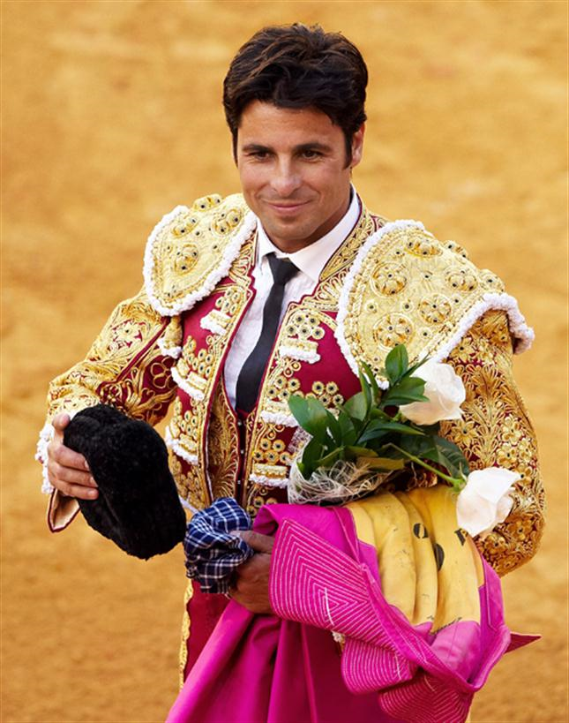
THE ROBERT BURNS ACADEMY
This week, we are going to do Coffee Break Spanish episode 6: More on family and the Spanish numbers 1-10

Slide 2
Family & numbers
https://radiolingua.com/2008/11/lesson-06-coffee-break-spanish/
Click on the hyperlink. This will take you to the page. Then press play!

Slide 3
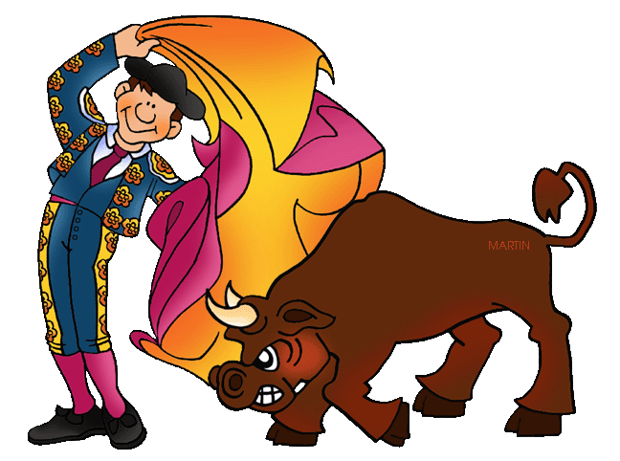
We learned in the last lesson the Spanish word for “my” is “mi”. The word for “your” is also very easy in Spanish. It is “tu” (pronounced “too”)
¡Gramática!

Slide 4
What do these mean?
Tu hermano
Your brother
Tu madre
Your mother
Tu madre y tu padre
Your mother and Your father
Tu hijo
Your son
Tu marido
Your husband

Slide 5
Be careful not to mix up these words!
Tú = you
Tu = your
¡Gramática!

Slide 6
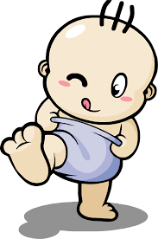
Mi mamá
Mi papá
Children use these words instead of “madre” and “padre”. These words are like the English words “mummy” and “daddy”

Slide 7
The Spanish word for “I have” is “tengo”

Slide 8
I have a brother
Tengo un hermano
I have a sister
Tengo una hermana

Slide 9
There are two words for “a” in Spanish!
Un = a (masculine words)
Una = a (feminine words)
¡Gramática!
On the next slide, put in the missing word! Un or Una. Then say what they mean in English.

Slide 10
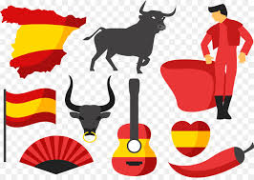
Tengo UN marido
Tengo UN hijo
Tengo UNA hija
Tengo UNA madre
Tengo UN padre
Tengo UN perro
Tengo UNA hermana
Tengo UN hermano
I have a husband
I have a son
I have a daughter
I have a mum
I have a dad
I have a dog
I have a sister
I have a brother

Slide 11
Now let’s learn the numbers in Spanish! Repeat the numbers on the next slide as you listen to the Podcast

Slide 12
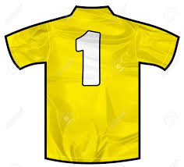
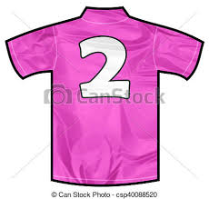
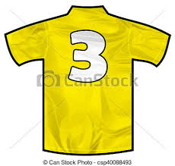
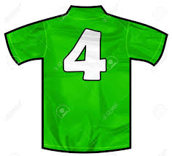
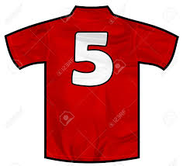
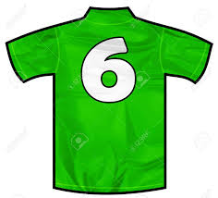
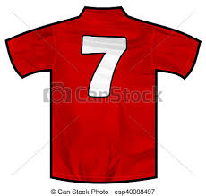
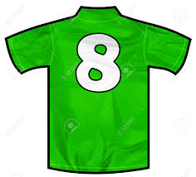
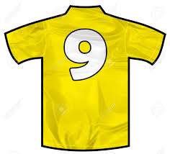
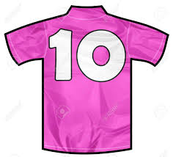
UNO
DOS
TRES
CUATRO
CINCO
SEIS
SIETE
OCHO
NUEVE
DIEZ

Slide 13
Now copy the numbers into your jotter!

Slide 14
Family & numbers
We will now use numbers to talk about our family in more detail

Slide 15
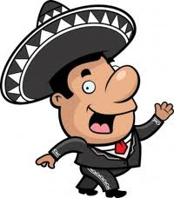
I have two brothers
Tengo dos hermanos
I have two sisters
Tengo dos hermanas

Slide 16
When saying you have 2 brothers or 3 sisters, you add an S to the end of the word “hermano” “hermana” like you would in English
¡Gramática!

Slide 17
What do these mean?
Tengo cinco hermanos
I have 5 brothers
Tengo ocho hijas
I have 8 daughters
Tengo tres hijos
I have 3 sons
Tengo nueve hermanas
I have 9 sisters

Slide 18
I have two brothers. They are called Pablo and Marco
Tengo dos hermanos. Se llaman Pablo y Marco
I have two sisters. They are called Maria and Sol
Tengo dos hermanas. Se llaman Maria y Sol

Slide 19
Now copy this vocabulary

Slide 20
Tengo dos hermanos. Se llaman Pablo y Carlo | I have two brothers. They are called Pablo and Carlo
Tengo dos hermanas. Se llaman Maria y Sol | I have two sisters. They are called Maria and Sol
I hope you have enjoyed the Spanish! Next week, we will do some German!

