Slide 1
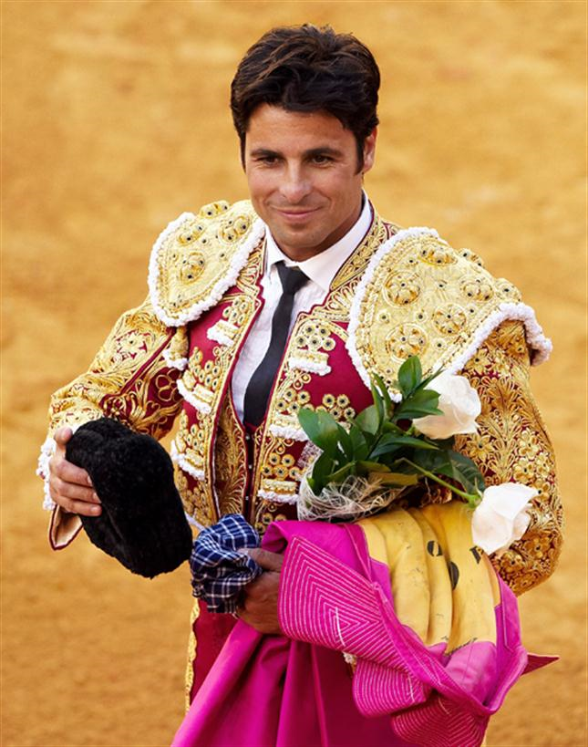
THE ROBERT BURNS ACADEMY
This week, we are going to learn to talk about our family with episode 5 of Coffee Break Spanish and Linguascope!

Slide 2
Mi familia
https://radiolingua.com/2008/11/lesson-05-coffee-break-spanish/
Click on the hyperlink. This will take you to the page. Then press play!

Slide 3
Mi familia
Now try saying these words for yourself!

Slide 4
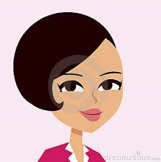
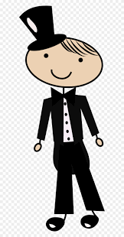
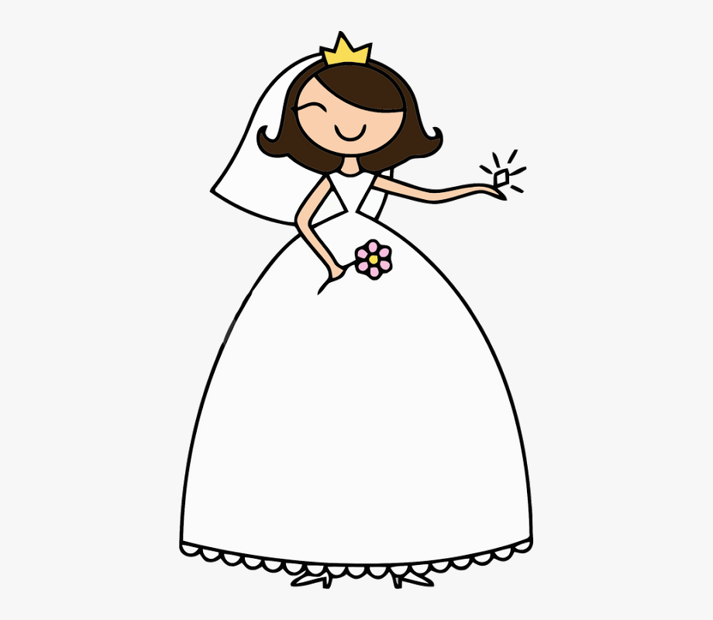
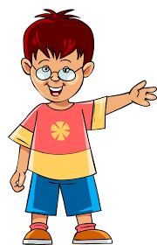
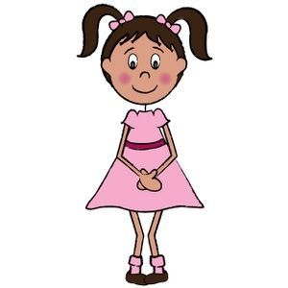
hermano
hermana
madre
padre
brother
sister
mother
father
marido
mujer
hijo
hija
husband
wife
son
daughter

Slide 5
The word for “my” is very easy in Spanish. It is “mi” (pronounced “me”)
Mi hermano
My brother
Mi madre
My mother
Mi madre y mi padre
My mother and my father

Slide 6
Introducing people
We are now going to learn how to introduce masculine members of our family!

Slide 7
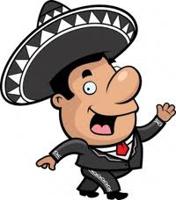
This is my brother
Este es mi hermano
Este es mi padre
This is my dad

Slide 8
Introducing people
We are now going to learn how to introduce feminine members of our family!

Slide 9
This is my sister
Esta es mi hermana
This is my mum
Esta es mi madre

Slide 10
Saying what people are called
Se llama means both “He is called” and “She is called”

Slide 11
This is my son. He is called Pablo
Este es mi hijo. Se llama Pablo
This is my mum. She is called Carmen
Esta es mi madre. Se llama Carmen

Slide 12
Copy the vocabulary on the next slides into your jotter

Slide 13
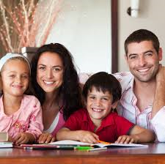
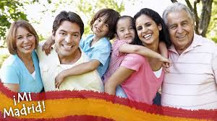
FAMILY MEMBERS 1
Mi hermano | My brother
Mi hermana | My sister
Mi padre | My dad
Mi madre | My mum
Mi hijo | My son
Mi hija | My daughter
Mi marido | My husband
Mi mujer | My mum

Slide 14
INTRODUCING PEOPLE
Este es mi hermano | This is my brother
Esta es mi hermana | This is my sister
SAYING PEOPLE’S NAMES
Se llama | He is called
Se llama | She is called
Mi hijo se llama Marco | My son is called Marco
Mi hija se llama Maria | My daughter is called Maria

Slide 15
Copy and Complete these sentences with either ESTE or ESTA. Then check your answers! Write what they mean in English as well!

Slide 16
Este es mi hermano. Se llama Tomás
Esta es mi mujer. Se llama Teresa
Este es mi hijo. Se llama Marcos
Esta es mi hermana. Se llama Sol
Esta es mi hija. Se llama Ana
Este es mi marido. Se llama Felipe

Slide 17
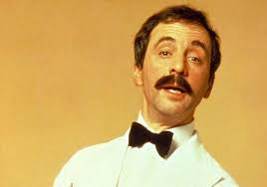
MIXED UP MANUEL
These sentences are all mixed up! Copy them and put the words in the correct order! Then check your answers!

Slide 18
MI HERMANO SE LLAMA CARLOS
ESTA ES MI HERMANA
ESTE ES MI MARIDO
MI MUJER SE LLAMA TERESA
MI HIJO SE LLAMA PABLO
MI SE HERMANO CARLOS LLAMA
MI ES HERMANA ESTA
MARIDO ESTE MI ES
LLAMA TERESA MI SE MUJER
PABLO LLAMA MI HIJO SE

Slide 19
Los padres | parents
La madre | mum
El padre | dad
El hermano | brother
La hermana | sister
El abuelo | grandad
La abuela | gran
El perro | dog
Los abuelos | grandparents
El bebé | baby
In Spanish there are 3 words for “the”
El is used with masculine words
La is used with feminine words
Los is used with plural words

