Slide 1

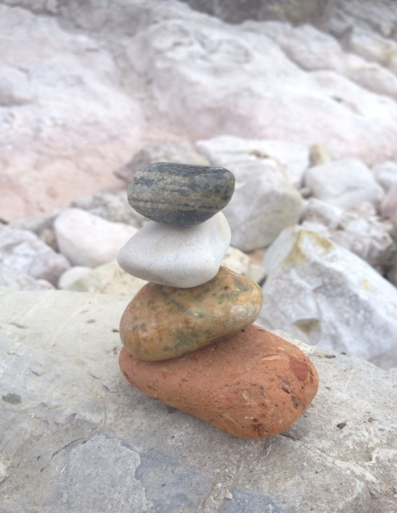
Welcome
Raising Awareness of
Mental Health and Wellbeing
Catrina

Slide 2
Learning Outcomes
Understanding of mental health and wellbeing and why it is important.
Be aware of some ways to look after you own mental health and wellbeing and how to talk to your children about it.
Be aware of what is going on in schools and the community to promote mental wellbeing.

Slide 3
Definitions
The World Health Organisation defines health as:
‘.. a state of (complete) physical, mental and social wellbeing and not merely the absence of disease or infirmity.’
(1948)

Slide 4

Definition of terms
Mental health is “ a state of wellbeing in which every individual realises his or her own potential, can cope with the normal stresses of life, can work productively and fruitfully, and is able to make a contribution to her or his community”.
It is our ability to enjoy life and cope with its challenges, it has two dimensions-
  Mental wellbeing: There are many different definitions of mental wellbeing but they generally include areas such as: life satisfaction, optimism, self esteem, mastery and feeling in control, having a purpose in life, and a sense of belonging and support.
  Mental illness: Mental illness refers to a diagnosable condition that significantly interferes with an individual's cognitive, emotional or social abilities e.g. depression, anxiety, schizophrenia.
Notes:
Mental health and wellbeing is an important part of overall health and wellbeing and can be affected by different factors, including life events such as relationship breakdowns, bereavement and work stress as well as mental health conditions such as depression or anxiety.

Slide 5
Stigma of Mental Illness
1 in 4 of us will experience a mental health problem at some
time in our lives. Three quarters of us know someone with a mental health problem.
Mental health problems affect about one in ten children and young people. They include depression, anxiety and conduct disorder, and are often a direct response to what is happening in their lives.
www.mentalhealth.org.uk
People with mental health problems often say that the reactions of family, friends, neighbours, work colleagues and employers is harder to deal with the illness itself.
Stigma can range from being ignored and excluded to verbal and physical harassment and abuse.
Stigma and fear of what people will think can prevent people from asking for help.
http://www.seemescotland.org/about/whyweneedtotacklestigma
Notes:
81% of people with lived experience of mental ill-health told ‘see me’ that they had experienced stigma. And many people keep quiet about their experiences due to uncertainty about how people would react - 59% of people don’t talk much about themselves because they don’t want to burden others with their mental health problem.

Slide 6
The influence of parents and carers
“Young people who perceive their parents as warm, caring, interested, and responsive, often referred to as “parent-child connectedness” are more likely to talk parents/carers about issues.”
Journal of Adolescent Health, 13 April 2012

Slide 7
The Mental Health Continuum
Good Mental Health & Wellbeing
Has a diagnosis of a mental health problem but copes with life well and has positive mental wellbeing
No diagnosable mental health problem and positive mental wellbeing
Maximum Mental Health Problems
Minimum Mental Health Problems
Has a diagnosis of a mental health problem and has poor mental wellbeing
No diagnosable mental health problem and poor mental wellbeing
Has a diagnosis of a serious mental health problem and poor mental wellbeing
No diagnosable mental health problem but poor mental wellbeing
Poor Mental Health & Wellbeing
Notes:
Things that can move you back up the continuum:-
Supports
Believe things can get better
Take control
Coping skills
Mindfulness skills
Do things that make you feel good

Slide 8










Top 10 Tips for Mental Health and Wellbeing
http://www.mentalhealth.org.uk/help-information/10-ways-to-look-after-your-mental-health/
Talk about your feelings
Accept who
you are
Eat well
Keep in touch
Care for others
Take a break
Keep active
Drink sensibly
Ask for help
Do something you are good at
Images created using Boardmaker Mayer-Johnson LLC Copyright© 1981-2008 Mayer-Johnson LLC. All rights reserved worldwide.

Slide 9
Supports
SPECIALIST
SUPPORT
TARGETED SUPPORT
UNIVERSAL SUPPORT
CAMHS, Community Mental Health Team, Primary Care Mental Health Team
GP, school nurses, Barnardos, Young Carers, Educational Psychology
Online resources, teachers, sports clubs, volunteering, peer and family support, scouts/guides, guided self help resources, 10 Tips for wellbeing

Slide 10
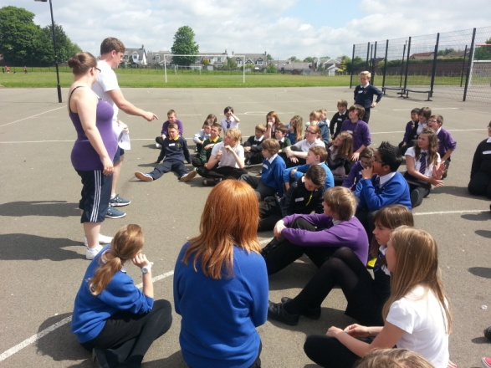
Promoting Positive Mental Health in EA
Curriculum
  HWB/PSE Programmes
  Positive Mental Attitudes – PMA
  Bounce Back P1 – S2
  HWB tracking
Permeation
  Active Learning
  Outdoor Learning
  Sport
  Arts

Slide 11
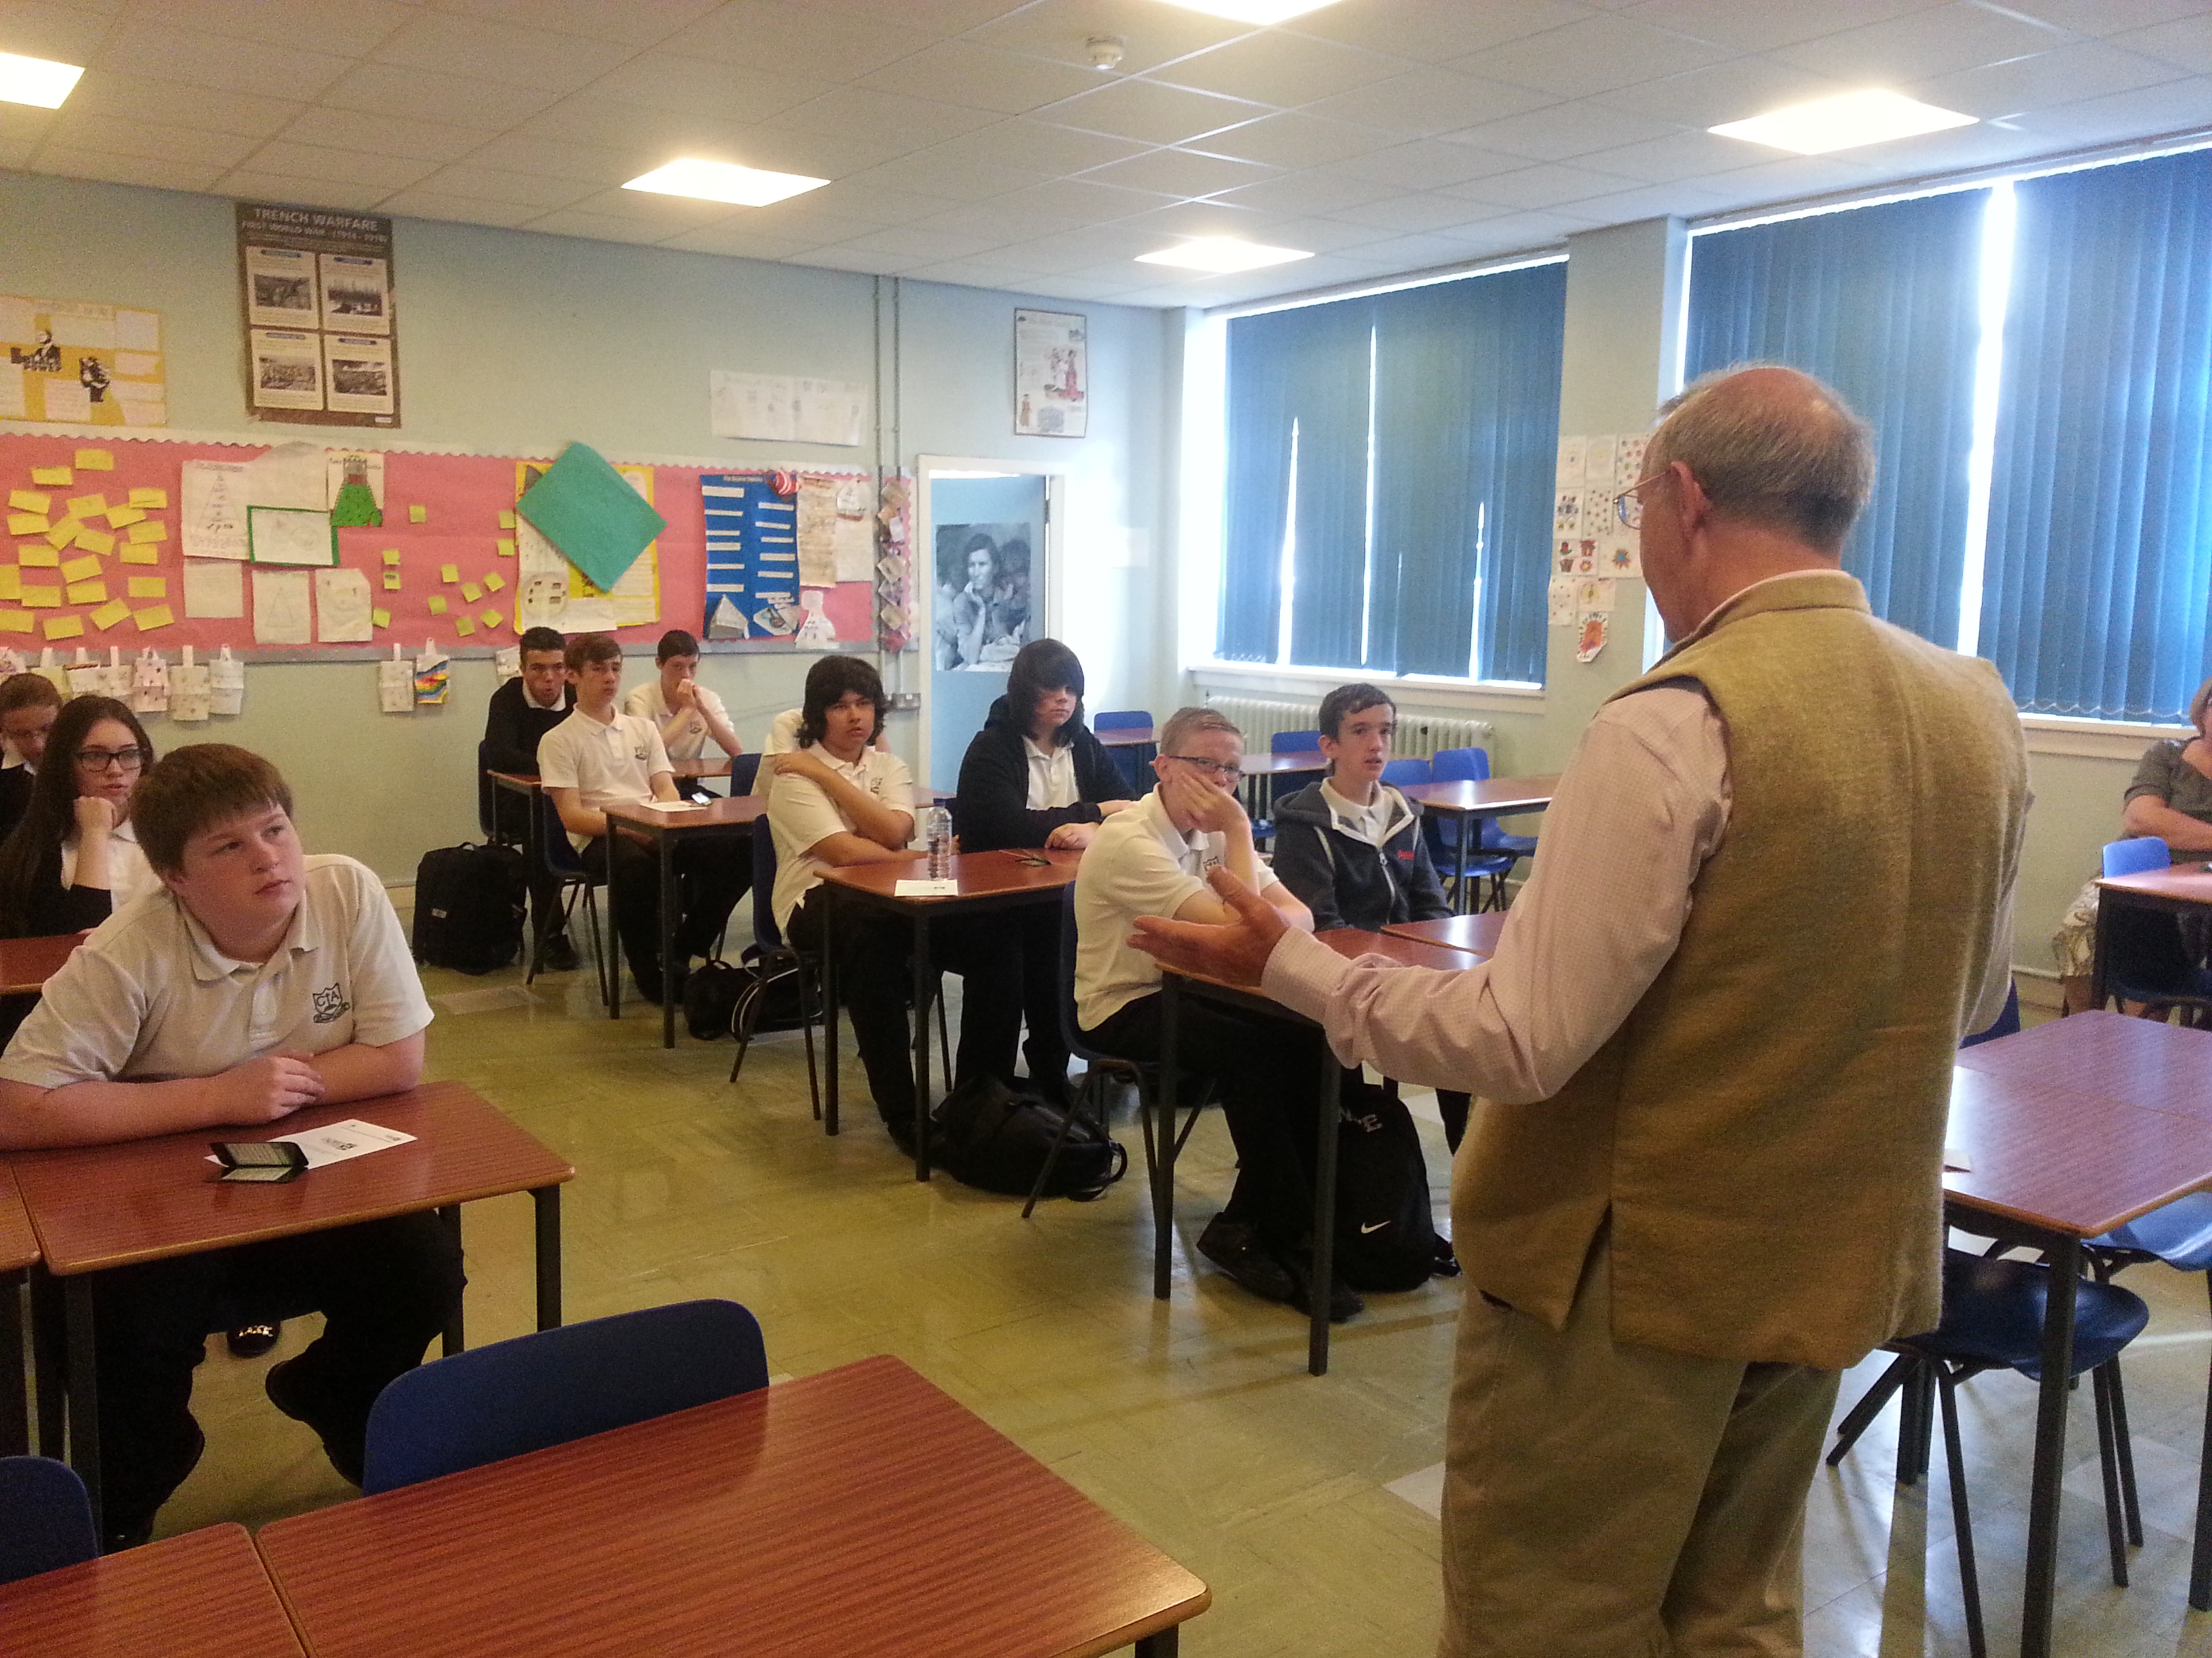
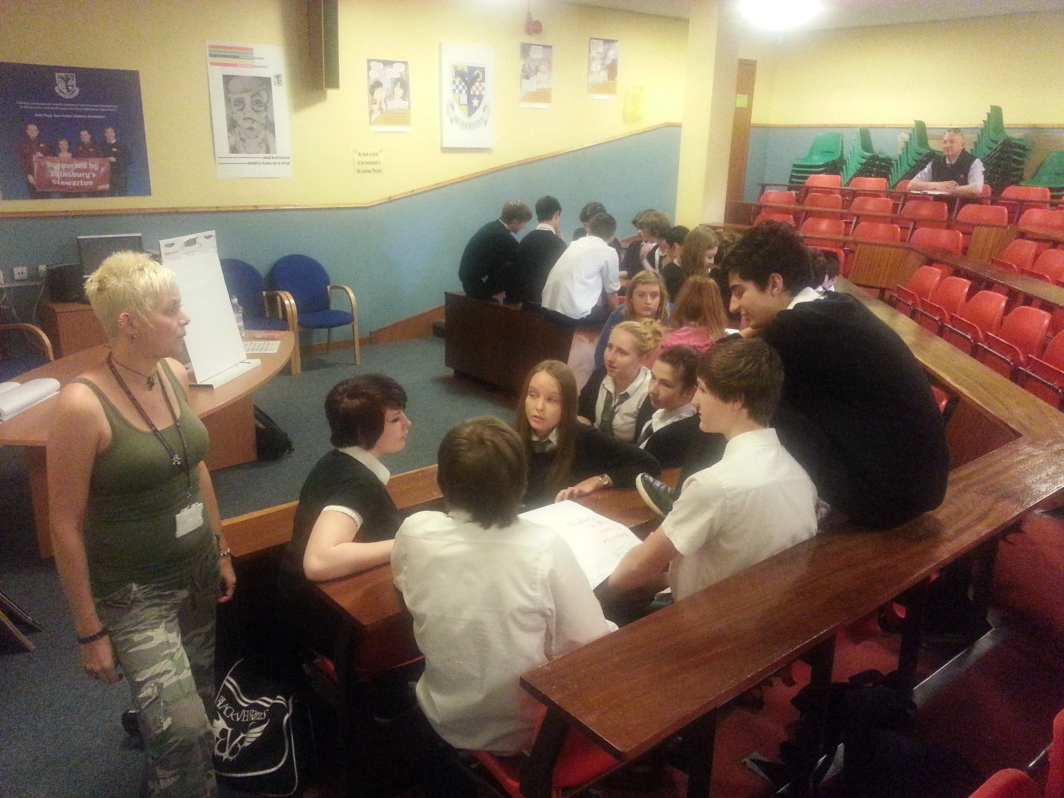
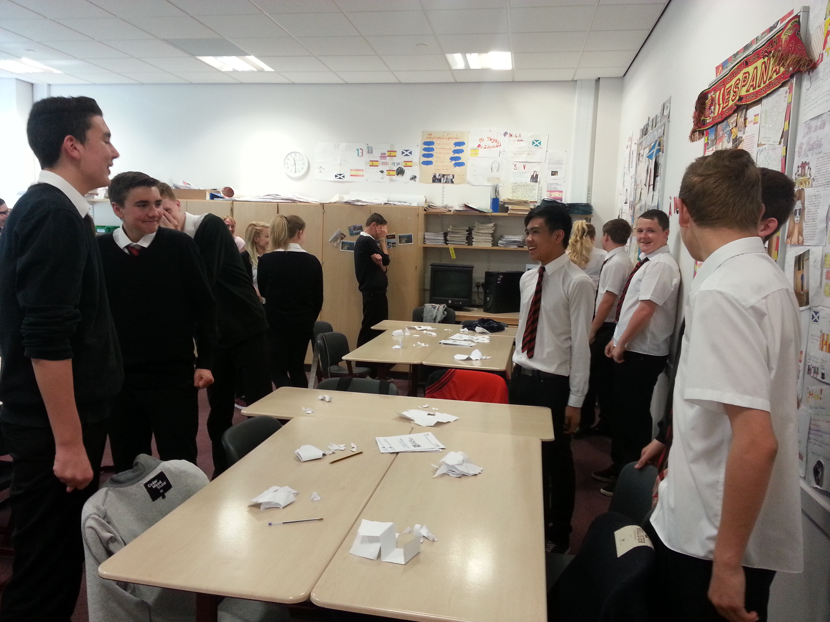
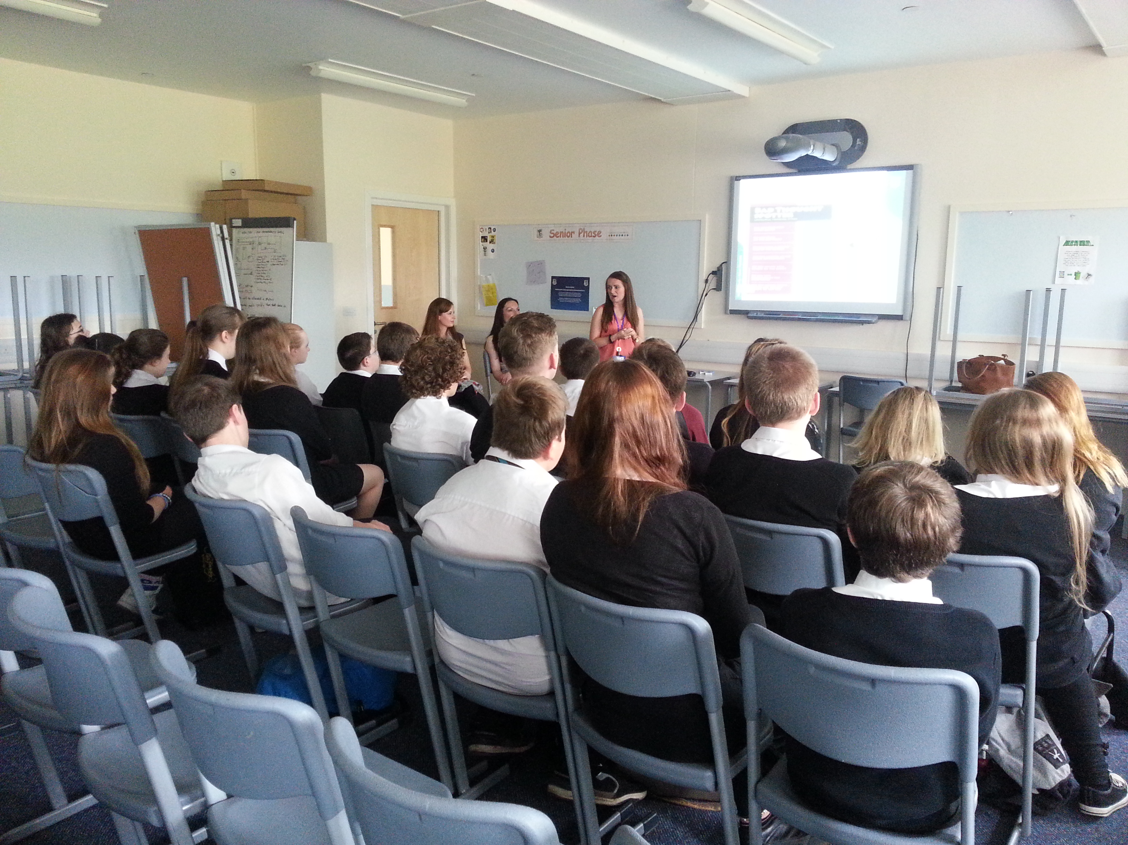
New Pupil Programmes
S5/6 Inside out Project
S3 Positive Mental Programme
  Health Road Show
  Embracing Arts Days Pilot
SAFE Talk peer mentors and training
S

Slide 12





Staff Training
Mental Health First Aid

Slide 13


Why Re-focus?
Vibrant Communities
Drop in funding available to public sector
Changes in demography
Increase in demand
Listening to our communities and stakeholders
Widening inequalities gap
Welfare Reform
National Drivers for change
Prevention and Early Intervention
Young People, Sport and Diversion
Active Schools
Play and Early Intervention
Lifestyle Development, Older People and Wellbeing
Communities
Adult Literacy, Numeracy and Learning
Sustainability
Property and Estate Rationalisation
Reduction of community facilities by 25%
Community Asset Transfer
Community led facility management
Sustainable Communities

Slide 14
Next Steps
Discussion

Slide 15
Targeted Supports
Relationships
Suicide
LGBT
www.madlyinlove.co.uk
Choices for Life
Breathing Space
Samaritans
See Me
Sandyford Initiative
LGBT Youth Scotland
Self Harm
Children in Care
Anxiety/ depressed
See Me
The Only Way is Up
Foundation
The butterfly project
tumblr
Who cares
Cedar Project
My journey app
www.sabp.nhs.uk/eiip/app
Mindfull
  11-17
  Mentor/self help/ counselling
www.thesite.org
Childline
Church
Youngscot

Slide 16
Targeted Support
Young Carers
Princes Trust
Church
Barnardos
Young Minds
Samaritans
NHS 24
SAMH
Breathing Space
Befriending Project
Youngscot
Childline

Slide 17

Targeted Supports Cont.
  Guidance/ Pupil Support Teacher
  Teachers / classroom assistants
  School nurse
  Educational Psychologists
  Vibrant communities staff (Active Schools)
  Youth worker/ sports coach/ social worker.

Slide 18
Strategic Development Model
Innovation
Staff Development
Pupils/Parents/
Carers/Partners
Notes:
There is a considerable amount of excellent work being carried out here in EA. To build on this good practice we need to take a strategic approach and ensure that we look for initiatives which will up skill our staff, maximise links with third sector and partner agencies, inform parents/carers and have a real impact on our children and young people. An initial action may be to ask the young people about the services we provided and how they think we could enhance the provision.
Parents and carers have also expressed that they require support and information on Mental Wellbeing. In order to try and address this point, steps have been taken to work with Linda Chisholm from Vibrant Communities and NHS colleagues to create a parents/carer notice board which we will take out to parents night sessions over the next 2 years. A help card similar to the S3 card will also be produced for parents /carers.

Slide 19
Pupil Voice
Pupils Councils
Youth Parliament

