Slide 1
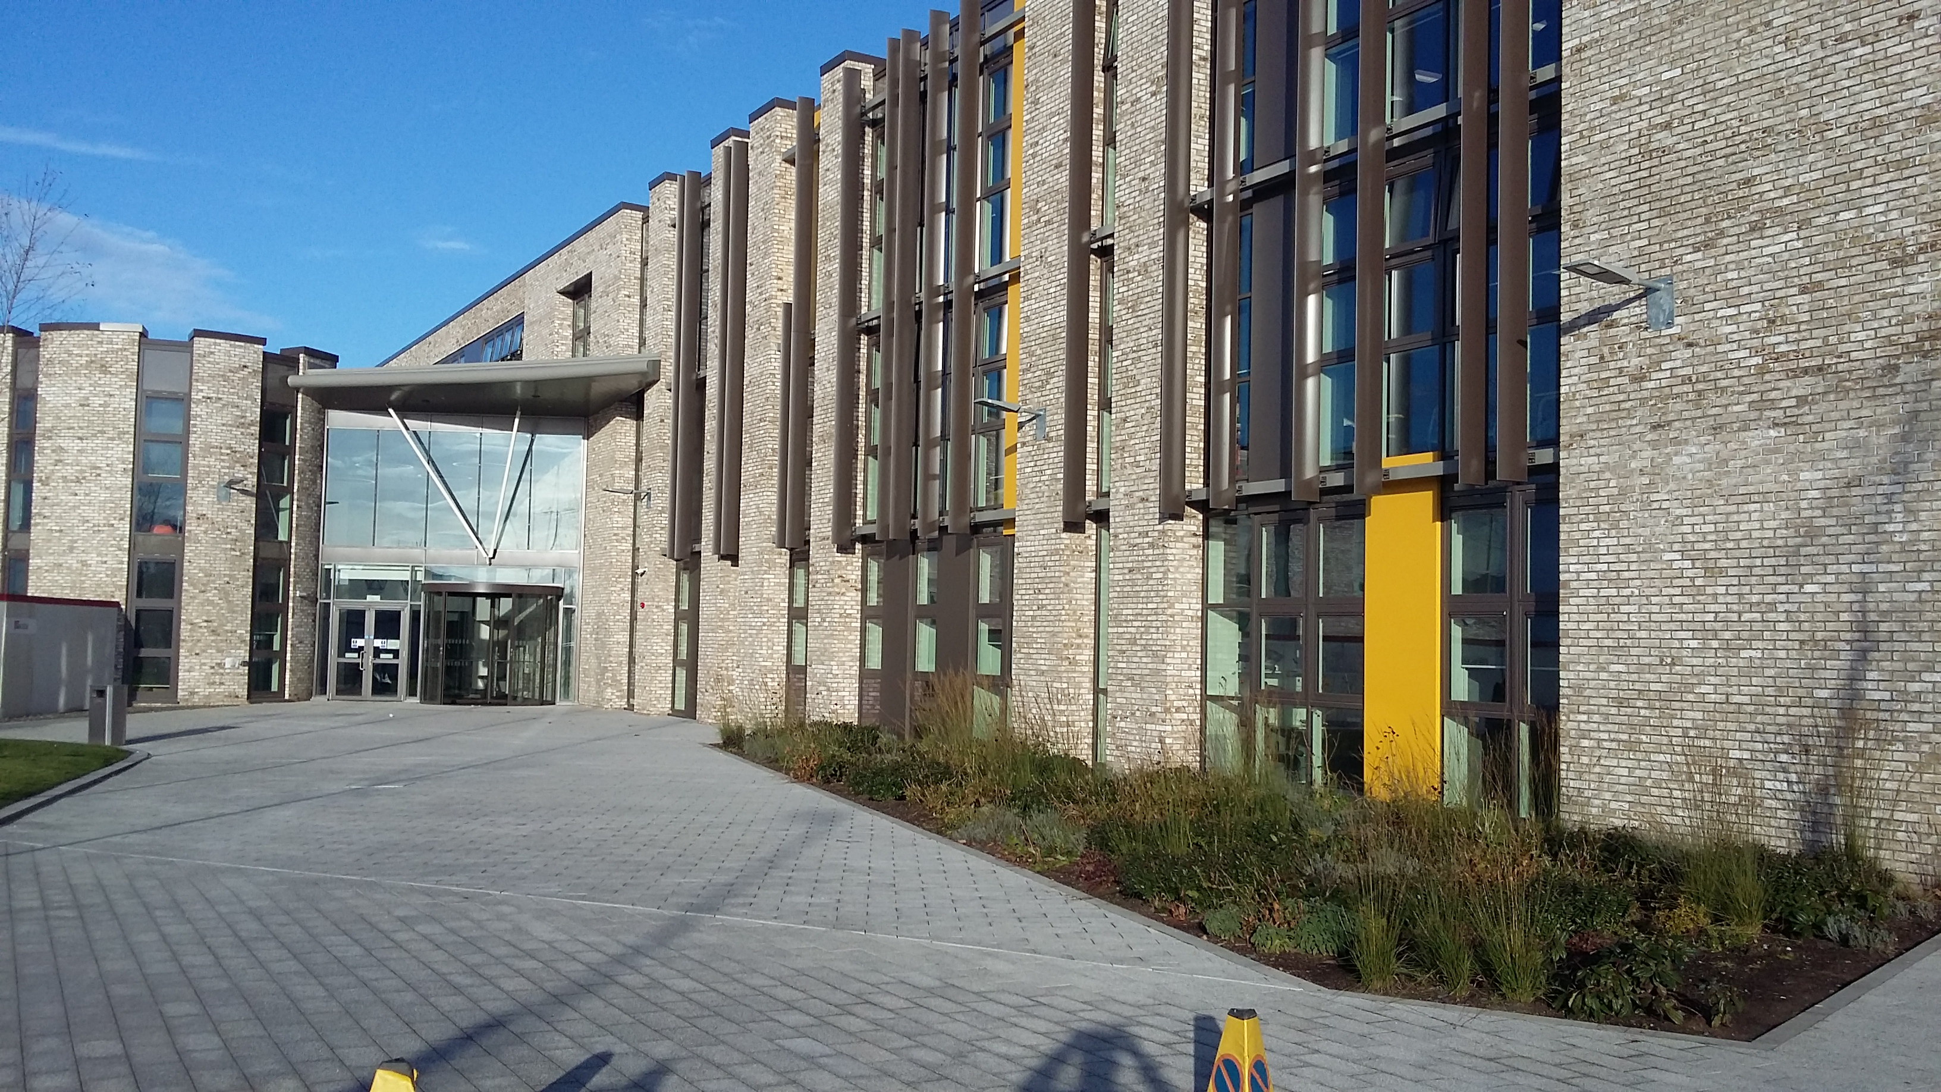
P7 Information Session
Welcome to Kilmarnock Academy

Slide 2
New Kilmarnock Academy
New Kilmarnock Academy opened April 18th 2018
Merge of Kilmarnock Academy and James Hamilton Academy
1206 pupils

Slide 3
Aspire Together, Achieve Together

Slide 4
Kilmarnock Academy - Uniform
Uniform Details
White Shirt & Tie
Plain Black Jumper/ cardigan
Black school trousers / Skirt
Black school shoes

Slide 5
Kilmarnock Academy – Differences
6 or 7 periods in a day – different subjects and different teachers.
Subject specialists.
New subjects – HE, Drama, Science.
New opportunities – extra-curricular activities, Erasmus.

Slide 6
Kilmarnock Academy – Key People
Mrs Wallace – S1 Transition
Mr Rose – Head Teacher
Pupil Support Teachers – 8 in total and 2 in each house

Slide 7
Kilmarnock Academy – Pupil Support
House
Burns
Fleming
Orr
Wallace

Slide 8
Kilmarnock Academy – S1 Classes
Classes will be made up with PTs Pupil Support.
They consult with all primaries and P7 teachers.
Pupils will be grouped into 4 Houses and will be in the same Houses as any siblings.

Slide 9
Kilmarnock Academy – S1 Timetable
 | 1 | 2 | 3 | 4 | 5 | 6 | 7
Monday | Mathematics CfE Ms Burns B20 | Religious Studies CfE Miss Borland B12 | Home Economics CfE Miss Harvey A02 | Spanish CfE Mr Reid C09 | English CfE Mrs Egerton C30 | Science CfE Miss Murray C22 | Music CfE Miss McGrath B05
Tuesday | French CfE Miss Baird C07 | Information Technology CfE Mrs Nicolson B29 | Music CfE Miss McGrath B05 | Social Subjects CfE Mrs Kelly B09 | Science CfE Miss Murray C22 | Mathematics CfE Ms Burns B20 | English CfE Mrs Egerton C30
Wednesday | English CfE Mrs Egerton C30 | Technical Studies CfE Mr Kirkland A11 | Mathematics CfE Ms Burns B20 | Social Subjects CfE Mrs Kelly B09 | French CfE Miss Baird C07 | Science CfE Miss Murray C22 | Art CfE Miss Boyd C01
 | 1 | 2 | 3 | 4 | 5 | 6
Thursday | French CfE Miss Baird C07 | PSE CfE Mrs Egerton C30 | Technical Studies CfE Mr Kirkland A12 | Physical Education CfE Mr Oates Games 1 | English CfE Mrs Egerton C30 | Mathematics CfE Ms Burns B20
Friday | Mathematics CfE Ms Burns B20 | Physical Education CfE Mr Oates Games 1 | Drama CfE Miss McCourt Stage | Social Subjects CfE Mrs Kelly B09 | English CfE Mrs Egerton C30 | Art CfE Miss Boyd C01
Name: Pupil Name | Register Group: 1B1 | Stage: S1

Slide 10
Kilmarnock Academy – S1 Expectations
Attendance.
Behaviour.
Commitment
Successful S1 = a great start to secondary school!

Slide 11
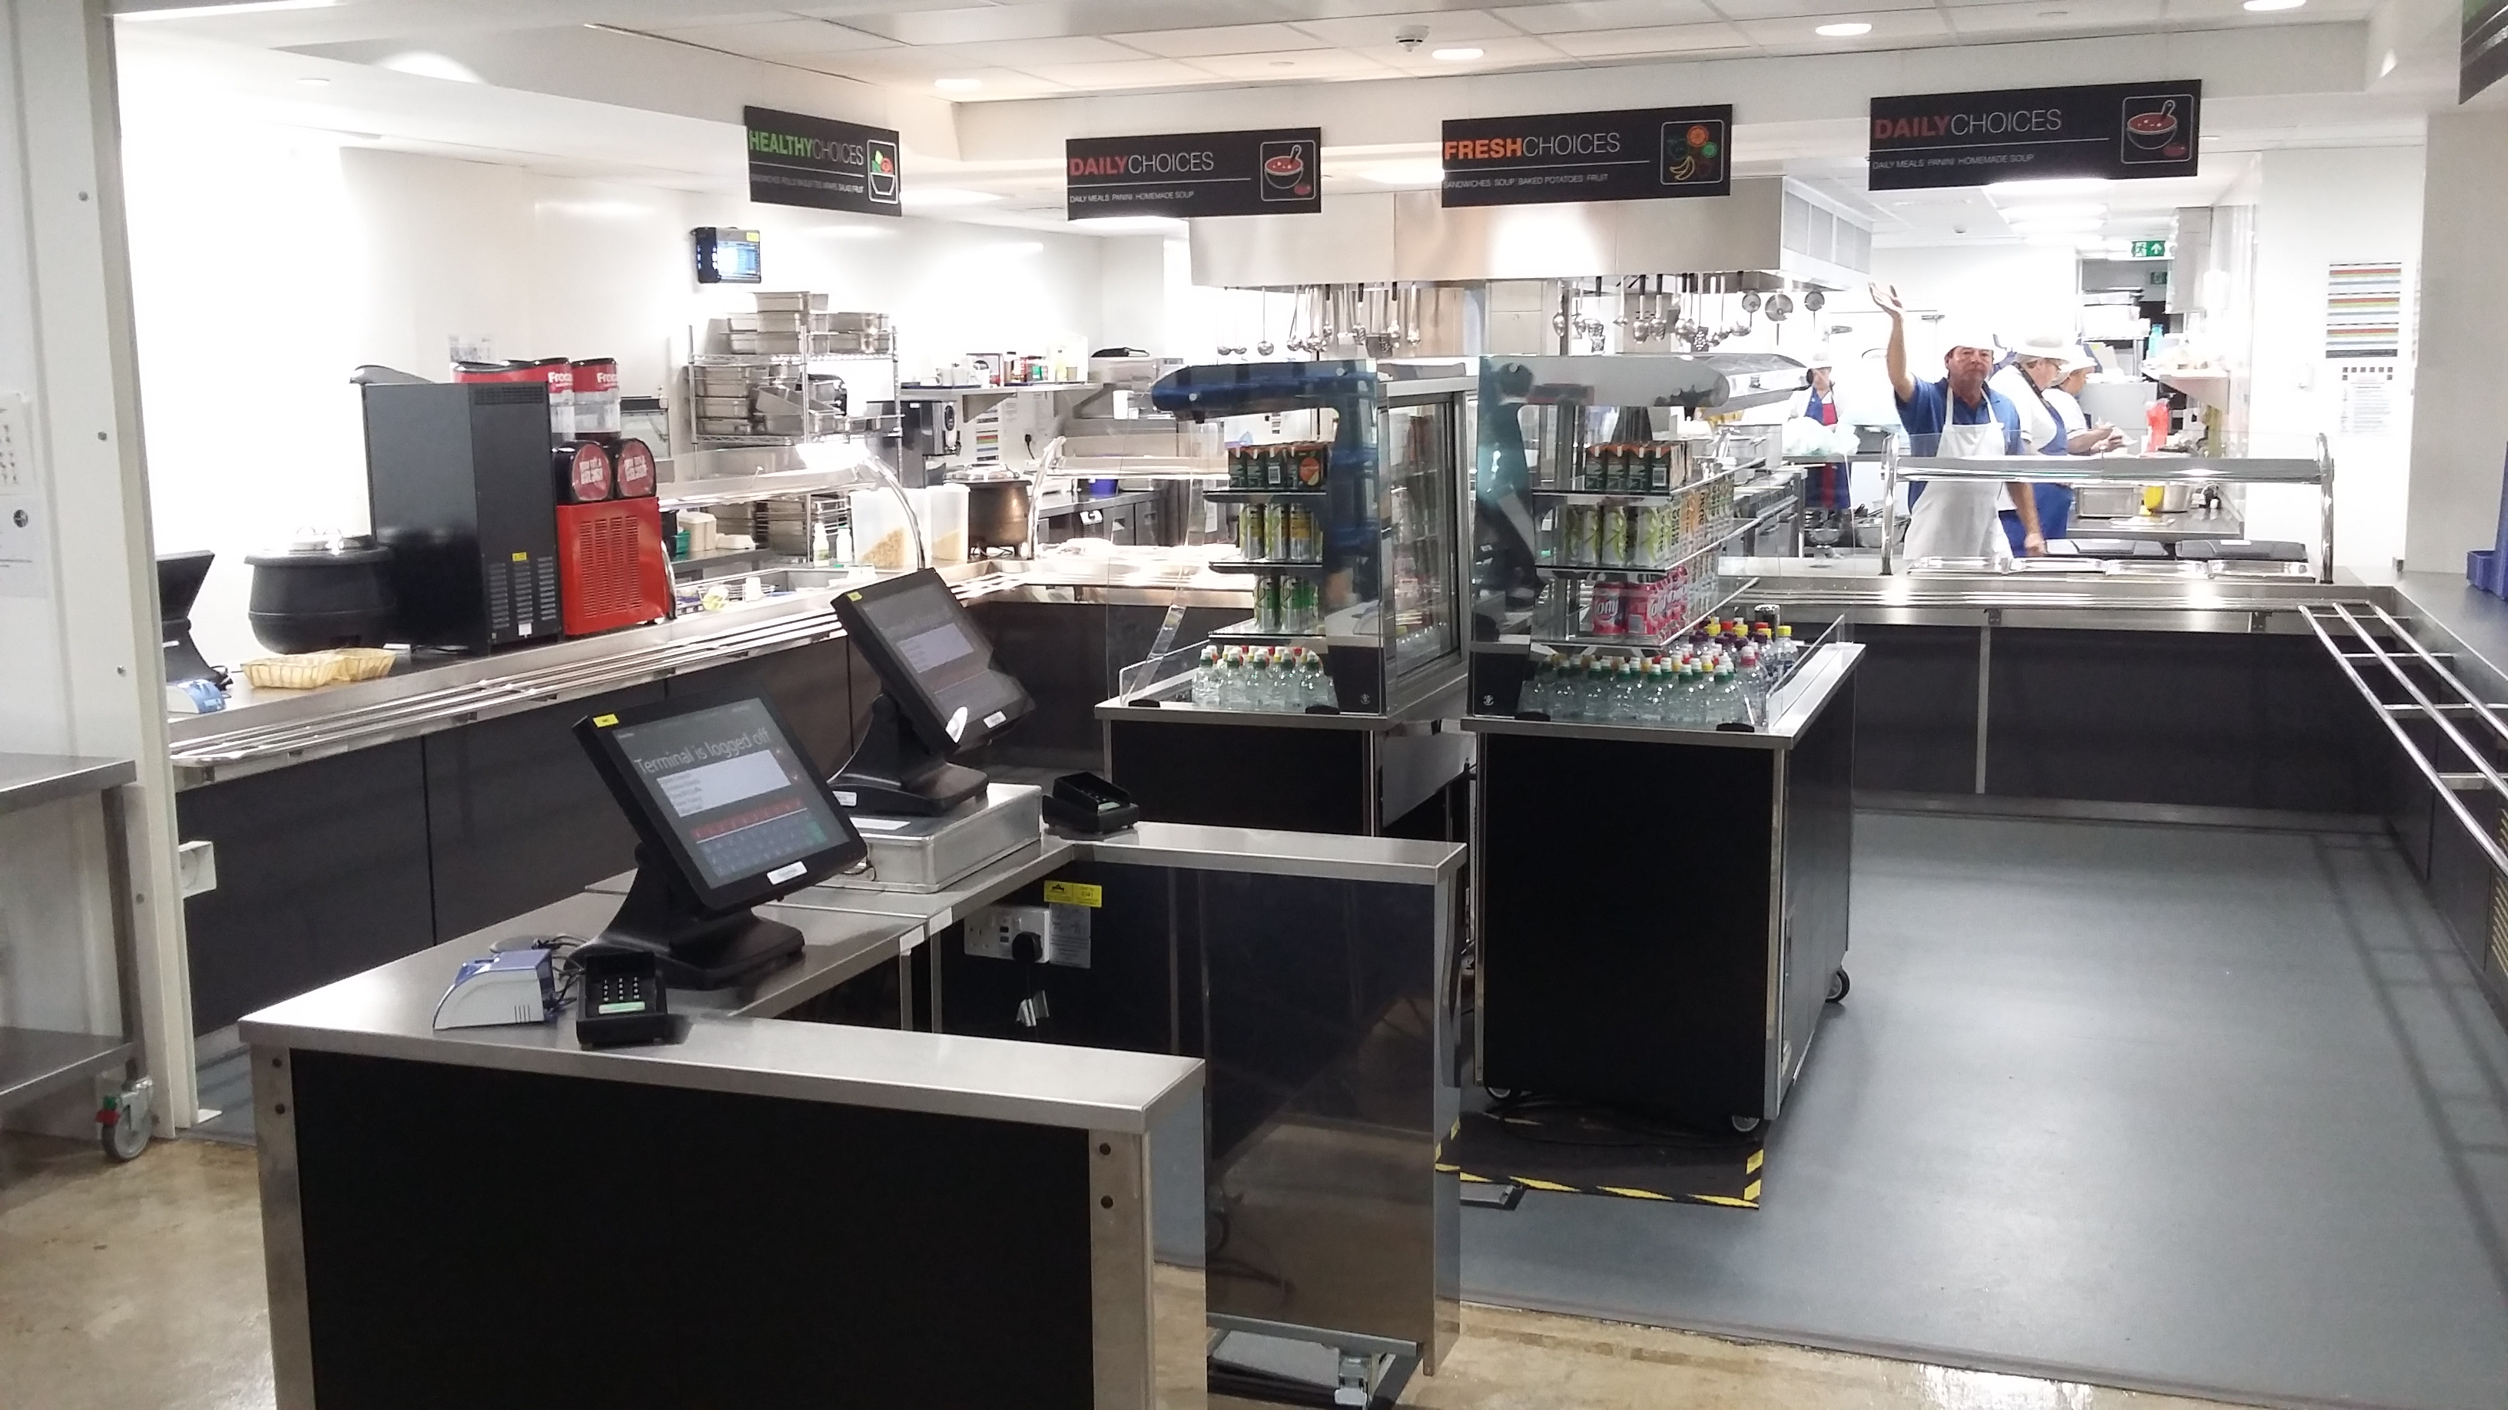
Kilmarnock Academy - Lunch

Slide 12
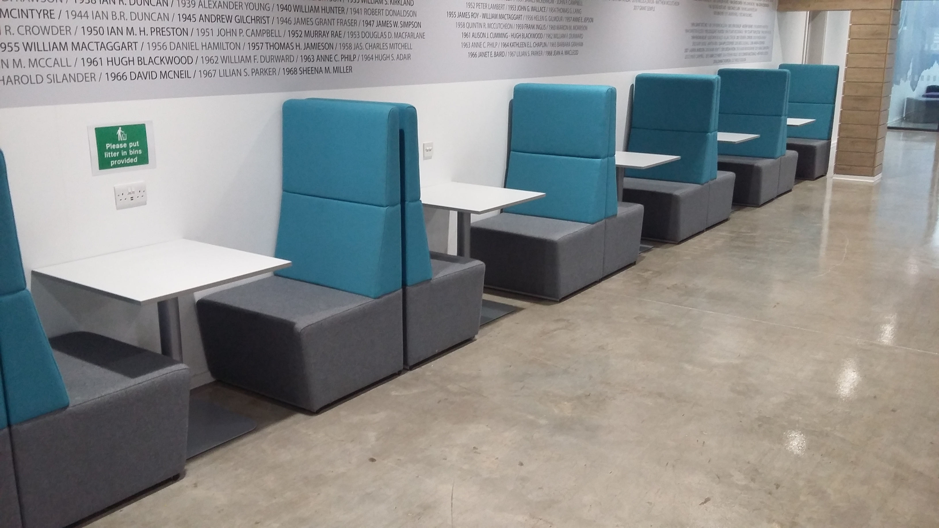
Kilmarnock Academy - Lunch

Slide 13
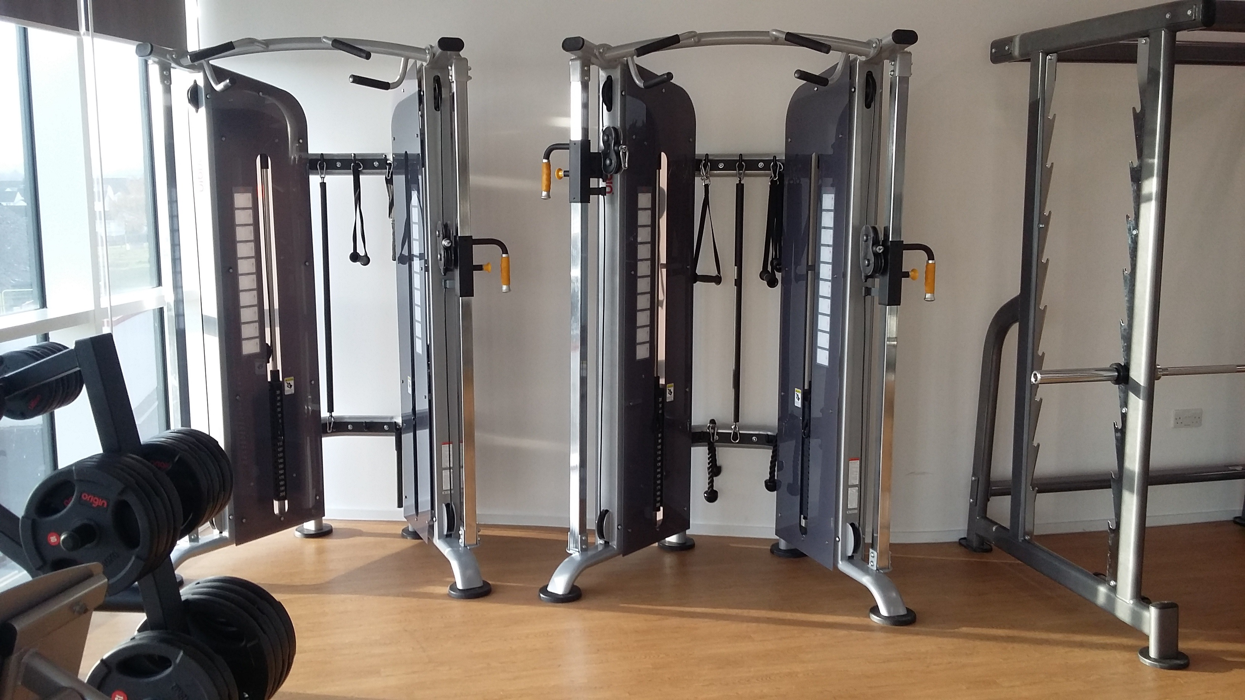
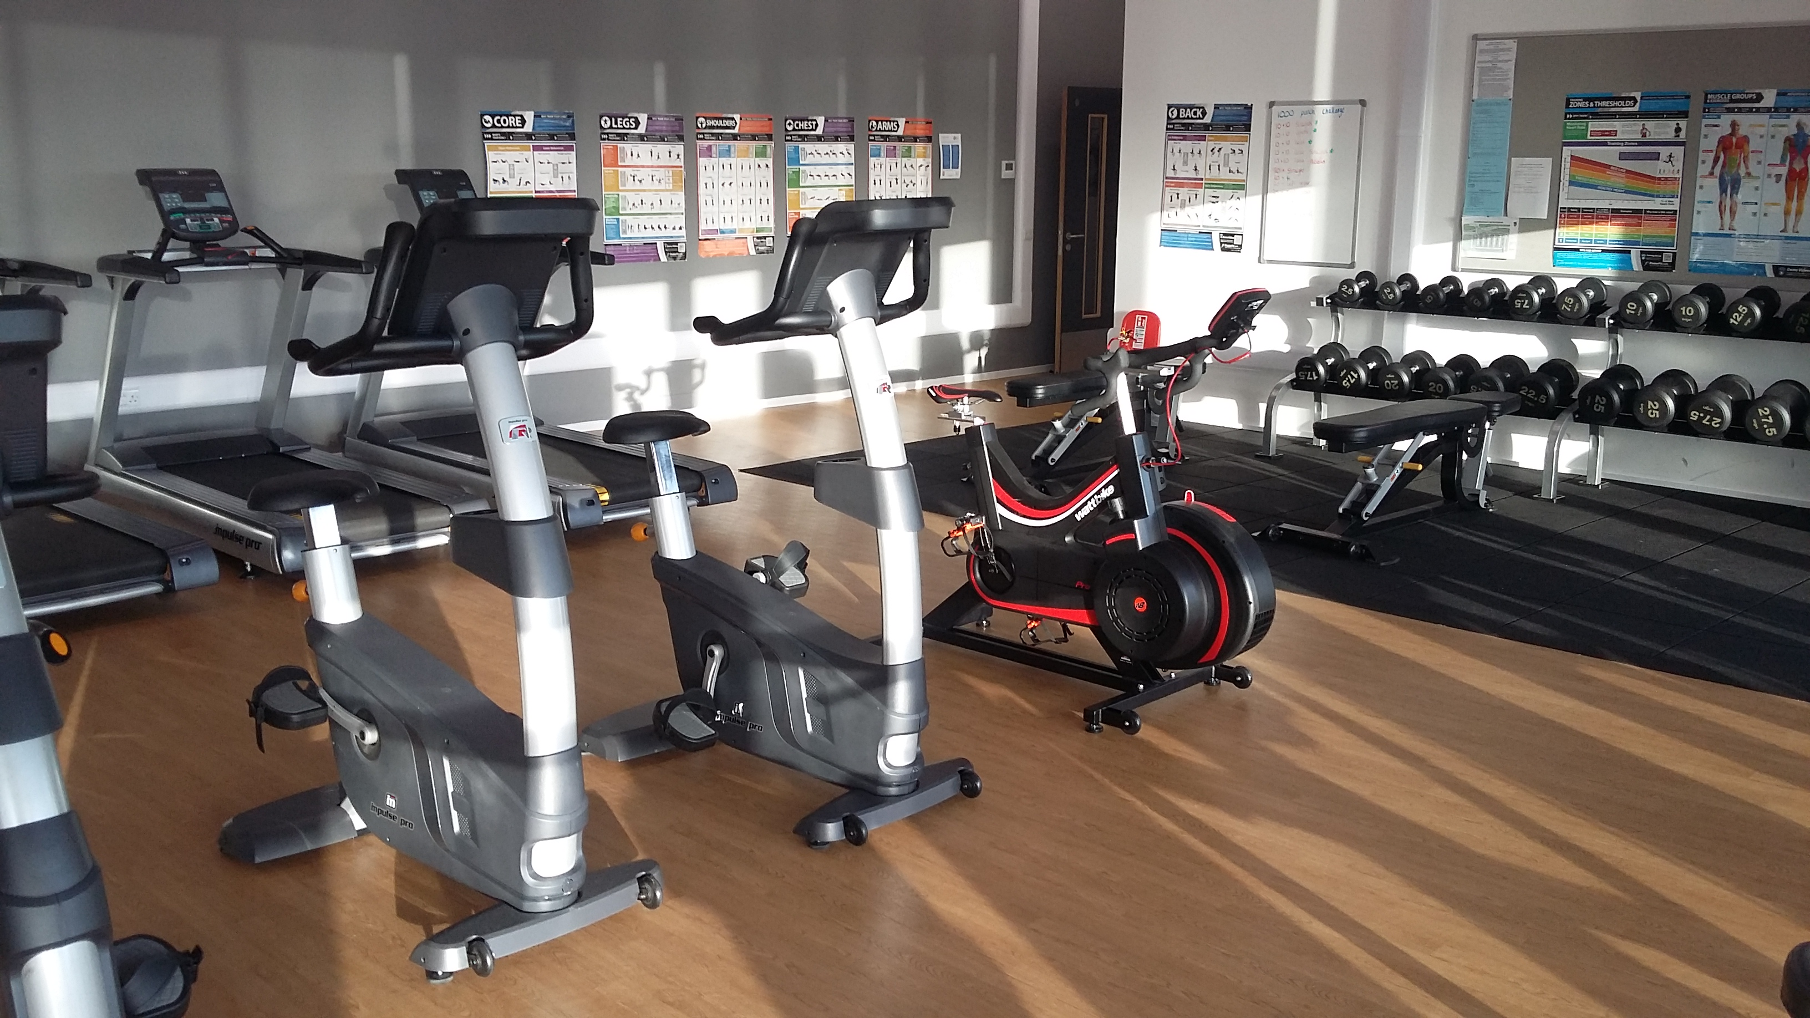
Kilmarnock Academy – PE (Fitness Suite)

Slide 14
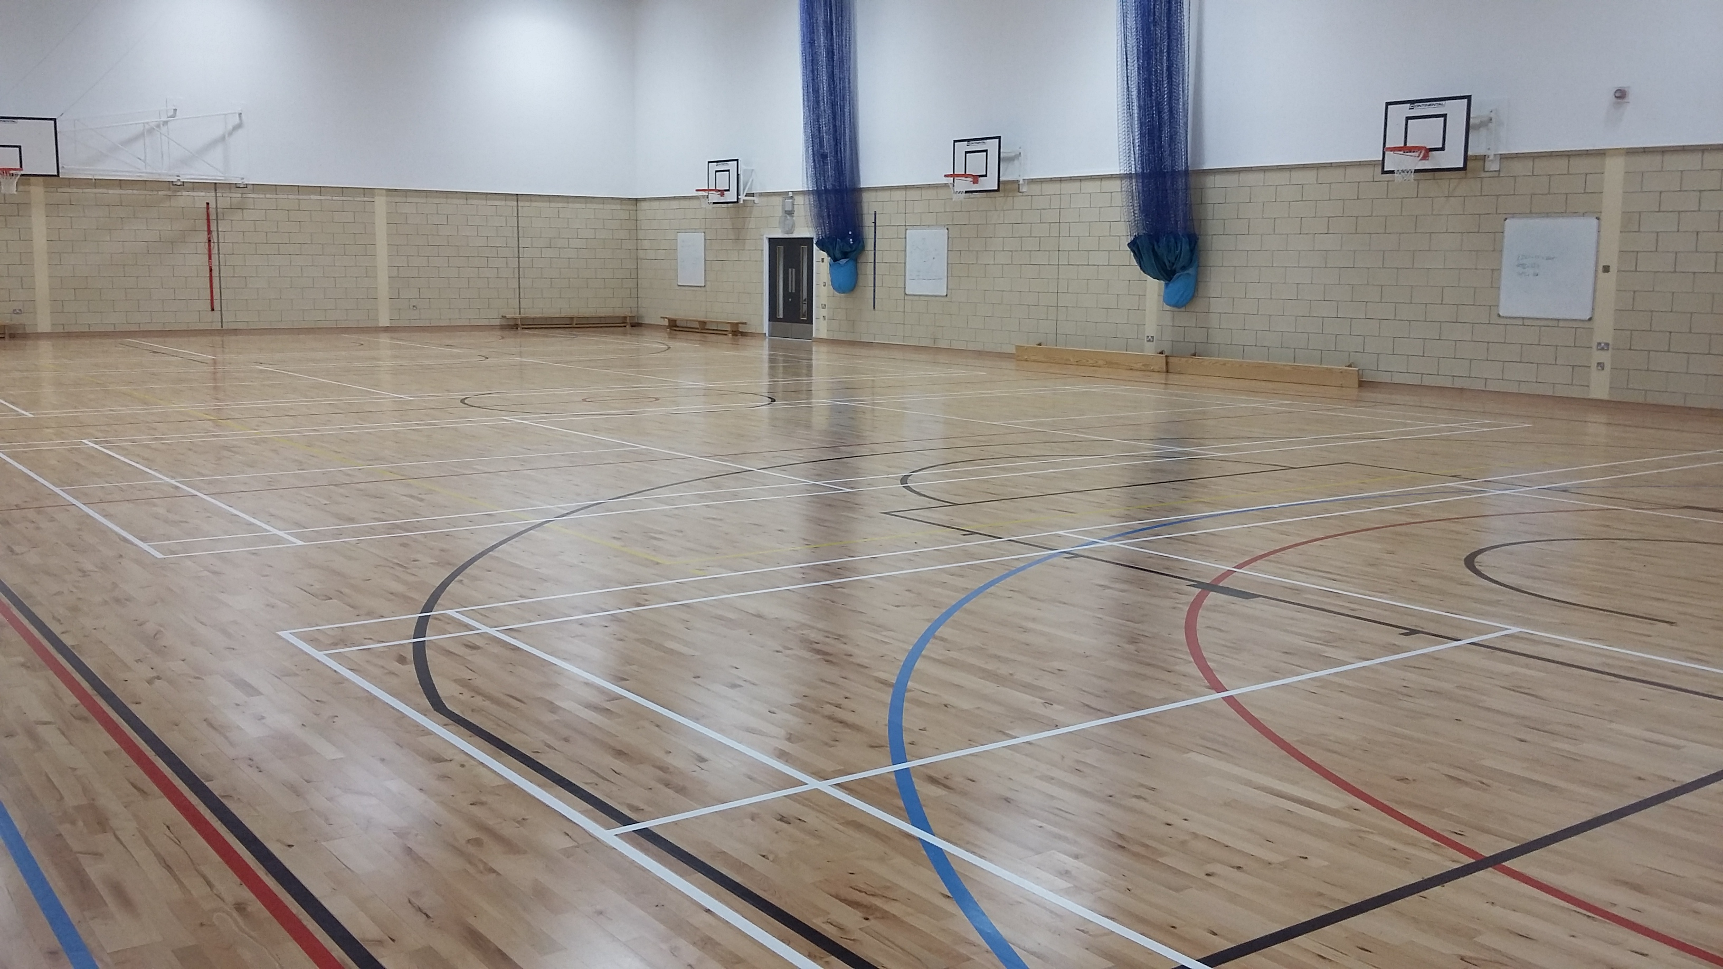
Kilmarnock Academy – PE

Slide 15
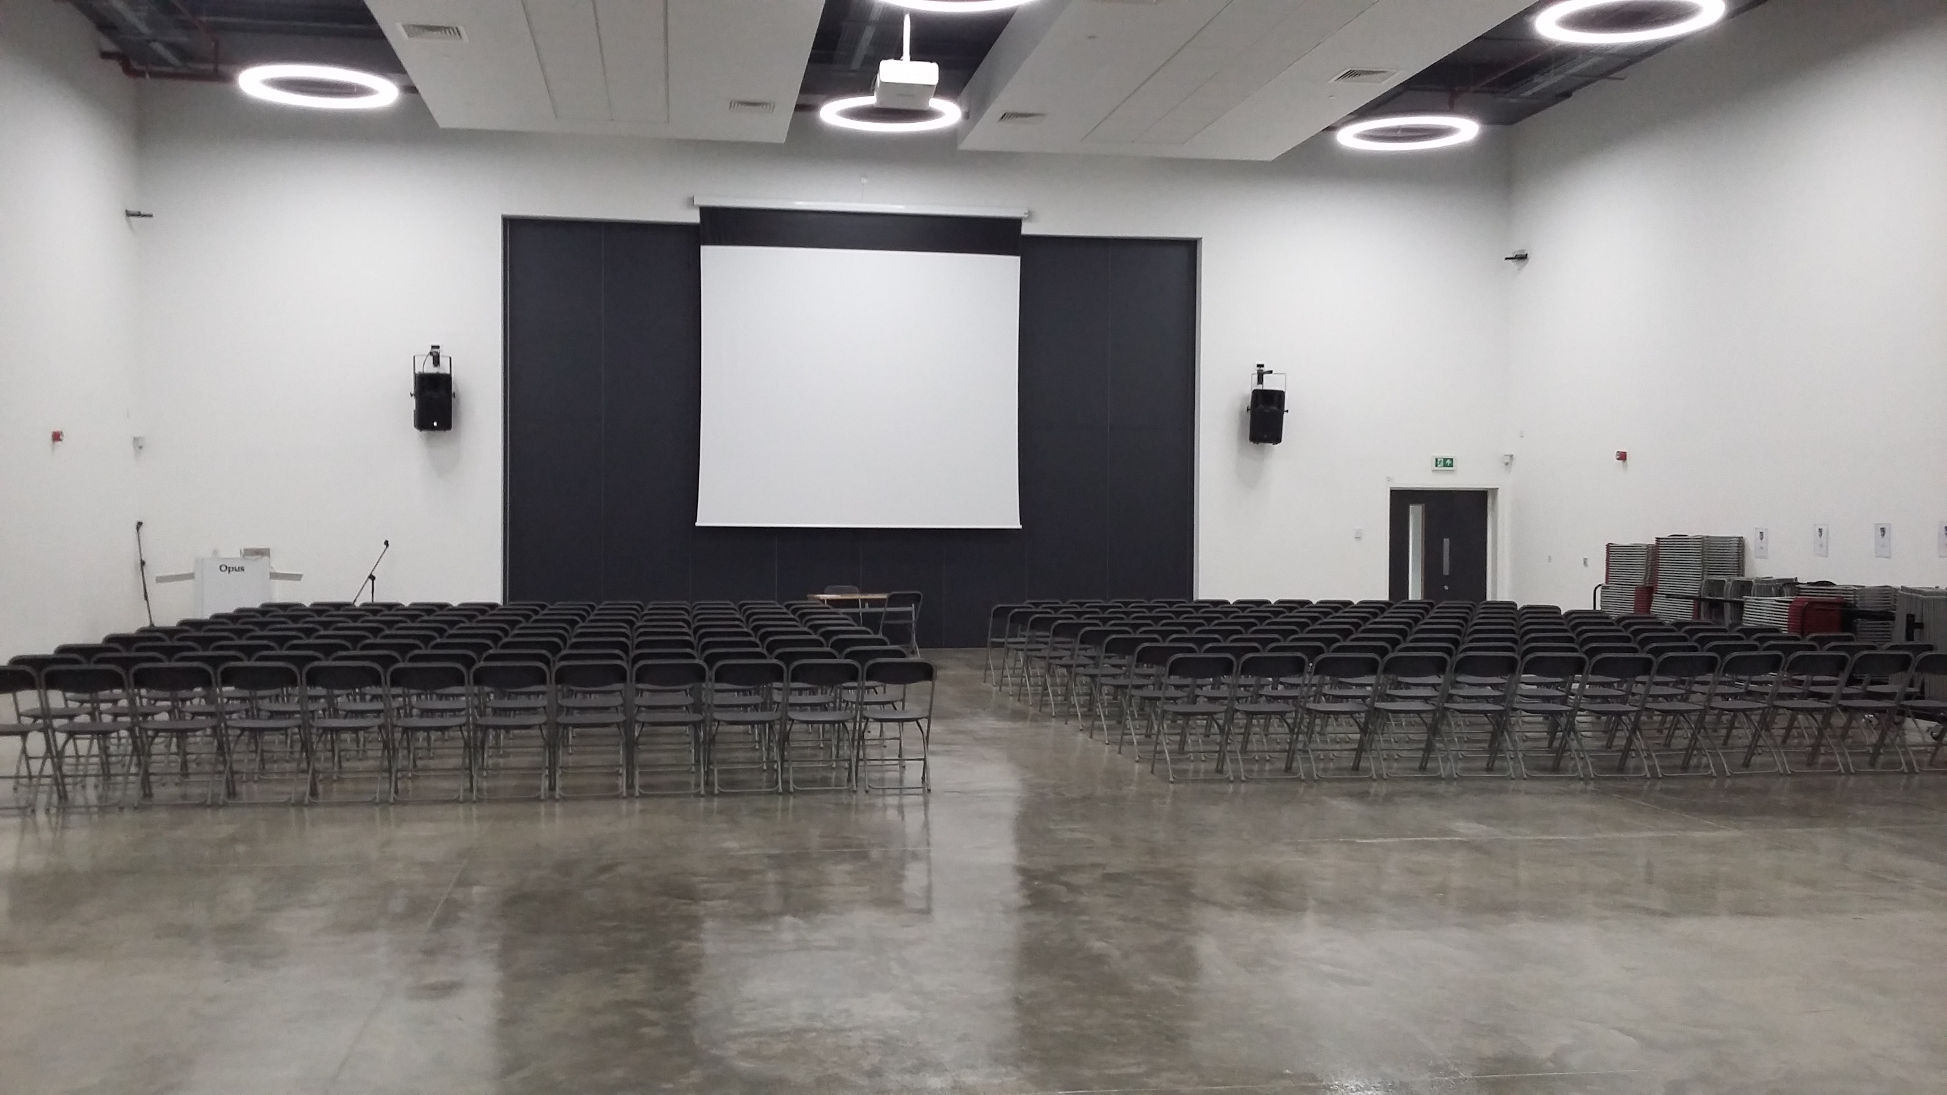
Kilmarnock Academy – Atrium Hall

Slide 16
Kilmarnock Academy – Dates for Your Diary!
WB 25th October 2022 – Modern Languages visit
WB 28th November 2022 – Social Subjects visit
Tuesday 13th December 2022 – P7 Information Evening at Kilmarnock Academy

Slide 17
Kilmarnock Academy – Dates for Your Diary!
WB 9th January 2023 – English visit
March 2023 – Mrs Wallace and Pupil Support visit
WB 24th April 2023 – Maths visit

Slide 18
Kilmarnock Academy – P7 Induction Days
Induction days take place on Tuesday 23rd Wednesday 24th and Thursday 25th May 2023
Tuesday and Wednesday will be an exciting opportunity to follow S1 timetable and meet classmates and staff.
Thursday 25th May will be P7 Science day – a fun day in Science!

Slide 19
Kilmarnock Academy
Questions?

