Slide 1
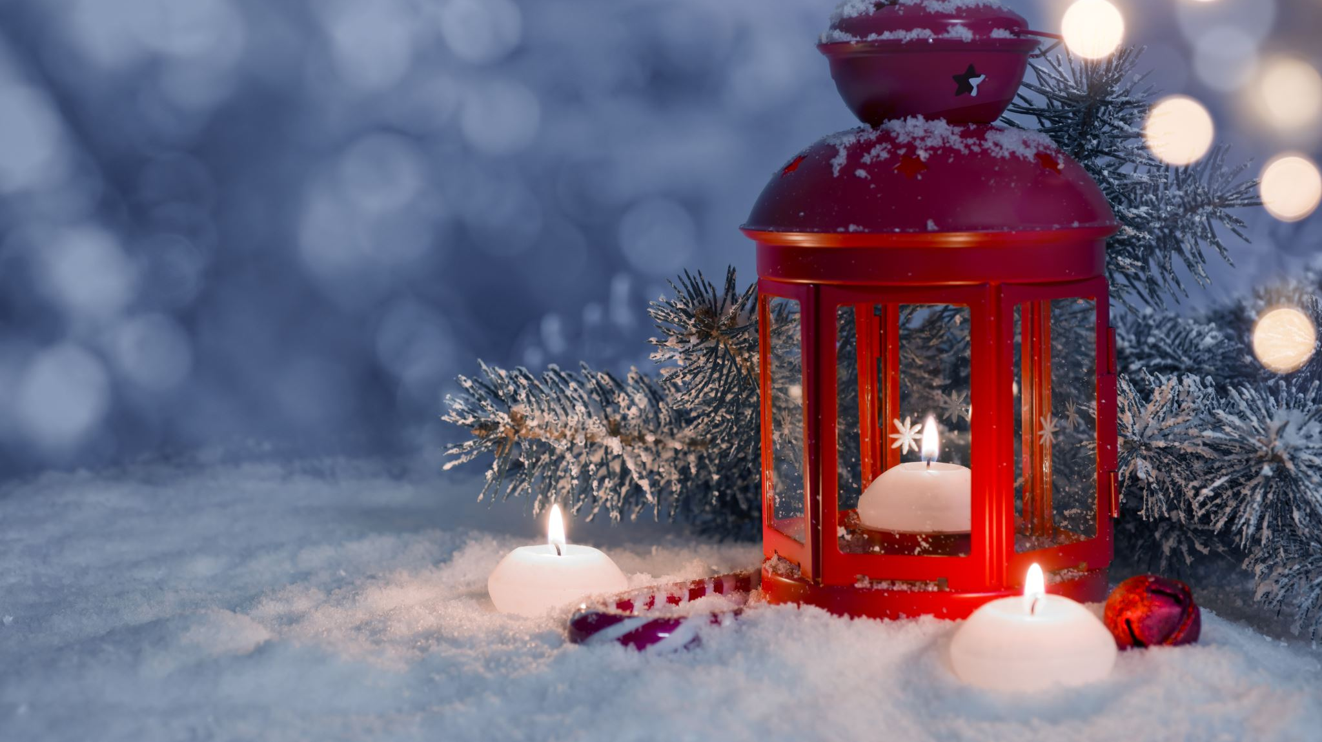
P4/5
Monday 19th December 2022

Slide 2
Monday 19th December 2022
Hello everyone, Mr Costello here.
Sorry we can’t all be together in class today (although I’m a bit relieved because you keep beating me at our new number shape game on the board!)
On the next few pages you will find work for your groups. Please attempt the work for your group and, if you feel like it, give another group’s work a go too!

Slide 3
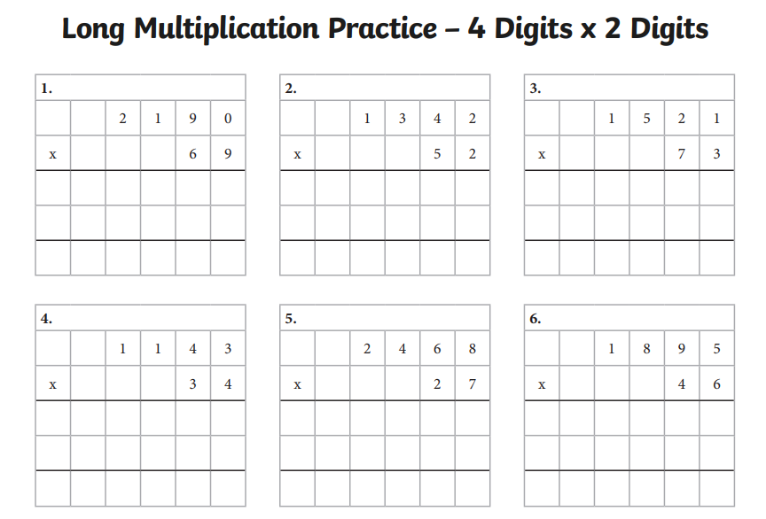
Maths - Circles
A dojo point awaits
anyone who gets them all right!

Slide 4
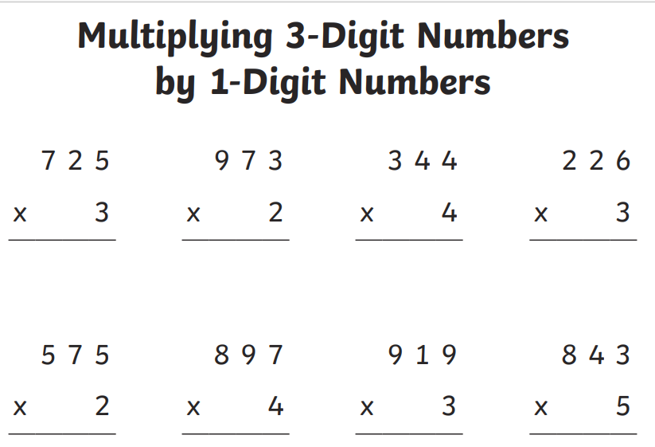
Maths - Squares
If you can do…
Q 1-4: Well done.
Q 1-6: Excellent!!
Q 1-8: Grab a Dojo point when we’re back in class!

Slide 5
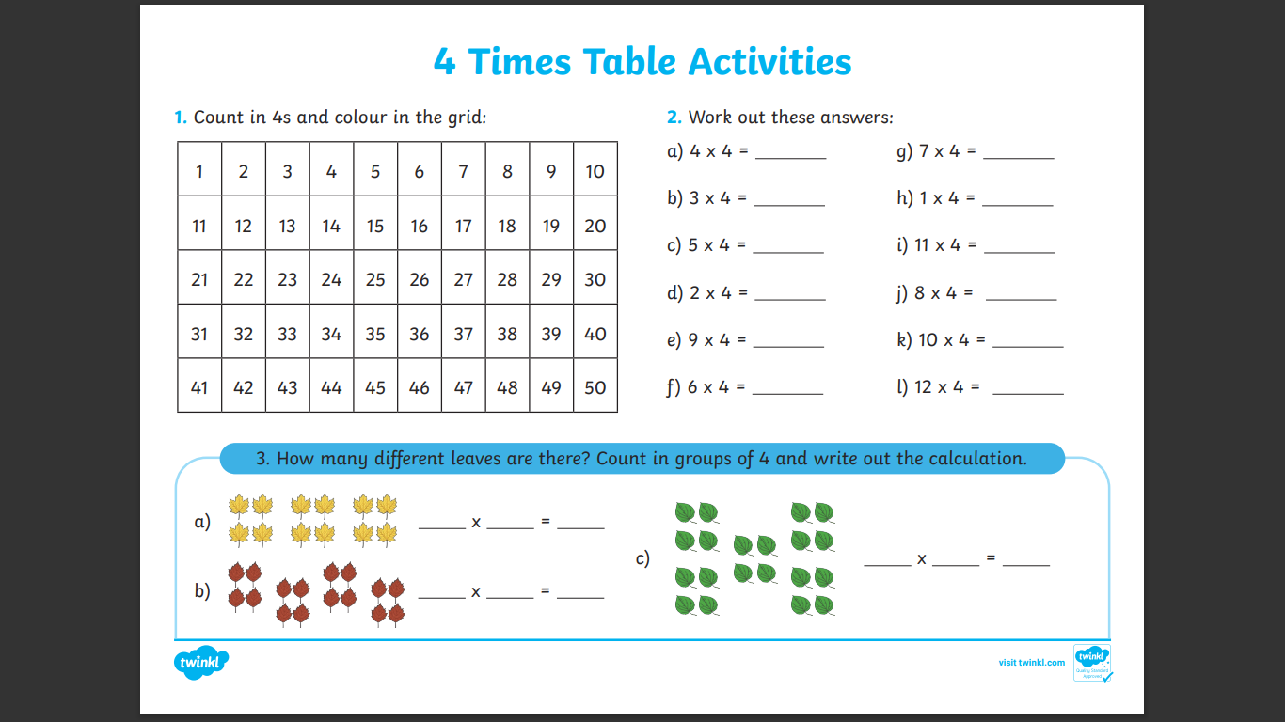
Maths - Triangles
Q1 – Instead of this question, can you list all the stations of the 4 times table? I’ll start…0, 4, 8…
Q2 – Remember to use arrays if you’re not sure. The first one would look like this:
O O O O
O O O O
O O O O
O O O O
Q3 – The answers will be how many leaves are in each group x the number of groups.

Slide 6
Literacy - everyone
Try to finish the story that is on the next page.
Remember some of the things we have discussed in class…
Full stops, capital letters, when to use ‘a’ or ‘an’, trying to make the story interesting for a reader. For example, things that are dangerous or funny or sad or exciting or unexpected might happen along the way. These things make stories interesting!
Most of all though, have fun writing it!

Slide 7
Alfie the Elf
It was Christmas eve and, as always, the North Pole had been an exciting, busy place. Alfie the elf was so tired from all the toy-making and was glad to be finished for the night.
Along with all the other elves, he stood outside in the snow getting ready to wave goodbye to Santa as he flew off to deliver all the presents. He heard Santa cheerfully yell “Ho! Ho! Ho!” as the reindeer pulled him high up into the starry night sky.
The elves all cheered and sang some Christmas songs together. While they were celebrating, Alfie noticed that one present had fallen out of Santa’s sleigh! He looked up in to the sky but Santa was too far away to call him back…

Slide 8
Finished.
Well done!

