Slide 2
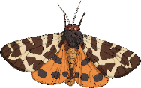






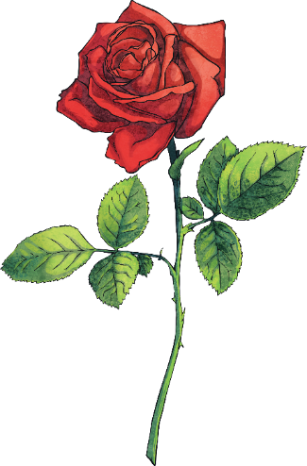




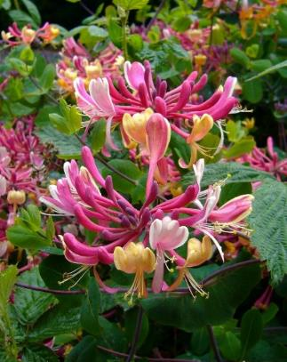
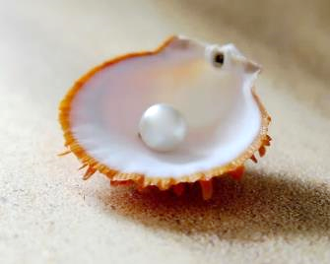
June’s Pinboard
Probably named after Juno, the Roman goddess of marriage who was married to the king of all gods, Jupiter.
June has the longest day of the year. You won’t see the sun go down until around 10p.m.
Each month has a special flower and birthstone. June’s flowers are honeysuckle and rose and its birthstones are
pearl, moonstone and alexandrite.
June has two zodiac signs: Gemini and Cancer.
Things to do:
camp outdoors
pick strawberries and make jam
use a large white sheet and torch to attract moths
use a sheet under a tree, then shake the tree and see what invertebrates have fallen onto it

Slide 3
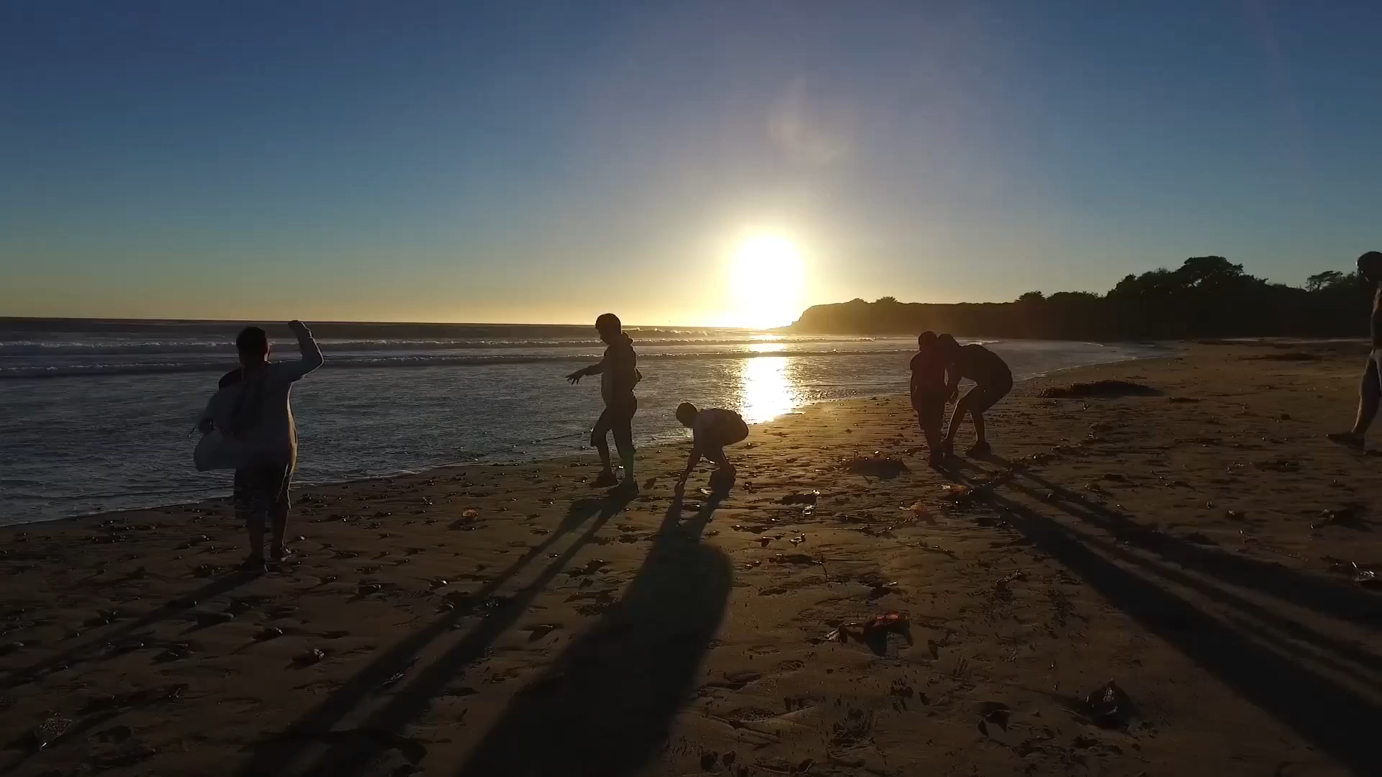
Summer Is Here!
This is the month with the longest hours of daylight so even after the school day ends, there is still plenty of light for us to get outside and explore.

Slide 4
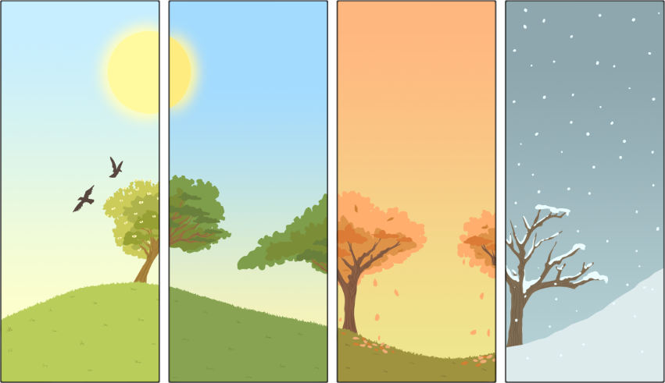
Goodbye Spring, Hello Summer!
The meteorological beginning of Summer is the 1st of June.
Weather scientists are called meteorologists. They divide the year into quarters, each containing three months. This makes it easier for them to compare information over the years and make forecasts.
Spring: March, April,
May
Summer: June,
July, August
Autumn: September, October, November
Winter: December, January, February
However, the astronomical beginning of summer
is the Summer Solstice (also known as Midsummer).

Slide 5
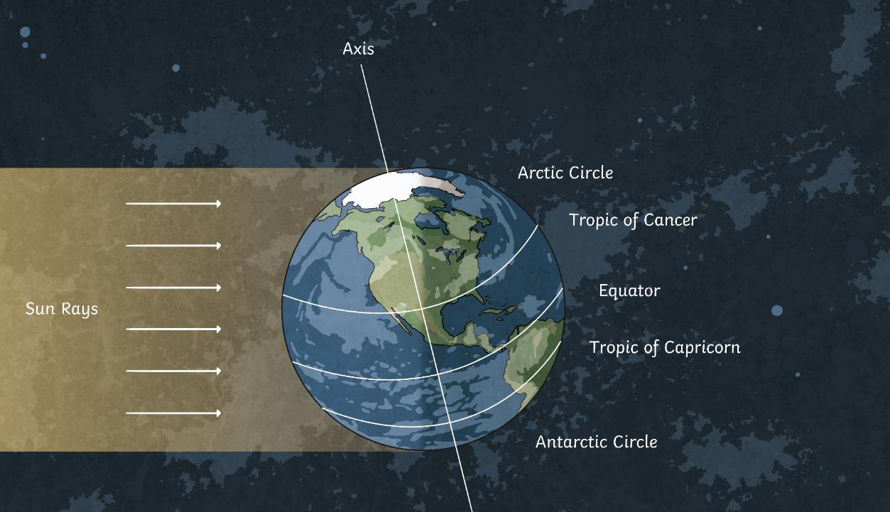
Summer Solstice
The astronomical summer begins around the 21st of June. However, you will need to check the date for each year as it varies depending on the position of the Earth when it orbits the Sun.
The summer solstice marks the time when the Sun reaches its highest point in the sky and there is the
most daylight.

Slide 6
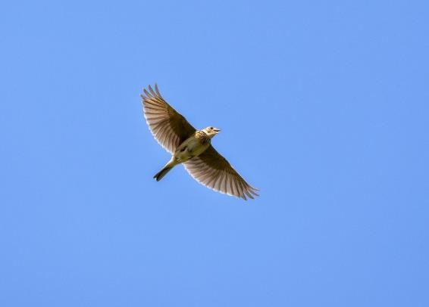

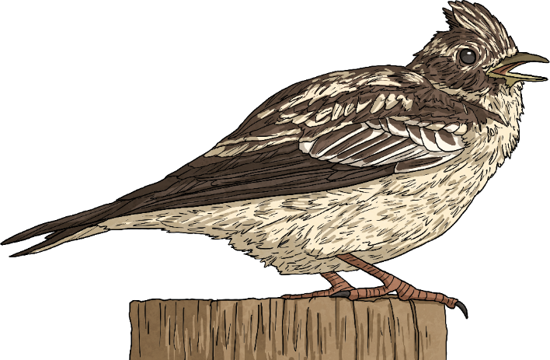
Singing Skylark
A skylark might not be the most interesting looking of birds, yet it’s call has inspired writers and poets.
It is streaky brown ‒ a great camouflage when on the ground.
Over farmland, the male will perform a song-flight, hovering at 300m, singing for up to an hour
before coming back down.
This is to mark
his territory.
Skylark numbers are declining
rapidly due to habitat loss.
The species is currently at Red
on the Conservation Status.
The RSPB have a short video of some hungry, noisy skylark chicks. Click here and scroll down the page to watch it.

Slide 7
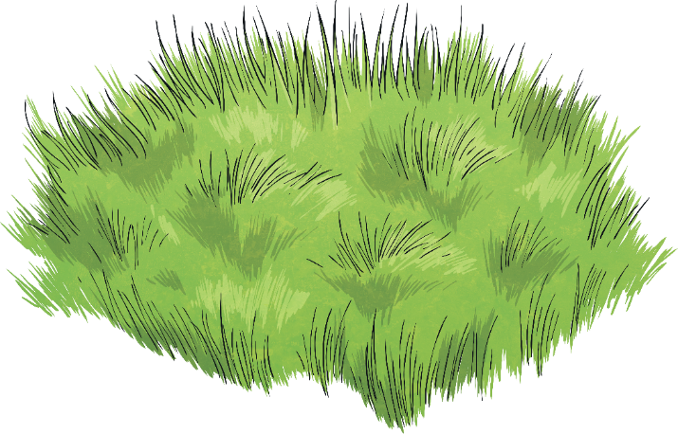
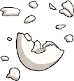
Egg-Citing Finds
Birds can have several broods during spring and summer to maximise their chances of survival. So while you’re out and about in your garden, the park or the woods, keep an eye on the ground for bits of discarded eggshells. If you do find a fragment of an eggshell, it was likely dropped there by a bird, cleaning out its nest.
Eggshells are made of calcium carbonate so their base colour is white. Different colours and patterns have evolved depending on the habitat the nests are made in.

Slide 8
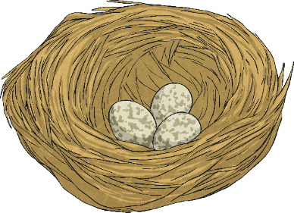
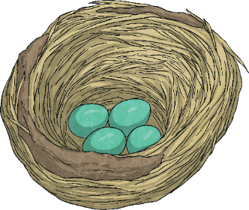
Egg-Citing Finds
Can you identify the type of bird that the eggshell came from?
Tree or shrub nesting birds
need the greatest camouflage so their eggs are brown and speckled.
Ground-nesting birds
usually lay blue or green-coloured eggs with or without speckles.
Birds that nest in holes
don’t rely on camouflage to keep their eggs protected but they do need to be able to see them in the darkness, so the eggs are often white or pale blue.
Answers

Slide 9
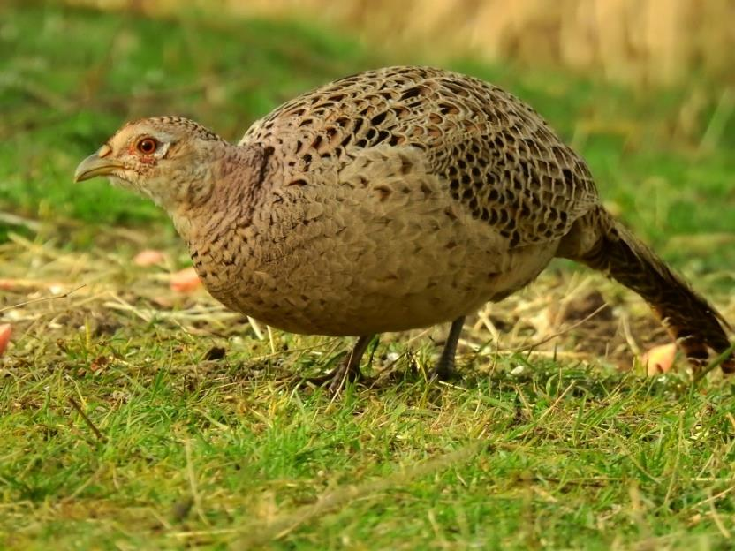
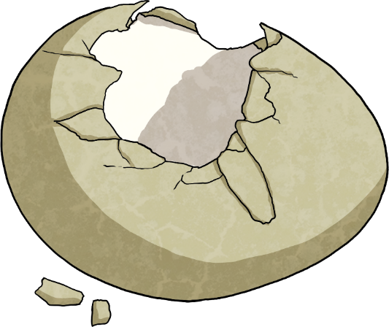


Egg Match or Egg Splat?
Can you match the discarded eggshells to the likely parent bird?
robin
buzzard
pheasant
Yes! A pheasant lays its eggs on the floor. The eggs are olive-brown without markings, helping their camouflage and keeping them protected.

Slide 10
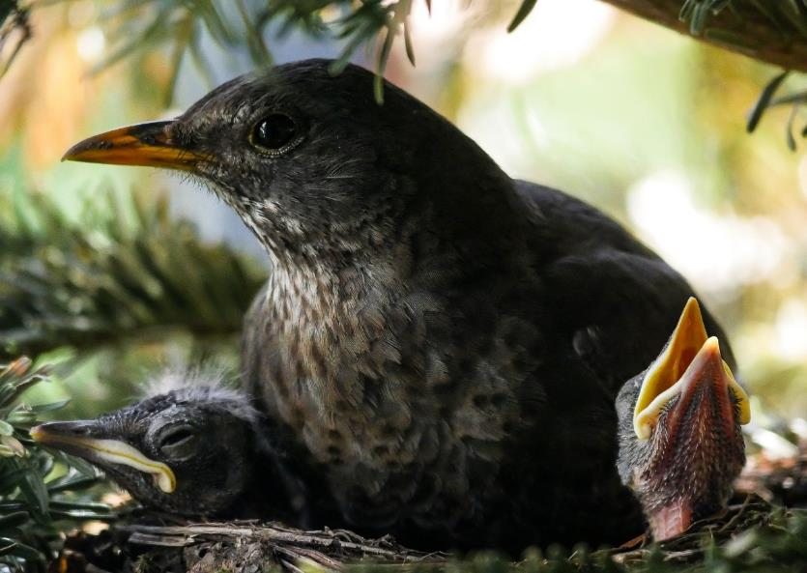
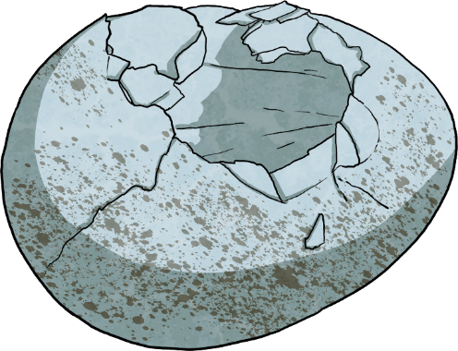

Egg Match or Egg Splat?
Can you match the discarded eggshells to the likely parent bird?
puffin
blackbird
skylark
Yes! A blackbird nests in trees or bushes and its eggs are blue-green with speckles.

Slide 11
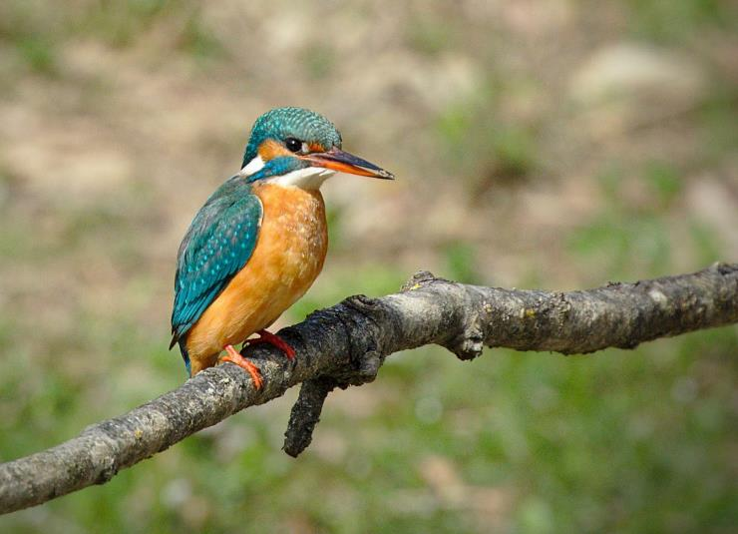
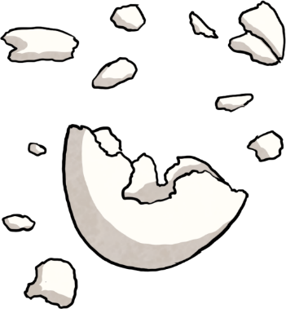
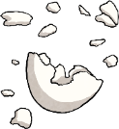
Egg Match or Egg Splat?
Can you match the discarded eggshells to the likely parent bird?
house sparrow
peregrine falcon
kingfisher
Yes! A kingfisher scrapes out a nest in the sandy riverbank and the eggs are laid underground so camouflage is less important. Its eggs are white and glossy.

Slide 12
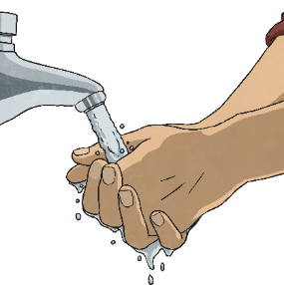
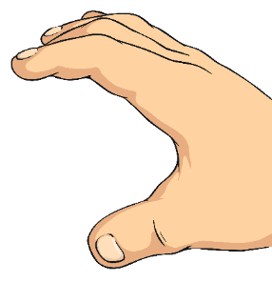

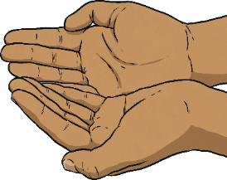

Be a Responsible Ornithologist
Remember to wash your hands thoroughly after handling any eggshells.
Don’t disturb nests and don’t remove
the eggs; it is against the law.
Please only investigate eggshells that are empty and discarded.

Slide 13
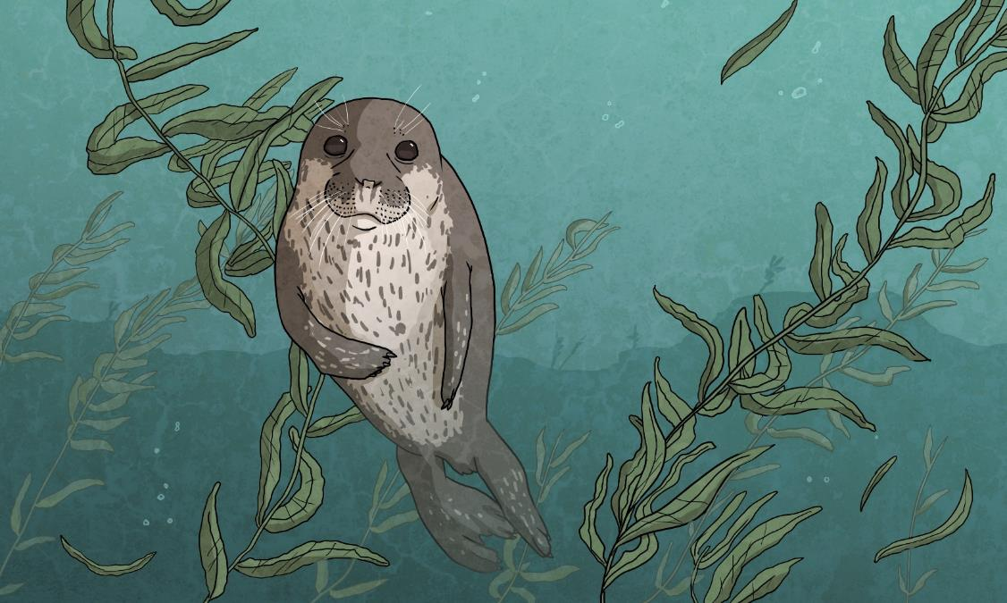
Not so Common Harbour Seals
Harbour seals are also called common seals and they are classed as a priority species in the UK Biodiversity Action Plan.
Fortunately, they are now found all around the Scottish coast but back in the 19th century they were hunted for their fur and their numbers dropped dramatically. Today seals come into conflict with the fishing industry, competing for fish and getting tangled in fishing gear.

Slide 14
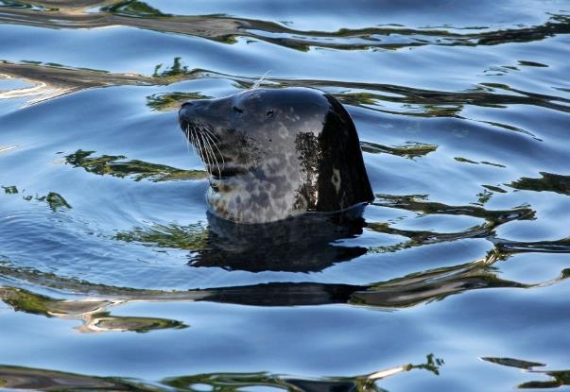
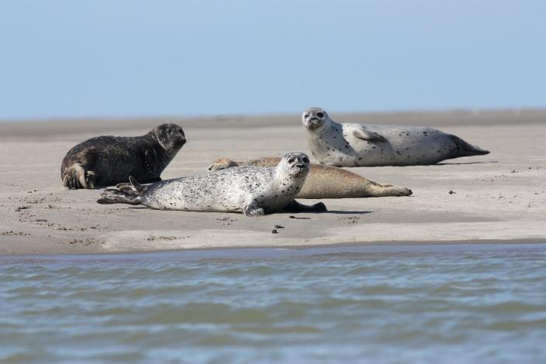
We have two types of seals around the coast of Scotland –
the harbour seal and the grey seal.
Harbour seals give birth to their pups around June or July while grey seals have their pups in autumn.
You can often see seal heads popping out of the water to have a look at what’s happening on the beach; they are very curious. At first, it may look like a dark ball bobbing on the waves but take a second look as it may be a seal.
You might even see them hauled up on the beaches or rocks in groups.

Slide 15
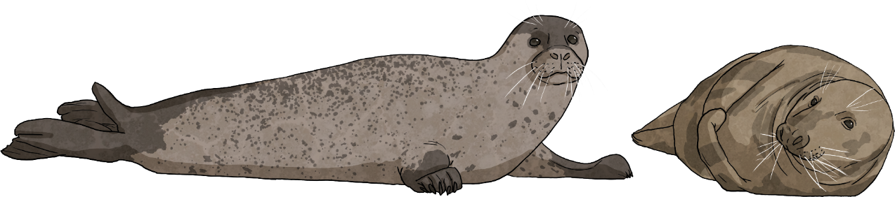
Even if all you can see is their heads, you can still identify what species they are as, rather conveniently, the shape of their noses is one of the ways to tell them apart.
Harbour seals
Grey seals
they’re mainly light brown or grey
they look more like a labrador dog
short muzzle
larger
has V-shaped nostrils that meet at the bottom
have some large speckles on fur
they lie flat when hauled up
smaller
long muzzle
they’re mainly grey in colour
they often lie in an upturned banana shape
they have lots of small speckles all over their fur
they look more like a cat
their nostrils are further apart

Slide 16
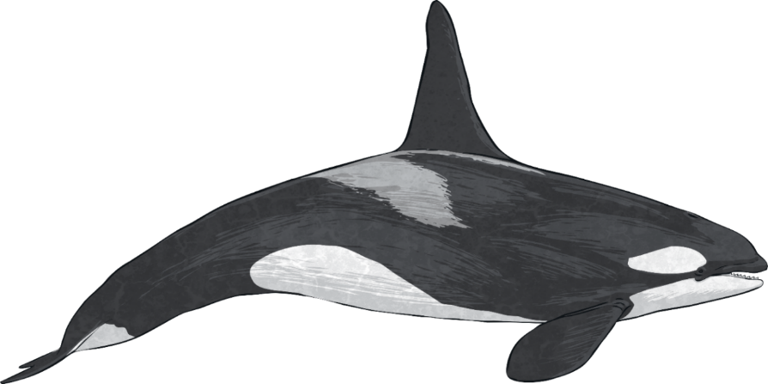
Orca Means Whale but an Orca is Not a Whale
How confusing it that!
However, it’s not a whale at all. The Orca (also known as ‘Killer Whale’)
is actually the largest
member of the
dolphin family.
You would be extremely lucky to spot an Orca off the coast of Scotland but your chances increase slightly in June when they come closer to the shore to feed on the harbour seals.
The Orca’s latin name is Orcinus orca and it means ‘whale’.
Click here to watch a clip on the BBC website. Can you spot the seal hiding from the Orca?

Slide 17
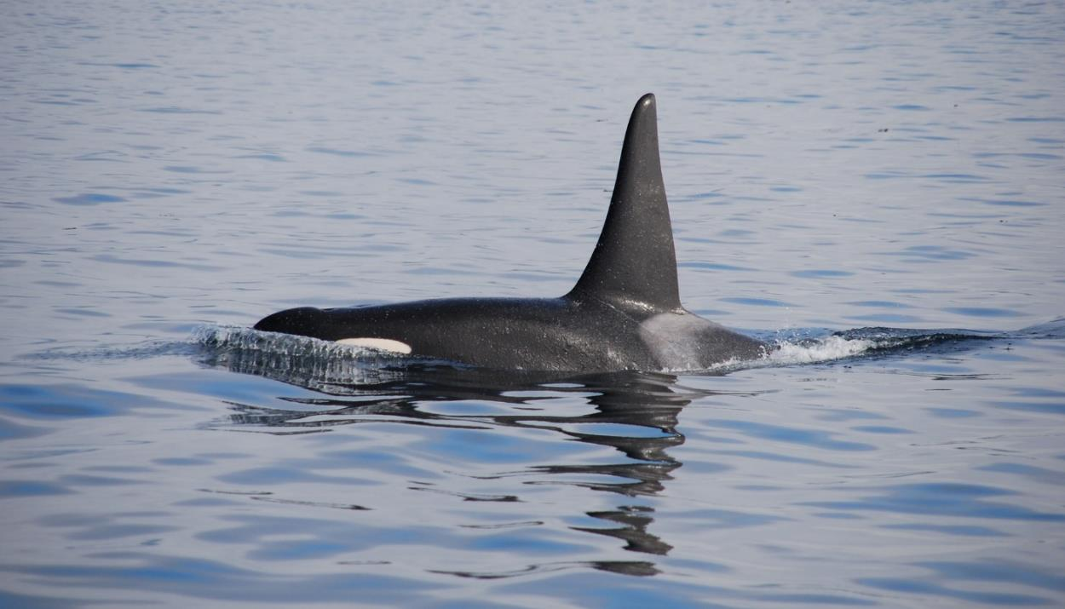
Orcas are massive animals and the largest adults in Scottish waters are around 7m long. Their dorsal fin is unmistakable, rising as tall as you out of the water.
The shape of the dorsal fin can be used to identify if it’s a male, female or juvenile.
The light grey on the body behind the dorsal fin is known as the saddle patch and is as unique as a fingerprint.

Slide 18
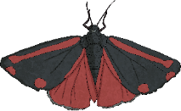


Like a Moth to a Flame
As the weather gets milder, you might enjoy sitting outside later in the evening, maybe for a meal around a fire or camping. Have you noticed that light attracts moths? You can take advantage of this to get a real good look at the variety of moths in your area.
Try to identify them by using a guide. Be patient as different moths will be active at different times and don’t touch them as they can easily be damaged.
What you need:
a dry, dark, calm evening
to stay away from the light
large white sheet
torch
pegs
washing line or branch
Peg your sheet on a washing line or over a branch.
Turn off nearby lights.
Shine your torch/light onto the sheet and wait patiently.
Identify the moths that you gather.

Slide 19
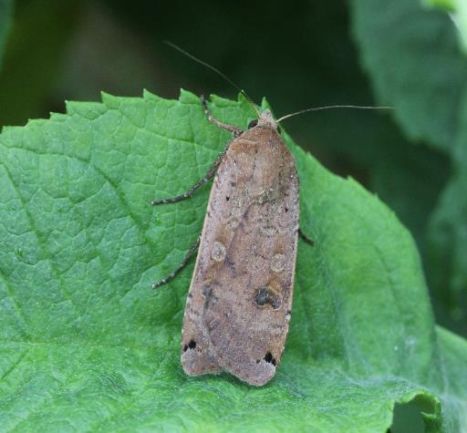
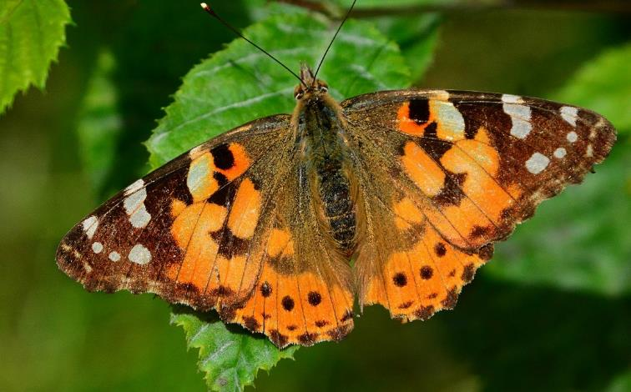
Shout Out to Moths
Moths don’t seem to have the same appeal as their relative, the butterfly.
Maybe it’s time to give moths the spotlight.
We have around 37 species of butterfly in Scotland but an impressive 1500 species of moths.
moth
butterfly

Slide 20
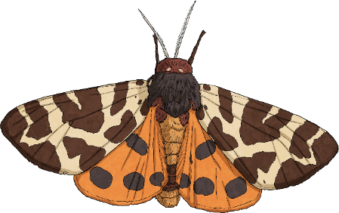
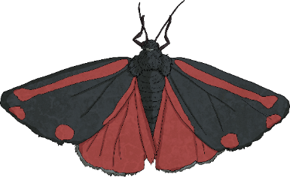
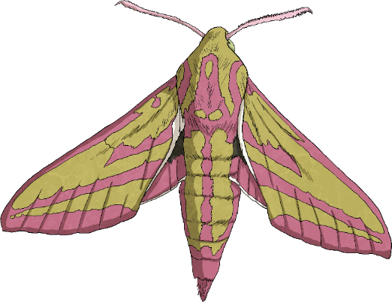
Shout Out to Moths
Butterflies are revered for their colour but you might be surprised by some of these eye-catching moths.
Cinnabar moth
Garden Tiger moth
Elephant Hawk moth
Changes in how we manage the countryside and use pesticides have had a big impact on moth numbers, which are in decline. Bees are rightfully celebrated as important pollinators but moths have a huge role pollinating overnight. Moths are also a critical part of the food chain because they are prey for birds and bats.
So let’s have a shout out for moths!

Slide 21

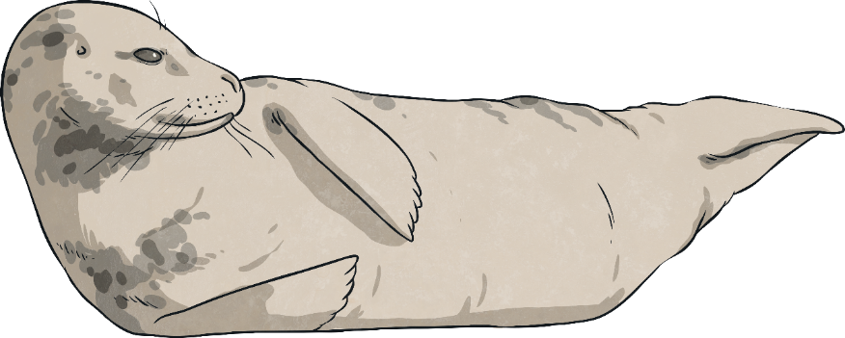
Now get out and about and see what’s WILD about
June where you are!

