Slide 1
Welcome to Lainshaw Early Childhood Centre
Parents Information

Slide 2
Lainshaw ELC Models
In East Ayrshire, there are 3 main models of delivery: Term Time, full year or combined early learning and childcare (ELC) packages.
In Lainshaw ECC we will be offering Model 1 & Model 3.
Model 1: 9am – 3pm Term Time provision.
Model 3: Blended Model or Split placement which provides a combination.
ELC packages of time in an ECC or funded provider and with a participating childminder - a Blended Model
or
In an ECC and with a funded provider - a Split Placement.

Slide 3
Lainshaw ECC Hours of Service
Operate on a Term Time basis (39 weeks of the year, copy of holidays in parent pack)
9am – 3pm
Doors open in morning at 8:50am until 9:10am (to allow for school drop off)
Doors open in the afternoon at 2:50pm until 3:10pm (to allow for school pick up)
Children enter and leave through main ECC doors

Slide 4
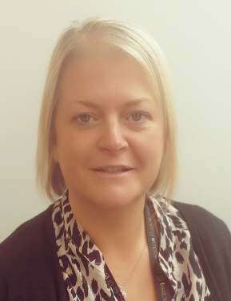
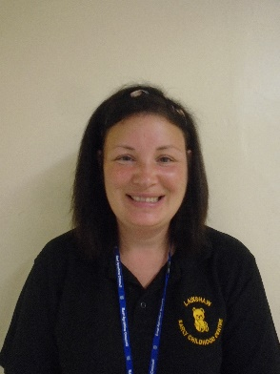
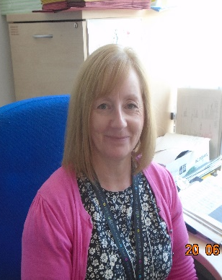
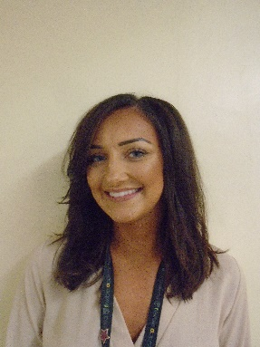
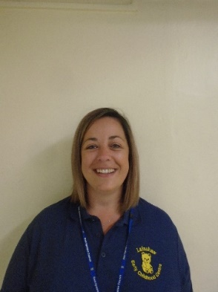
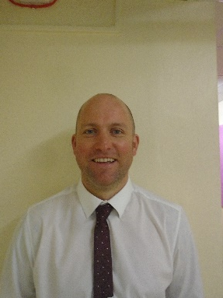
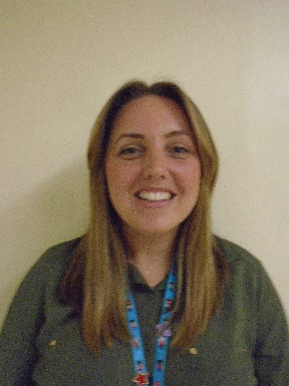
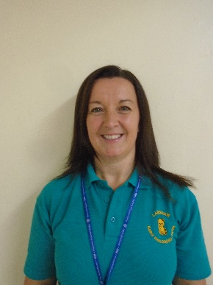
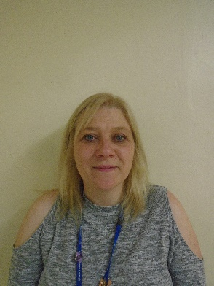
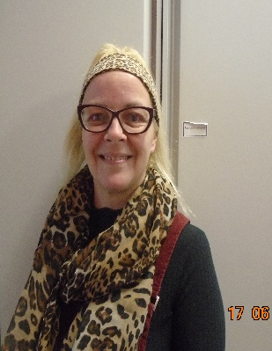
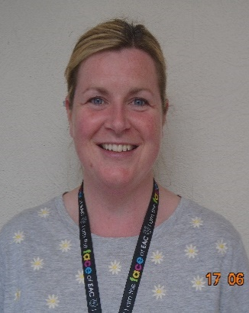
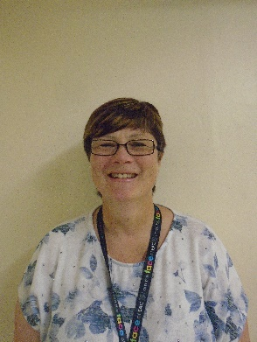
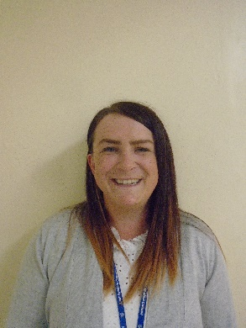
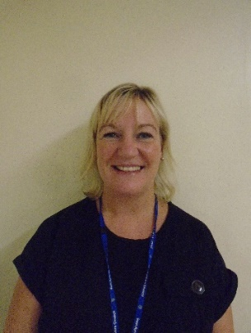
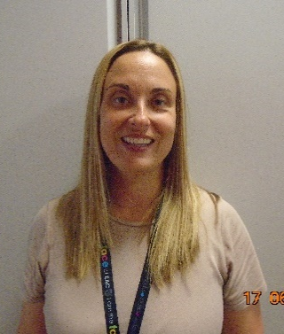
Our Staff Team
Mr Johnstone (HT)
Lynne (Acting Depute Manager)
Leanne
(SELCP)
Carole
(Clerical)
Sarah
(ELCP)
Natalie
(ELCP)
Debbie
(ELCP)
Dawn
(ELCP)
Karen
(ELCP)
Gayle
(ELCP)
Carole
(ELCP)
Ruth
(ELCP)
Lorraine
(ELCP)
Hayley
(ELCP)
(support Assistant)
Stacey
(Support Assistant)
(Support Assistant)

Slide 5
Our Extended Team
Claire Ferguson – Educational Psychologist
Hazel Wills – Community Practitioner
Beverley Hervey/Christine Hunter/Margaret Cruickshanks – Health Visitors
Hayley King – Communication Champion

Slide 6
What will my child need to bring with them:
Drawstring bag with change of clothes
Water bottle
Wellies
Waterproofs
All can be left in the ECC please put your child’s name on everything

Slide 7
What does a typical day in the ECC look like:
Children arrive and have Welcome time with their keyworker
Free play time – children can choose to play indoors or outdoors with high quality experiences on offer and snack.
Group/story/song time
Lunchtime
Free Play time – children can choose to play indoors or outdoors with high quality experiences on offer.
Home time

Slide 8
Parental Involvement
Parent Council
Parent workshops
Events
Outings

Slide 9
Lunches
East Ayrshire council provides a 2 course healthy hot meal for every child which is served at tables in the ECC playroom.
A staff member will sit at the table with the children to model healthy eating and good table manners
The choices are either soup/choice of 2 main courses or choice of 2 main courses and a dessert (this is rotated)
Milk or water to drink
Menu options are available for you to view on the school/ECC App

Slide 10
Learning Journals
All children will have an online learning journal
Parents will be sent log in details
You will be kept updated with observations, photos and learning targets for your child
You will be able to comment on posts
Staff will aim to upload weekly
Please speak to your child about their learning, it’s a great way to see what your child has been learning in the ECC.
http://lainshaw.yourlearningjournals.co.uk

Slide 11
Communication with parents
ECC School App – Username: Lainshaw
Password: 2016
Lainshaw ECC BLOG: https://blog.glowscotland.org.uk/ea/ealainshawpseccmain2018/
Lainshaw ECC Telephone Number: 01560 483653
Email: Jason.johnstone@eastayrshire.org.uk (Head Teacher)
Lynne.ogilvy@eastayrshire.org.uk (Acting Depute Manager)
Meetings
Settling report within 6 weeks of your child starting the ECC
Progress meeting in November
Progress/Transition meeting in May

Slide 12
Enrolment Pack
Enrolment form
Care Plan
Photo/Social Media Consent
Tooth Brushing Opt out form
Sun cream consent
Attendance
Student Consent
Learning Journal Consent
Copy of Holidays
Copy of Infectious diseases
Communication – App/BLOG/Email

Slide 13
Any Questions?

