Slide 1
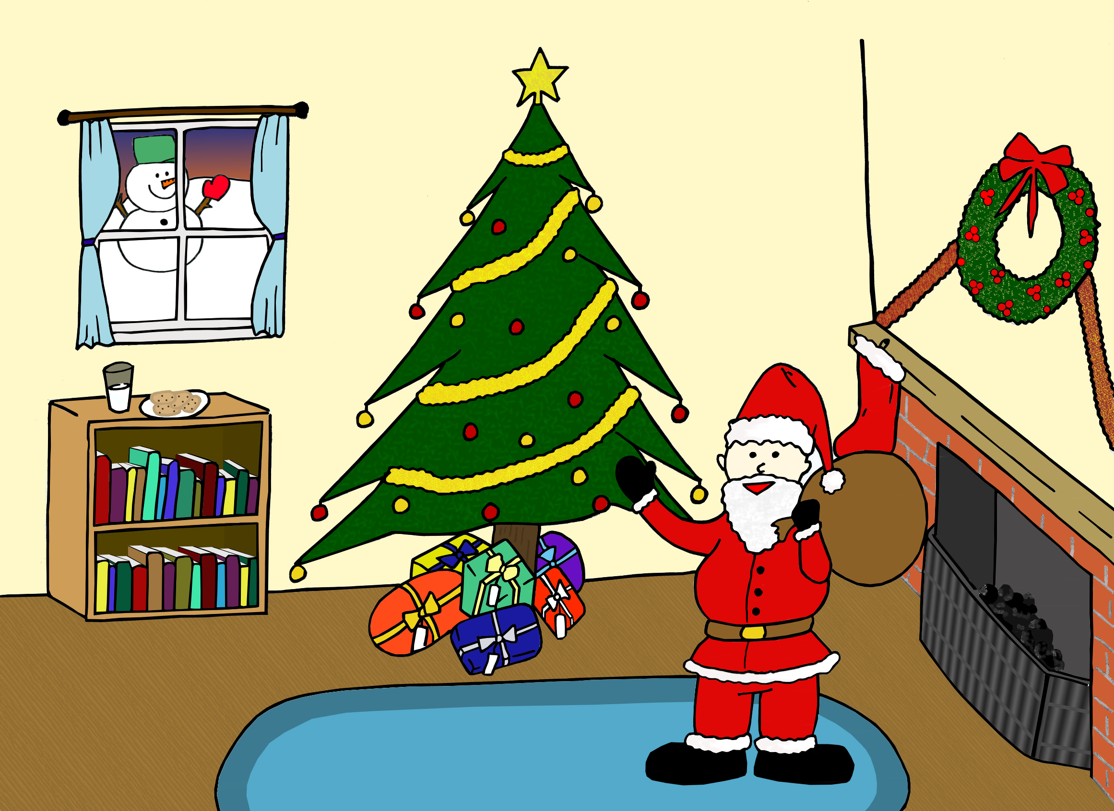
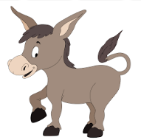
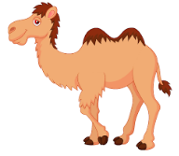
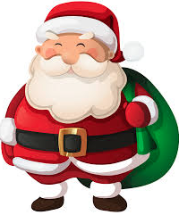







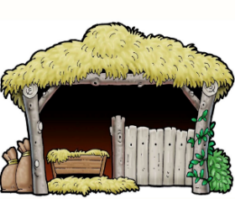
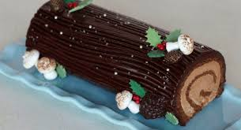
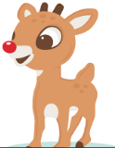

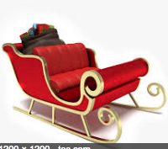

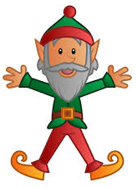
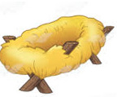




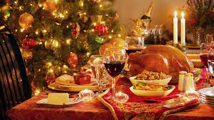
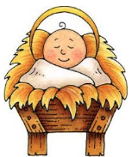

Write your prize here
Write your prize here
Write your prize here
Write your prize here
Write your prize here
Write your prize here
7
6
16
20
4
3
le chameau
le bonhomme de neige
l’âne
Père Noël
la bougie
l’auberge
Write your prize here
Write your prize here
Write your prize here
Write your prize here
Write your prize here
Write your prize here
19
11
1
22
23
18
la bûche de Noël
l’étable
la dinde
des ornaments
le cadeau
l’ange
Write your prize here
Write your prize here
Write your prize here
Write your prize here
Write your prize here
Write your prize here
9
15
17
24
12
2
le renne
la cheminée
le traîneau
from 1+2!
l’elfe
la mangeoire
Write your prize here
Write your prize here
Write your prize here
Write your prize here
Write your prize here
d
14
21
13
10
5
8
une lettre au Père Noël
le reveillon
le bébé
le sapin de Noël
la boule
l’étoile
tekhnologic

